Slide 1
AI²: Safety and Robustness Certification of Neural Network with Abstract Interpretation
Gehr, Mirman, Drachsler-Cohen, Tsankov, Vechev, Chaudhuri
2018 IEEE Symposium on Security and Privacy
Verifica del Software
A.A. 2019-2020
Niccolo’ Vettorello 1237291

Slide 2
INTRODUCTION
First sound and scalable static analyzer for deep neural networks
It over-approximates the behavior of the network and can automatically prove safety properties on realistic N. N.
Rethinks the concept of analysis using the well-studied abstract interpretation framework as theoretical base
Can handle Fully Connected N. N. and Convolutional N. N. that use the ReLU activation function and Max Pooling layers

Slide 3
INTRODUCTION
Deep Neural Networks are used in safety-critical applications with an ever-increasing rate:
Self-driving cars
Malware detection
Pedestrian detection

Slide 4
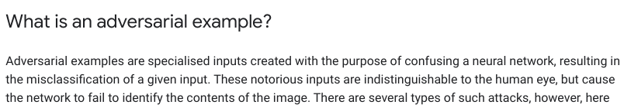
INTRODUCTION
Nonetheless, N. N. are not perfect and can be vulnerable to the so-called adversarial examples
Adversarial examples are effectively obtained by perturbing some sample with respect to a certain feature, giving rise to different type of attack, e.g. Brightness Attack, Fast Gradient Signed Method
https://www.tensorflow.org/tutorials/generative/adversarial_fgsm

Slide 5
INTRODUCTION
Local robustness (or robustness): all samples in the neighborhood of a given input are classified with the same output
Some people have focused on increasing robustness of networks: ad hoc training techniques have been developed
Other tried to find method to measure how robust a network was
In any case, no existing analyzer deals with CNN, a widely used type of N.N.
Why the progress in this area seems so slow?

Slide 6

INTRODUCTION
PROBLEM
Even with basic samples and simple perturbations there is a combinatorial explosion, and thinking to test every possible input-output couple is absolutely not reasonable (and not tractable)
Original
Perturbed
The brightening attack brings all pixes above the threshold of 1 – δ to max brightness.
For the simple example above there are 10¹¹⁵⁴ possible perturbations.

Slide 7
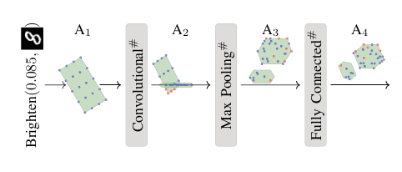
INTRODUCTION
POSSIBLE SOLUTION
Use of Abstract Interpretation
Approximation of
all possible outputs
Input and
perturbation
type
Abstraction of a layer
Approximation of all
possible perturbations

Slide 8
INTRODUCTION
MAIN CONTRIBUTIONS
A sound and scalable method for analysis of deep neural networks
A prototype of analyzer, tested and evaluated, that is able to handle Feed-Forward and Convolutional N.N.
The detection of an application for AI²: evaluation of neural networks defenses in terms of robustness

Slide 9
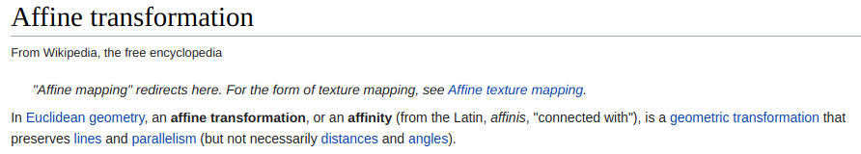
REPRESENTING N. N. AS A CAT FUNCTION
Conditional Affine Transformation: an Affine Transformation function guarded by a logical constraint
We’ll show how to represent the network as a CAT function. In this way we can use the Abstract Interpretation framework to handle it.

Slide 10
REPRESENTING N. N. AS A CAT FUNCTION
NOTATION
1) x_{i} is the i^{th} entry in a vector x ∈ R^{n}
2) For a matrix W ∈ R^{nxm}
a) W_{i} is the i^{th} row
b) W_{i,j} is the element at i^{th} row, j^{th} column

Slide 11
REPRESENTING N. N. AS A CAT FUNCTION
CAT FUNCTIONS
f(x) ::= W ∙ x + b |
case E₁: f₁(x), . . ., case E_{k}: f_{k}(x) |
f(f’(x))
E ::= E Ʌ E | x_{i} >= x_{j} | x_{i} >=0 | x_{i} < 0
Returns f _{i} (x) for the
first E_{i} satisfied by x

Slide 12
REPRESENTING N. N. AS A CAT FUNCTION
GENERAL STRUCTURE OF A NETWORK
Neuron
...
W^{I}
W^{O}
Input
matrix
Output
matrix
Outputs of one layer
are inputs of the next
layer
Layer

Slide 13
REPRESENTING N. N. AS A CAT FUNCTION
RESHAPING OF INPUTS
Inputs are often in the form of a three-dimensional matrix or of a vector.
We can reshape a 3D matrix W ∈ R^{mxnxr} into a vector x^{v} ∈ R^{n∙m∙r} by listing elements in the matrix by depth, column and row.
More formally, given x
x^{v} = (x_{1, 1, 1}, …, x_{1, 1, r}, x_{1, 2, 1}, … , x_{1, n, r}, x_{2, 1, 1}, … ,x_{m, n, r})^{T}

Slide 14
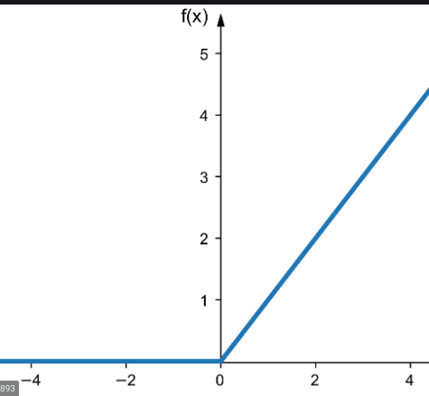
REPRESENTING N. N. AS A CAT FUNCTION
ReLU ACTIVATION FUNCTION
x ∈ R
ReLU(x) = max(0,x)
x ∈ R^{m}
ReLU(x) = (ReLU(x₁), …, ReLU(x_{m}))

Slide 15
REPRESENTING N. N. AS A CAT FUNCTION
ReLU TO CAT
ReLU = ReLU_{n} º … º ReLU₁
where
ReLU_{i}(x) = case (x_{i} >= 0): x,
case (x_{i} < 0): I_{i←0} ∙ x
I_{i←0} is the identity matrix with the i^{th} row replaced by zeros
Returns the vector with
the i^{th} value set to 0

Slide 16
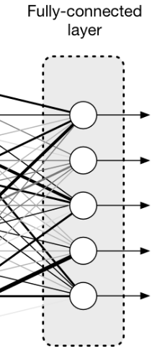
REPRESENTING N. N. AS A CAT FUNCTION
FULLY CONNECTED (FC) LAYER
An FC Layer can be seen as the function
FC_{W, b}: R^{m} → R^{n}
FC_{W, b}(x) = ReLU(W∙x + b)
Takes as input a vector x ∈ R^{m} and returns a vector y ∈ R^{n}
It’s parameterized by a matrix W ∈ R^{nxm} because everyone of the n neurons of the layer has a vector of m weights, one for every element of the input vector x
It’s parameterized by a vector b ∈ R^{n} because every neuron has a bias

Slide 17

REPRESENTING N. N. AS A CAT FUNCTION
CONVOLUTIONAL LAYER (CL)
CONV_{F}: R^{mxnxr} → R^{(m-p+1) x (n-q+1) x t}
(F₁^{p,q}, …, F_{t}^{p,q})
F_{i}^{p,q}:R^{mxnxr} → R^{(m-p+1) x (n-q+1)} b ∈ R, W ∈ R^{pxqxr}
p,q ∈ N
p <= m
q <= n

Slide 18
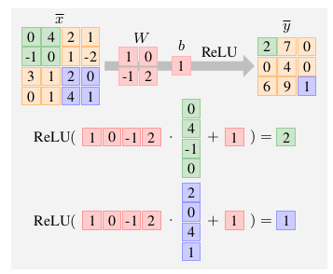
REPRESENTING N. N. AS A CAT FUNCTION
CONVOLUTIONAL LAYER: EXAMPLE

Slide 19
REPRESENTING N. N. AS A CAT FUNCTION
CONVOLUTIONAL LAYER TO CAT
Can we see a Convolutional Layer as a CAT function?
Yes, we reshape modify the various matrixes to obtain a function in the form:
CONV_{W}^{F}_{, b}: R^{m∙n∙r} → R^{(m-p+1) ∙ (n-q+1) ∙ t}
We do this by creating a matrix W^{F} and a vector b of bias that simulate the sliding of the filter

Slide 20
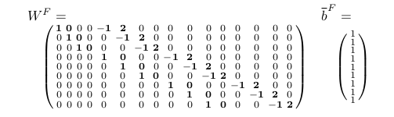
REPRESENTING N. N. AS A CAT FUNCTION
CONVOLUTIONAL LAYER TO CAT: EXAMPLE
x^{v} = [0, 4, 2, 1, -1, 0, 1, -2, 3, 1, 2, 0, 0, 1, 4, 1]

Slide 21
REPRESENTING N. N. AS A CAT FUNCTION
CONVOLUTIONAL LAYER TO CAT: EXAMPLE
ReLU(W^{F} ∙ x^{v} + b) =
[2, 7, 0, 0, 4, 0, 6, 9, 1] =
y^{v}

Slide 22
REPRESENTING N. N. AS A CAT FUNCTION
MAX POOLING (MP) LAYER
MaxPool_{p,q}: R^{m x n x r} → R^{m/p x n/q x r}
y_{i, j, k} = max({x_{i’, j’, k} | p(i-1) < i’ <= p∙i,
q(j-1) < j’ <= q∙j})
Neurons take disjoint sub-rectangles within the input matrix and return their max value: the original height is then decremented of a factor p and the original width is decremented by a factor q

Slide 23
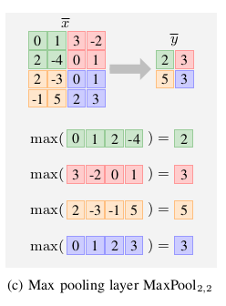
REPRESENTING N. N. AS A CAT FUNCTION
MAX POOLING (MP) LAYER: EXAMPLE

Slide 24
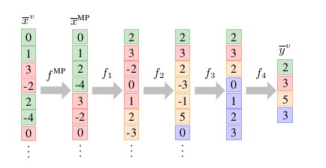
REPRESENTING N. N. AS A CAT FUNCTION
MAX POOLING (MP) LAYER AS CAT FUNCTION
MaxPool’_{p, q}: R^{m ∙ n ∙ r} → R^{m/p ∙ n/q ∙ r}
MaxPool’_{p, q} = f_{m/p ∙ n/q ∙ r} º … º f₁ º f^{MP}

Slide 25
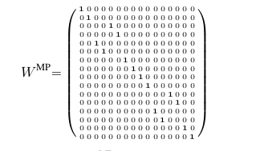
REPRESENTING N. N. AS A CAT FUNCTION
MP LAYER AS CAT: DEFINITION AND EXAMPLE
f^{MP} = W^{MP} ∙ x^{v}
16 X 16

Slide 26
REPRESENTING N. N. AS A CAT FUNCTION
MP LAYER AS CAT: DEFINITION AND EXAMPLE
Every f_{i} handles the index interval [i, i + p∙q - 1] (a sub-rectangle). Let k be the index associated with the maximum value within the sub-rectangle, then we have
f _{i} = W_{i, k} ∙ x
Where W^{i, k} is given by the basis vectors
e₁, …, e_{i - 1}, e_{k}, e_{i + p∙q}, …, e_{m ∙ n – (p ∙ q -1 ) ∙ (i -1)}

Slide 27
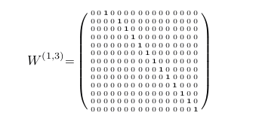
REPRESENTING N. N. AS A CAT FUNCTION
MP LAYER AS CAT: DEFINITION AND EXAMPLE

Slide 28
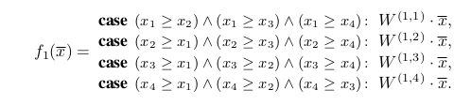
REPRESENTING N. N. AS A CAT FUNCTION
MP LAYER AS CAT: DEFINITION AND EXAMPLE
In general k , that is the index of the max value within the sub-rectangle, is not known in advance, so we have to consider p∙q possible cases
For example we have

Slide 29
REPRESENTING N. N. AS A CAT FUNCTION
FULLY CONNECTED FEEDFORWARD
ARCHITECTURE (FNN)
FC
LAYER
FC
LAYER
FC
LAYER
...

Slide 30
REPRESENTING N. N. AS A CAT FUNCTION
CONVOLUTIONAL ARCHITECTURE (CNN)
CONVOLUTIONAL
LAYER
FC
LAYER
MP
LAYER
...

Slide 31
ABSTRACT INTERPRETATION
Find suitable abstract domain(s)
Define abstract operators that are sound and as precise as possible

Slide 32
ABSTRACT INTERPRETATION
BOX DOMAIN
Set of constraints of the form
a <= x_{i} <= b
a <= b
a,b ∈ R ∪ {-∞, +∞}
Fast but quite imprecise
y
x

Slide 33
ABSTRACT INTERPRETATION
POLYHEDRA DOMAIN
Set of linear constraints of the form
A ∙ x <= b
For some matrix A and some vector b
Precise but computational expensive
y
x

Slide 34
ABSTRACT INTERPRETATION
ZONOTOPES DOMAIN
Center-symmetric, convex, closed polyhedron
z: [a₁, b₁] x [a₂, b₂] x … x [a_{m}, b_{m}] → R^{n}
z(e) = M ∙ e + b
e_{i} ∈ [a_{i}, b_{i}]
b: bias vector, captures the center of the zonotope
M: matrix that captures the boundaries of the zonotope around the center
y
x
x

Slide 35
ABSTRACT INTERPRETATION
ABSTRACTING CAT FUNCTIONS
f = f’’ º f’
T_{f} = T_{f’’} º T_{f’} concrete transformer (collecting version)
T#_{f} = T#_{f’’} º T#_{f’} abstract transformer (abstract operator)

Slide 36
ABSTRACT INTERPRETATION
ABSTRACTING CAT FUNCTIONS: COMPOSITION
a ∈ A
f(x) = f₂(f₁(x))
T#_{f}(a) = T#_{f2}(T#_{f1}(a))

Slide 37
ABSTRACT INTERPRETATION
ABSTRACTING CAT FUNCTIONS: EXAMPLE
f(x) = ReLU2(ReLU1( ∙ x))
ReLU_{i} = case (x_{i} >= 0): x,
case (x_{i} < 0): I_{i←0} ∙ x
W
2 | -1
0 | 1

Slide 38
ABSTRACT INTERPRETATION
ABSTRACTING CAT FUNCTIONS: AFFINE TRANSFORMATION
a ∈ A
f(x) = W ∙ x + b
T#_{f}(a) = Aff(a, W, b)
Our abstract domain must support affine transformations (Aff operator)

Slide 39
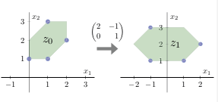
ABSTRACT INTERPRETATION
ABSTRACTING CAT FUNCTIONS: EXAMPLE
z₀ : [-1, 1]³ → R²
z₀ (e₁, e₂, e₃) = (1 + e₁/2 + e₂/2, 2 + e₁/2 + e₃/2)
Aff(z₀, W, [0 0]^{T}) =
(2 ∙ (1 + e₁/2 + e₂/2) - (2 + e₁/2 + e₃/2), 2 + e₁/2 + e₃/2) =
(e₁/2 + e₂ – e₃/2, 2 + e₁/2 + e₃/2)

Slide 40
ABSTRACT INTERPRETATION
ABSTRACTING CAT FUNCTIONS: CASE FUNCTIONS
To abstract case functions our abstract domain must support:
a) meet operator : it’s the abstraction of the set intersection. It must be true that:
γ^{n}(a) ∩ {x ∈ R^{n} | x |= E} ⊆ γ^{n}(a E)
Where:
a ∈ A
E is an inequality expression
γ^{n} is the concretization function for vectors ∈ R^{n}

Slide 41
ABSTRACT INTERPRETATION
ABSTRACTING CAT FUNCTIONS: CASE FUNCTIONS
b) join operator : it’s the abstraction of the set union. It must be true that:
γ^{n}(a₁) ∪ γ^{n}(a₂) ⊆ γ^{n}(a₁ a₂)
Where:
a₁, a₂ ∈ A
γ^{n} is the concretization function for vectors ∈ R^{n}

Slide 42
ABSTRACT INTERPRETATION
ABSTRACTING CAT FUNCTIONS: CASE FUNCTIONS
c) bottom element ⊥ : satisfies:
γ^{n}(⊥) = {}
⊥ E = ⊥
⊥ a = a
a ∈ A
E is an inequality expression
γ^{n} is the concretization function for vectors ∈ R^{n}

Slide 43
ABSTRACT INTERPRETATION
ABSTRACTING CAT FUNCTIONS: CASE FUNCTIONS
a ∈ A
E is an inequality expression
f(x) = case E₁: f₁(x), …, case E_{k}: f_{k}(x)
T#_{f}(a) = _{1<= i <= k} f_{i}#(a E_{i})

Slide 44
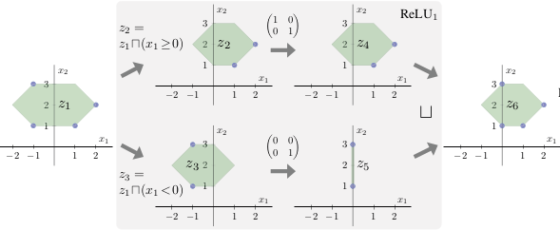
ABSTRACT INTERPRETATION
ABSTRACTING CAT FUNCTIONS: EXAMPLE

Slide 45
ABSTRACT INTERPRETATION
SOUNDNESS
It can be proved that:
For any CAT function with concrete transformer T_{f}: P(R^{m}) → P(R^{n}) and for any abstract input a ∈ A
T_{f} (γ^{m}(a)) ⊆ γ^{n} (T#_{f} (a) )

Slide 46
ABSTRACT INTERPRETATION
ROBUSTNESS PROPERTIES
N: R^{m} → R^{n}
(X, C) ∈ P(R^{m}) x P(R^{n})
X – robustness region
C – robustness condition
N satisfies robustness property (X,C) if
for all x ∈ X we have N(x) ∈ C
NOTE: Abstract Interpretation is here used to prove robustness properties. However, the framework is completely general and can be used to prove any type of property

Slide 47

ABSTRACT INTERPRETATION
LOCAL ROBUSTNESS
(X, C_{L})
X – robustness region
C_{L} – robustness condition, contains all the outputs with the same label

Slide 48
ABSTRACT INTERPRETATION
LOCAL ROBUSTNESS
Typically one wants to find if there is some label L for which
(X,C_{L}) holds

Slide 49
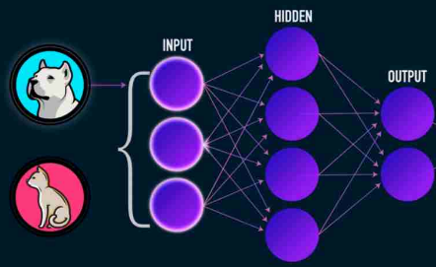
ABSTRACT INTERPRETATION
LOCAL ROBUSTNESS: EXAMPLE
DOG
0.7
CAT
0.3

Slide 50
ABSTRACT INTERPRETATION
LOCAL ROBUSTNESS
It’s like asking
“given this particular set of inputs X and this particular set of labels, can we find a label that represents the classification of all the inputs belonging to X?”
DOG
CAT

Slide 51
ABSTRACT INTERPRETATION
PROVING PROPERTIES
Let T#_{N} be the abstract transformer for the neural network N. Then by the properties of α and γ and by soundness we know that to argue that a property (X, C) holds is sufficient to prove that
γ^{n}(T#_{N}(α^{m}(X))) ⊆ C
DOG
CAT

Slide 52
ABSTRACT INTERPRETATION
PROVING PROPERTIES
NOTE: if C can be expressed as a CNF (Conjuctive Normal Form) there is a general method to prove that
γ^{n}(T#_{N}(α^{m}(X))) ⊆ C
DOG
a
CAT

Slide 53
ABSTRACT INTERPRETATION
PROVING PROPERTIES
C =
¬C =
γ^{n}(a) ⊆ C <=>
DOG
CAT

Slide 54
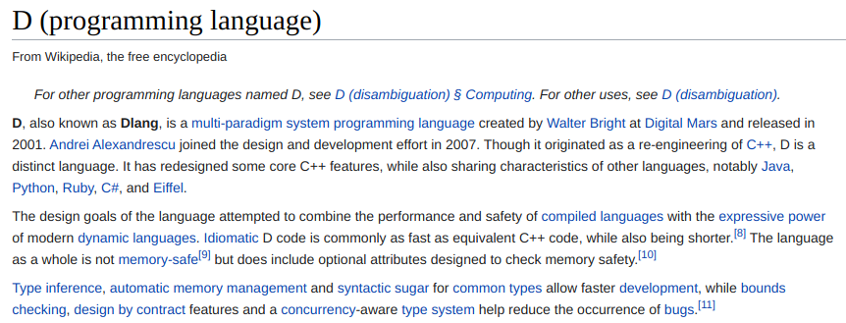
IMPLEMENTATION
DOG

Slide 55
IMPLEMENTATION
Supports:
Convolutional layers
Max Pooling layers
Fully Connected layers
DOG

Slide 56
IMPLEMENTATION
PROPERTIES
(X, C)
X - robustness region, specified by a zonotope
C - conjunction of linear constraints
Typically X is a box or a line, precisely captured by a zonotope
DOG

Slide 57
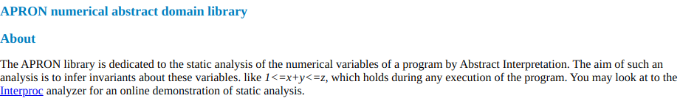
IMPLEMENTATION
ABSTRACT DOMAINS
Box
Polyhedra
Zonotope
DOG
http://apron.cri.ensmp.fr/library/

Slide 58
IMPLEMENTATION
BOUNDED POWERSET DOMAIN
P(A), where A is an abstract domain
An element of the bounded powerset domain is a set of max N elements of the abstract domain A, for some constant N
We denote this domain by appending the value N to the abstract domain name, e.g. Zonotope64
DOG

Slide 59
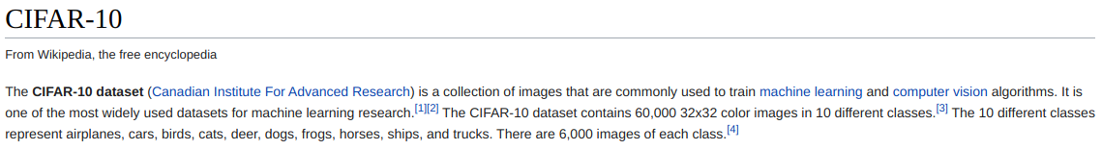
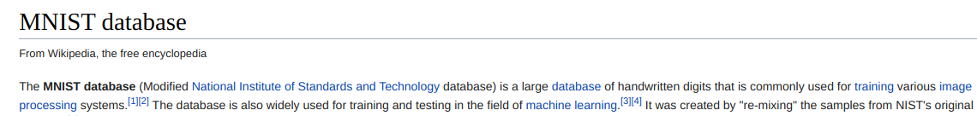
EVALUATION
EXPERIMENTAL SETUP: DATASETS
DOG

Slide 60
EVALUATION
EXPERIMENTAL SETUP: CNN
Trained on both datasets until test set accuracy was at least 0.9
LeNet Architecture: 2 CL → 1 MP → 2 CL → 1MP → 3FC
DOG

Slide 61
EVALUATION
EXPERIMENTAL SETUP: FNN
Trained on both datasets until test set accuracy was at least 0.9
7 different architectures:
  3 x 20
  6 x 20
  3 x 50
  3 x 100
  6 x 100
  6 x 200
  9 x 200
DOG

Slide 62
EVALUATION
EXPERIMENTAL SETUP: PROPERTIES
(X, CL)
where X captures changes in lighting
We define the robustness region as
δ ∈ Δ = {0.001, 0.005, 0.025, 0.045, 0.065, 0.085}
AI² is used to check whether all input belonging to the robustness region are classified with the same label as x
DOG

Slide 63
EVALUATION
EXPERIMENTAL SETUP: PROPERTIES
- NOTE 1: as δ increases, the robustness region gets larger
- NOTE 2: the definition of S_{x, δ} entails that every pixel of the image x can be brightened independently: this fact allows to treat cases in which only one part of the image is brightened more easily
- NOTE 3: in general, AI2 can be used to verify every property in which the robustness region can be specified by a zonotope
DOG

Slide 64
EVALUATION
EXPERIMENTAL SETUP
10 images for each dataset: thus we have one property for every couple (image, δ) = 60 properties per dataset
Box, Zonotope, ZonotopeN (with N between 2 and 128)
AI² is compared to Reluplex on FNN
Ubuntu 16.04.03 Server, two Intel Xeon E5, 512GB RAM
DOG

Slide 65
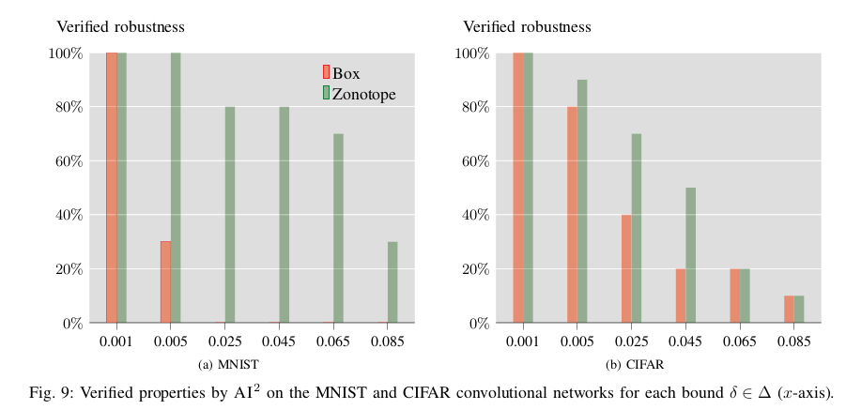
EVALUATION
ROBUSTNESS OF CNN
DOG

Slide 66
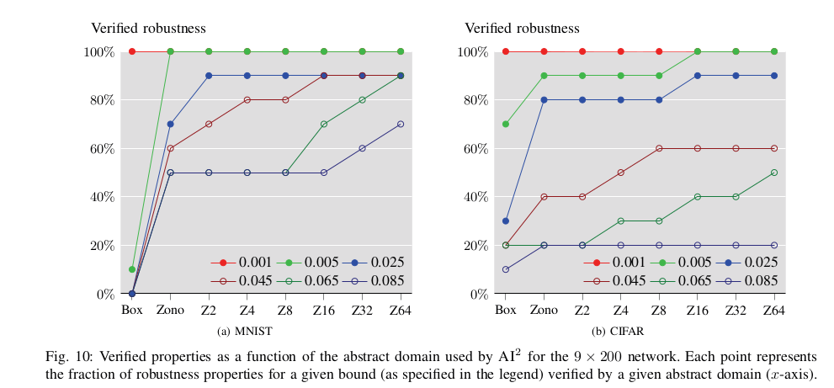
EVALUATION
PRECISION OF ABSTRACT DOMAINS
DOG

Slide 67
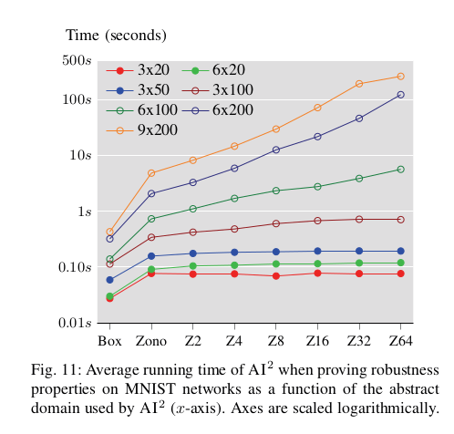
EVALUATION
AVERAGE RUNNING TIMES
DOG

Slide 68
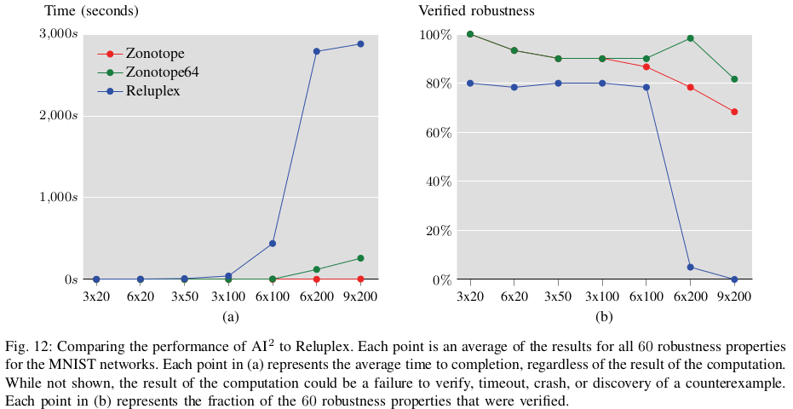
EVALUATION
COMPARISON TO RELUPLEX
DOG

Slide 69
COMPARING DEFENSES WITH AI²
A defense is “an algorithm whose goal is to reduce the effectiveness of a certain attack against a specific network”
We can use AI² to measure the size of the robustness region
Intuitively a greater size of the robustness region means a better defense
DOG

Slide 70
COMPARING DEFENSES WITH AI²
FGSM
(Fast Gradient Sign Method)
Take a network N and an image x
Compute a vector ρ_{N, x} in the input space along which is very probable to find an adversarial example
Generate an adversarial example in the following way:
a = x + ε∙ρ_{N, x}
for some value ε
DOG

Slide 71
COMPARING DEFENSES WITH AI²
ROBUSTNESS REGION
For this experiment the robustness region (here called Line) is defined as
1) This robustness region is a zonotope
2) It captures all points from x to x +δ ∙ ρ_{N, x} for some bound δ: a large δ implies a large robustness region
DOG

Slide 72
COMPARING DEFENSES WITH AI²
DEFENSES
GSS and Ensemble: the common idea behind them is to add a regularization term, that encodes the FGSM attack, to the loss function;
MMSTV: during the training phase adds a perturbation layer before the input layer. This perturbation layer applies the FGSM^{k} attack (a multi-step variant of FGSM).
DOG

Slide 73
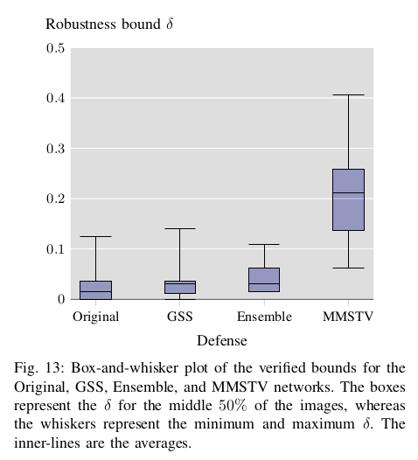
COMPARING DEFENSES WITH AI²
DOG

Slide 74
FUTURE WORK
New abstract transformers to expand supported N. N. features
A library to model the most common perturbations
DOG

Slide 75
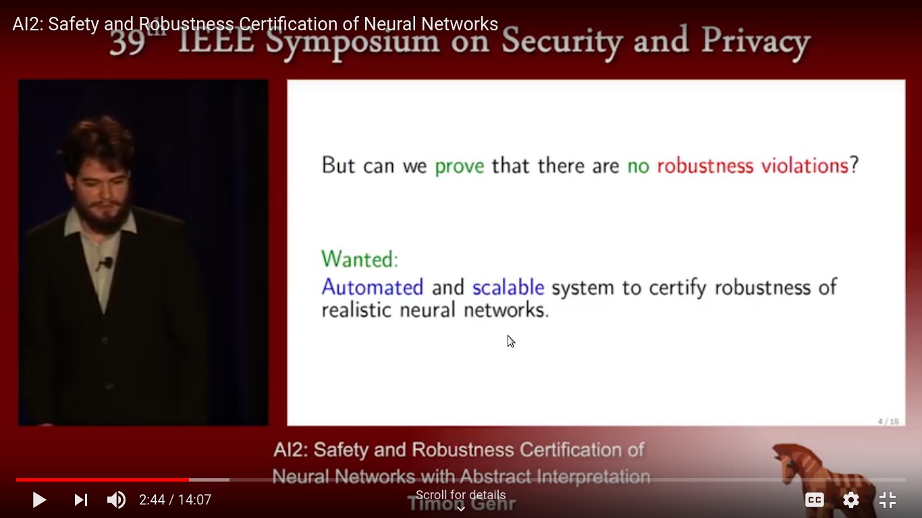
RELATED LINKS
https://www.youtube.com/watch?v=LJnjCMV8KzA
https://www.sri.inf.ethz.ch/publications/gehr2018ai
DOG

