Slide 1
Analog To digital converter
Submitted by- Vasundhara Pant
20CS3071

Slide 2
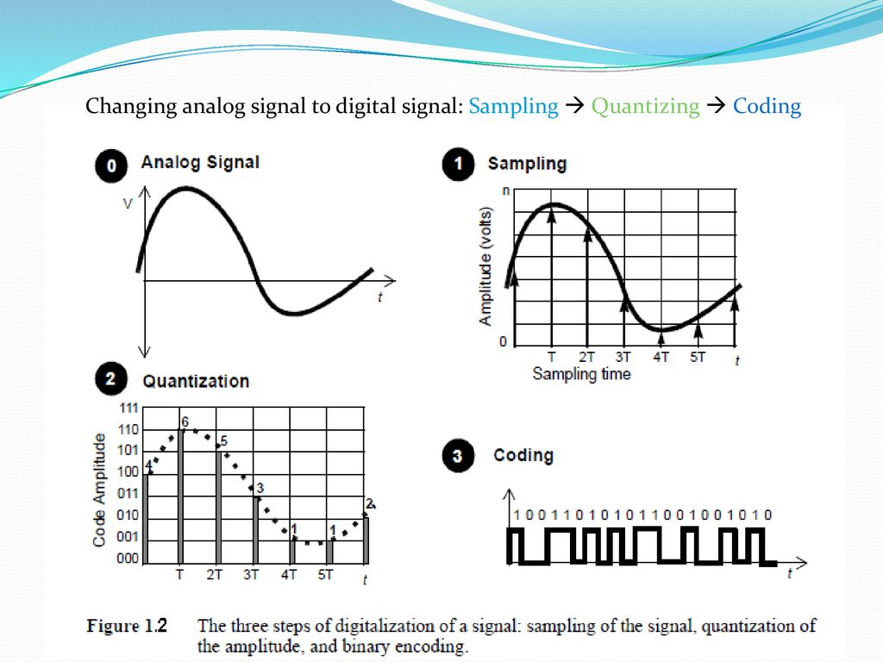

Slide 3
Difference
Analog signal | Digital signal
Analog signals are continuous signals. | Digital signals are not continuous, they are discrete signals.
We can represent analog signals in the form of sine waves. | We can represent digital signals in the form of square waves.
The values of voltage will be in a continuous range | The values of voltage will be discontinuous.
Records the information as it is. | Converts the information into binary form.
These signals are used in analog devices. | Digital electronic devices like computers, smartphones, smartwatches, etc. use these signals
Examples: Any natural sound, human voice, data read by analog devices. | Examples: Electronic signals, computer signals, data read by digital devices.

Slide 4
need of digital signal
At present, the usage of digital devices is increasing. These devices work based on the digital signal. An analog to digital converter plays a key role in such kind of devices to convert the signal from analog to digital.
AC (air conditioner) includes temperature sensors to maintain the temperature within the room. So this conversion of temperature can be done from analog to digital with the help of ADC.
It is also used in a digital oscilloscope to convert the signal from analog to digital to display.
ADC is used to convert the analog voice signal to digital in mobile phones because mobile phones use digital voice signals but actually, the voice signal is in the form of analog. So ADC is used to convert the signal before sending the signal toward the transmitter of the cell phone.

Slide 5
Digital signals are less susceptible to noise and they can be easily processed in digital domain and also they are easy to store in digital domain.
Digital signals can be used for long distance transmission
Using digital transmission purposes we can easily detect errors as compared to analog signals

Slide 6
Input-output(whole idea about project)
In this project we will be converting analog signals taken from sine wave or cos waves etc. to digital signals by using MATLAB only we will not use any kind of hardware everything will be done based on coding in MATLAB.
Will ask for inputs from users like to form the analog signal equation will be asked.
In output table containing binary values of the converted form will be shown.
Also graphs will be shown depicting the original graph in the discrete form of the analog signal and also the graph of the signal after sampling will be shown in discrete form.

Slide 7
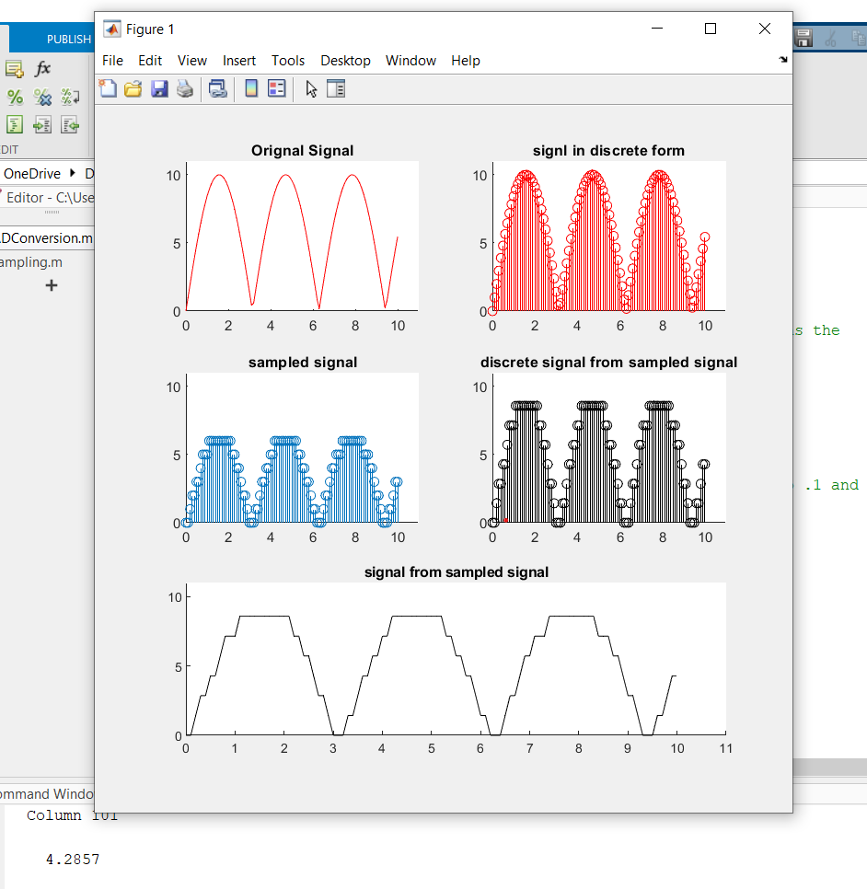
Conversion process
Make an analog signal using -time vector (will be mentioned in code) and some equation like of sinx , cosx, etc. which forms analog signals( will ask user to type the equation)
Sampling will be performed in which according to some sampling frequency samples will be taken -graph will be shown showing discrete value
Quantization - value will be quantized using fix(y/q) function in MATLAB it will round off the given decimal (input) valued in integral
Output Graph showing sampling result i.e. signal in discrete forms
Then these quantized valued will be converted to binary outputs. Using coding
Hence we will get the binary value for the analog signals

Slide 8
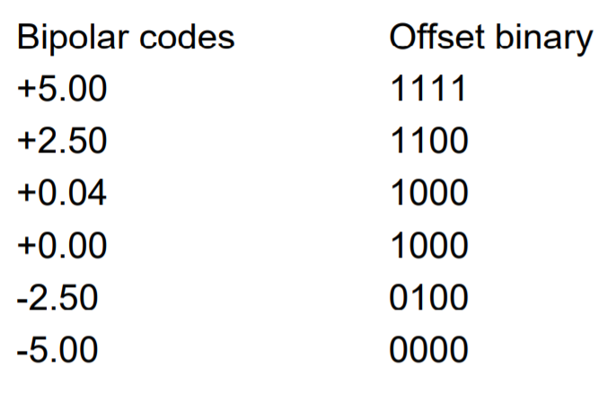
Output table to represent binary numbers
Such kind of table will be shown in output to represent the binary converted form of analog signal.
Will use dec2bin(a,n)
Function in MATLAB
To convert decimal to binary

