Slide 1

Btech project on Water Quality Prediction
Mentor – Dr. Rahul Kumar
Submitted by- Vasundhara Pant

Slide 2
Acknowledgement
I would like to express my special thanks of gratitude to my
Professor, Dr. Rahul Kumar, who has always encouraged
and motivated me throughout the duration. Without his
continuous guidance and persistent help, this project would
not have been a success.
I am grateful to the Rajiv Gandhi Institute of Petroleum
Technology, Jais and the department of Computer Science &
Engineering for providing me such a great opportunity to work
on this project. Last but not the least I would like to thank my
parents and friends who had helped me directly or indirectly
towards the completion of this project.

Slide 3
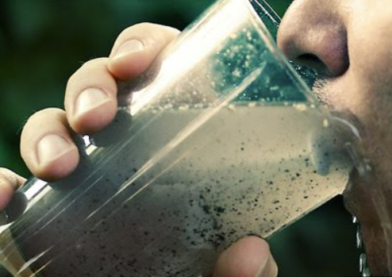
Motivation
In recent years, water pollution has become a serious problem affecting water quality. Therefore, to design a model that predicts water quality is nowadays very important to control water pollution, as well as to alert users in case of poor quality detection. Motivated by these reasons, in this study, we take the advantages of machine learning algorithms to develop a model that is capable of predicting the accuracy and then detect whether water is potable or not.

Slide 4


Specifications of Project
Data set - https://www.kaggle.com/datasets/adityakadiwal/water-potability Taken from Kaggle
Following 8 machine learning algorithms are used for model training-
Decision Tree
K-Nearest Neighbours(KNN)
Logistic Regression
Random Forest
XGBoost Classifier
Support Vector Machines(SVM)
AdaBoost Classifier
Gaussian Naive Bayes

Slide 5




Model preparing process
Interface/Language/Tools/DBMS used in project

Slide 6
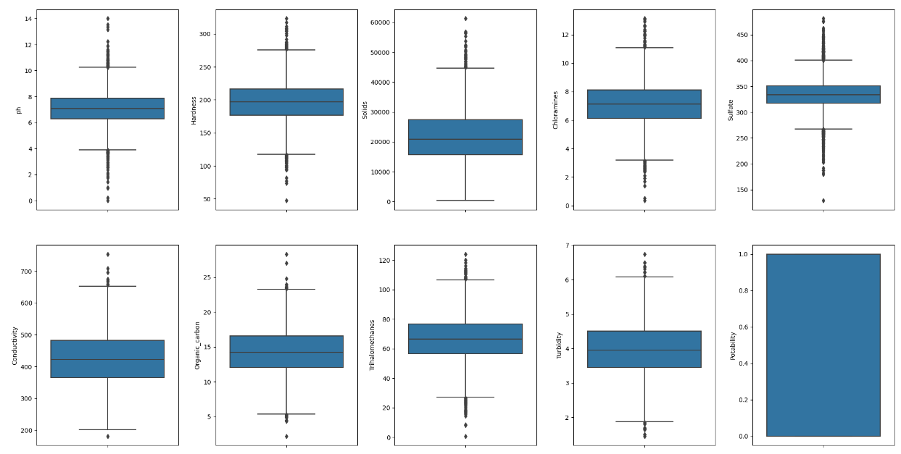
Exploratory Data analysis
An outlier is a data-item/object that deviates significantly from the rest of the objects. They can be caused by measurement or execution errors. The analysis for outlier detection is referred to as outlier mining. Outlier removal means when you are too away from the mean we can check the outlier by using boxplot our data we are having outlier in solids parameter so we have a choice to remove this outlier or not so we choose not to remove it because it might be possible that water is good or drinkable due to excess of solids.

Slide 7
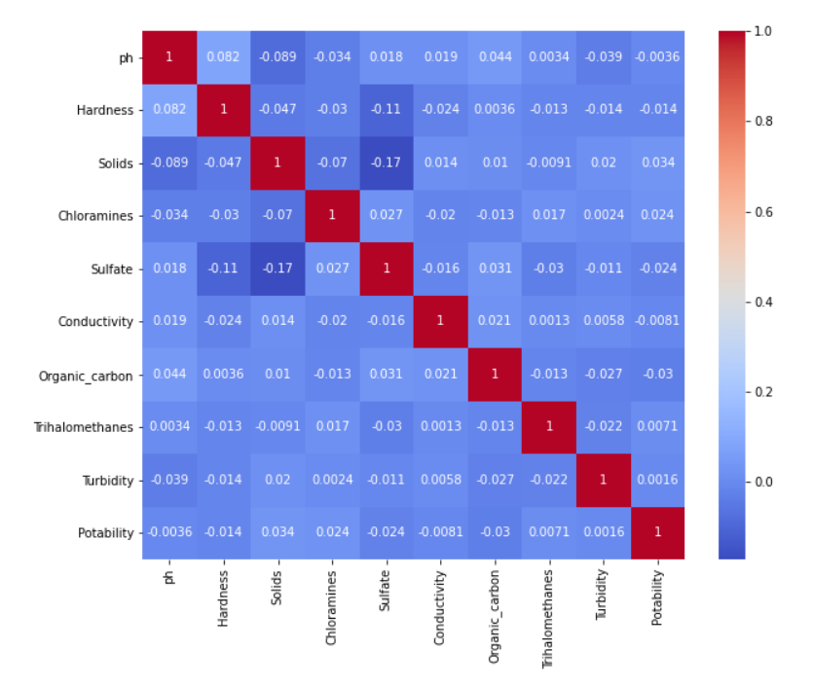
Exploratory Data analysis
For dimensionality reduction we need to check which feature is less important after checking data correlation’s through heatmap they are not correlating even about 50% hence we haven’t done dimensionality reduction and have used all the 9 parameters

Slide 8
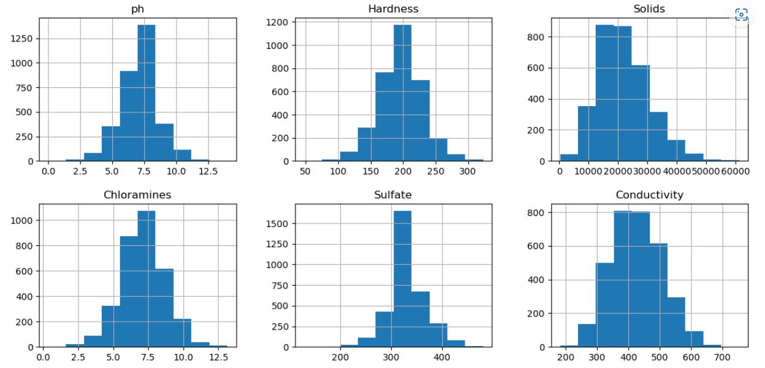
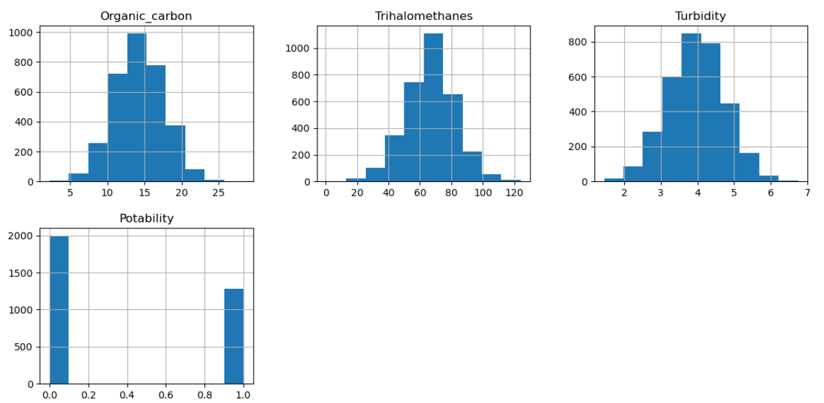
Exploratory Data analysis
We have analysed data using histogram and found no need of normalisation as it is already normalised.

Slide 9
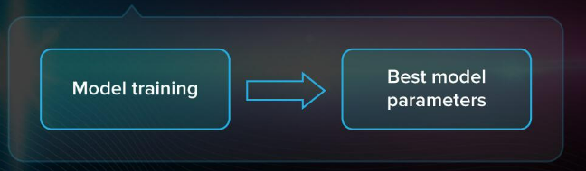
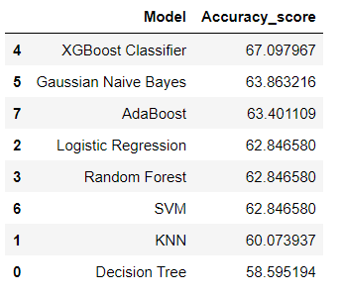
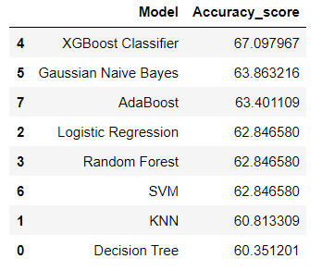
Model Optimization
Model Optimization also called Hyper Parameter Tuning. After we have calculated the results from all models, we have done model optimization to take out the best accuracy possible and for that we have used Grid search.
It gives parameters which will give the best possible accuracy. Have done model optimization for Decision Tree and KNN.
For other models we have already used Best parameters hence haven’t done model optimization again.
Before Model Optimization After Model Optimization

Slide 10
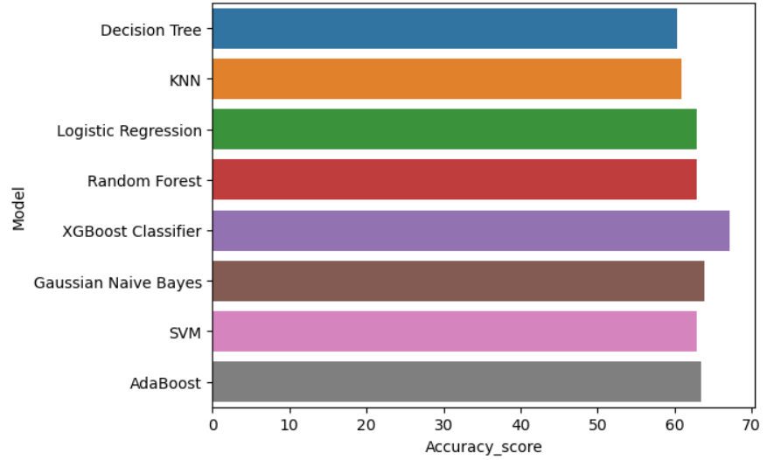
Conclusion
We can observe from the mentioned bar graph that xgboost classifier has clearly outperformed other methods. It has the maximum achieved accuracy i.e., 67.097967.

Slide 11
Future Aspects
To propose a nine-layer multilayer perceptron (MLP) which is used
with a K-nearest neighbor (KNN) imputer to deal with the problem of missing values and then compute accuracy using ML algorithms this time we have used mean value to fill the corresponding null values.
To develop an algorithm to predict water quality using less number of parameters-to reduce number of parameters and make an efficient ML model to detect water quality.

Slide 12
Thank you

