Slide 1


emrQA: A Large Corpus for Question Answering on Electronic Medical Records (EMR)
Anusri Pampari
University of Illinois Urbana Champaign (UIUC)
Preethi Raghavan Jennifer Liang Jian Peng
IBM Research IBM Research UIUC

Slide 2
Impact of question answering on EMR
08/31/96 ascending arotic root replacement with homograft with omentopexy. The patient continued to be hemodynamically stable making good progress. Physical examination: BMI: 33.4 Obese, high risk. Pulse: 60. resp. rate: 18
08/31/96 ascending arotic root replacement with homograft with omentopexy. The patient continued to be hemodynamically stable making good progress. Physical examination: BMI: 33.4 Obese, high risk. Pulse: 60. resp. rate: 18
Record Date: 1 May 1995
Does the patient have any medication allergies ?
08/31/96 ascending arotic root replacement with homograft with omentopexy. The patient continued to be hemodynamically stable making good progress. Physical examination: BMI: 33.4 Obese, high risk. Pulse: 60. resp. rate: 18
08/31/96 ascending arotic root replacement with homograft with omentopexy. The patient continued to be hemodynamically stable making good progress. Physical examination: BMI: 33.4 Obese, high risk. Pulse: 60. resp. rate: 18
Record Date: 21 Jan 1997
08/31/96 ascending arotic root replacement with homograft with omentopexy. The patient continued to be hemodynamically stable making good progress.
Coumadin has caused bleeding from the mouth and nose
Transdermal nitroglycerin caused headache
Potassium replacement has caused marked hyperkalemia
08/31/96 ascending arotic root replacement with homograft with omentopexy. The patient
Record Date: 8 Oct 1998
longitudinal records of a patient
Inaccurate/incomplete use – third common cause of deaths in US in 2016 ^{[1]}
Need automation – need question answering system !

Slide 3
Building question answering (QA) datasets
Scale of QA annotations manually generated or crowdsourced -
Open Domain
EMR
Closed Domain
None
InsuranceQA, ProcessBank
Scale of data: 100-10K
SQuAD, NewsQA
Scale of data: 100K
We address the scalability limitation of manual generation with semi-automated framework.

Slide 4


Contributions: framework & dataset
Question
[2]
Intermediate Representation
(logical forms)
Answer
Large-scale QA generation for any domain
emrQA:
400K question-answer pairs
emrQA:
1M question - logical form pairs
Interpretable QA !

Slide 5
Manual QA annotation: Challenges
: 18
Record Date: 8th Jan 1997
Longitudinal Records
Domain Knowledge
To understand questions
To collect answers
. The patient continued to be hemodynamically stable making good progress.
Record Date: 8th Oct 1998
longitudinal records of a patient
Q: What is the dosage of Nitroglycerin?
A: Nitroglycerin 40 mg daily , evening
We address these bottlenecks and semi-automate the QA annotation process.

Slide 6
Answering on longitudinal records made easy !
Question answering divided into independent subtasks -
question
Question Answering
answer
Coreference Resolution
Record Date: 8th May 1995
Relation Learning
NLP subtasks
longitudinal records of patient

Slide 7
Answering on longitudinal records made easy !
Question answering divided into independent subtasks -
What caused headache ?
question
Question Answering
answer
Coreference Resolution
Record Date: 8th May 1995
Relation Learning
NLP subtasks
longitudinal records of patient
Nitroglycerin 40 my daily.
It caused headache

Slide 8
Answering on longitudinal records made easy !
Rules (logical forms) combine subtask annotations to generate answers -
question
Rules
(logical forms)
answer
Coreference Resolution
Record Date: 8th May 1995
Relation Learning
NLP subtask
annotations
longitudinal records of patient

Slide 9

Incorporate domain knowledge: rules/logical forms
[3]
domain
knowledge
question
Rules
(Logical forms)
answer
Coreference Resolution
Record Date: 8th May 1995
Relation Learning
NLP subtask
annotations
longitudinal records of patient
One-time expert annotated rules – generate QA pairs on many patient records

Slide 10
emrQA: I2b2 NLP subtask annotations
[3]
domain
knowledge
Medications
question
Rules
(Logical forms)
Coreference Resolution
answer
Relation Learning
Record Date: 8th May 1995
Concepts/Assertions
Heart Disease Risk
I2b2 NLP subtask
Annotations
longitudinal records of patient
I2b2 annotations - accessible subject to a license agreement

Slide 11
emrQA: Schema to define rules/logical forms
Schema captures relations/properties between entities in question and answer -
What is the dosage of |medication| ?
What is the dosage of Lisinopril ?
What is the dosage of Paracetamol ?
MedicationEvent
|medication|
dosage
startDate
endDate
MedicationEvent (|medication|)
[dosage = x]
given
ConditionEvent
|problem|
diagnosisDate
status
What does the patient take
Lisinopril for ?
What does the patient take
|medication| for ?
MedicationEvent(|medication|)
given
ConditionEvent(x)
question collection
9 Events, 11 Relations, 22 attributes
Generate question - logical form templates

Slide 12
emrQA: Logical forms to generate answers from i2b2
patient X record annotations
I2b2 Medications challenge
I2b2 NLP subtask
annotations
<Medication = Nitroglycerin
dosage = 40mg >
<Medication = Nitroglycerin
dosage = 90mg >
What is the dosage of |medication|?
What is the dosage of Nitroglycerin?
MedicationEvent (|medication|)
[dosage=x]
MedicationEvent (Nitroglycerin)
[dosage=x]
Answer 1: 40 mg
Answer 2: 90 mg
question - logical form
templates
Evidence 1: Nitroglycerin 40 mg daily
Evidence 2: Nitroglycerin 90 mg p.o.
question - logical form – answers
generated for patient X

Slide 13
emrQA: Generation Framework
Schematic
(Events, Attributes, Relations)
Year 2015
Year 2014
Year 2013
nitroglycerin 40 mg daily , evening. The patient …………………………………….
Coreference
Template
Question
Collection
Question
Template
Logical Form
Template
Medication
i2b2
longitudinal records
What is the dosage of
|medication| ?
<Medication = Nitroglycerin dosage = 40mg >
MedicationEvent (|medication|)
[dosage=x]
Answer = 40mg,
Evidence = Nitroglycerin 40 mg
daily, evening
MedicationEvent (Nitroglycerin)
[dosage=x]
What is the dosage of
Nitroglycerin ?
Physician's manual annotation process semi-automated !

Slide 14
emrQA: Data statistics
Question templates
Question – logical form pairs
Logical form templates
Question – answer pairs
How was the |problem| managed ?
680
How was the patient’s |problem| treated ?
What was done to correct the patient’s |problem| ?
Question Paraphrase Templates
94
400K
{MedicationEvent (x) OR ProcedureEvent (x)}
given
{ConditionEvent (|problem|) OR SymptomEvent (|problem|)}
1M
Logical Form Template
30% questions in emrQA have more than one answer (# of answers range from 2-60)

Slide 15
emrQA: Question characteristics
Fine grained
answer
What is the dosage of |medication| ?
MedicationEvent (|medication|) [dosage=x]
63 %
Course grained answer
How does the patient manage her |problem| ?
MedicationEvent(x) given {ConditionEvent(x)}
52 %
At least
one relation
What does the patient take |medication| for ?
MedicationEvent(|medication|) given {ConditionEvent(x)}
47 %
Operators on entities
What are the labs with elevated numbers out of range?
LabEvent (x) [date=x, (result=x) > lab.refhigh]
25 %
Need
Medical KB
What are the labs with elevated numbers out of range?
LabEvent (x) [date=x, (result=x) > lab.refhigh]
12 %

Slide 16
emrQA: Answer reasoning categories
Medical/world KB
Syntactic Variation
Multiple Sentence
Incomplete Context
Class Prediction
Synonym
Arithmetic
Temporal
emrQA Vs SQuAD
New !
emrQA is as representative/more complex than SQuAD (crowdsourced data)

Slide 17
emrQA: New answer reasoning categories
Arithmetic
Question: Show me any LDL > 100 mg/dl in the last 6 years?
Evidence: gluc 192, LDL 115, TG 71, HDL 36
13%
Temporal
Question: What were the results of the abnormal A1C on 2115-12-14?
Evidence: HBA1C 12/14/2115 11.80
18%
Incomplete Context
Question: What is her current dose of iron?
Evidence: Iron 325 mg p.o. t.i.d
29%
New reasoning categories in emrQA, not present in SQuAD

Slide 18
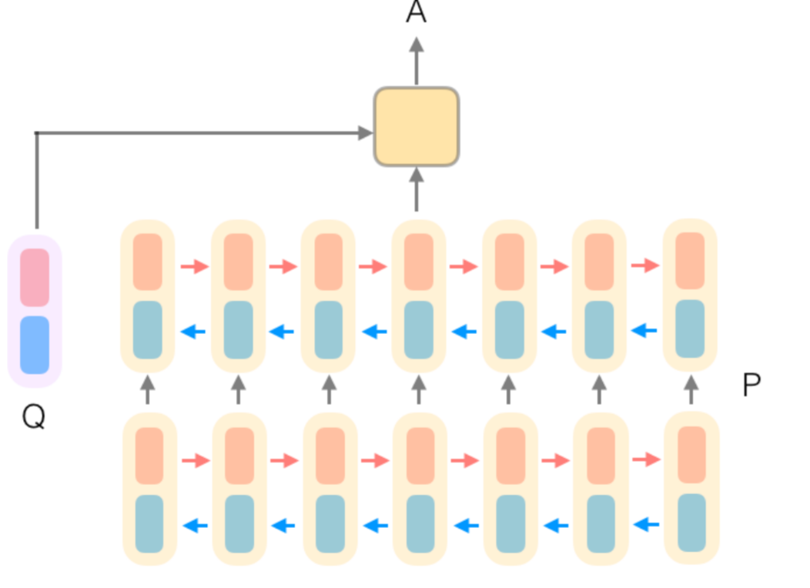
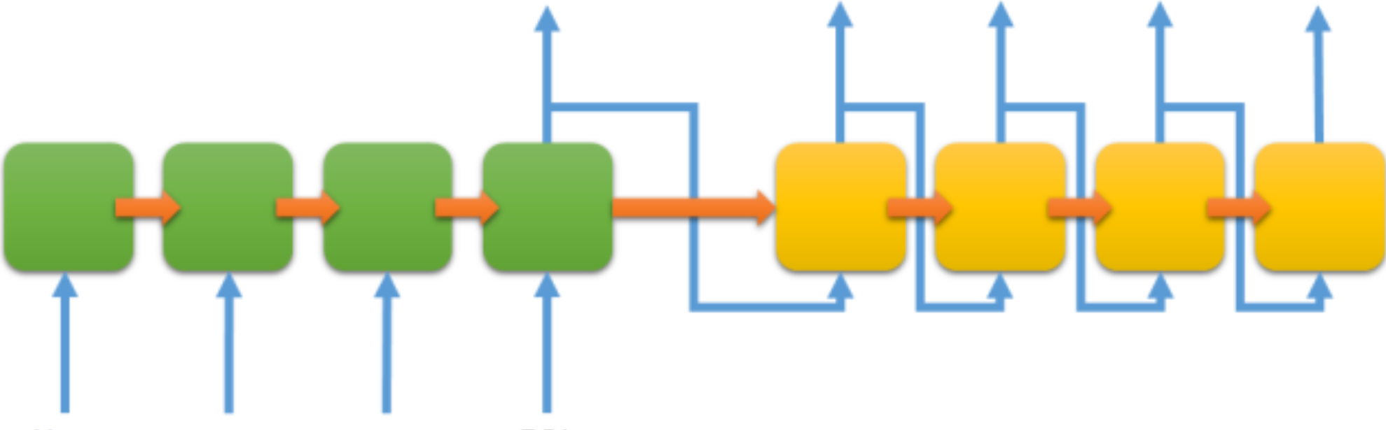
Neural learning on emrQA
What is the dosage of
nitroglycerin ?
Nitroglycerin 40 mg daily, evening
question
answer evidence
: 18
logical form
DrQA reader
longitudinal records of a patient
MedicationEvent (Nitroglycerin)
[dosage=x]
What is the dosage of
nitroglycerin ?
question
Seq2Seq with attention
logical form
emrQA is non-trivial to existing top-performing neural models

Slide 19

Interpretable models on emrQA
Nitroglycerin 40 mg daily, evening
What is the dosage of
nitroglycerin ?
answer evidence
question
Hybrid Models
MedicationEvent (Nitroglycerin)
[dosage=x]
: 18
logical form
logical form
longitudinal records of a patient
Accuracy of end-to-end neural models
Interpretability using logical forms

Slide 20
Conclusions
QA generation framework for any domain
emrQA: 400K question-answer pairs on EMRs
– representative/complex compared dataset generated using crowdsourcing
Logical Forms for interpretable models

Slide 21
References/Credits
[1] Wikipedia/Medical_Errors
[2] Image credits: This Photo by Unknown Author is licensed under CC BY-SA-NC
[3] Image credits: This Photo by Unknown Author is licensed under CC BY-SA

Slide 22
Availability
ArXiv: https://arxiv.org/abs/1809.00732
emrQA generation scripts: https://github.com/panushri25/emrQA
I2b2 NLP annotations: https://www.i2b2.org/NLP/DataSets/
- accessible subject to a license agreement
Thank you !
Questions/Comments/Feedback?
Anusri Pampari - pampari2@Illinois.edu

Slide 23
Additional Slides

Slide 24
Schema for Logical Forms
EMR data to be represented using semantic frame representation
(entities, events, attributes, relations)
causes
MedicationEvenT
Medication = “Labetalol”
CUI = C0022860
Indication
Strength
Route
Formulation
Sig
DailyMaxDosage
Setting
OrderType (single admin, prn, routine)
StartTime
EndTime
NegationFlag = N
HypotheticalFlag = Y
Adherence
MedicationEvenT
Medication = “Labetalol”
CUI = C0022860
Indication
Strength
Route
Formulation
Sig
DailyMaxDosage
Setting
OrderType (single admin, prn, routine)
StartTime
EndTime
NegationFlag = N
HypotheticalFlag = Y
Adherence
SymptomEvenT
Symptom = “Swelling”
CUI = C0038999
BodyLocation
DateOfSymptomOnset
Duration
Frequency
Severity
NegationFlag = N
HypotheticalFlag = Y
15_3778 | NoteID 125 | 2012-07-09 | Nephrology
Review of patient's allergies indicates:
Labetalol Swelling
15_3778 | NoteID 125 | 2012-07-09 | Nephrology
Review of patient's allergies indicates:
Labetalol Swelling
Electronic Medical Record Note
Electronic Medical Record Note
Semantic Frames

Slide 25
emrQA: Quality
Less than 5% have grammatical errors in questions
Manual analysis on 500 questions
Less than 6% have missing answer for a question
Manual analysis on 100 QA pairs

Slide 26
emrQA: Distribution
Dataset | # QA | # QL | # clinical notes
Relations | 141K | 1M | 425
Medications | 255K | 198K | 261
Heart Disease | 30K | 36K | 119
Obesity | 23K | 280 | 1K
Smoking | 4k | 6 | 502
emrQA | 400K | 1,2M | 2K

Slide 27
emrQA: Question Characteristics
test results (11%)
medications for problem (9%)
problem existence (8%).
The long tail following this includes questions about
medication dosage
response to treatment
medication duration
prescription date
Etiology
Temporal constraints were frequently imposed on questions related to tests, problem diagnosis and medication start/stop.

Slide 28
Answer Reasoning: emrQA Vs SQuAD
Lexical Variation (synonym)
Question: Has the patient ever been treated with insulin ?
Evidence: Patient sugars were managed o/n with sliding scale insulin and diabetic
Lexical Variation (medical/world knowledge)
Question: Has the patient complained of any CAD symptoms?
Evidence: 70-year-old female who comes in with substernal chest pressure
Syntactic Variation
Question: Has this patient ever been treated with ffp?
Evidence: attempt to reverse anticoagulation , one unit of FFP was begun
Multiple Sentence
Question: What happened when the patient was given aortic root replacement?
Evidence: The patient tolerated the procedure well and was transferred to
the ICU with his chest open
15 %
33%
39 %
9%
60 %
64%
24 %
14%

Slide 29
Schema for Logical Forms
EMR data to be represented using semantic frame representation
(entities, events, attributes, relations)
causes
MedicationEvenT
Medication = “Labetalol”
CUI = C0022860
Indication
Strength
Route
Formulation
Sig
DailyMaxDosage
Setting
OrderType (single admin, prn, routine)
StartTime
EndTime
NegationFlag = N
HypotheticalFlag = Y
Adherence
MedicationEvenT
Medication = “Labetalol”
CUI = C0022860
Indication
Strength
Route
Formulation
Sig
DailyMaxDosage
Setting
OrderType (single admin, prn, routine)
StartTime
EndTime
NegationFlag = N
HypotheticalFlag = Y
Adherence
SymptomEvenT
Symptom = “Swelling”
CUI = C0038999
BodyLocation
DateOfSymptomOnset
Duration
Frequency
Severity
NegationFlag = N
HypotheticalFlag = Y
15_3778 | NoteID 125 | 2012-07-09 | Nephrology
Review of patient's allergies indicates:
Labetalol Swelling
15_3778 | NoteID 125 | 2012-07-09 | Nephrology
Review of patient's allergies indicates:
Labetalol Swelling
Electronic Medical Record Note
Electronic Medical Record Note
Semantic Frames

Slide 30
Interpretable models on emrQA
Nitroglycerin 40 mg daily, evening
What is the dosage of
nitroglycerin ?
answer evidence
question
Hybrid Models
MedicationEvent (Nitroglycerin)
[dosage=x]
: 18
logical form
logical form
longitudinal records of a patient
Accuracy of end-to-end neural models
Interpretability using logical forms

