Slide 1

CAPSTONE PROJECT
SECURE DATA HIDING IN IMAGES USING STEGANOGRAPHY
Presented By: J Panvi Krishna
Student Name : J Panvi Krishna
College Name & Department : Rajeev Gandhi Memorial College of Engineering and Technology & Computer Science Engineering and Business Systems

Slide 2
OUTLINE
Problem Statement
Technology used
Wow factor
End users
Result
Conclusion
Git-hub Link
Future scope

Slide 3
Problem Statement
❓ What is the Problem?
Insecure communication over the internet can lead to data breaches.
Traditional encryption methods make messages detectable but not hidden.
Need for a secure and undetectable way to share secret messages.
💡 Solution:
Steganography: Hide messages inside images so they remain invisible to unauthorized users.

Slide 4
Technology used
🛠️ Tech Stack
Frontend: HTML, CSS, JavaScript 🎨
Backend: Flask (Python) 🐍
Libraries Used: OpenCV, Waitress, Werkzeug
Deployment: Render (for hosting) 🌐

Slide 5
Wow factors
✨ Key Highlights:
✔ Undetectable Encryption – Secret messages remain hidden inside images.
✔ User-Friendly Interface – Easy encryption & decryption with a few clicks.
✔ Secure Message Retrieval – Only those with the correct password can decrypt.
✔ Downloadable Encrypted Images – Users can store or share encrypted images safely.
✔ Fast Processing – Works in real-time with minimal delay.

Slide 6
End users
👤 Target Audience:
Individuals – Secure private messages from unauthorized access.
Organizations – Confidential communication between teams.
Cybersecurity Professionals – Research in data security.
Journalists & Activists – Secure sensitive information exchange.

Slide 7
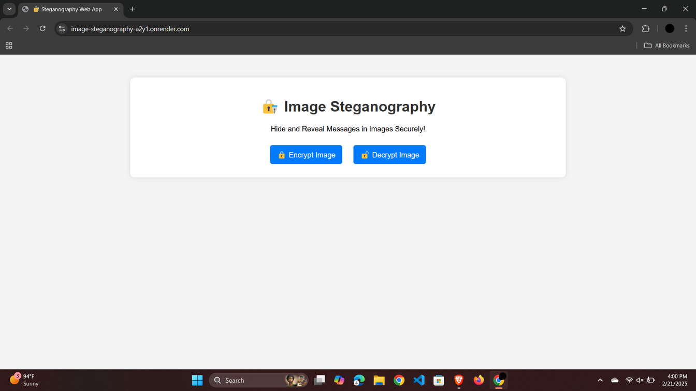
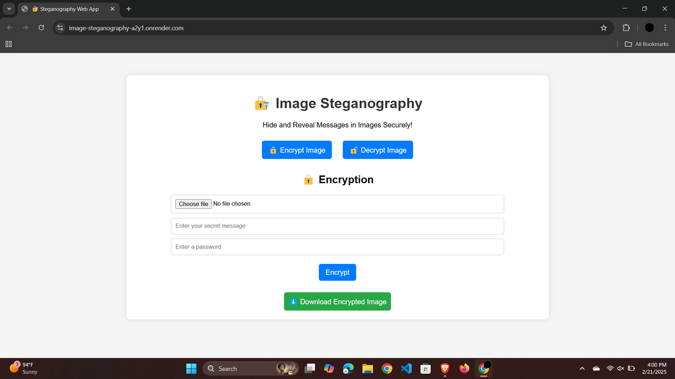
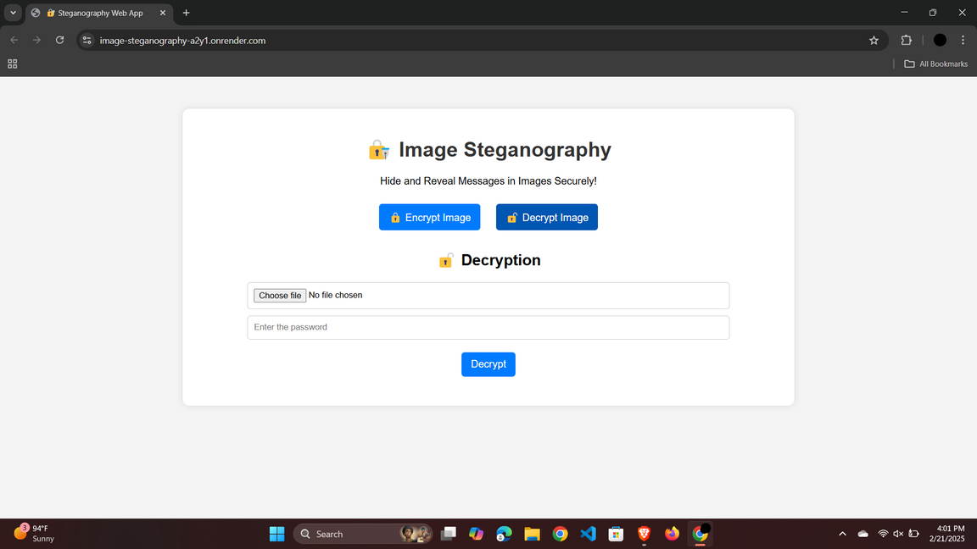
Results

Slide 8
Conclusion
🔹 This project demonstrates the practical use of image steganography.
🔹 Provides a secure and undetectable method for message hiding.
🔹 Future enhancements can make it more advanced and robust.

Slide 9
GitHub Link
📌 Source Code:
🔗 GitHub Repository (click on link)

Slide 10
Future scope
🚀 Enhancements & Future Work
🖼️ Support for Different Image Formats (JPEG, PNG, BMP, etc.)
🔑 Advanced Encryption Methods (AES, RSA for additional security)
📱 Mobile App Development (Android & iOS support)
🎭 Invisible Watermarking for added security
🌍 Multi-language Support for Global Users

Slide 11
THANK YOU

