Slide 1
SEARCH HELP
-Manvendra Singh Panwar

Slide 2
WHAT IS SEARCH HELP?
Used to display all possible values for a field in the form of list.
We can select the value from the hit list instead of manually entering.
Search helps are objects used to assign input help(F4) to screen field.
F4 is standard function of SAP system.

Slide 3
TYPES OF SEARCH HELP
Elementary Search help
Collective Search help

Slide 4
ELEMENTARY SEARCH HELP
It has only one tab where certain fields will be present in which you can enter the values and retrieve the corresponding values for the field.

Slide 5
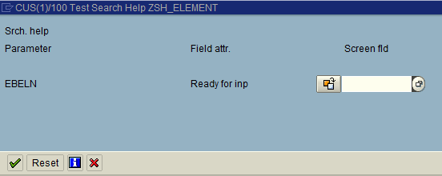

Slide 6
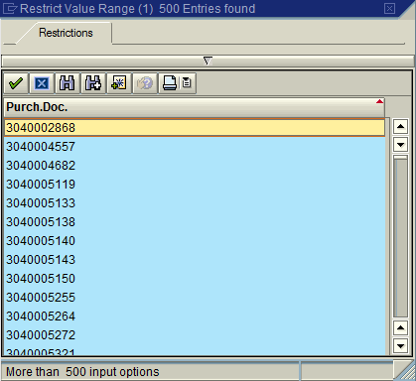

Slide 7
COLLECTIVE SEARCH HELP
It is collection of several tabs of elementary search helps for assisting to fill the value in the field.

Slide 8
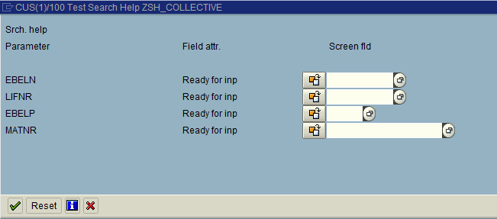

Slide 9
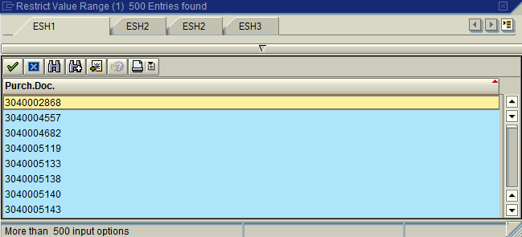

Slide 10
DIFFERENCE BETWEEN ELEMENTARY AND COLLECTIVE SEARCH HELP
Elementary Search help | Collective Search help
Defines a search path where we will define the table from which the data has to be read and the selection criteria | Combination of elementary search helps. When we need to fetch data based on multiple selection criteria’s
Used to get data from a single table. | Used to get data from multiple tables.

Slide 11
STEPS TO CREATE ELEMENTARY SEARCH HELP
Go to SE11.
Click search help radio button.
Create Elementary Search help.
Select the Selection method.
Fill the search help parameters.
Save, check and activate.
Now execute and press F4 on selected field.
We can see the list of possible values for the input field.

Slide 12
ATTRIBUTES TAB
Last Changed On/By
Package
Original Language

Slide 13
SELECTION METHOD
The selection method determined the database table from which the value has to be fetched.
We can also give help view if we want to display fields from more than one table.

Slide 14
DIALOG TYPE
When the dialog type is given as display values immediately, there is no restriction for the values.
If the value has to be restricted , the dialog type ‘Display values with restrictions’ could be selected and also search help exit has to be provided.

Slide 15
STEPS TO CREATE COLLECTIVE SEARCH HELP
Go to SE11.
Click search help radio button.
Create Collective Search help.
Provide the values in Definition tab.
Select include search help tab.
Provide the name of search help which is already created.
Save, check and activate.
Now execute and press F4 on selected field.
We can see the list of possible values for the input field.

Slide 16
SEARCH HELP EXIT
Search help exit is used to modify the F4 values at run time before its being displayed as a list to the user for selection.
Eg. When User1 require only Material type as Finished goods and User2 require only Material type as Raw material, for this scenario we can use search help exit.

Slide 17

APPEND SEARCH HELP
This is to enhance the collective search help. Without modifying the existing collective search help we can add search helps using append search help.
F5 is the shortcut key for append search help in collective search help.

Slide 18
SEARCH HELP USING FUNCTION MODULE
We can create search help using function module ‘F4IF_INT_TABLE_VALUE_REQUEST’.

Slide 19
MATCHCODE OBJECT
For parameters and select-options, we use matchcode object.
Eg :Parameters : p_ebeln type ekko_ebeln matchcode object zms_searchhelp.

Slide 20
THANK YOU

