Slide 1

GenMed
Find Generic Medicines for your needs.
A Deterministic Exact-Match Engine for Cost-Effective Pharmaceutical Substitutions.
By:- Nihal Panwar 4MCA

Slide 2
Objectives & SDG Alignment
Addressing the critical need for affordable healthcare access through intelligent data pipelines.

Slide 3


Aligning with Global Impact Goals
Goal 3: Good Health & Well-being Democratizes access to essential, high-quality generic medicines (PMBJP network), actively reducing out-of-pocket expenditures.
Goal 9: Industry & Innovation Replaces manual pharmacy queries with an automated, scalable NLP and deterministic mapping algorithm.
Specialization Concepts Integrates Natural Language Processing (NER) for parsing, Data Science for inventory structuring, and Full-Stack Architecture.

Slide 4
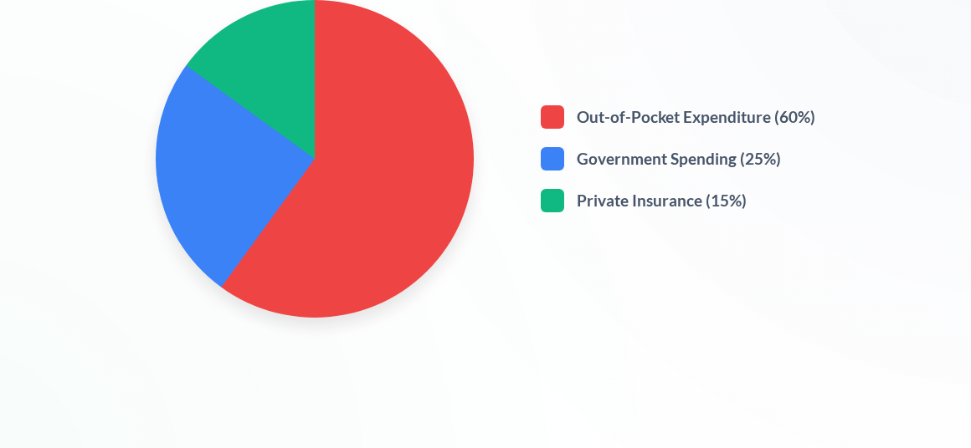
The Cost Problem: Healthcare Expenditure

Slide 5
Analysis Phase
Evaluating existing healthcare search limitations and establishing robust system requirements.

Slide 6
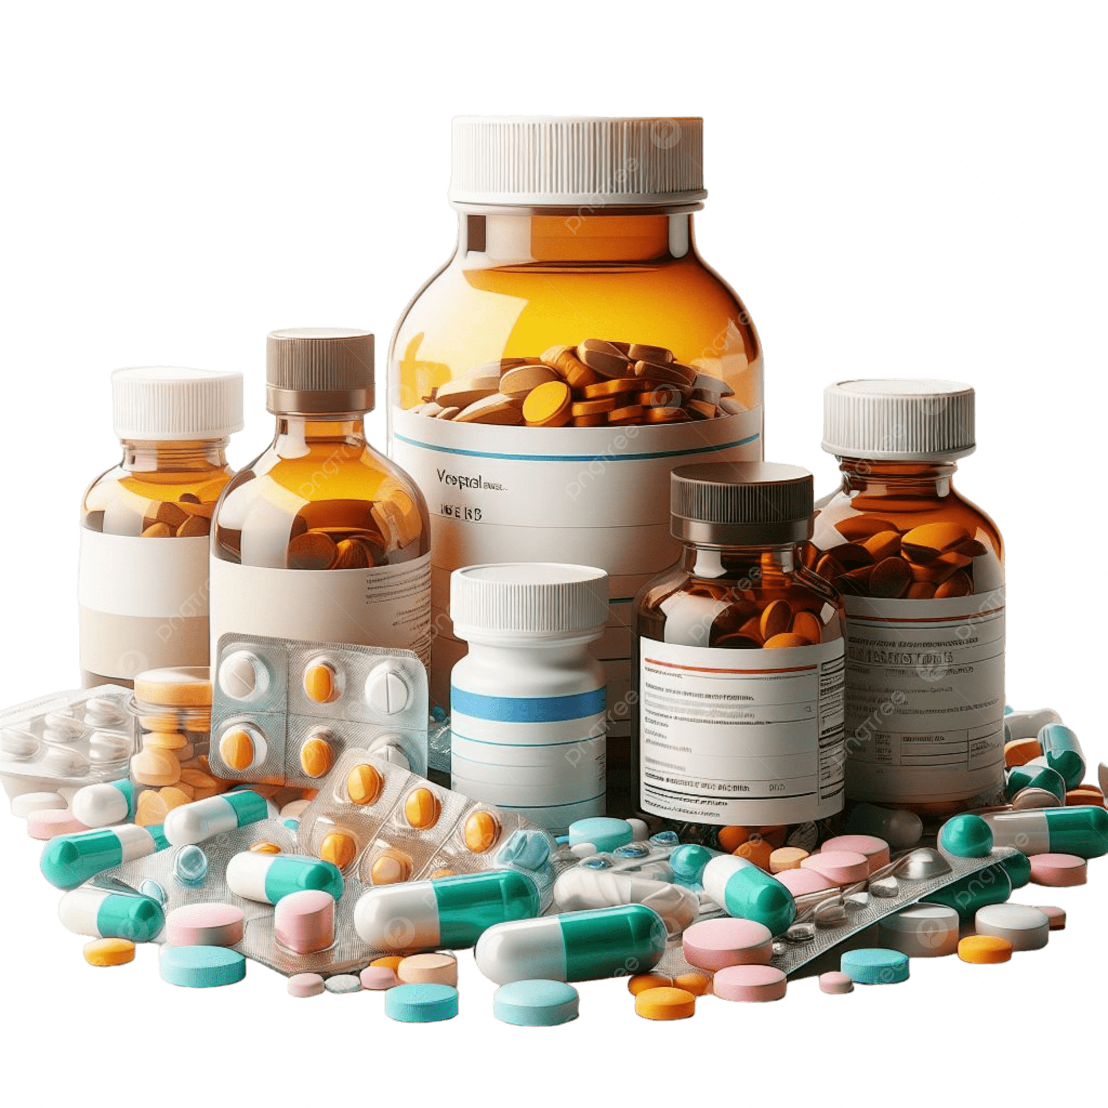

Limitations of Current Systems
Dangerous Probabilistic Matching Existing recommendation engines use algorithms like Cosine Similarity, which can output the wrong drug if names are textually similar.
Fragmented Inventory Data Patients cannot easily cross-reference expensive branded prescriptions against localized, government-subsidized generic inventories.
Lack of Equivalency Focus Most platforms focus on brand-to-brand substitution rather than mapping precise Active Pharmaceutical Ingredients (APIs).
Zero Clinical Interaction Oversight Existing apps only compare prices without checking if stacking generic alternatives triggers dangerous Drug-Drug Interactions.
No Counterfeit Safety Net No consumer tool cross-references batch numbers against CDSCO monthly recall blacklists or detects artificial price dumping.

Slide 7









Proposed System Features
NLP Entity Extraction
Deterministic Engine
PMBJP Integration
Utilizes advanced NLP exclusively for Named Entity Recognition (NER) to safely parse user input into distinct 'Brand' and 'Dosage' parameters without probabilistic guessing.
Enforces a strict, rule-based Exact-Match algorithm against the chemical composition (salt strings), guaranteeing 100% therapeutic equivalency in recommendations.
Directly maps results to the official Jan Aushadhi database, proving real-world cost savings via local government generic centers.

Slide 8
Deterministic Equivalency Mapping: Extracts chemical salts via NER and queries the generic database for a guaranteed therapeutic match.
Dynamic Savings Calculator: Computes and displays financial savings per unit/strip dynamically.
"Equivalency Trust" Display: Renders a split-screen view mapping the side effect profiles of both the branded and generic drugs to visually prove therapeutic equivalency.
Multi-Layer Counterfeit Detection: Integrates a statistical Price Anomaly Heuristic and an OSINT-driven CDSCO Batch Blacklist Scraper to identify suspicious market dumping and recalled spurious drugs.
Cognitive Interaction Engine: Cross-references patient inputs against the OpenFDA API to flag potentially adverse Drug-Drug interactions.
Proposed System Features

Slide 9
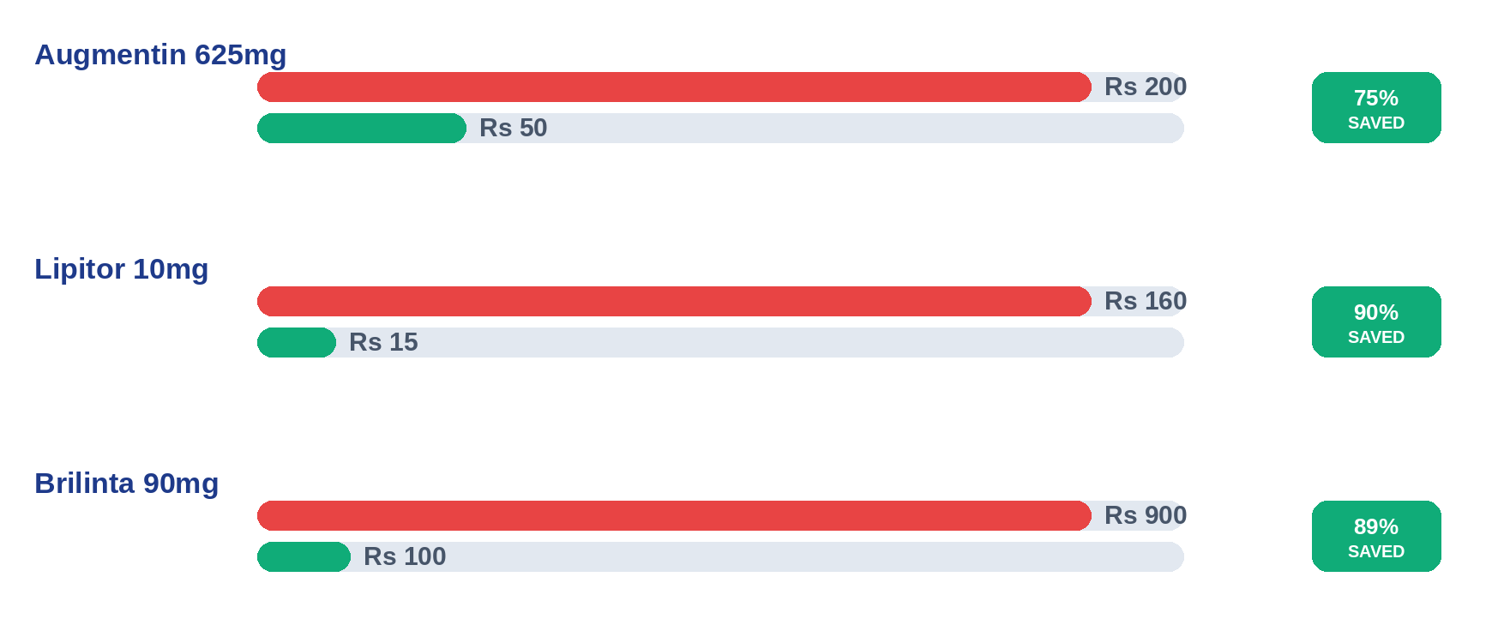
Cost Savings Analysis (Per Strip)

Slide 10


Requirement Specifications (SRS)
Functional Requirements
Non-Functional Requirements
Query System: Users input branded medicine names and dosages naturally.
Accuracy: 100% deterministic accuracy required; failsafe UI message if no exact salt match.
Equivalency Mapping: Extract chemical salts and query the generic database.
Performance: Sub-second latency for NLP extraction and database querying.
Savings Calculator: Compute and display financial savings per unit/strip dynamically.
Scalability: Architecture must support large-scale ingestion of scraped pharmaceutical datasets.
Geolocation: Locate nearest Jan Aushadhi Kendra based on results.

Slide 11
Design Phase
Architectural blueprints covering System Modules, Database Design, Algorithmic Logic, and UI Prototyping.

Slide 12









Microservices Architecture
Client Presentation
API Gateway
Algorithmic Engine
A React.js frontend providing a secure interface. Features dynamic visual feedback, savings gauges, and interactive geospatial mapping for pharmacies.
Node.js/Express server acting as the traffic controller. Handles user session management and orchestrates calls to the MongoDB cluster.
Python/FastAPI microservice. Ingests raw text, runs NER for parameter extraction, and executes strict chemical validation rules.

Slide 13
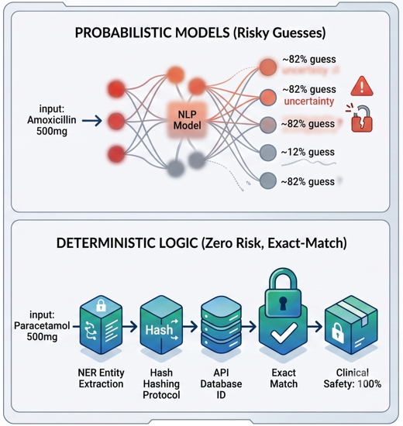
Algorithm Design
Deterministic Mapping Logic
Replaces risky probabilistic models with a strict, rule-based Exact-Match algorithm. NLP is isolated strictly to Named Entity Recognition (NER) for initial text extraction.
By enforcing a strict hash-matching protocol against Active Pharmaceutical Ingredients (APIs), the system ensures absolute zero risk of clinical hallucination or improper substitution.
Notes:
The deterministic SHA-256 hash match also triggers our Clinical Failsafe: if no exact salt match is found, the system refuses to guess and alerts the user to consult a physician instead of returning an uncertain substitution.

Slide 14


Database Schema Design (MongoDB)
Branded_Drugs Collection
Generic_Inventory Collection
Stores commercial pharmaceutical data. Designed for rapid lookups of user input.
Houses the PMBJP dataset. Optimized for strict chemical matching.
_id: ObjectID
_id: ObjectID
brand_name: String (Indexed)
generic_name: String
active_ingredients: Array of Objects [{salt: String, strength: String}]
salt_composition_hash: String (Strict Index for exact match)
mrp_price: Decimal
jan_aushadhi_price: Decimal
Blacklisted_Batches Collection
Janaushadhi_Stores Collection
CDSCO OSINT: indexes alphanumeric batch numbers for instant spurious/recalled drug alerts.
Geospatial: MongoDB 2dsphere indexing maps the nearest physical Jan Aushadhi Kendra.

Slide 15

UI/UX Prototype Vision
Minimalist Search Interface: Clean search bar prioritizing immediate patient utility without complex medical jargon.
Split-Screen Comparison: Dynamically renders the expensive branded medication against the chemical equivalent generic.
Visual Savings Gauge: A bold, color-coded metric instantly calculating the percentage of money saved.
Actionable Failsafes: Hard-coded warnings if exact matches aren't found, preventing unsafe substitutions.
"Equivalency Trust" Cards: Displays salt-bound side-effect profiles to visually prove the generic has the exact same safety profile as the expensive brand.
Consumer Safety Alerts: Real-time UI badges for Drug-Drug Contraindications, CDSCO Batch Blacklist warnings, and Price Anomaly discount-dumping flags.

Slide 16
Thank You!

