Slide 1

GenMed
AI-Powered Pharmacy Invoice Auditing
Nihal Panwar,4MCA
MCA Programme, CHRIST (Deemed to be University), Delhi NCR

Slide 2

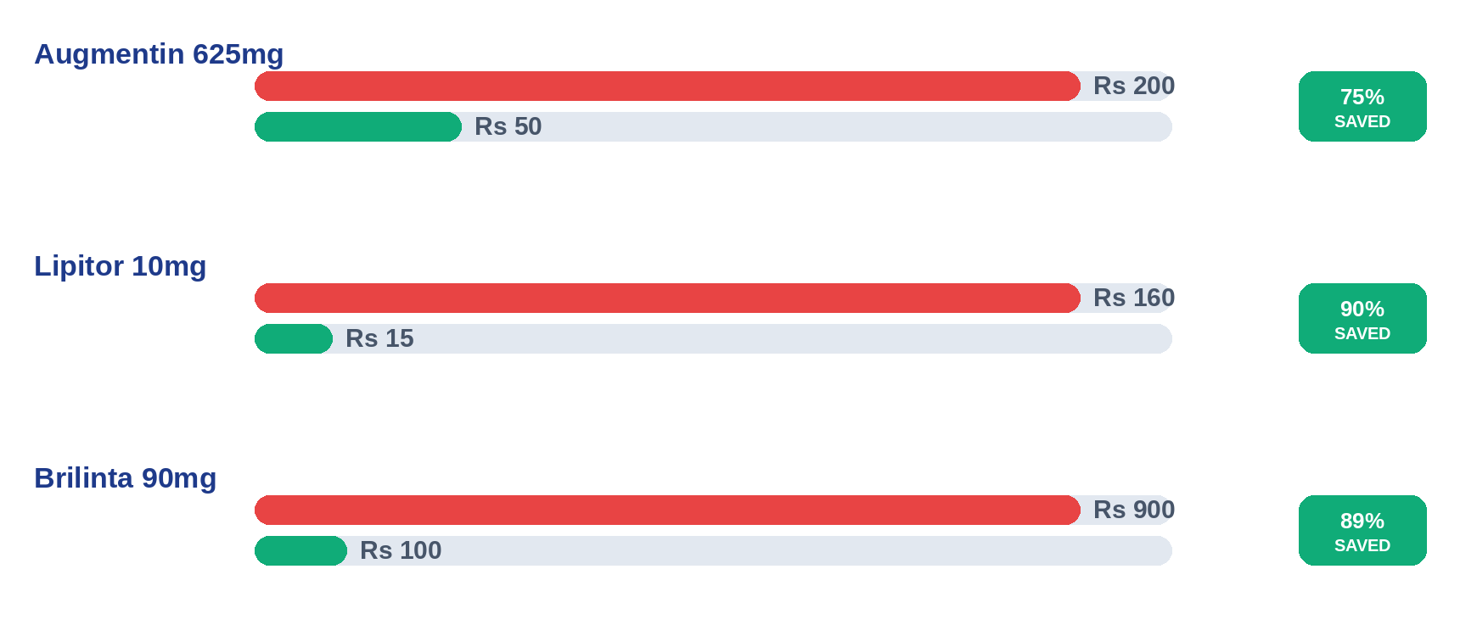
Cost Savings Analysis (Per Strip)

Slide 3



Three Big Problems in Pharmacy Billing
What goes wrong when you buy medicine today
Overcharging
High Patient Cost
Hidden Health Risks
Many pharmacies charge more than the government's price limit (NPPA/DPCO).
Patients aren't shown cheaper generic options (like Jan Aushadhi) for the same medicine.
Paper bills hide dangerous drug combinations and medicines that are officially banned.
GenMed — AI-Powered Pharmacy Invoice Auditing
2

Slide 4




Built to Run Fully Offline
everything runs on the local machine, instantly
Local Database
Instant Drug Matching
Switched to a local MongoDB database after campus Wi-Fi blocked the cloud version.
Matches drug names on the spot, without needing the internet.
1-Hour Rule Cache
Smart Memory (LRU)
Keeps government drug rules loaded in memory so it doesn't re-read them every time.
Remembers past results, so repeated items are checked instantly.
GenMed — AI-Powered Pharmacy Invoice Auditing
3

Slide 5



Checking the Price is Fair
How the system cleans up drug names and does the math
Cleaning Up Drug Names
What's the Legal Price?
Removes extra wording and sorts ingredients so the same medicine is always recognized the same way.
Legal Price = Govt. Price × Quantity × 1.12
Flagging Overcharges
Raises a flag whenever the price paid is higher than the legal limit.
The 1.12 simply adds the standard 12% GST on top of the government price.
If the invoice charges more than this amount, the system flags it right away.
GenMed — AI-Powered Pharmacy Invoice Auditing
4

Slide 6


Keeping Patients Safe
Three safety checks run on every prescription
Banned Medicines
Checks each drug against the official list of banned medicine combinations.
Antibiotic Rules
Makes sure strictly-controlled antibiotics follow the required prescription rules.
Risky Combinations
Compares every pair of medicines to catch dangerous interactions.
GenMed — AI-Powered Pharmacy Invoice Auditing
5

Slide 7


The 50% Milestone
50%
Completed & Verified
PROJECT COMPLETE
Core System Built
Tested End to End
Works Fully Offline
Reads bills, matches drug names, checks prices, and checks safety — all working together.
A full automated test confirms the whole process works correctly.
No cloud or internet connection needed to run.
GenMed — AI-Powered Pharmacy Invoice Auditing
6

Slide 8

Problems I Solved Along the Way
Three roadblocks that changed how we built this
1
2
3
Switched to a Local Database
Built Our Own Matching Tool
Fixed How Doses Are Compared
The campus network blocked our cloud database, so we moved everything to run locally instead.
The local database couldn't search text well, so we built a faster matching tool ourselves.
Separated dose amounts from drug names so the safety checks compare medicines correctly.
GenMed — AI-Powered Pharmacy Invoice Auditing
7

Slide 9



What's Left to Do
Plans for the rest of the project
A Visual Dashboard
A simple website where users can see their audit results clearly.
Better Bill Reading
Improve how the system reads faded or hard-to-read printed bills.
Auto-Updating Data
Automatically refresh drug price and safety data every week.
GenMed — AI-Powered Pharmacy Invoice Auditing
8

Slide 10
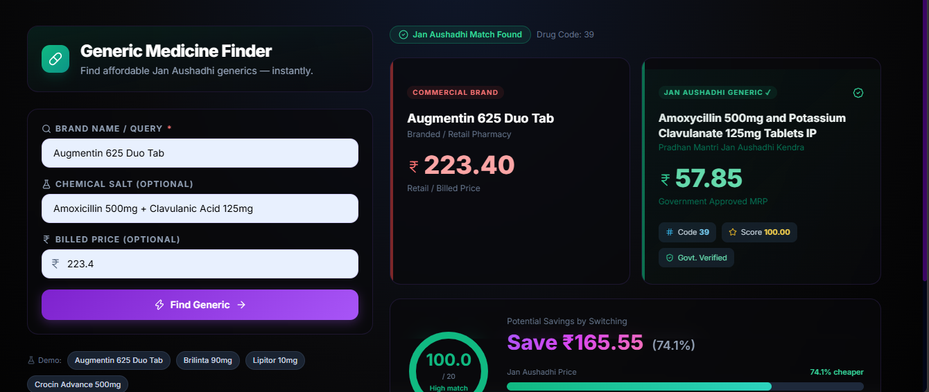

Slide 11
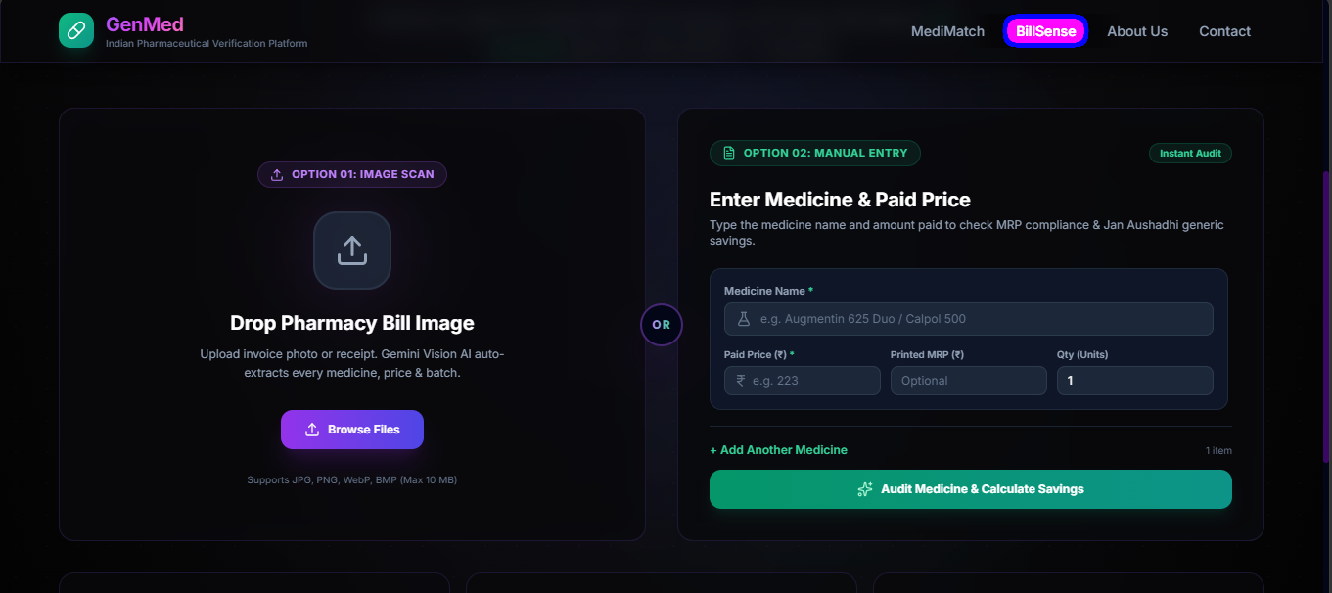

Slide 12
