Slide 1
tcp 几个新特性介绍
潘卫平
2014.10

Slide 2
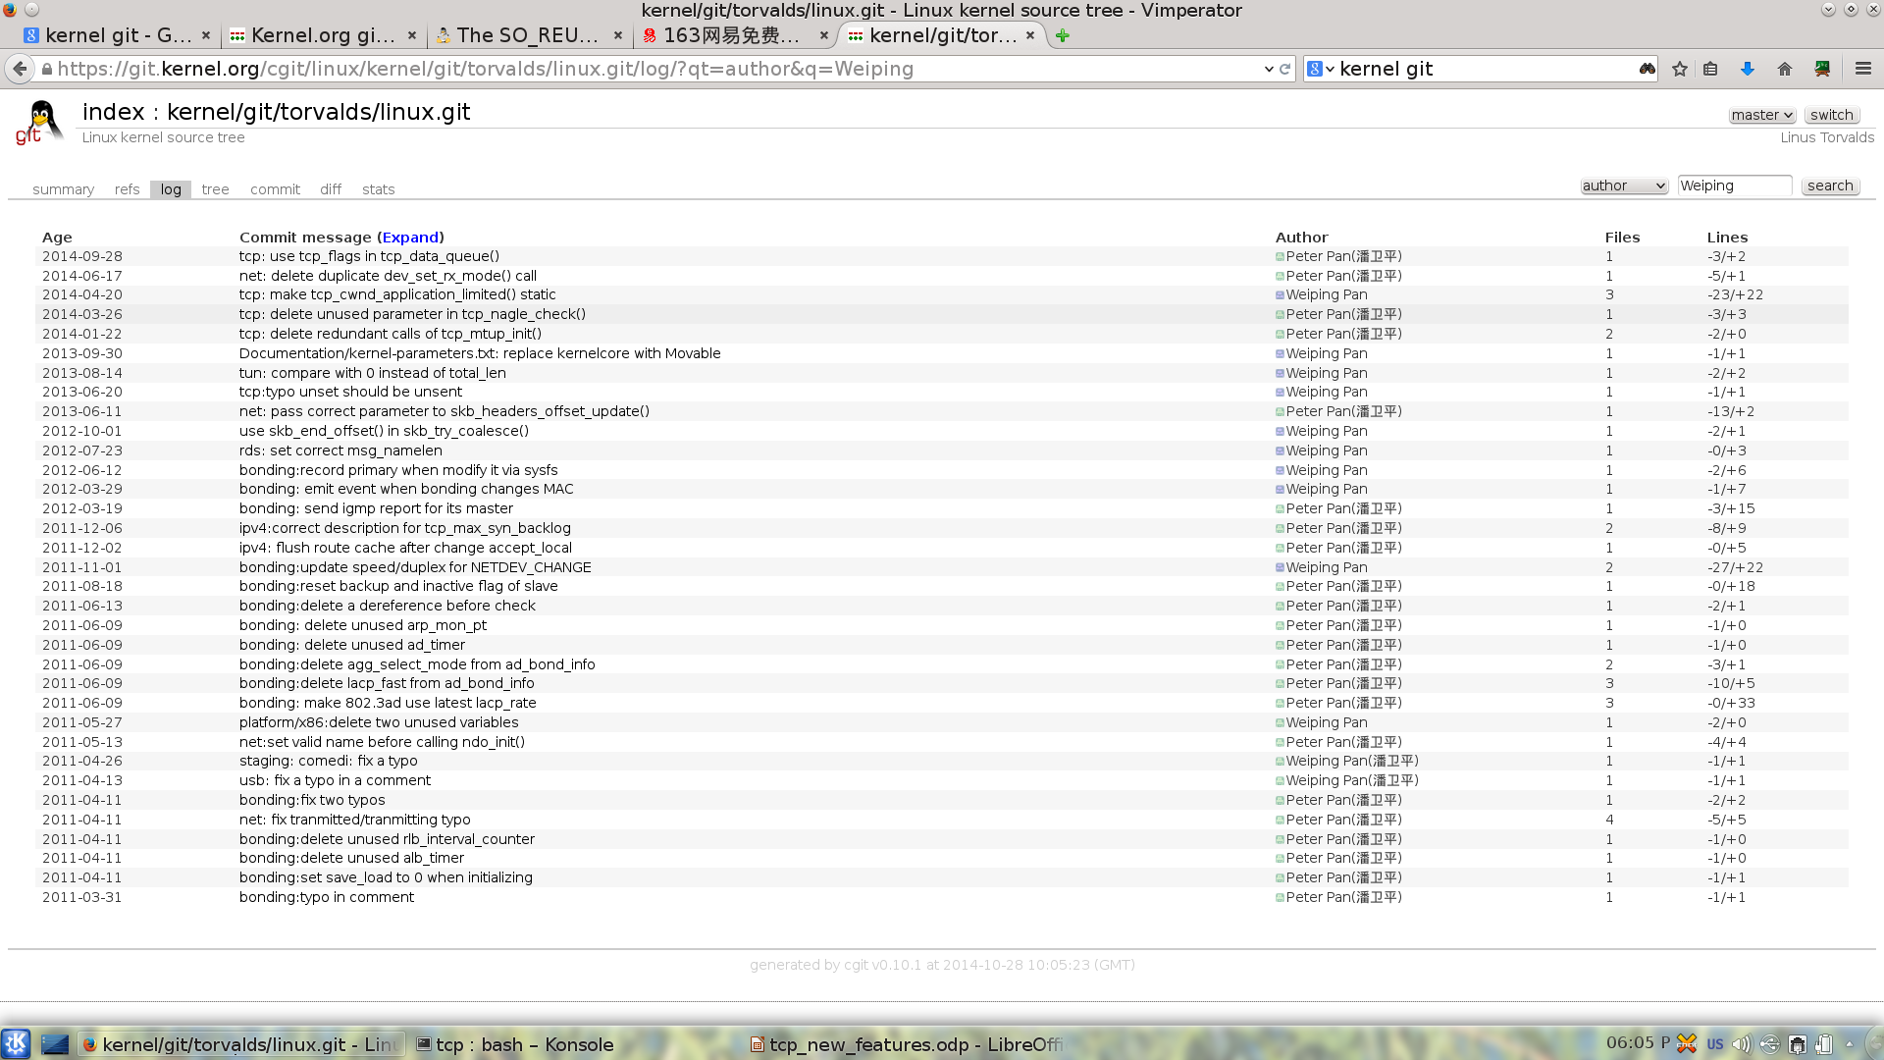
Who am I ?
https://git.kernel.org/cgit/linux/kernel/git/torvalds/linux.git/log/?qt=author&q=Weiping

Slide 3
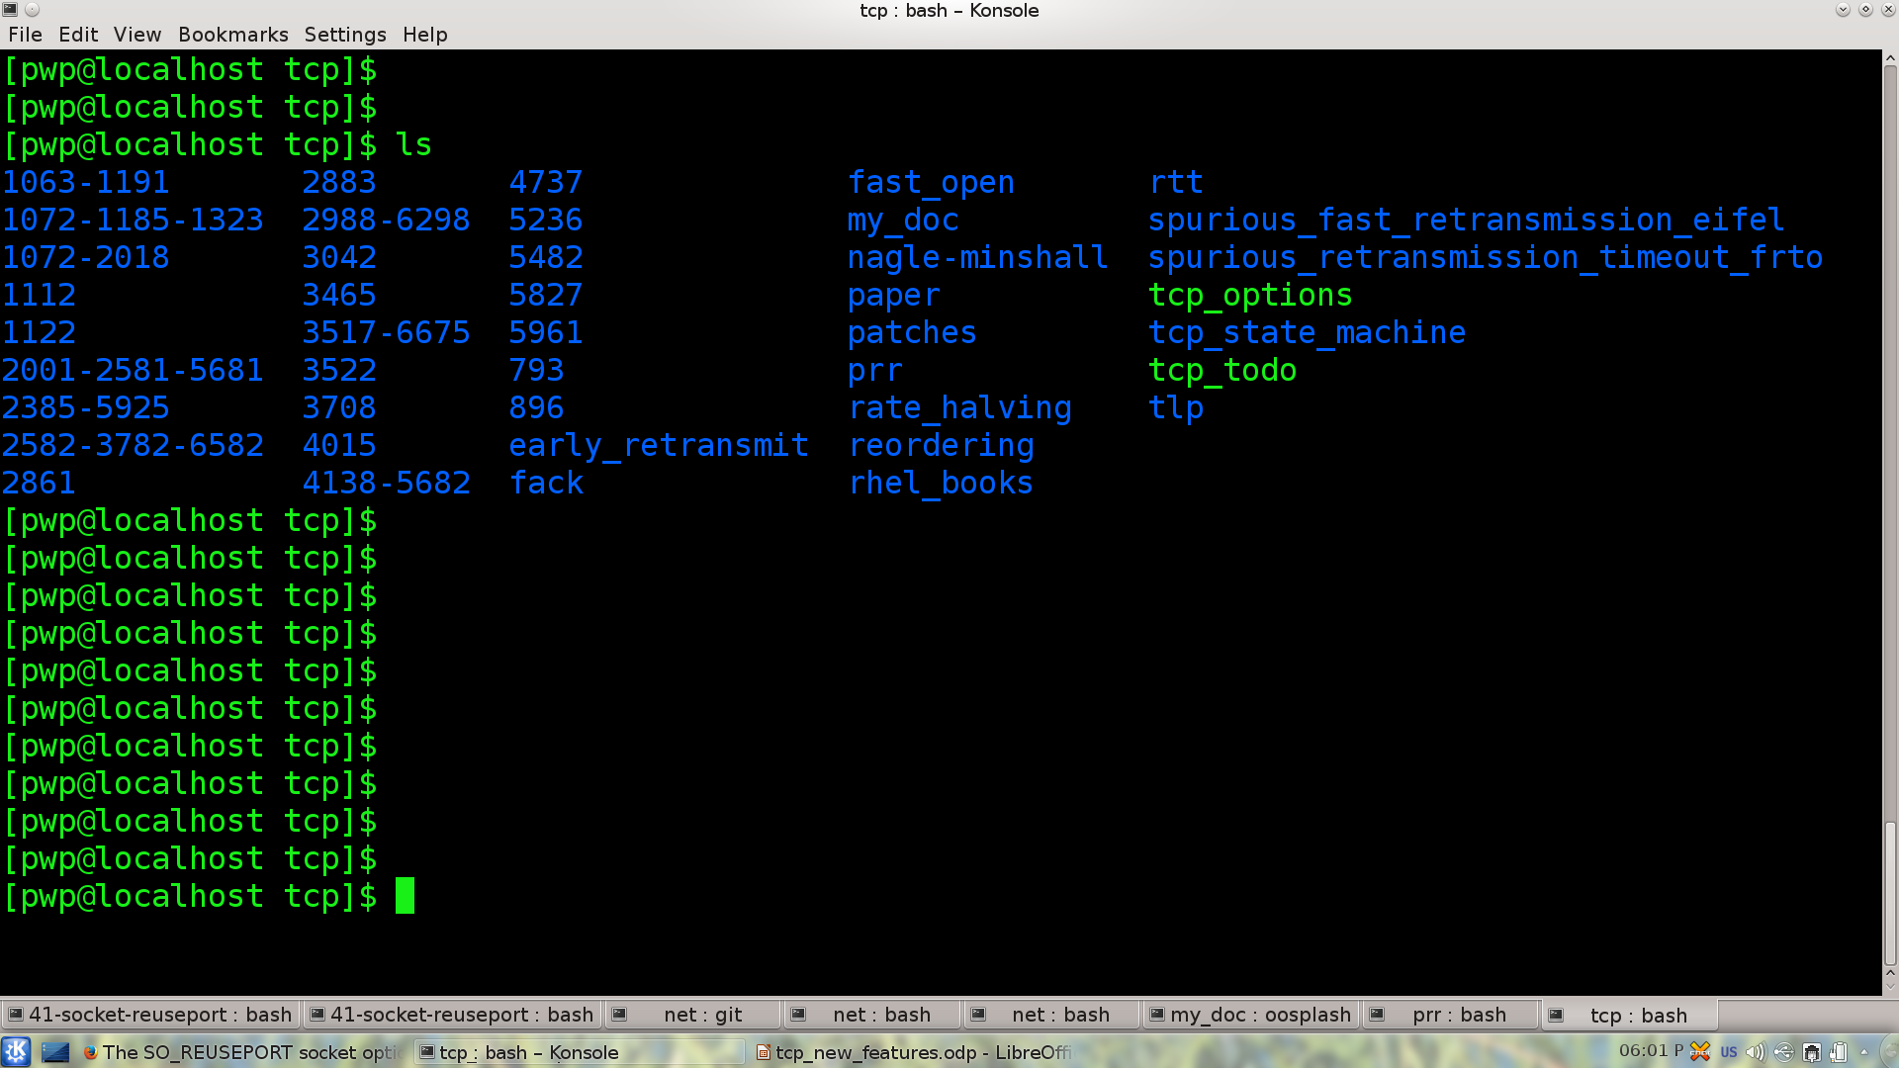
Who am I ?

Slide 4
提纲——tcp 几个新特性
tcp bypass
ER early retransmit
TLP tail loss probe
PRR proportional rate reduction
TSQ tcp small queues
SO_REUSEPORT

Slide 5
1. tcp bypass
socket
socket
tcp_sendmsg
tcp_recvmsg
write_queue
receive_queue
tcp_write_xmit
tcp_v4_rcv
ip_queue_xmit
ip_rcv
Qdisc + device
device

Slide 6
MS BASE AF_UNIX BYPASS TCP_STREAM_MS
1 15.64 5.90 5.12 32% 86%
2 30.93 9.81 10.48 33% 106%
4 58.22 19.70 21.29 36% 108%
8 117.00 39.00 42.74 36% 109%
16 231.08 84.59 83.90 36% 99%
32 439.39 159.93 163.03 37% 101%
64 879.13 323.31 322.78 36% 99%
128 1617.55 632.50 646.34 39% 102%
256 3091.72 1316.36 1206.93 39% 91%
512 5077.18 2359.51 2342.00 46% 99%
1024 7403.20 6302.20 3335.23 45% 52%
2048 10194.40 13922.19 5751.23 56% 41%
4096 13338.08 22566.45 9447.29 70% 41%
8192 14467.93 28122.20 13758.43 95% 48%
16384 22463.15 37522.42 26804.36 119% 71%
32768 14743.58 30591.61 17040.15 115% 55%
65536 24743.77 33855.93 40418.15 163% 119%
131072 13925.14 31762.52 48292.60 346% 152%
262144 16126.15 32912.89 25610.47 158% 77%
524288 12080.51 35059.27 30608.31 253% 87%
1048576 10539.06 28200.14 16953.69 160% 60%

Slide 7
2.ER —— early retransmit
static int tcp_time_to_recover(struct sock *sk)
{
if (tp->do_early_retrans
&& !tp->retrans_out
&& tp->sacked_out
&& (tp->packets_out == (tp->sacked_out + 1)
&& tp->packets_out < 4)
&& !tcp_may_send_now(sk))
return 1;
}

Slide 8
3.TLP——tail loss probe
定时器 max(2*SRTT, 10ms)
static bool tcp_write_xmit( )
{
if (tcp_transmit_skb () == 0) // 发送成功
tcp_schedule_loss_probe()
}

Slide 9
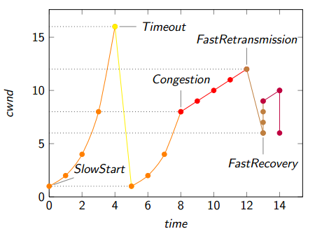
4.PRR——proportional rate reduction

Slide 10
rfc2001->rfc2581->rfc5681 (without sack)
调整 ssthresh = max (cwnd / 2, 2)
cwnd = ssthresh + 3
重发snd_una 包
接收到新的重复ACK cwnd = cwnd + 1
退出 cwnd = ssthresh (平衡点)
static inline unsigned int tcp_packets_in_flight(struct tcp_sock *tp)
{
return tp->packets_out - tcp_left_out(tp) + tp->retrans_out;
}
static inline unsigned int tcp_left_out(const struct tcp_sock *tp)
{
return tp->sacked_out + tp->lost_out;
}

Slide 11
rfc3517->rfc6675 (with sack)
static void tcp_cwnd_down(struct sock *sk)
{
tp->snd_cwnd = min(tp->snd_cwnd, tcp_packets_in_flight(tp) + 1);
}

Slide 12
prr核心算法
static void tcp_cwnd_reduction(struct sock *sk, const int prior_unsacked)
{
int newly_acked_sacked = prior_unsacked -
(tp->packets_out - tp->sacked_out);
tp->prr_delivered += newly_acked_sacked;
if (tcp_packets_in_flight(tp) > tp->snd_ssthresh) {
u64 dividend = (u64)tp->snd_ssthresh * tp->prr_delivered + tp->prior_cwnd - 1;
sndcnt = div_u64(dividend, tp->prior_cwnd) - tp->prr_out;
}
tp->snd_cwnd = tcp_packets_in_flight(tp) + sndcnt;
}

Slide 13
5.TSQ——tcp small queues
根据——对速度的估计
限制——进入Qdisc或驱动的包的数量为2，
或者 为1ms时间内能传输的包的个数
socket 限速 ?
SO_MAX_PACING_RATE
Qdisc fq

Slide 14
6.SO_REUSEPORT
未使用SO_REUSEPORT
process
listen thread
accept()
fork()
process
process

Slide 15
使用SO_REUSEPORT
listen thread
accept()
fork()
process
listen thread
accept()
fork()
process
listen thread
accept()
fork()
process

Slide 16
What can I do ?

