Slide 1


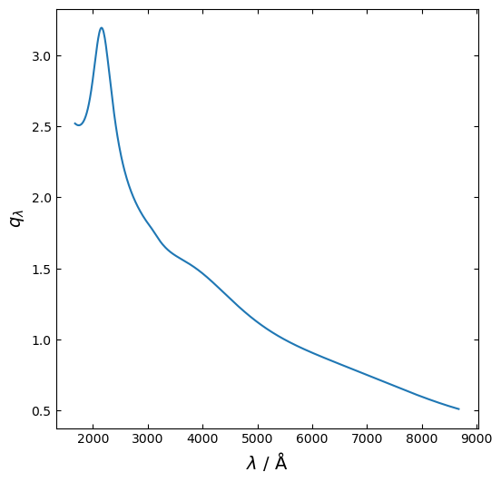
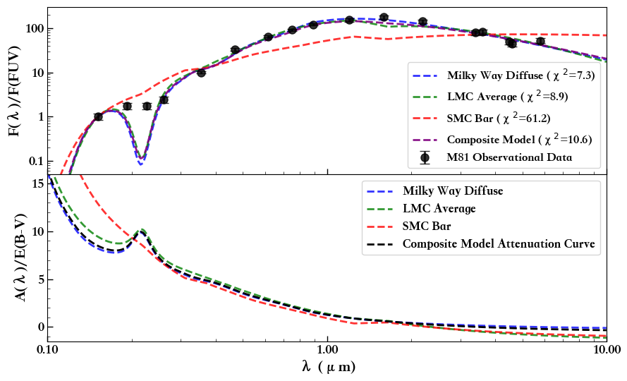
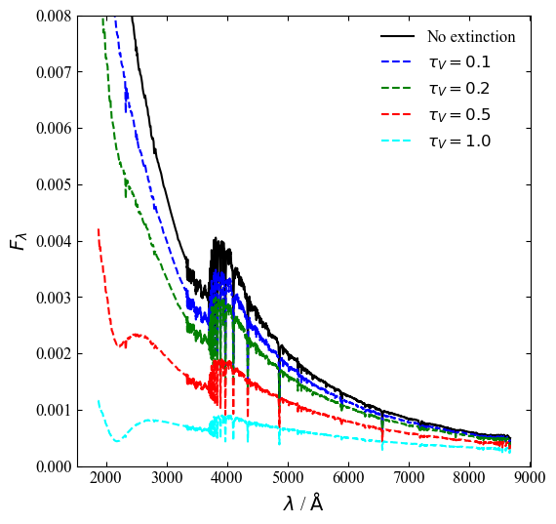
Dust Attenuation Modeling and Fitting
Weixuan Pan, Yewei Mao*
Department of Astronomy, School of Physics and Materials Science, Guangzhou University
★ SED Fit for M81 Multi-band Photometric Data ★
A Bump Feature
but Weaker than the MW Type
MW-type Attenuation Law
MW Attenuation Curve
SSP Spectra with
Various Attenuation Amounts
The Attenuation Laws
Used in Fitting the M81 SED

