Slide 1
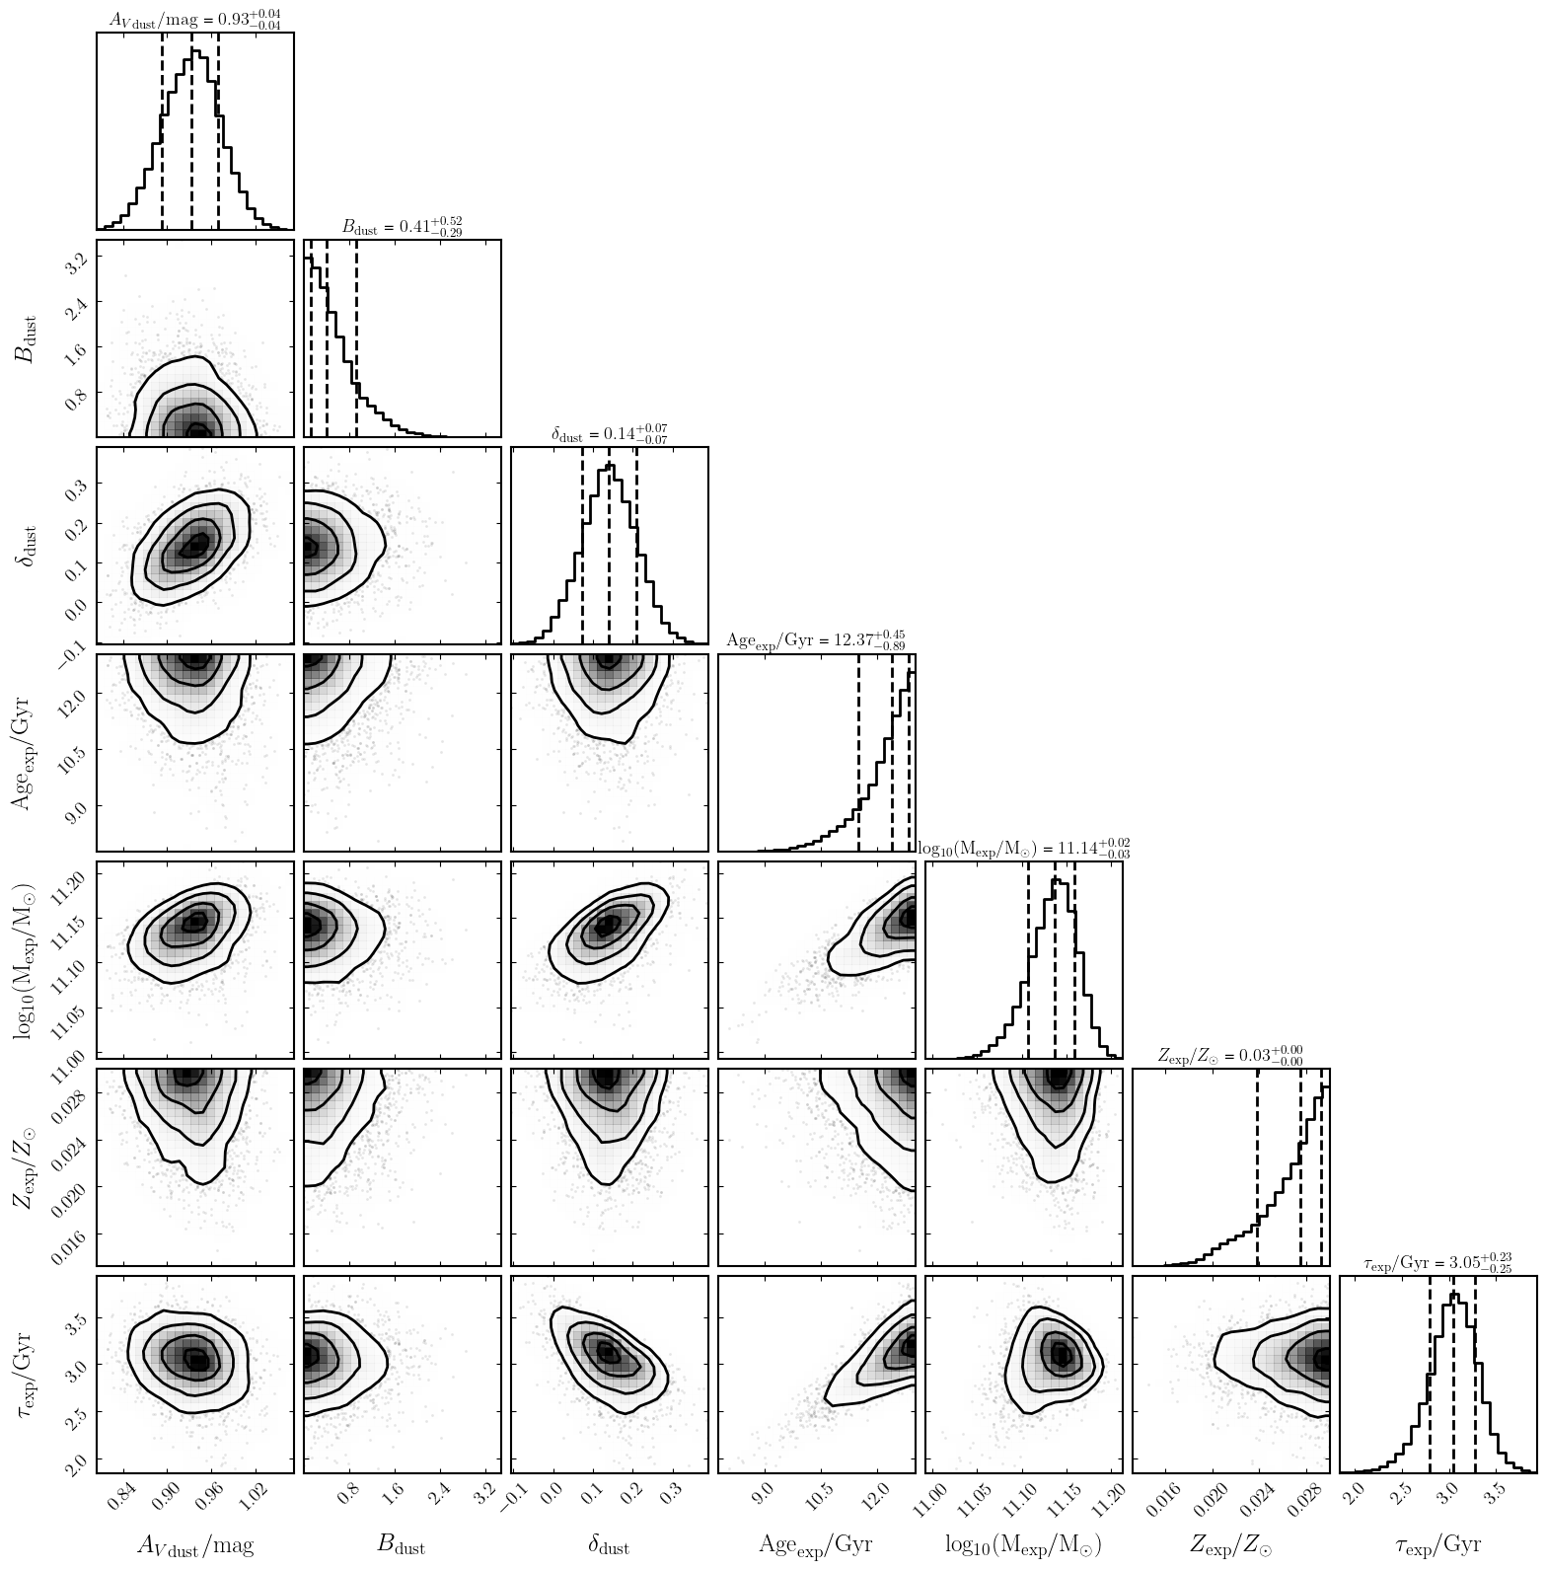
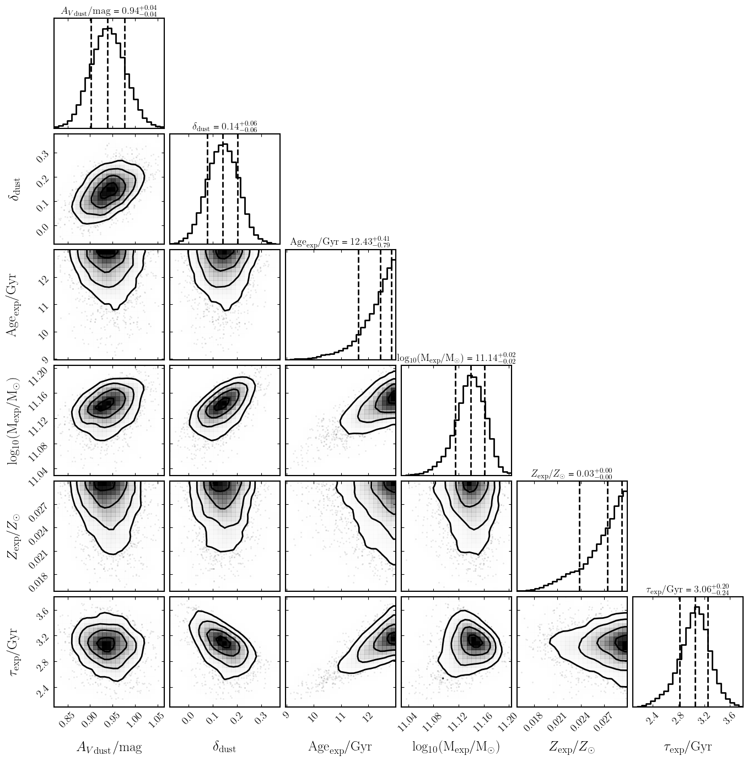
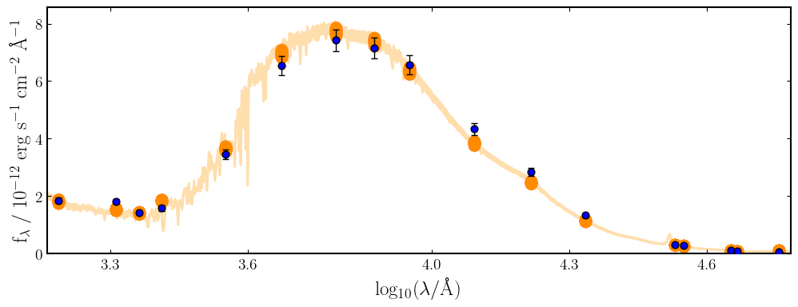

Dust Attenuation Models Comparison
Model 1: Salim Model (with bump)
ln Z₁ = 446.881 ± 0.196
Model 2: Salim Model (no bump)
ln Z₂ = 448.420 ± 0.190
Δln Z = -1.539 ± 0.273
Favors no-bump model

