Slide 1
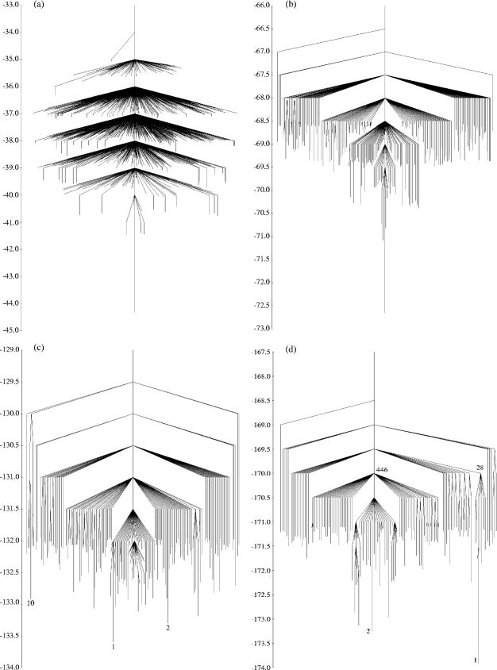
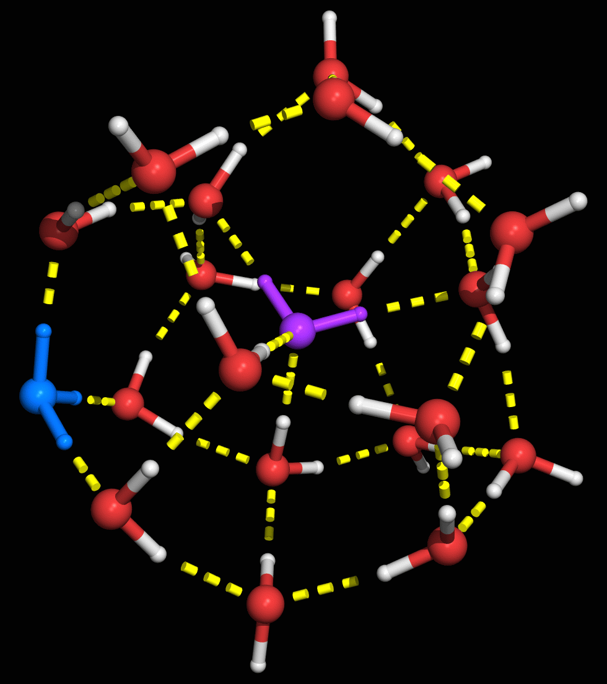
Potential energy surfaces: the key to structure, dynamics, and thermodynamics
K. D. Jordan
Department of Chemistry
University of Pittsburgh
Pittsburgh, PA
ACS PRF Summer School on
Computation, Simulation, and Theory in Chemistry,
Chemical Biology, and Materials Chemistry, June 15-18, 2005

Slide 2
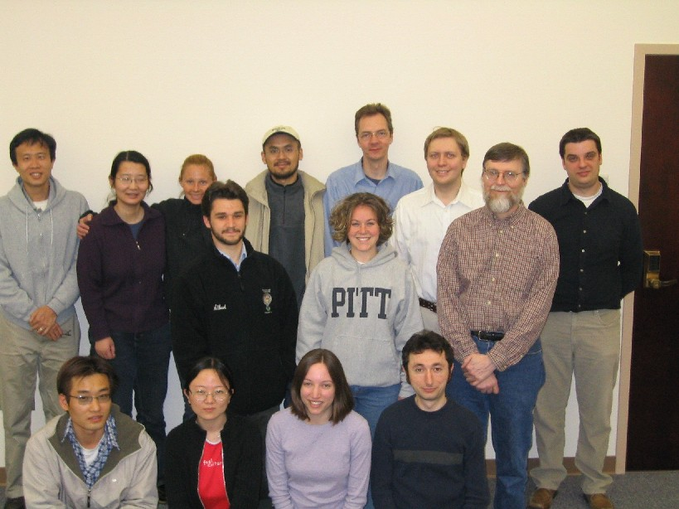
Jordan Group – May 2005

Slide 3
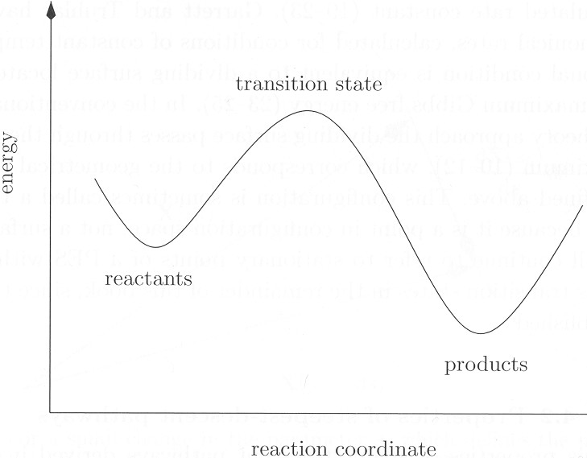
Potential energy surfaces (PES)
Key to understanding
  Chemical reactions
  Dynamics/energy transfer
  Spectroscopy
  Thermodynamics
Methods of obtaining and representing PES
  analytical model potentials
  quantum chemistry (grid of energies)
Quantum chemical energies on grid of geometries can be fit to analytical potentials for subsequent use in studies of spectroscopy or dynamics
  Limited to about 10 atoms
“On the fly” methods can handle larger systems

Slide 4
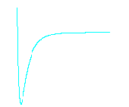
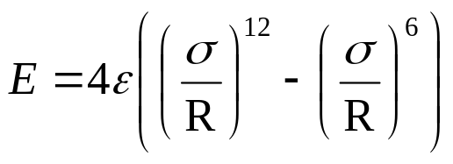
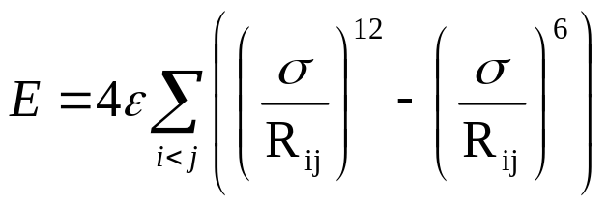
Example – Lennard-Jones (LJ) clusters
2^{1/6}σ
E
Two atoms:
R
R
R
ε
repulsion
dispersion (van der Waals)
Multiple atoms - assume pairwise additive:
a
1
2
3
Isomers
  different minima on potential energy surface
  number of isomers grows exponentially with # of atoms
  a and b – permutation-inversion isomers
  E_{a} = E_{b} ≠ E_{c}
b
1
3
2
c

Slide 5
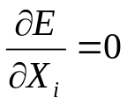
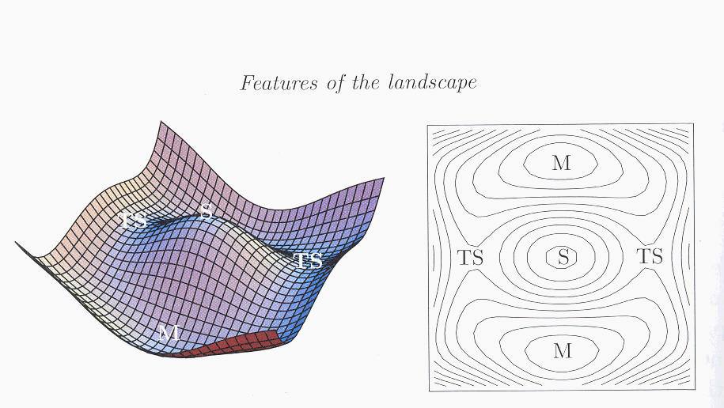
Stationary points for all coordinates X_{i}
  local minima – curvature positive in all directions
  1st order saddle points – curvature – in one direction, + in all others
Potential energy surface for a two-dimensional system, i.e., E(x,y) [from Wales]
Contour map of PES; M = minimum, TS =1st order saddle point, S = 2nd order saddle point

Slide 6
Minimization methods
  Calculus based methods
    Steepest descent (1st deriv.)
      only finds “closest” minimum
      convergence is guaranteed
    Newton-Raphson (NR) (1st and 2nd deriv.)
        not guaranteed to converge
    Quasi-Newton methods (1st and 2nd deriv.)
      2nd derivatives can be evaluated numerically by update procedures
    Eigenmode following (1st and 2nd deriv.)
      extended range of convergence
  Monte Carlo (MC) based methods
    Simulated annealing
      Start at high T, and gradually lower T
    Basin-hopping (a hybrid MC/calculus method)
  Neural network approaches

Slide 7
E
E
E(kJ/mol)
Figures from Energy Landscapes, by D. Wales.
E(kJ/mol)
Easy to find global minimum
Hard to find global minimum
Locating the global minimum – major challenge
even small clusters can have over 10¹⁰ minima!
  Brute force approaches, e.g., starting from many initial structures, work for only the simplest systems
  Monte Carlo methods such as basin hopping useful for systems containing 100 or so atoms (very computationally demanding)

Slide 8
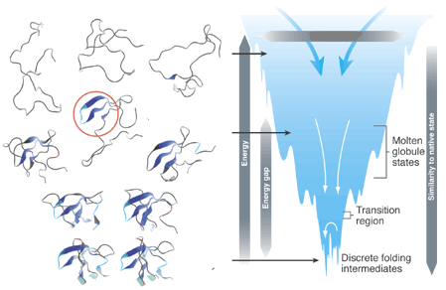
Protein folding
Entropy
unfolded
partially folded
folded
Even though my examples are drawn from cluster systems, the issues considered are relevant for a wide range of other chemical and biological systems, e.g., to the “protein folding” problem. The above figure is from Brooks et al., Science (2001).

Slide 9
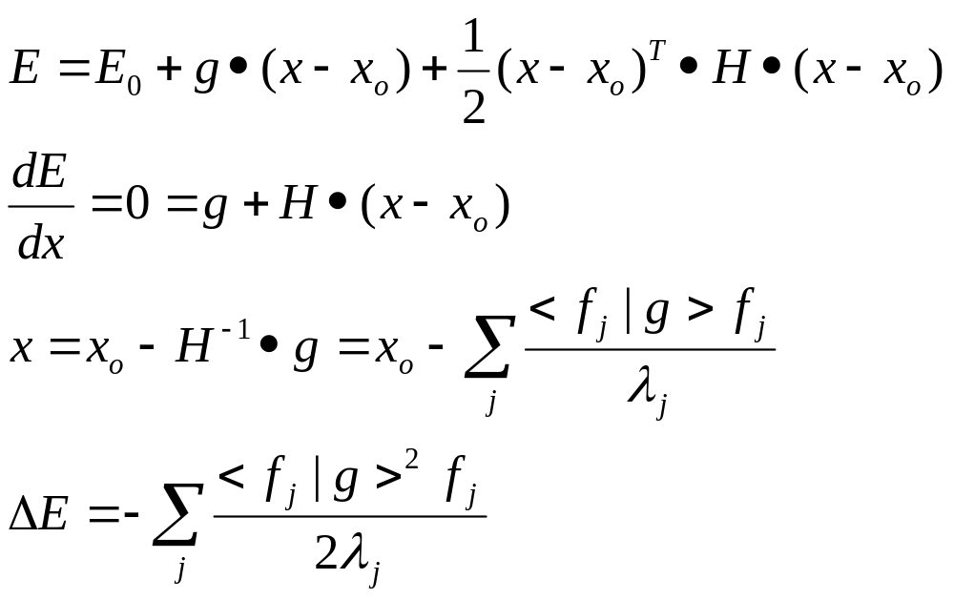
Locating transition states and reaction pathways
  Harder than locating local minima
  Elastic band and other 1st derivative (gradient)-based methods
  Eigenmode following (EF) (1st and 2nd deriv).
    Methods using analytical Hessian (d²E/dx_{i}dx_{j} matrix)
    Methods with approximate Hessian (update methods)
EF method

Slide 10
Energy (kJ/mol)
Energy (kJ/mol)
Icosahedral
Icosahedral
FCC
Disconnectivity diagram Ar₁₃
(from D. Wales)
Disconnectivity diagram Ar₃₈
(from D. Wales)

Slide 11
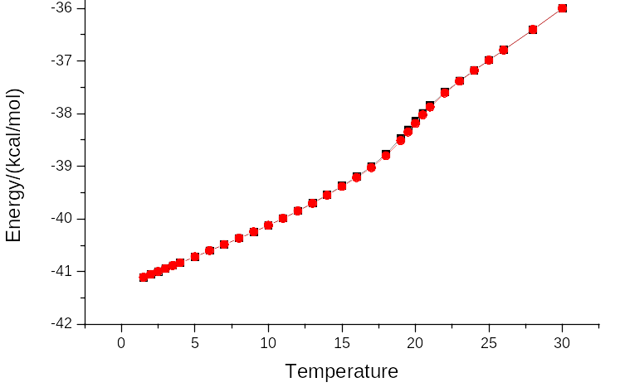
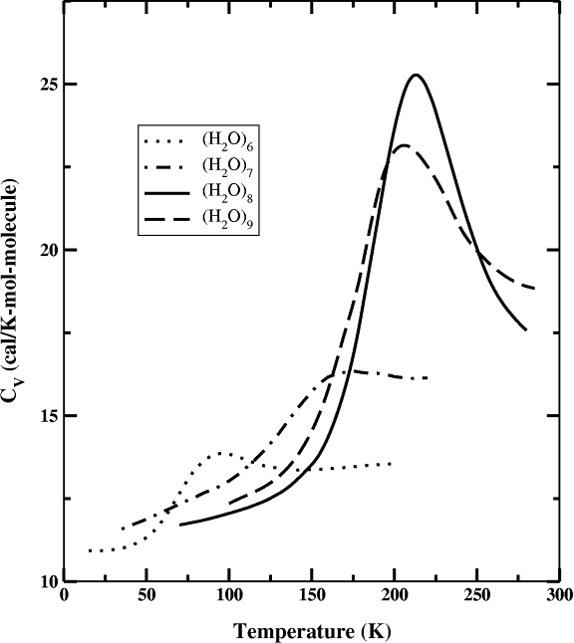
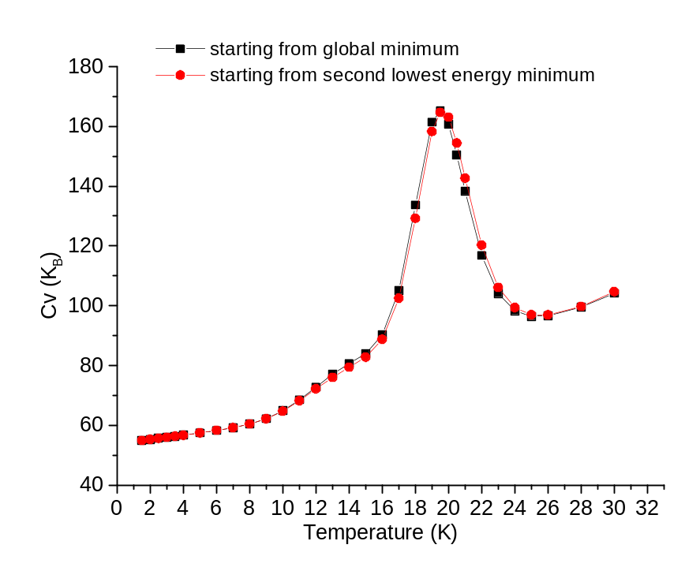
Thermodynamics of clusters
  from Monte Carlo (or MD) simulations
Potential energy vs. T, LJ₃₈
solid liquid
C
FCC Icosahedral
C
C vs. T, (H₂O)₈ (Tharrington and Jordan)
C vs. T, LJ₃₈ (Liu and Jordan)

Slide 12
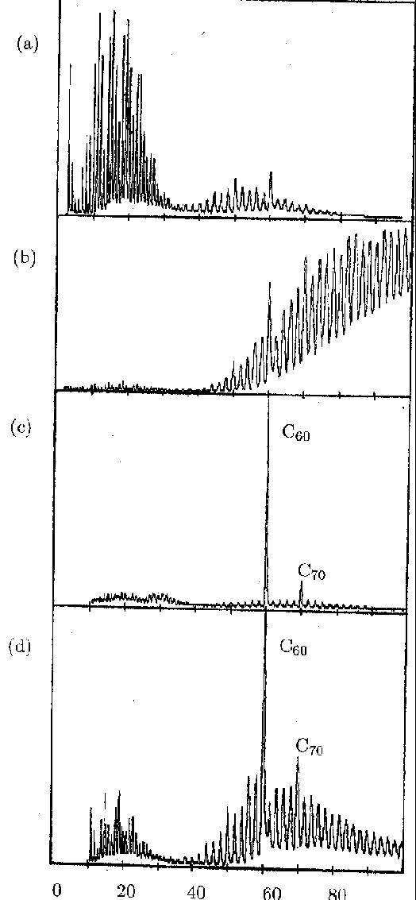
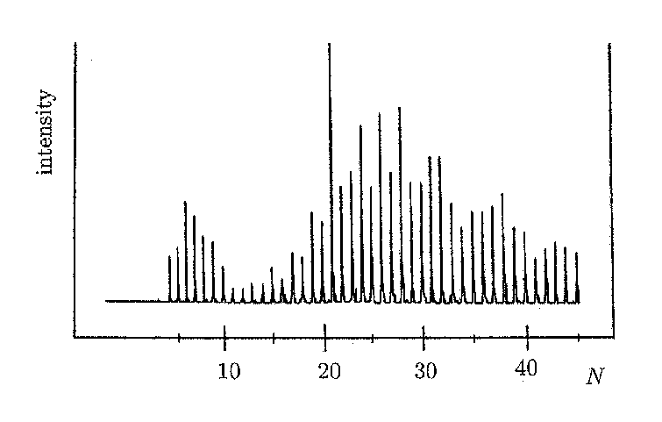
Magic number clusters
  arrangements of atoms that are especially stable
    Often connected with high symmetry
  illustrate several of the issues discussed thus far
21
60
6
60
Mass spectrum of (H₂O)_{n}H⁺: magic # at n = 21(from Castleman + Bowen)
Mass spectrum of C_{n}⁺: magic # at n = 60 (from Kroto)

Slide 13
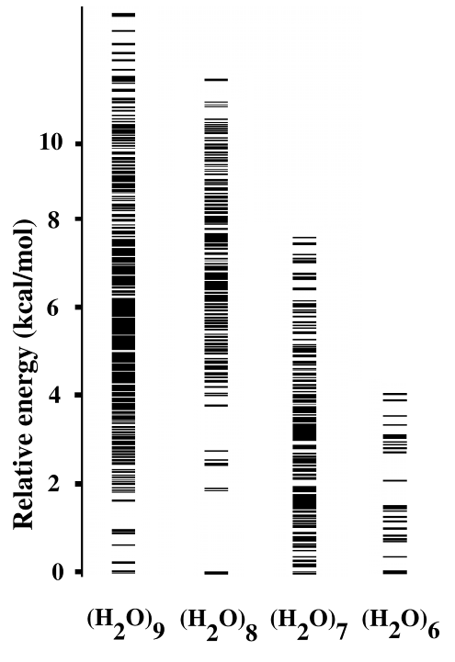
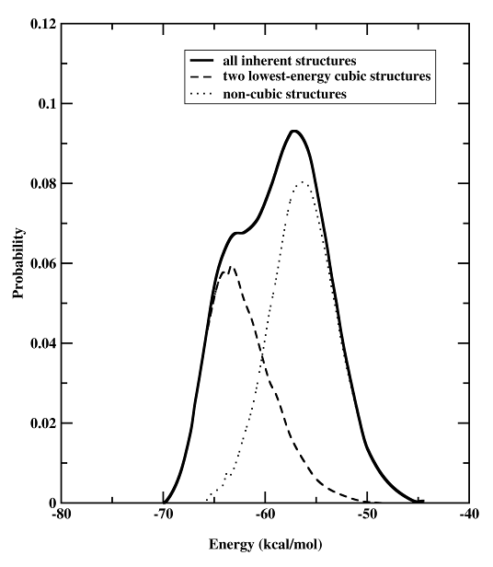
Pot. Energy distribution for (H₂O)₈, T ≈ T_{max}
Densities of local minima of (H₂O)_{n} clusters
Bimodal potential energy distribution
  Only low-energy cubic species populated at low T
  Many inherent (non-cubic) structures populated at high T
  System shuttles back and forth between “solid” (cubic) and “liquid” (non-cubic) structures

Slide 14
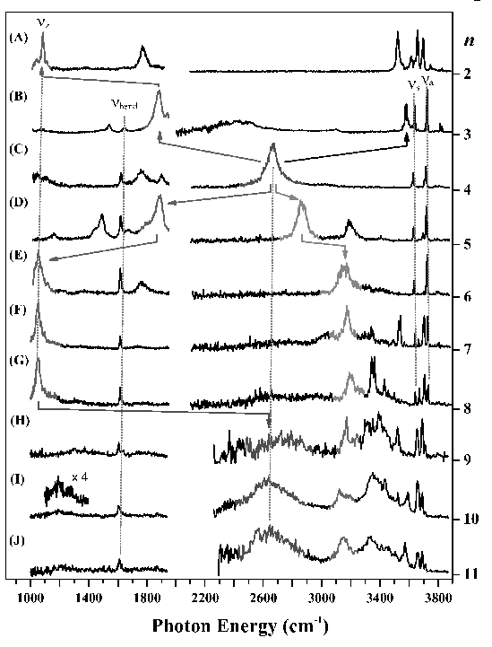
Mass spectra alone tell us very little about the structures.
Recently, the combination of new experimental techniques plus electronic structure calculations have enabled researchers to establish the structures of many cluster systems.
  Our own work has focused on H⁺(H₂O)_{n} and (H₂O)_{n}⁻ clusters.
IR spectra of (H₂O)_{n}H⁺, n = 2-11, from Duncan, et al., Science, in press

Slide 15
One of the biggest challenges in theoretical/computational chemistry is choosing the suitable approach
  Model potentials vs. quantum chemistry (each of these has several variants)?
  Do we need to allow for temperature?
  Is the dynamics well described classically, or is a quantum treatment required?
  In modeling vibrational spectra, does the harmonic approximation suffice?
Approach to be adopted dictated by the nature of the problem being studied
This will be illustrated by considering the protonated water clusters

Slide 16
Approaches for modeling
model potentials (molecular mechanics/force fields)
  applicable to thousands of atoms
  generally neglect polarization and not suitable for cases with rearrangement of electrons
quantum chemistry
  tens – few hundred atoms
  Wavefunction-based vs. DFT
primary
QM/MM methods
    primary region – treated quantum mechanically
    Secondary region – treated with a force field
secondary

Slide 17
Choice of theoretical approaches for our studies of H⁺(H₂O)_{n}
  there is no model potential that provides a near quantitative description of the interactions in protonated water clusters
    → must use quantum chemical methods (DFT or MP2)
  for the n = 5 - 8 clusters, the dominant species are not the global minima
    → must include vibrational ZPE and allow for finite T effects
    → must employ a scheme which can locate all the low-energy minima (not just those we anticipate)
  for addressing some aspects of the vibrational spectra, it is necessary to go beyond the harmonic approximation

Slide 18
Quantum Chemistry (electronic structure methods)
Hψ = Eψ
    H = Hamiltonian : contains kinetic energy operator, el.-nuclear interactions, el.-el. Interactions
    A complicated partial differential equation
    In general – must introduce approximations
Orders of magnitude more expensive than using model potentials
  Even fastest methods scale as N³, where N = number of atoms
    Research underway to get O(N) scaling for large systems
  But not subject to limitations of model potentials
    Includes polarization
    Applies to all bonding situations
    All properties accessible
Software: both commercial and public domain programs
  GAMESS, Spartan, Gaussian 03, NWChem, Jaguar, and many others

Slide 19
Properties:
  charge distributions, dipole moments
  electrostatic potentials
  polarizabilities
  geometries – minima and transition states
  vibrational spectra
  electronic excitation and photoelectron spectra
  NMR shifts
  thermochemistry
For complex systems, the other major challenge is the exploration of configuration space
  Even if one or two isomers dominate under experimental conditions, it may be necessary to examine a very large number of isomers in the electronic structure calculations
  Accounting for finite T/energy effects

Slide 20
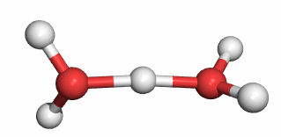
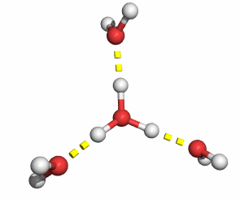
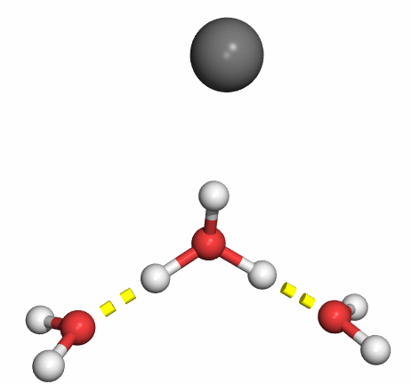
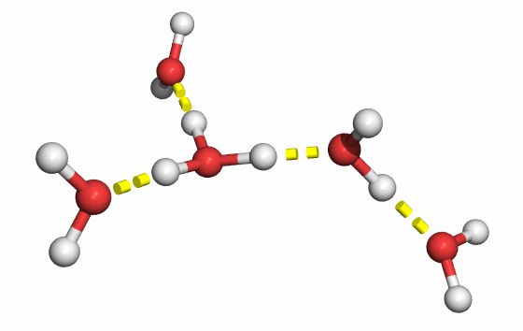
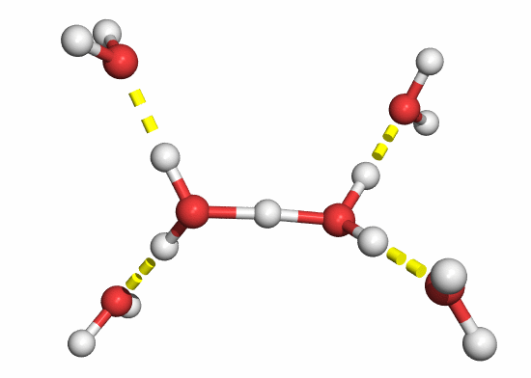
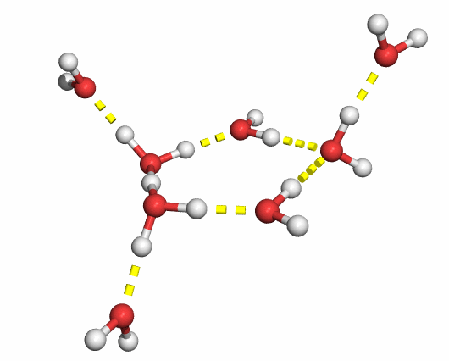
Structures responsible for observed spectra
H⁺(H₂O)₂
H⁺(H₂O)₄
H⁺⁽H₂O)₃
H⁺(H₂O)₅
H⁺(H₂O)₆
H⁺(H₂O)₈
For the n = 5 - 8 clusters, these are not the global minimum isomers.

Slide 21
Accounting for finite temperature on cluster stability
E_{el} (T=0)
E_{el}(T=0)+ ZPE
E(T = T’)
H(T=T’)
G(T=T’)
From electronic structure calculations
Optimize geometries
Account for vibrational zero-point energy
Calculate harmonic frequencies
Population of excited vibrational,
rotational levels
Account for PΔV = ΔnRT (ideal gas)
Include entropy

Slide 22
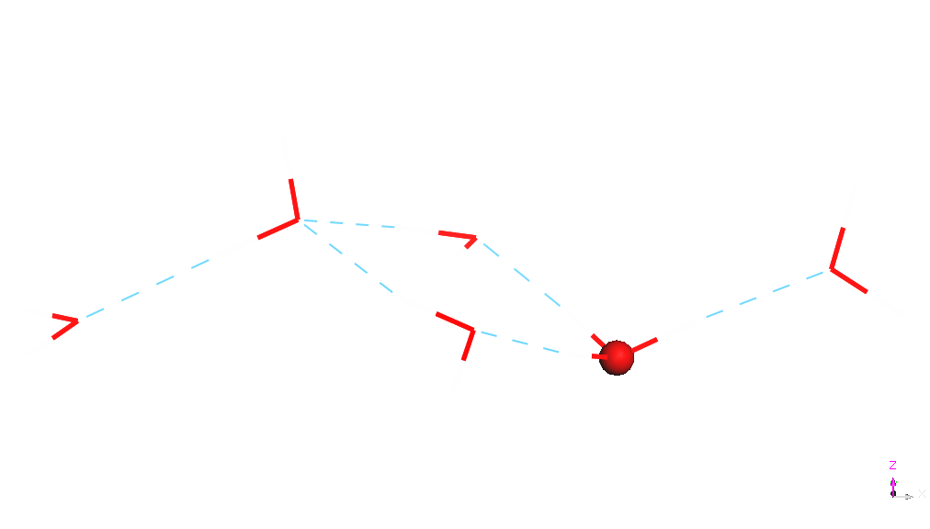
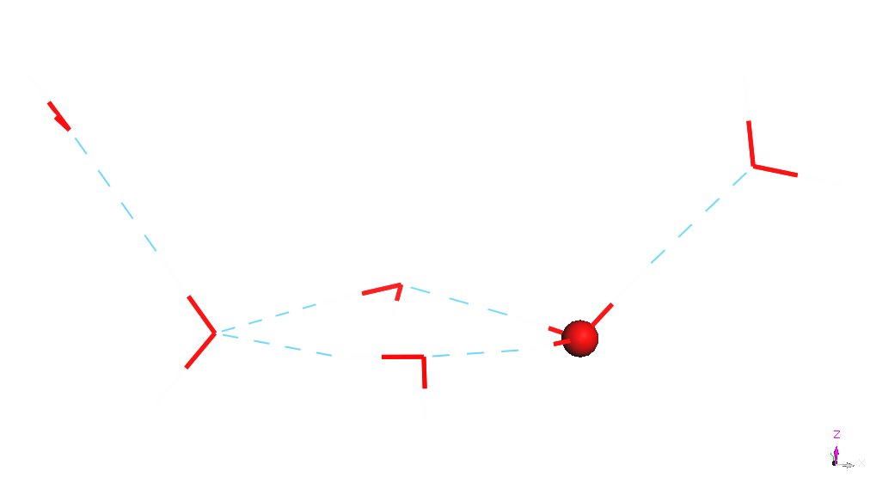
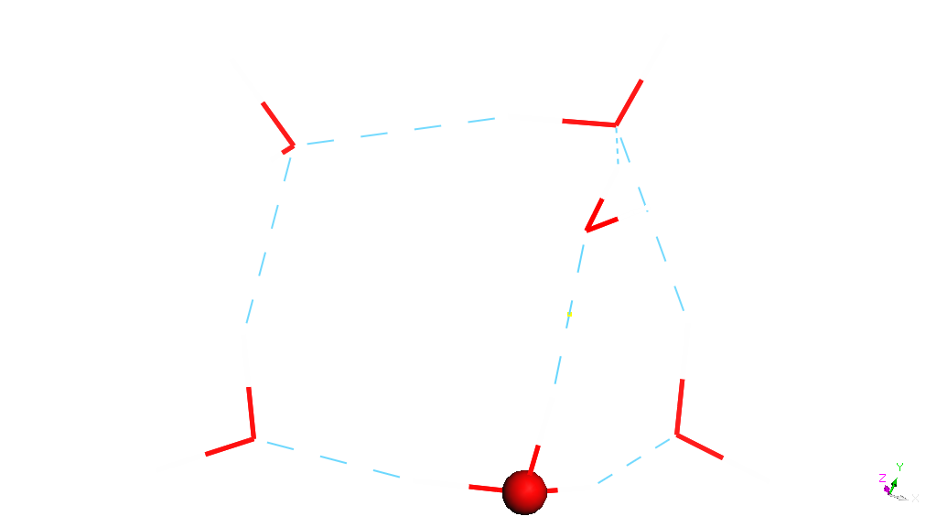
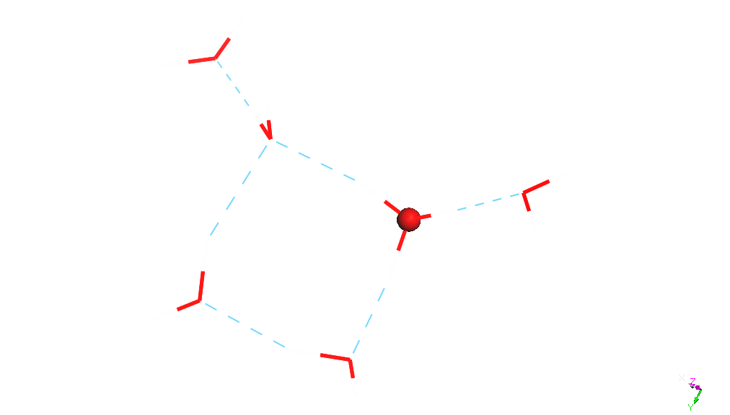
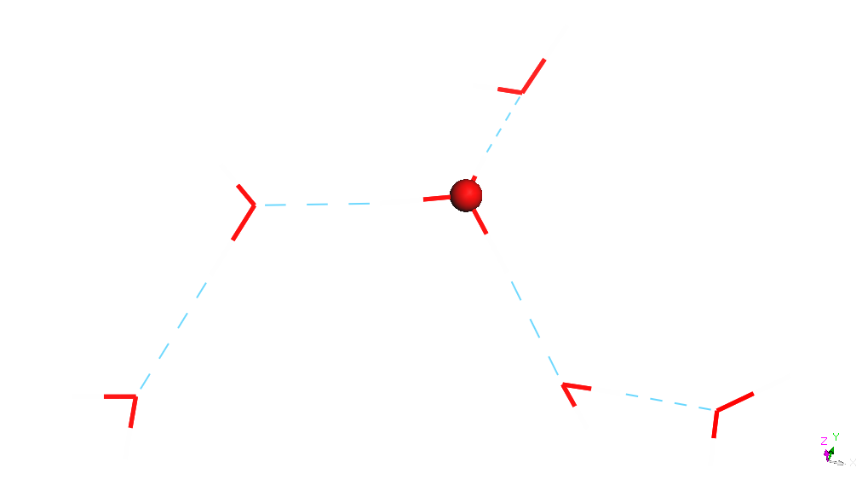
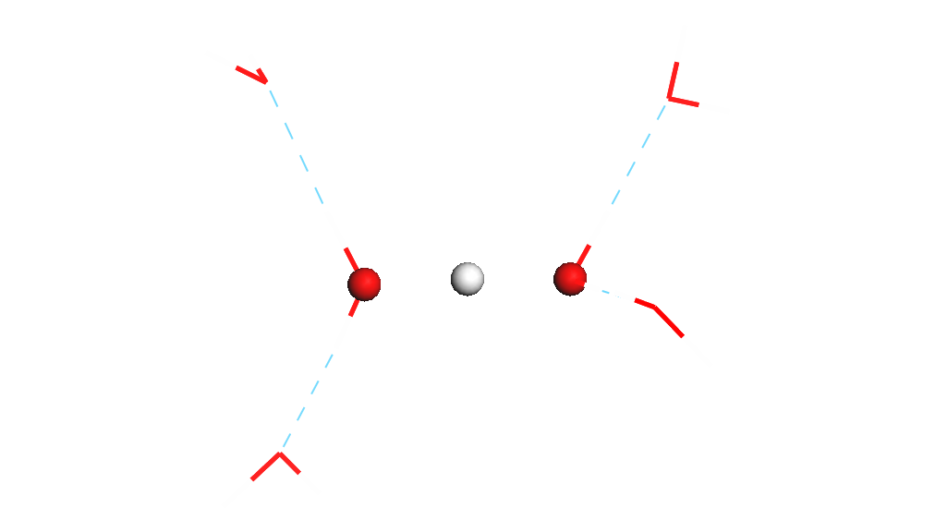
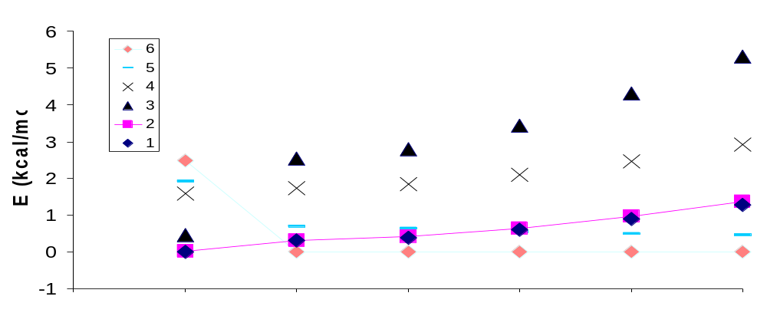
(H₂O)₆H⁺
1.
2.
3.
4
5.
6.
3
4
1, 2
5
6
E^{ele}
E^{ele}+ZPE
G(50K)
G(100K)
G(150K)
G(200K)
Isomers with dangling water molecules (low frequencies) favored by ZPE and by entropy
Zundel-type ion dominates under the experimental conditions, T ≈ 150 K.

Slide 23
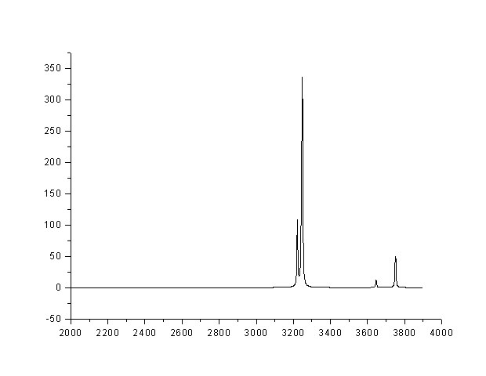
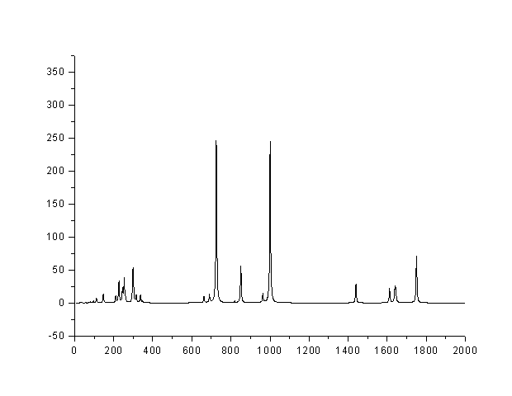
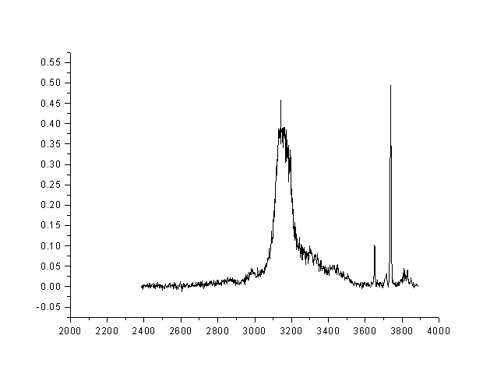
Comparison of calculated and measured vibrational spectra of H⁺(H₂O)₆
Theory
Intensity
Expt.
Intensity
Excellent agreement between theory and experiment, except that the harmonic, T = 0 K calculations cannot account for the broadening of the OH stretch spectra of H-bonded OH groups.
  need to account for vibrational anharmonicity (e.g., stretch/bend coupling)
  probably also need to account for finite T effects on the spectra

Slide 24
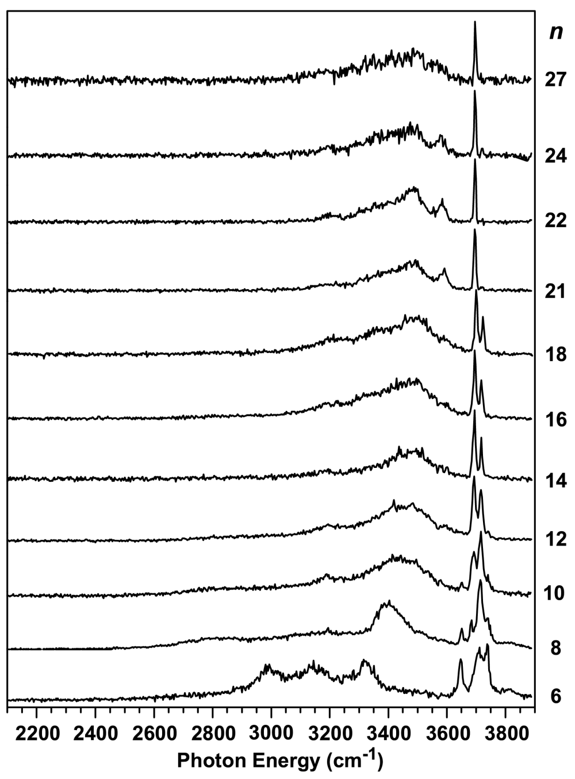
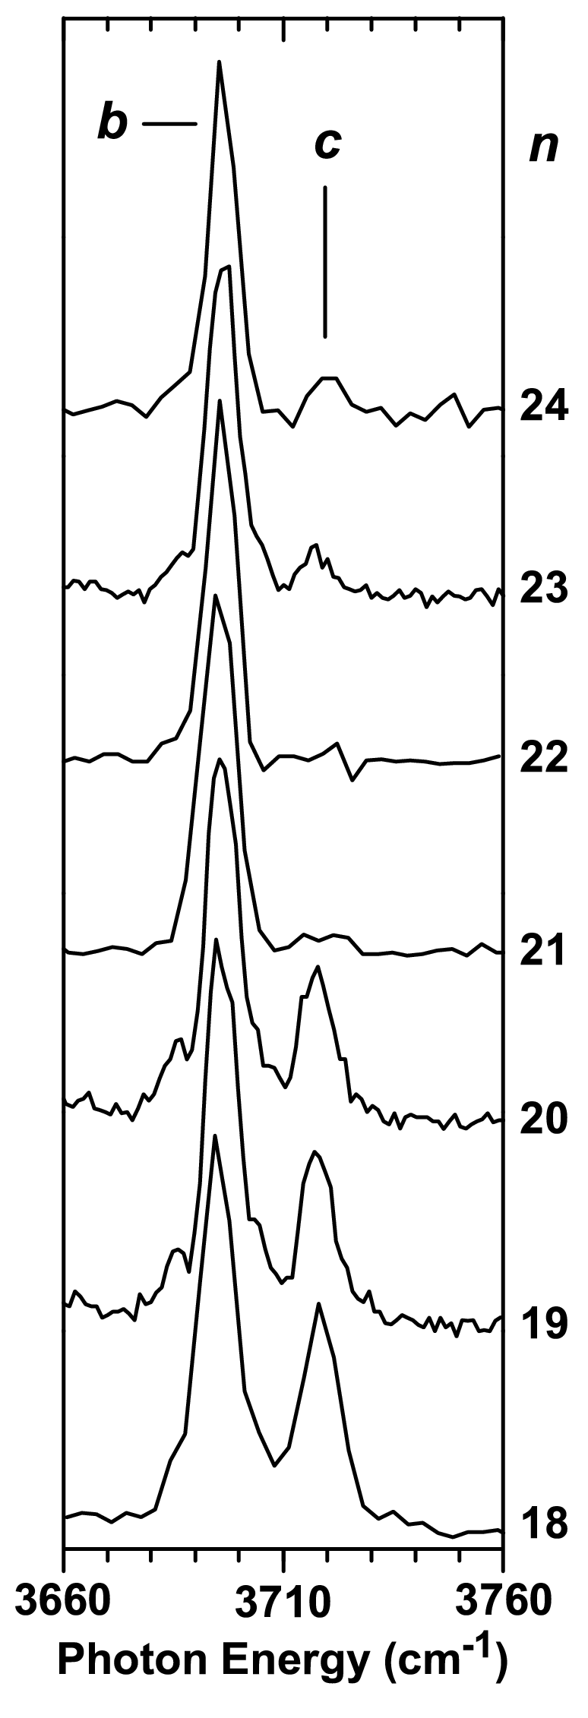
vibrational spectra of H⁺(H₂O)_{n}, n = 6-27
Collapse to a single line in the free OH stretch region
free-OH region of spectra reflect structural transitions
at n = 12 and n = 21(Shin et al., Science, 2004)

Slide 25
Lowest-energy n=21 structure found in ab initio geometry optimizations
Dodecahedron with H₃O⁺ on surface (blue) and H₂O (purple) inside cage
4 H-bonds with interior H₂O
causes a rearrangment of the H-bonding in the dodecahedron
there are only 9 free-OH
groups (Castleman's experiments suggested 10)
all free-OH associated with AAD waters - explains single lines in free OH stretch
If the excess proton placed on interior water, it rapidly jumps to surface.

Slide 26
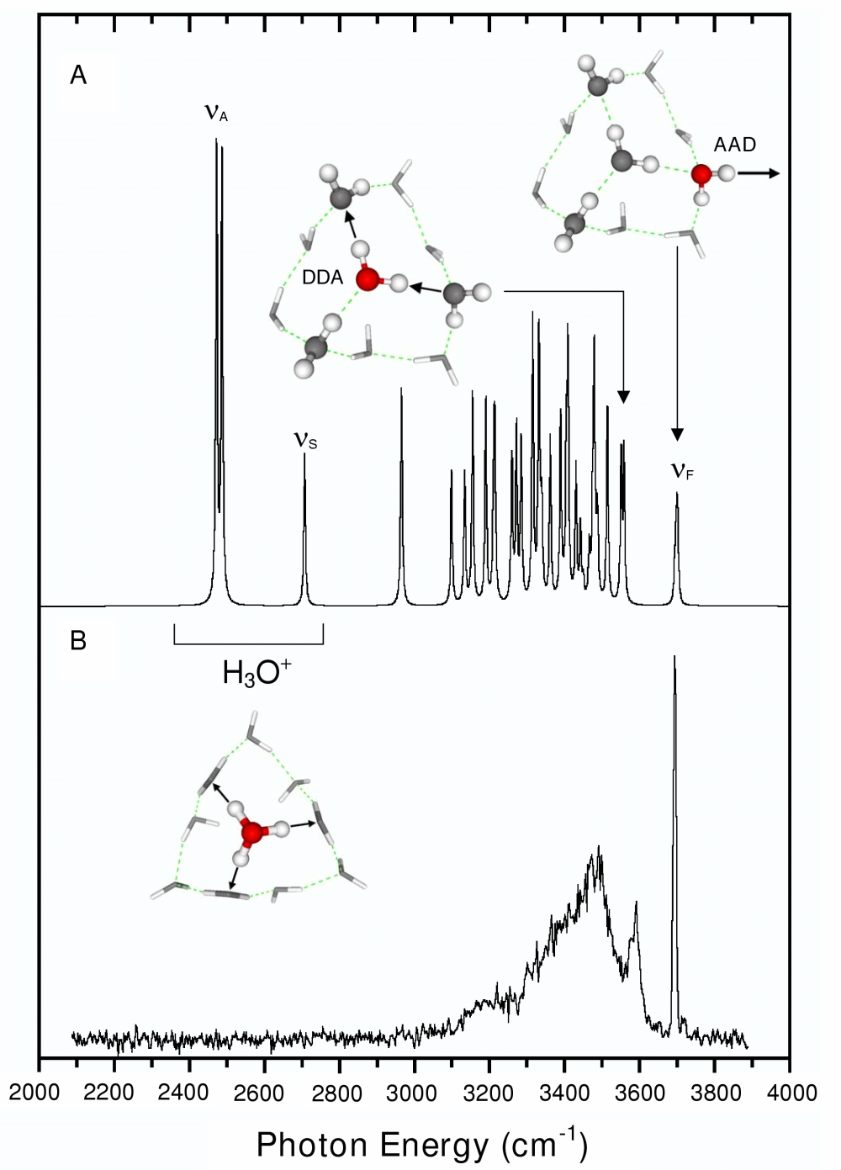
Interplay between spectroscopy and dynamics
  concentration of ions so low cannot obtain spectra by simple absorption
  Obtain spectra instead by dissociation
Predissociation spectroscopy
H⁺(H₂O)_{n} H⁺(H₂O)_{n-1} + H₂O
hν
Mass spec.
Mass spec.
source
Calculated vs. expt. spectra of magic # cluster.
No transitions observed in H₃O⁺ OH stretch region

Slide 27
If the ion does not fall apart on the timescale of the experiment, no signal will be observed.
210
Cold clusters
  Spectra dominated by 2-photon absorption
    Is it possible that H₃O⁺ OH stretch vibrations undergo appreciable shifts with > T?
    If so, this could turn off the 2-photon absorption.
free OH
Eigen OH
10⁻⁶ s.
190
T(K)
T_{m}
170
10⁻² s.
150
130
τ
without Ar
with Ar
These problems illustrate the interplay between structure, spectra, and dynamics inherent in much of today’s research

Slide 28
Vibrational anharmonicity
Several transitions of the H⁺(H₂O)_{n} clusters are not well described in the harmonic approximation
Diatomic molecule:
  V(x) = a_{o}x²( 1 + a₁x³ + a₂x⁴ + …)
  harmonic anharmonicity
  E(v) = 1/2 hω_{e}(v+1/2) – ω_{e}x_{e}(v+1/2)² + ω_{e}y_{e}(v+1/2)³ + …
x=(R-R_{e})/R_{e}
ω_{e} = harmonic frequency
ω_{e}x_{e}, ω_{e}y_{e} = first two anharmonicity constants
B_{e} = rotational constant
α_{e} = vibr.-rot. coupling
ω_{e} = sqrt(4a_{o}*B_{e})
α_{e} = (a₁ + 1)(6B_{e}²/ ω_{e})
ω_{e}x_{e} = (5a₁²/4 – a₂)(3B_{e}/2)
Depends on 3rd and 4th derivatives
Dunham expansion: unique mapping between 1D potential and the spectroscopic parameters
This mapping is lost for polyatomic molecules
Polyatomic molecules:
  diagonal anharmonicity: V_{iii}, V_{iiii}
  off-diagonal anharmonicity: V_{iij}, V_{ijk}, V_{iijj}. etc. - couple modes

Slide 29
Approaches for treating anharmonicity
2nd-order vibrational perturbation theory
    Requires V_{iij}, V_{ijk}, V_{iiii}, V_{iijj}
      can be calculated with standard electronic structure codes
    Can’t handle shared proton in H₅O₂⁺
      x⁴ term dominates: PT fails
    Can’t handle “progressions” as in CH₃NO₂⁻(H₂O)
  Vibrational SCF (VSCF)
    can be done using ab initio PES (grids)
    can’t handle progressions
  Vibrational CI
    need a representation of the PES
    limited to about 12 degrees of freedom
  Diffusion Monte Carlo methods
    difficulty in handling excited states

Slide 30
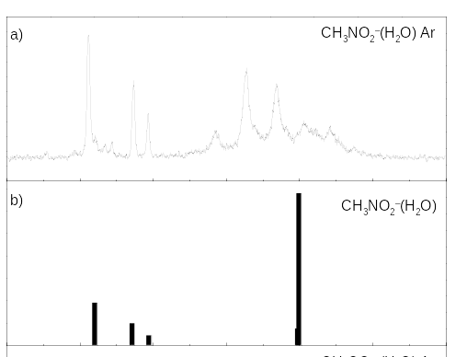
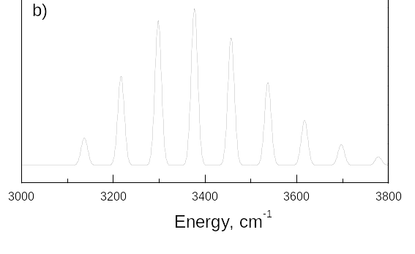
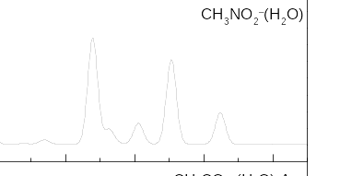
CH₃NO₂⁻(H₂O) – an example of important off-diagonal vibrational anharmonicity
Experimental spectrum displays 5 (≈ 90 cm⁻¹ spacing) transitions in the OH stretch region – only two lines expected
  This is a consequence of strong OH stretch/water rock coupling
    Key coupling term: V_{SAR} = k_{ASR}Q_{S}Q_{A}Q_{S}
    Configuration interaction with Hamiltonian including this cubic term and with product basis set A, AR, AR², S, SR, SR², etc, accounts for observed spectrum (S = symmetric OH stretch, A= asymm. OH stretch, R = water rock)
  Note how this coupling results in a band with overall width of several hundred cm⁻¹
  Such couplings important for energy redistribution
expt.
theory-harmonic
CH stretch
OH stretch
theory - anharmonic
From Johnson, Sibert, Jordan and Myshakin, 2004

Slide 31
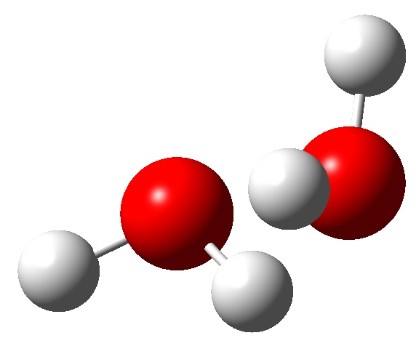
(H₂O)₂ – an example illustrating the importance of vibrational anharmonicity of frequencies, ZPE, geometry
Vibrational frequencies and zero-point energies (cm⁻¹) of (H₂O)₂ .
mode | calculated |  | expt.
 | harmonic | anharm.
1 | 3935 | 3753 | 3745
2 | 3915 | 3745 | 3735
3 | 3814 | 3648 | 3660
4 | 3719 | 3583 | 3601
5 | 1650 | 1595 | 1611
6 | 1629 | 1585 | 1593
7 | 630 | 502 | 520
8 | 360 | 310 | 290
9 | 184 | 138 | 108
10 | 155 | 114 | 103
11 | 147 | 113 | 103
12 | 127 | 60 | 87
ZPE | 10133 | 9898
donor
donor
acceptor
Frequencies calculated using the MP2 method.
Anharmonicities calculated using 2nd order vibrational PT.
Excellent agreement between the calculated anh. frequencies and experiment.
Intermolecular vibrations

Slide 32
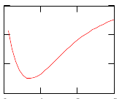
Changes in bond lengths of (H₂O)₂ upon vibrationally averaging
parameter | at minimum | vibr. averaged | Expt.
R_{OO} | 2.907 | 2.964 | 2.976
(R_{OH})₁ | 0.960 | 0.911 | -
(R_{OH})₂ | 0.968 | 0.946 | -
(R_{OH})₃ | 0.962 | 0.918 | -
(R_{OH})₄ | 0.962 | 0.918 | -
E
R_{e}
R_{o}
R
Actually, this raises an interesting question concerning the development of model potentials for classical MC or MD simulations.
  Namely, should one design the potential to give the correct R_{e} or R_{o} values?

Slide 33
Various issues concerning electronic structure calculations
Method | Formal scaling | Special scaling considerations | Limitations
Hartree-Fock | N⁴ | O(N) has been achieved for some large systems | No dispersion and other correlation
DFT | N³-N⁴ | O(N) scaling has been achieved for some large non-metallic systems | No dispersion
MP2 | N⁵ | O(N) scaling possible with localized orbital MP2 | May not give chemical accuracy
Coupled-cluster | N⁷ | O(N) scaling possible with use of localized orbitals | Lack of analytical gradients, Hessians
Monte Carlo | N³ | N² scaling | Fixed node, lack of analytical gradients, Hessians

Slide 34
Challenges facing electronic structure theory
There is still no reliable method for calculating accurate interaction energies between molecules and extended systems.
Example – coronene (7 fused benzene rings)
  standard QC methods
    need flexible basis sets to treat dispersion
    Near linear dependency, large BSSE with basis sets such as aug-cc-pVTZ
    not clear MP2 is suitable for this problem
  DFT methods
    Could use with plane waves (to solve linear dependency and BSSE problems)
    But inappropriate due to neglect of dispersion
  DMC would need to run very long to reduce statistical error below a few tenths of a kcal/mol
Excess electron in bulk water or even in a (H₂O)₂₀ cluster
  Need very large basis sets and inclusion of high-order correlation effects
  Solution in this case possible by use of quantum Drude oscillators

Slide 35
Some considerations concerning model potentials
For simulations of large systems, model potentials are essential
Typically, these model potentials include
  Bond-stretch, bend, torsional contributions.
  Electrostatics (generally using point charges)
    Pose special challenges for extended or periodic systems
  Lennard Jones (dispersion plus short-range repulsion)
Growing realization that dipole polarizability is important
  Can greatly increase the cost of the simulations
Many of the issues can be illustrated by considerations of models for water.

Slide 36
Water models
  TIP3P – 3 atom-centered charges + OO LJ int.
  TIP4P – 3 charges (-2q displaced from O), + OO LJ int.
  Dang-Chang (DC) – like TIP4P, but with polarizable center added to M site (0.215 Å from O atom)
  TTM – 3 charges (-2q at M site), 12-10-6 (AR⁻¹² + BR⁻¹⁰ + CR⁻⁶) OO interaction, 3 polarizable sites
  AMOEBA – atom-centered charges, dipoles, quadrupoles, OO, HH, and OH LJ, 3 polarizable sites
+q
M, -2q
+q
Water dimer: interaction energies (kcal/mol)
 | SAPT | DC | TTM | AMOEBA
electrostatic | -5.3 | -5.5 | -5.3 | -6.1
polarization | -1.3 | -0.8 | -0.9 | -1.3
dispersion | -0.4 | -1.5 | -7.4 | -1.9
Exch.-repulsion | 2.0 | 3.1 | 8.7 | 4.2
Total | -5.0 | -4.7 | -4.9 | -5.1

Slide 37
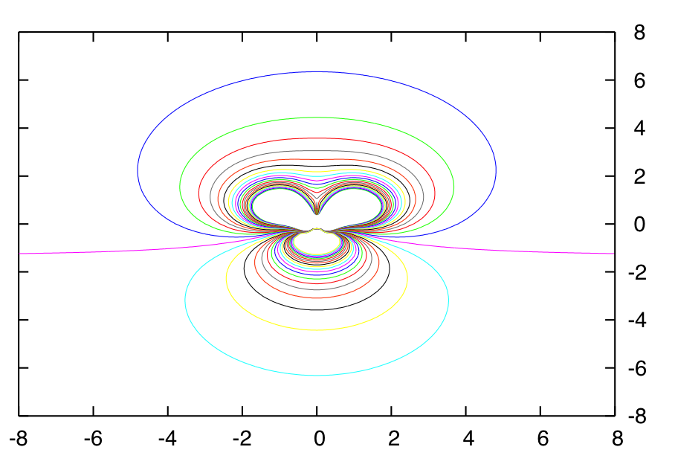
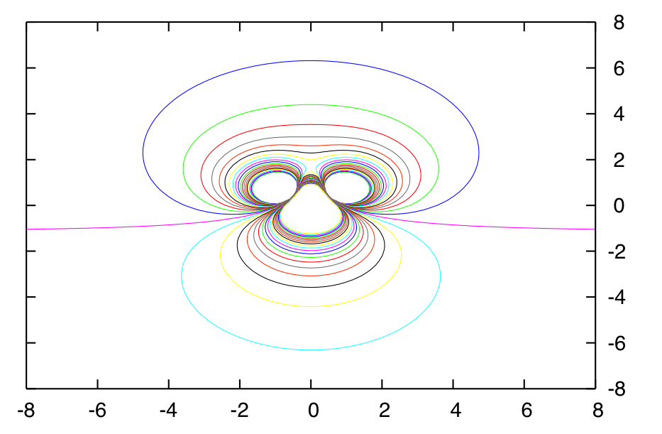
MP2 – in-plane
In-plane electrostatic potential of the water monomer from MP2 ab initio calculations from and from the DC water model. Distances in Å.
Outer contour = 0.005 au = 3 kcal/mol
0.005
-0.005
DC model – in plane
H
O
M
0.005
H
DC model: q = +0.519 H atoms, -1.038 M site, 0.215 Å from the O atom.
-0.005

Slide 38
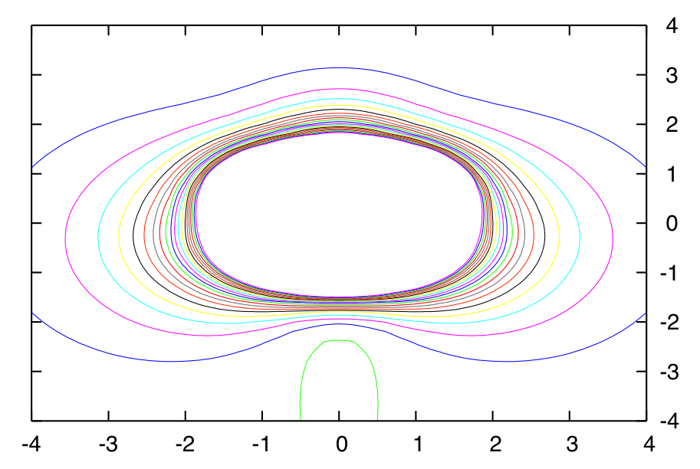
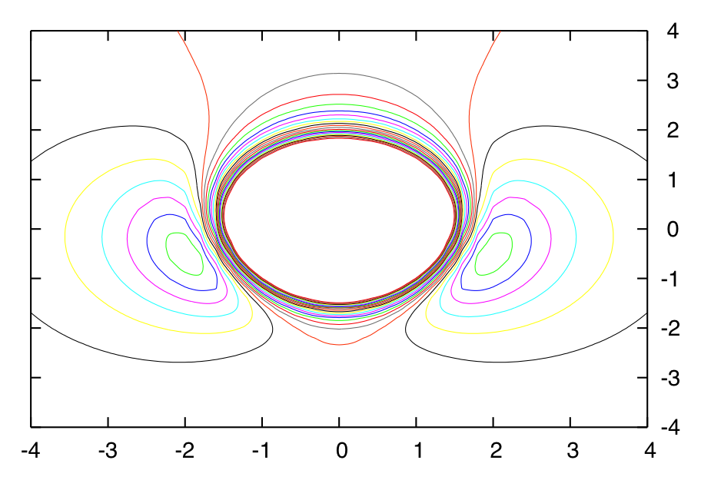
In-plane electrostatic potential: DC – MP2. Outer blue contour -0.0005 au = 0.3 kcal/mol. Distances in Å.
Perp.-to-plane electrostatic potential: DC – MP2. Outer black contour 0.0005 au = 0.3 kcal/mol. Distances in Å.
In these figures the part of the electrostatic potential near the atoms has been cut out.
A three-point charge model cannot realistically describe the electrostatic potential potential of water!!
Yet, nearly all simulations of water, ice, and biomolecules in water use models with simple point charge representations of the charge distribution.

Slide 39
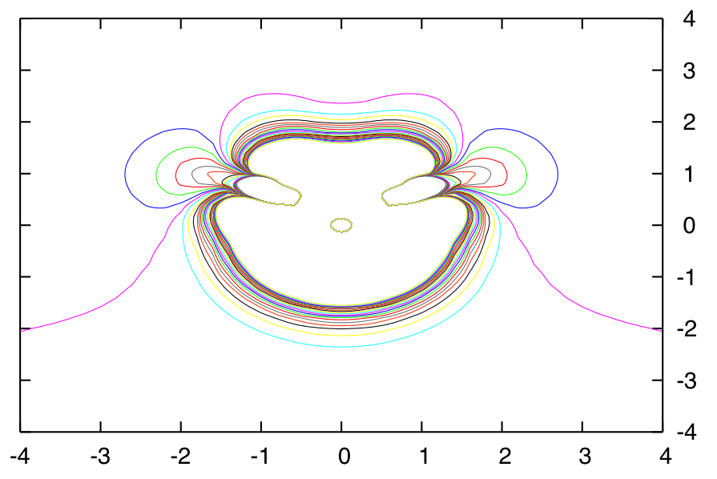
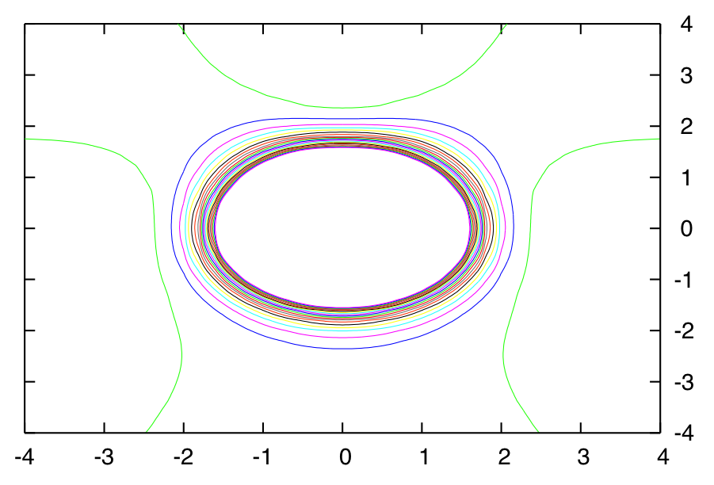
GDMA-MP2
In-plane
Differences between the electrostatic potentials from a distributed multipole analysis with moments through the quadrupole on each atom and from MP2 level calculations.
Overall the agreement is excellent except for short distances.
0
Perp. to plane
0

Slide 40
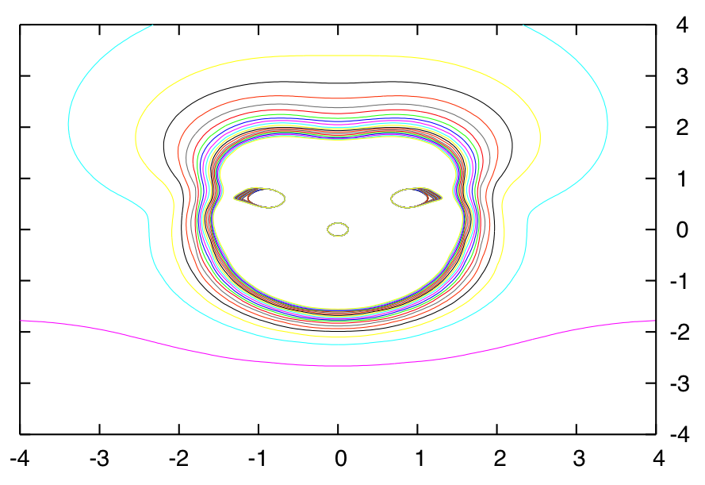

Amoeba-MP2
In-plane electrostatic potential: Amoeba – MP2. Outer blue contour -0.0005 au = 0.3 kcal/mol. Distances in Å.
0
Perp.-to-plane electrostatic potential: Amoeba – MP2. Outer light blue contour 0.0005 au = 0.3 kcal/mol. Distances in Å.
0
Amoeba should give results identical to GDMA. Differences due to change in HOH angle and scaling of the atomic quadrupoles.

Slide 41
More on polarization interactions
  2-body interactions – interaction between each pair uninfluenced by other molecules
  Many-body interactions – Interaction between A and B alters interactions between A and C and B and C.
+
+
A
μ_{A}^{B}
-
-
+
+
μ_{B}^{A}
B
-
-
Inert gas clusters – many-body effects dominated by dispersion
Water clusters – many-body effects dominated by polarization
+
C
E = E₁ + E₂ + E₃ + … + E_{n}
  In general the series converges rapidly
  Water clusters – 3-body contributions represent 20 – 30% of the net binding energy
-
μ_{i}^{j –} dipole induced on i by charges on j
Isolated water monomer – dipole moment = 1.85 D
Water molecule in liquid water – dipole moment ~ 2.6 D
μ_{A}^{B} in turn induces a dipole moment on B. Infinite series!

Slide 42
Effective 2-body potentials for water, e.g. TIP4P and SPC/E, have charges that give a dipole significantly larger than experiment for the monomer
  account in an effective mater for polarization effects in bulk water
  overestimate dipoles of water molecules at interfaces and in clusters
Many strategies have been introduced for treating polarization
  point polarizable sites – induced dipoles
  fluctuating charges (in-plane polarization only)
  Drude oscillators – two fictitious charges coupled harmonically
If atom-centered polarizable sites are employed, it is essential to damp the short range interactions to avoid unphysical behavior at short distances

Slide 43
The orbital picture reconsidered.
One of the most extensive concepts in chemistry is the orbital picture.
  This is so deeply engrained that we sometimes forget that for many electron systems orbitals are a construct (result from assuming separability of the wavefunction)
  In much of chemistry the orbitals that we consider are valence-like
    These are precisely the orbitals that can be calculated using electronic structure codes and minimal basis sets.
      H₂: bonding σ_{g} and antibonding σ_{u}
      Ethylene: bonding π and σ and antibonding π* and σ*
  In dealing with the spectroscopy of molecules there are also excited states resulting from promoting electrons into Rydberg orbitals
    These arise from higher energy atomic orbitals and tend to be spatially extended.
    Rydberg states are very sensitive to the environment of a molecule and may vanish in the condensed phase (recall properties of the particle in the box)

Slide 44
Issues connected with unfilled orbitals
Excited states
HF, H₂O, NH₃, and CH₄ do not display singlet excited states with valence character
  The valence states “dissolve” in the Rydberg sea (quote from Robin)
HCl, H₂S, PH₃, and SiH₄ do display singlet excited states with valence character
  With the longer XH bonds of the latter, the empty unfilled valence orbitals drop below the Rydberg orbitals and are observed
Anions
If the anion lies energetically above the neutral (negative electron affinity), the anion lies in the continuum of the neutral plus a free electron
  This is the case for Be, N₂, ethylene, benzene, CH₃Cl, etc.
  Typically the electron falls off (autoionizes) in 10⁻¹⁴ sec.
  Poses a special challenge for theory

Slide 45


Potential energy curves of CH₃Cl and CH₃Cl⁻
Decay processes
  electron detachment
  dissociation (CH₃ + Cl⁻)
1,1-dichlorethane
  electron transmission spectrum of – two peaks due to the two σ* orbitals
  dissociative attachment – one peak due to the lower-lying anion
    electron attachment from upper anion to fast to give Cl⁻
(results from P. Burrow, Univ. Nebraska)

Slide 46

Vibrational excitation cross sections for two vibrations of CH₃Cl.
The peaks are due to resonances (temporary anion states).
From P. Burrow.
Temporary anions pose a significant challenge to theory
  Standard variational approaches → collapse onto continuum
  Several methods have been developed for treating such species
  The resonance energy is actually complex
    E_{res} = E_{r} –i/2Γ
      E_{r} = resonance position, Γ = width
    Time dependence exp(-iE*t): complex energy – decays in time

Slide 47

Electrons bound in electrostatic potentials
  Most famous case: dipole bound anions
The electron is so extended, that it should be possible to develop a one-electron model approach
An excess electron bound to a (H₂O)₆ chain
Important interaction terms
  Exchange/repulsion
  Polarization (e--water, water-water)
  Electrostatics [e- - permanent charges on (H₂O)]
  Dispersion – left out of all earlier model potential studies
Cannot simply add a C/R⁶ term, due to extended nature of excess electron.
We have developed a Drude model of excess-electron molecule interactions.

Slide 48



Drude model
+q -q charges +q, -q coupled through a force constant k
R The position of the -q charge is kept fixed.
In the presence of a field, the system has a polarizability of q²/k.
An electron couples to the Drude oscillator via qr∙R/r³
,

Slide 49





Drude model based on the Dang-Chang water model
H charge = 0.519e
H
O
M site: 0.215 Å from O atom.
Negative charge (-1.038e) plus Drude oscillator with q²/k = α = 1.444 Å³
H
Determined using procedure of Schnitker and Rossky
Scaled so that model potential KT energy reproduces ab initio KT result for (H₂O)₂⁻
Damping coefficient scaled so that model potential CI energy reproduces ab initio CCSD(T) result for (H₂O)₂⁻
b
r - position of electron
R - displacement of the Drude oscillator

Slide 50









Single Drude Oscillator:
Wavefunction:
Electron orbitals described in
terms of s, p Gaussians. { }
in “MO” basis set
3D harmonic oscillator functions { }
Multiple Drude Oscillators:
Basis set:

Slide 51
Several strategies for solving
  fully self-consistent treatment of e⁻-water polarization, e⁻-water dispersion, intramolecular induction, intramolecular dispersion.
  self-consistent treatment of e⁻-water polarization, e⁻-water dispersion, intramolecular induction. Treat intramolecular dispersion through R⁻⁶ terms.
  self consistent treatment of e⁻-water polarization, e⁻-water dispersion.. Treat intramolecular induction using classical Drude oscillators and treat intramolecular dispersion through R⁻⁶ terms.

Slide 52


Surface state and interior electron bound states of (H₂O)₂₀⁻
Considerable interest in these species in light of recent work from the Neumark and Zewail groups.
The anion is not bound in the KT and Hartree-Fock approximations. Electron binding is a result of correlation effects which cause a large contraction of the excess electron
Geometries provided by M. Head_Gordon.

