Slide 1
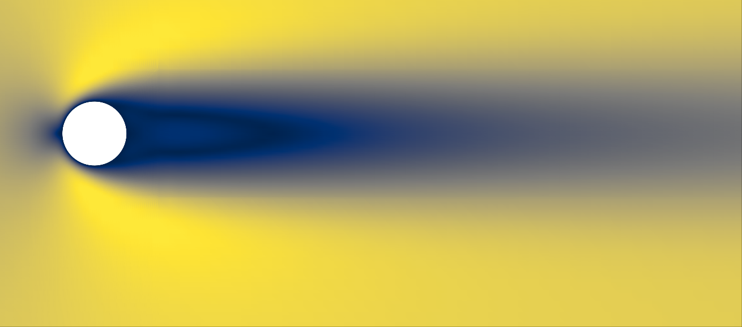
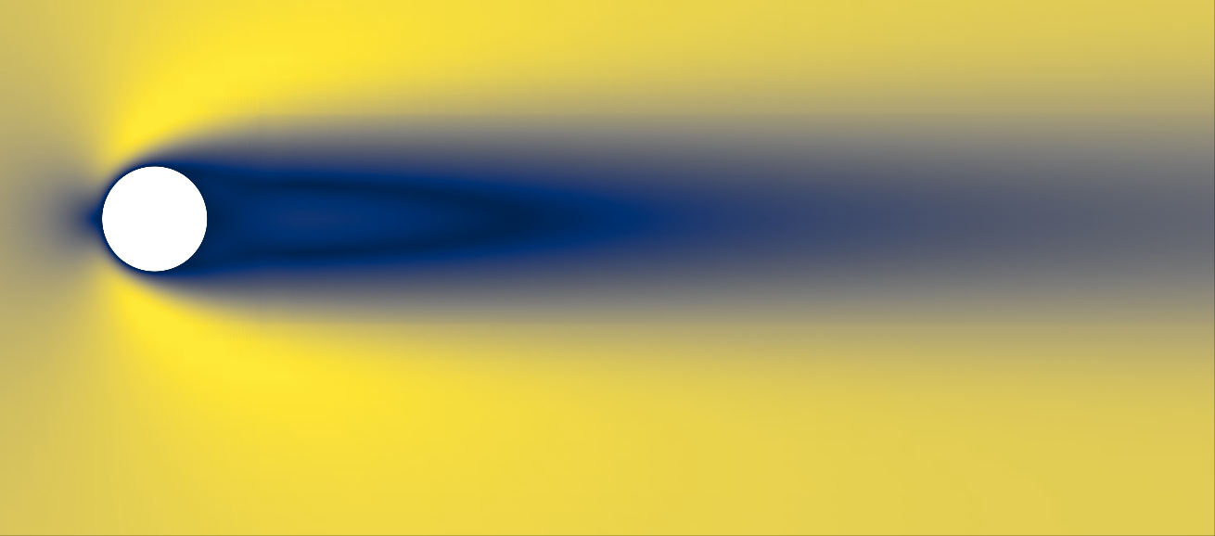
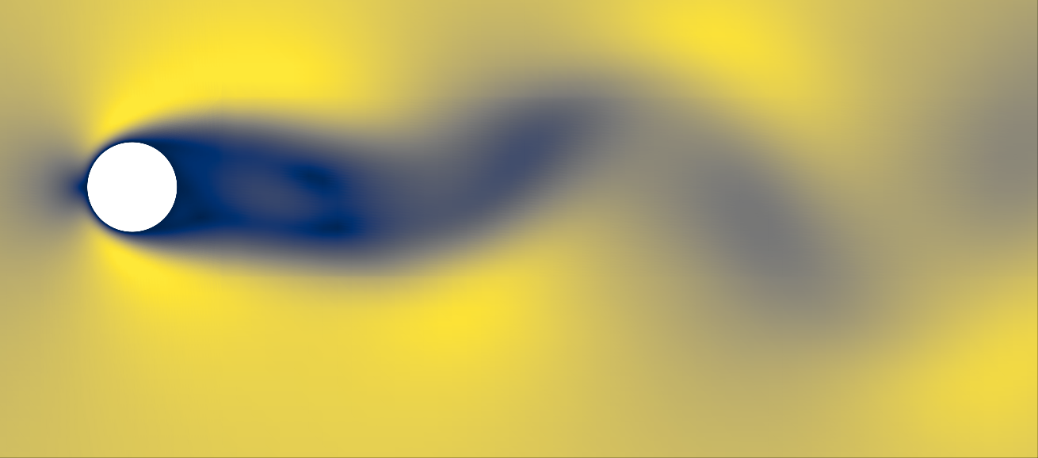
a Two-level hierarchy
π(μ)
Selected r / (r, s)
Independent
rollout
native coordinates
E2 router
parameter-only
Applicability +
selection
Top-1 / adj. Top-2
Decode
physical space
T2-C fusion
α(μ̃, π̄, dₙ)
Predicted fields
û(t), p̂°(t)
μ
Top-1: identity
Top-2: fusion
Regime-local specialists
Steady S
Hopf H
Periodic P
initialization
Physical history
Hₙ
History descriptor
dₙ (chart-independent)
Admissible pairs: S–H or H–P
b Regime-local specialist
Galerkin backbone
Fᵣᴳ
ȧ
History
Hₙ
POD encode
chart-local
Local history
(aₙ, bₙ)
Stepᵣ
chart-specific
aₙ₊₁
Pressure map
algebraic
γ ⊙ Qᴾᴾ + ρᵖ
+
bₙ₊₁
Sparse MoE
velocity correction ρᵘ
Velocity update
Pressure reconstruction
Shared expert E₀
Structured expert responses
ξₙ
Group Top-1
channel Top-2
Σω
nonlinear + linear
+ low-rank quadratic
Top-2 Eₑ₁, Eₑ₂
Notes:
RAL-MoE-ROM method schematic. Native editable text, shapes and connectors. Three circular-cylinder reference images are native crops of existing CFD-reference velocity panels, not newly computed results or T2-C predictions. Sources: C:/Users/panxy1019/Documents/CHANNEL/RAL_MOE_ROM_ICLR2027/figures/original/steady_physical_fields.png; C:/Users/panxy1019/Documents/CHANNEL/RAL_MOE_ROM_ICLR2027/figures/original/hopf_physical_fields.png; C:/Users/panxy1019/Documents/CHANNEL/RAL_MOE_ROM_ICLR2027/figures/original/periodic_physical_fields.png. The Hopf reference is near onset and weakly perturbed. Color bars are omitted for qualitative regime identification; these thumbnails are not a quantitative cross-regime magnitude comparison.
Method source: C:/Users/panxy1019/Documents/CHANNEL/PMD_Galerkin_Pan_ICLR (1)/sections/method.tex. Gamma pressure gating retained from current manuscript. Group Top-1 and channel Top-2 refer to hierarchical sparse routing; the shared expert bypasses sparse selection. The two selected specialists retain independent native states. Physical-space assembly is identity for Top-1 and T2-C for an adjacent Top-2 pair. No fused-state feedback.
Design brief: C:/Users/panxy1019/Downloads/RAL_MoE_ROM_Figure1_Nature_style_redraw_plan.md. User requested three regime thumbnails, overriding the brief's thumbnail-removal recommendation.
Visual references supplied by user: https://www.nature.com/articles/s41467-021-26434-1 ; https://www.nature.com/articles/s42256-023-00685-7 ; https://www.nature.com/articles/s42256-024-00938-z ; https://www.nature.com/articles/s43588-025-00904-8 ; https://www.nature.com/articles/s41467-026-70245-1 . Article pages for PINN-SR and S3GM were accessible; several dedicated figure pages returned access redirects. No published artwork is reproduced.

