Slide 1
🎵
SoundSelf
Share your music. Share your worldview.
Arts & Big Data · Sungkyunkwan University
Prof. Jahwan Koo · Spring 2026

Slide 2
What is SoundSelf?
A Streamlit web dashboard where users curate their favorite tracks, visualize their musical identity, and discover other curators — through taste compatibility, not algorithms.
♪ My Music Profile
◎ Taste Compatibility
Register tracks with personal commentary. Browse by genre. View stats.
Match with other curators by genre and mood (0–100%).
◈ Mood Tag System
⊞ Taste Map
Tag tracks with emotional contexts — rainy day, deep focus…
2D scatter plot of your music on genre × intensity axes.
✦ Spotify Import
Fetch Liked Songs directly from Spotify API with audio features.

Slide 3
Why SoundSelf?
THE PROBLEM
THE OPPORTUNITY
Streaming algorithms optimize for engagement, not identity
No platform lets you explain WHY you love a track
Music taste as self-expression is invisible online
Human curation is undervalued vs. machine recommendation
Connect people through genuine taste, not listening volume
Give music commentary a social layer
Visualize your musical identity as data art
Spotify API enables real-time personal data integration
Built with Python · Streamlit · Plotly · Spotify Web API

Slide 4
Live Demo
https://soundself-sakanamango.streamlit.app/
01
My Music Profile
Add a track · browse by genre · view taste stats
02
Taste Map
2D scatter: genre axis × intensity axis — your musical fingerprint
03
Mood Tag Filter
Filter by emotional context: rainy day, deep focus…
04
Spotify Import
Login → fetch Liked Songs → valence × energy analysis
05
Curator Feed
Discover tracks from high-compatibility curators

Slide 5
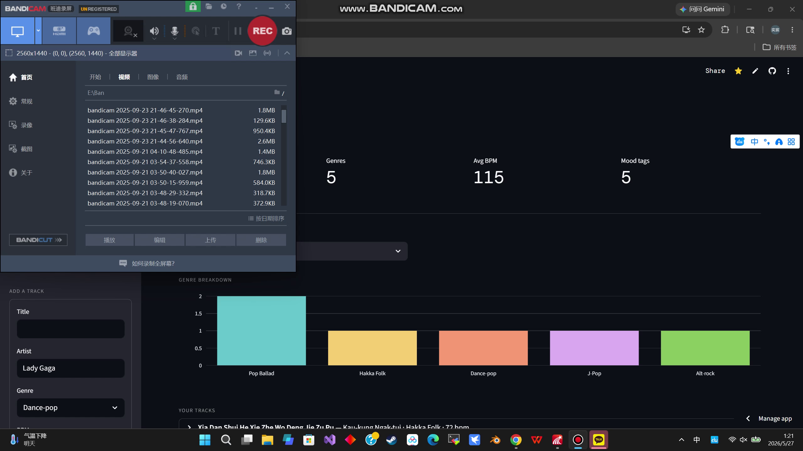

Slide 6
What I Learned
TECHNICAL
DESIGN
Spotify OAuth 2.0 Authorization Code flow with server-side client_secret
Streamlit session_state resets on redirect — workaround with URL params
Audio features API
Deploying Python apps on Streamlit Cloud with secrets management
Usage of Claude AI for designing my project
Data visualization as identity — scatter plots can be self-portraits
Mood tagging bridges subjective feeling and objective music data
UX: the add-a-track form needs to feel personal, not like a spreadsheet
Curator discovery works better with context than with pure similarity scores

Slide 7
Thank You
share your music. share your worldview.
https://github.com/pany7066-art/soundself
Arts & Big Data · Sungkyunkwan University · Prof. Jahwan Koo · Spring 2026

