Slide 1
AWS API Gateway
API & Services - Engineering Workshop 2
Monday, 24th of February 2025

Slide 2
What is AWS API Gateway? (1)
Amazon API Gateway is an AWS service for creating, publishing, maintaining, monitoring, and securing REST, HTTP, and WebSocket APIs at any scale.
Using API Gateway we can create:
RESTful APIs (flag-ship product, full feature set);
HTTP APIs (often called v2, no full feature set, a sub-set of the REST product);
WebSocket API
Note: there is a separate service for the Graph QL equivalent called AWS AppSync.

Slide 3
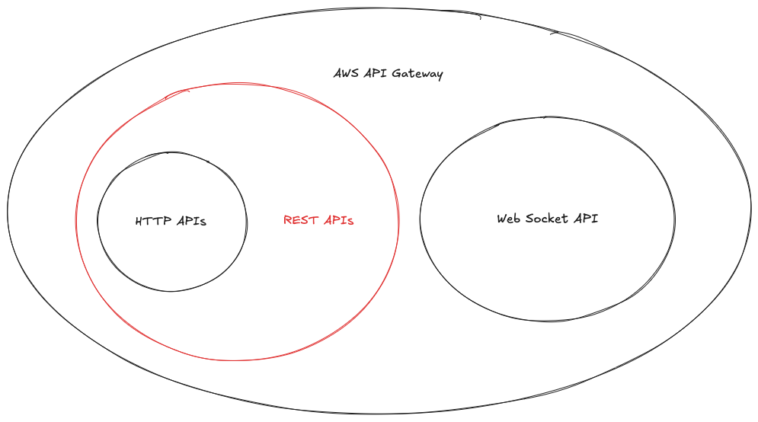
What is AWS API Gateway? (2)

Slide 4
Why do we need AWS API Gateway?
API Gateway is our enabler for moving away from Edge to the new AWS cloud environment.
Exit the rTSAs within 2 years (leave the BBUK platform);
Right-size the Solution for IMS (functionality and non-functional requirements);
Well-supported technology (get help if we need it);
Consolidate around a set of technical skill sets;
Limit the number of 3rd parties that we must manage;

Slide 5
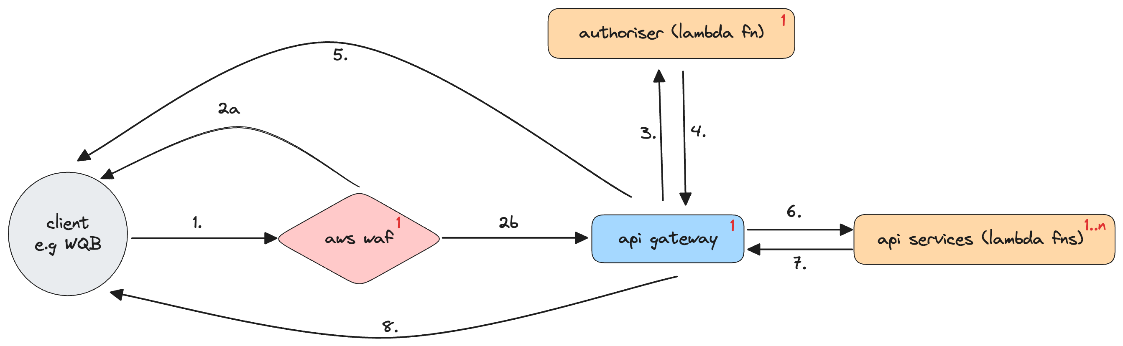
Where does AWS API Gateway sit in the existing landscape? (1)
High-level workflow

Slide 6
Where does AWS API Gateway sit in the existing landscape? (2)
Highlighted – subject of today’s workshop.

Slide 7
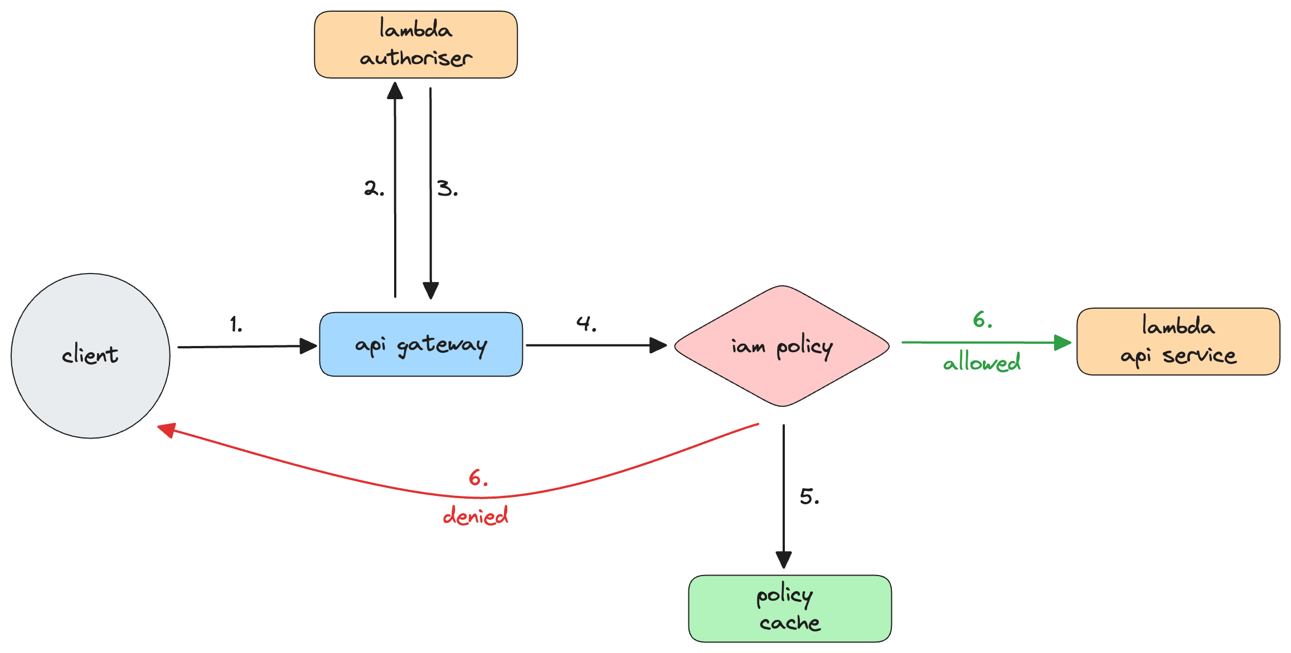
How does AWS API Gateway work? (1)
Note: This example excludes AWS WAF for simplicity.

Slide 8
How does AWS API Gateway work? (2)
When a client makes a request to an API method, AWS API Gateway calls the authoriser lambda function.
The authoriser takes the caller’s identity (context, token, request parameters) as an input and returns an IAM policy (either allowed or denied) as the output.
The result is returned to API Gateway.
API Gateway allows the request if the IAM policy contains an explicit allow, or denies it, if it contains an explicit deny.

Slide 9
AWS API Gateway Lambda Authorisers (1)
A lambda authoriser can be of two types:
REQUEST - Where the API Gateway passes request parameters to the authoriser Lambda function as part of the event object. Request parameters can include headers, path parameters, query parameters stage variables or context variables.
TOKEN - Where we must specify a custom header as the token source when we configure the authoriser for the API. The API client must pass the required authorisation token in the header of the incoming request. Upon receiving the incoming method request, API Gateway extracts the token from the custom header. It then passes the token as the authorisationToken property of the event object of the lambda function in addition to the method ARN as the methodArn property.
On this guide we focus on the TOKEN authoriser lambda. Below is an example of the event object that is passed to the authoriser lambda:

Slide 10
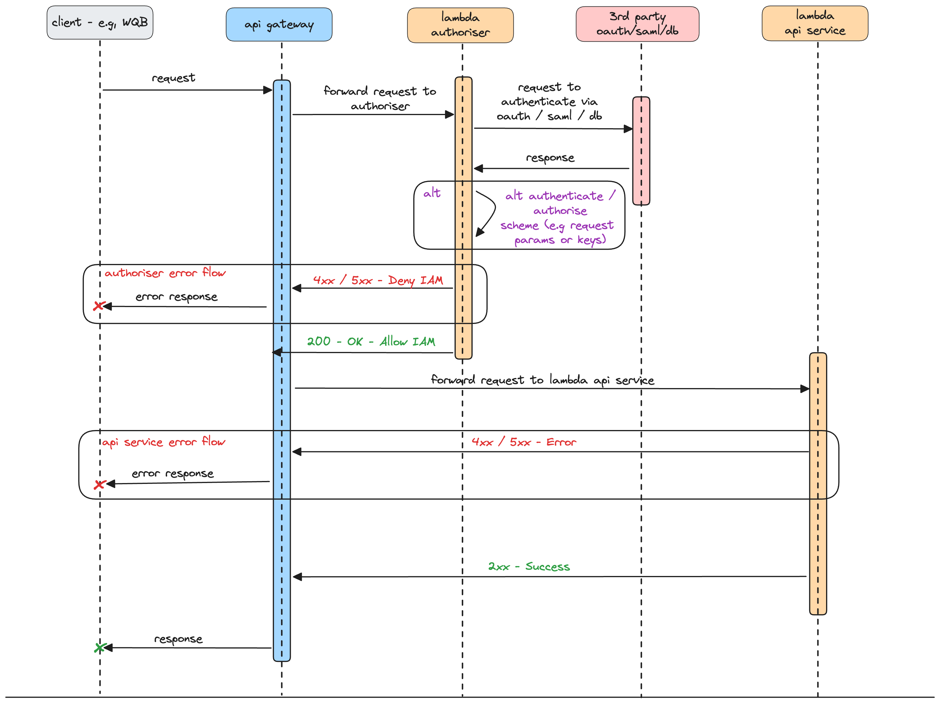
AWS API Gateway Lambda Authorisers (2)

Slide 11
AWS API Gateway Lambda Authorisers (3)
The API Gateway lambda authorisation flow works like this:
The client calls a method on an API Gateway API, passing a bearer token or some request parameters.
API Gateway checks if the method request is configured to go through the authoriser. If it is, it calls the lambda authoriser function.
The lambda function authenticates the caller. The lambda function returns an IAM policy and a principal identifier. If the lambda function does not return that information, the call fails. The function can authenticate in the following ways:
By calling out to an OAuth provider to get an OAuth access token (e.g, Auth0, Ping).
By calling out to a SAML provider to get a SAML assertion (e.g, Cognito).
By generating an IAM policy based on the headers and request parameter values.
By decoding a JWT token inline, using keys.
By looking up / retrieving information from a database.
API Gateway evaluates the IAM policy.

Slide 12
AWS API Gateway Lambda Authorisers (4)
If authorisation caching is enabled, API Gateway caches the policy so that the Lambda authoriser function is not invoked again to save costs. The time to live of this is configurable and set to a default of 5 minutes.
Depending on the evaluation:
If access is denied, API Gateway returns a suitable HTTP status code, such as:
200 - OK
403 - ACCESS_DENIED
401 - UNATUHTORISED
500 - AUTHORISER_FAILURE / AUTHORISER_CONFIGURATION_ERROR / API_CONFIGURATION_ERROR
If access is allowed, API Gateway returns 200 - OK, and proceeds to invoke the lambda service function associated with the method.

Slide 13
How does this look in code? Using IntelliJ Idea.

Slide 14
Other AWS API Gateway features
We will have a look at these in AWS:
Importing API definitions via Swagger.
Various types of integrations with back end (e.g lambdas or private link);
Api Keys.
Caching.
Validation.

Slide 15
Playground time. Using O’Reilly Sandbox. ☹

Slide 16
Where do we find the documentation for this service?
Amazon Developer Documentation: https://docs.aws.amazon.com/apigateway/latest/developerguide/apigateway-rest-api.html
Terraform documentation with regarding AWS API Gateway:
https://registry.terraform.io/providers/hashicorp/aws/latest/docs/resources/api_gateway_rest_api

Slide 17
Roadmap – starting next Quarter.
Create an instance of our API Gateway (no resources at this stage);
Link it to AWS WAF;
Create various API Keys;
Setup caching;
Have the code as IaC to be able to deploy it in multiple environments;
Create authorizer lambda (even if we do not have a clear path around how we are going to handle authorization);
Attempt to do Postcode Address Finder / or other simpler APIs;

Slide 18
Q/A Questions & Answers

Slide 19
Upcoming workshops
Highlighted – AWS Lambda Functions – w/c 3rd of March

