Slide 1
AWS WAF
API & Services - Engineering Workshop 1
Tuesday, 18th of February 2025

Slide 2
What is AWS WAF?
In a nutshell, WAF lets us control access to our content.
WAF or Web Application Firewall is an AWS service that help us protect application and services from traffic issues such as bad actors (3rd party agents, bots) or common attack patterns (such as SQL injection or XSS - - cross site scripting).
It has integrations with various AWS cloud services such as:
Cloud Front Distributions (Web Applications);
AWS API Gateway (Only for REST APIs);
AWS AppSync (AWS’s Graph QL equivalent);
Load Balancers (Middleware that distributes traffic to different servers);
And others …

Slide 3
Why do we need AWS WAF?
In APIGee Edge, we have the pre-request flow which is made of similar functionalities to AWS WAF.
There are rules defined by BBUK to handle requests that might contain XSS / SQL injections.
Note: Edge also has rules for rate-limiting & throttling. We can use WAF for these or we can use a combination between WAF and API Gateway (more about that next week when we discuss API Keys);

Slide 4
How does AWS WAF work? (1)
WAF works by leveraging web ACLs (Access Control Lists).
Access Control Lists are made from rules or rule groups. An ACL gives us fine-grained control over all the HTTP(s) web request that our protected resource responds to.
Types of rules:
IP address origin of the request.
Country of origin of the request.
String match or regex match in part of the request (like EDGE).
Size of a particular request.
Detection of malicious code (SQL or scripting).
Other OWASP Top 10 rule sets.

Slide 5
How does AWS WAF work? (2)
We would need to have an AWS API Gateway - RESTful instance (Note: WAF does not work with HTTP instance).
We need to create an ACL and associate it with our RESTful AWS API Gateway instance.
Add rules & rule groups to the ACL.
These can be default AWS rules & rule groups (managed by AWS).
Custom ACL rules using the “Add rules and rule groups”.
We need to setup what happens when a rule is matched – either allow or block request.
We need to set up rule priority and the order in which rules are processed.
Hit “Create web ACL” to save the ACL list.

Slide 6
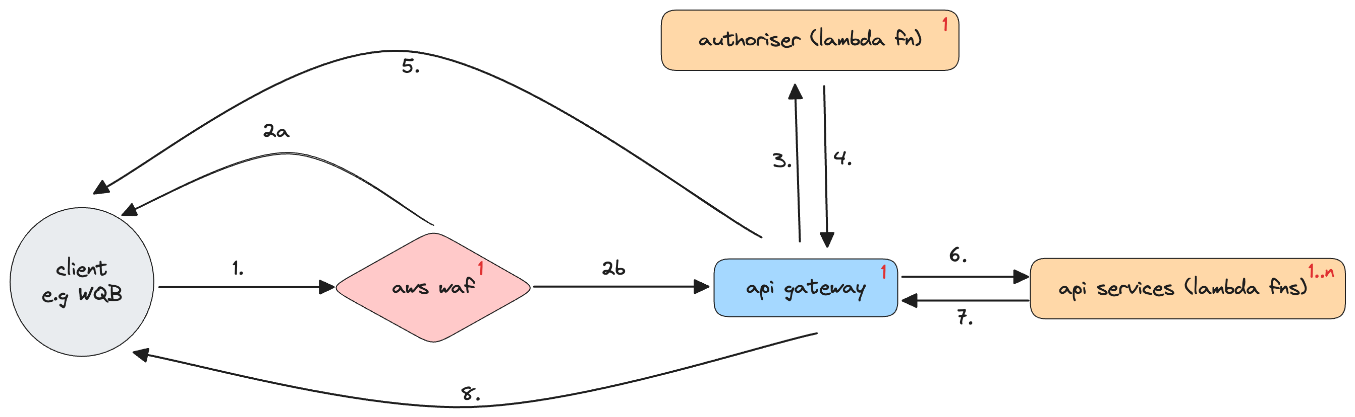
Where does WAF sit in the existing landscape? (1)
Highlighted – subject of today’s workshop.

Slide 7
Where does WAF sit in the existing landscape? (2)
High-level workflow

Slide 8
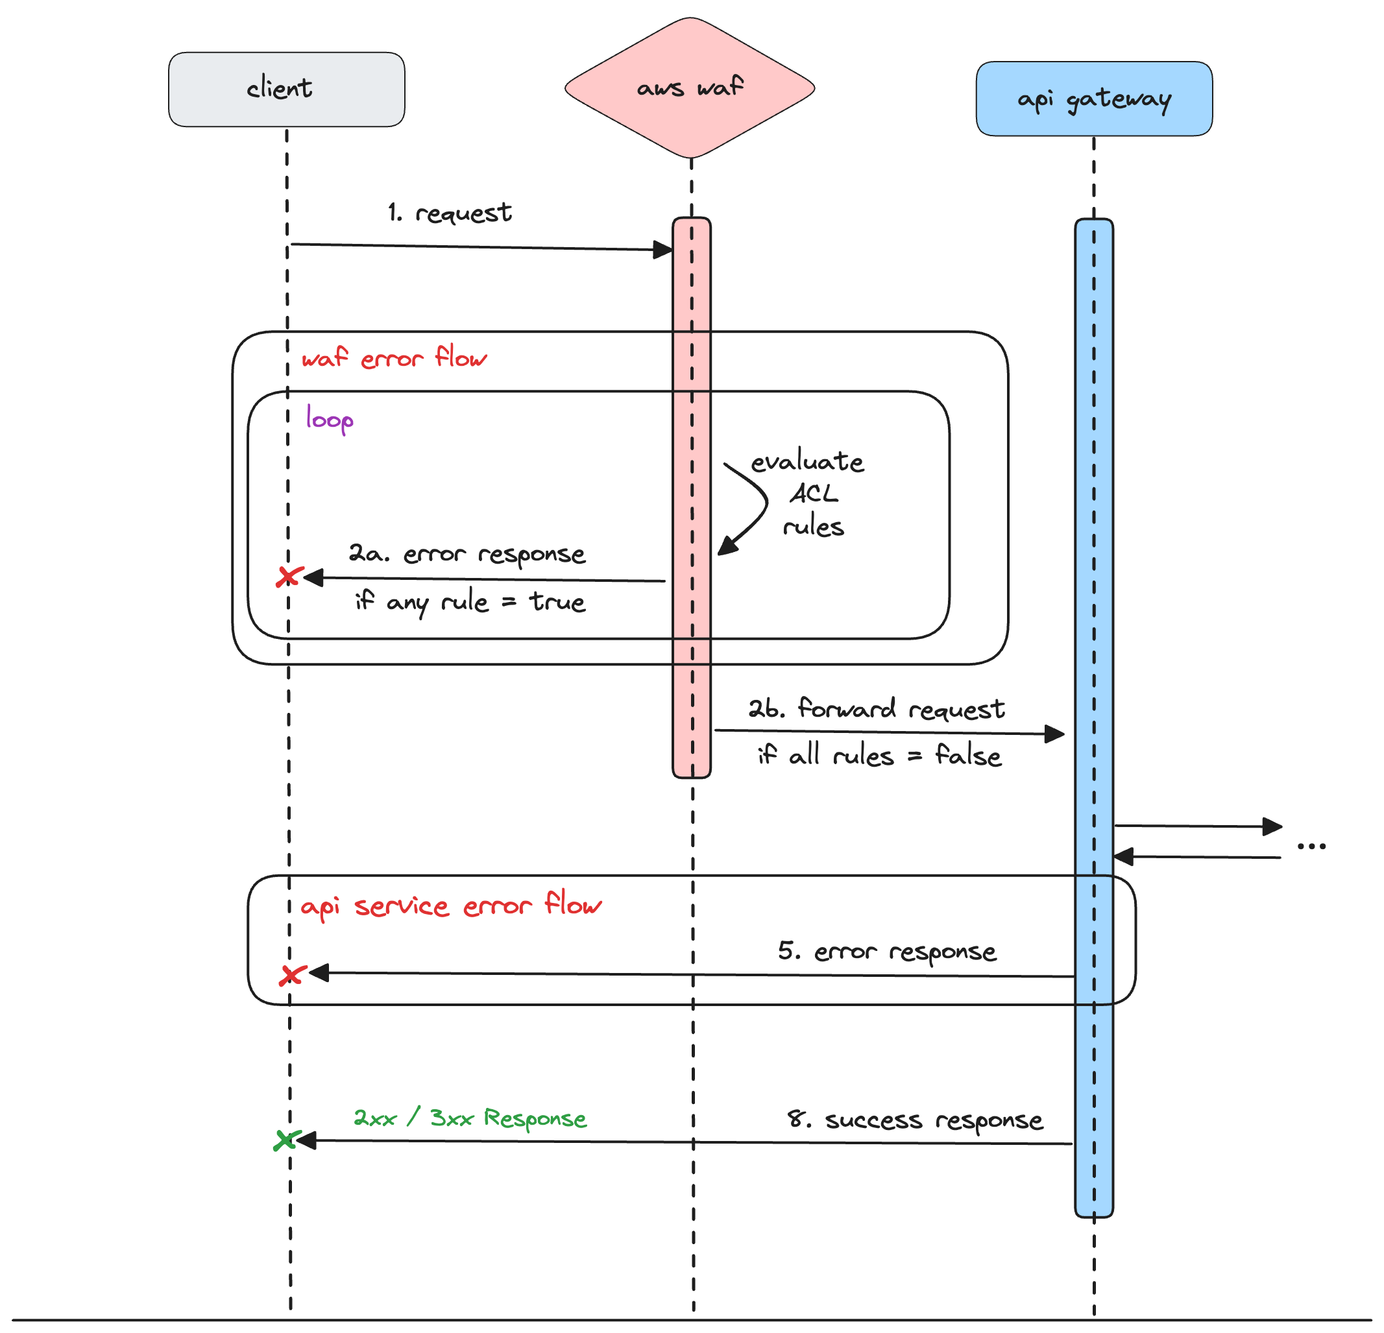
How does the workflow work?
Note: Numbers on the
actions match previous
diagram.

Slide 9
Demonstration time. Using O’Reilly Sandbox.

Slide 10
Where do we find the documentation for this service?
Amazon Developer Documentation:
https://docs.aws.amazon.com/waf/latest/developerguide/waf-chapter.html
Terraform documentation with regarding WAF:
Creating Web ACLs: https://registry.terraform.io/providers/hashicorp/aws/latest/docs/resources/wafv2_web_acl
Creating rule groups: https://registry.terraform.io/providers/hashicorp/aws/latest/docs/resources/wafv2_rule_group
Associating rule groups with existing resources: https://registry.terraform.io/providers/hashicorp/aws/latest/docs/resources/wafv2_web_acl_association

Slide 11
Roadmap – starting next Quarter.
We would need to take the rules we have in EDGE and convert them to WAF rules.
We can enhance the rules with existing AWS sets (e.g. OWASP Top 10).
We must validate these with Security.
This would need to be defined in code, using Terraform for multiple environments.
To begin with we will develop against a localhost, or a sandbox (but more about that next quarter).

Slide 12
Q/A Questions & Answers

Slide 13
Upcoming workshops (1)
Highlighted – AWS API Gateway – w/c 24th of February

Slide 14
Upcoming workshops (2)
Highlighted – AWS Lambda Functions – w/c 3rd of March

