Slide 1

React & Redux
悟空
2016年03月11日

Slide 2
React组件
Small
Component
props
Data Resource
Middle
Component
State
Small
Component
props

Slide 3
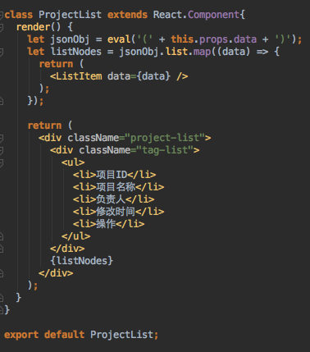
Problems
1、组件内部逻辑不清晰
2、组件之间通信
3、数据流控制

Slide 4
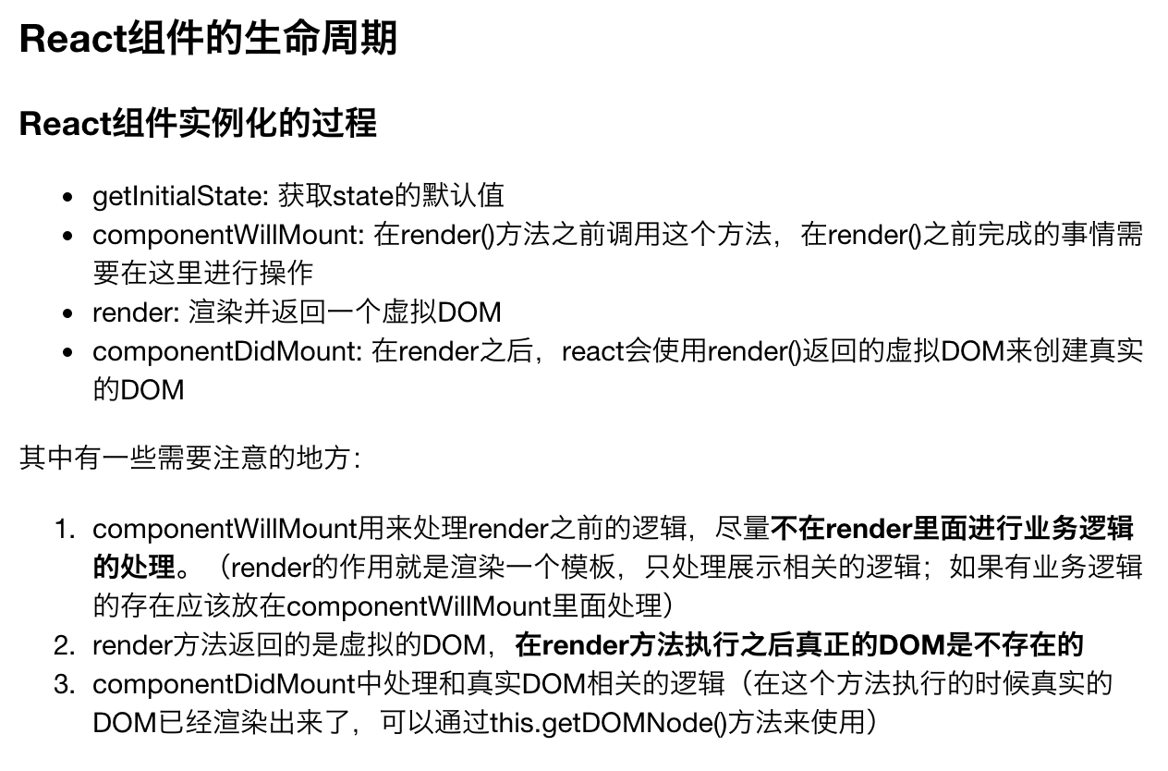

Slide 5
Big
Component
Small
Component
props
Data resource
Middle
Component
State
State
Small
Component
props
How？

Slide 6
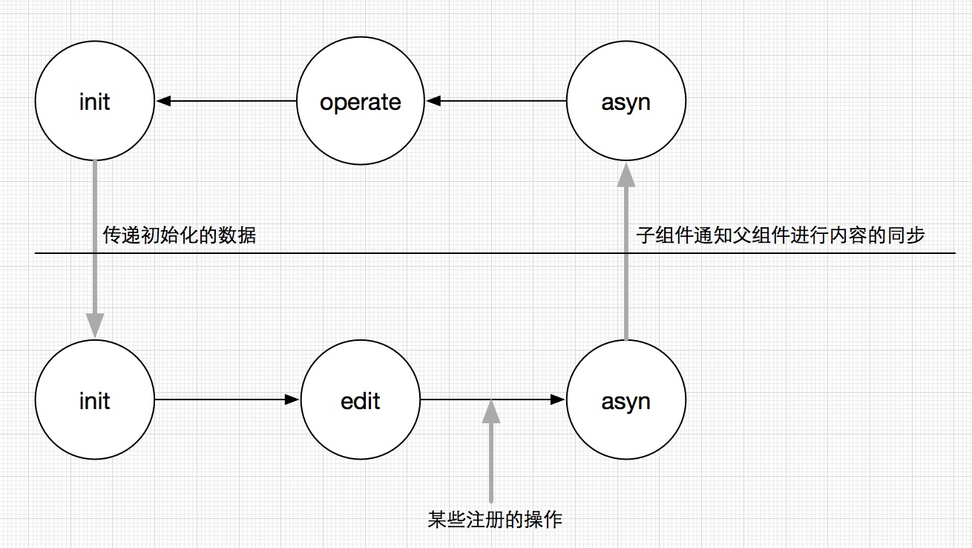

Slide 7

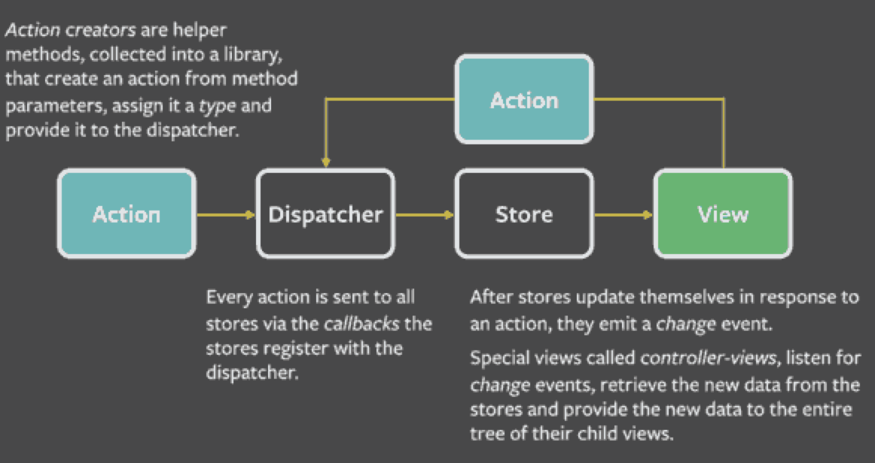
Flux

Slide 8
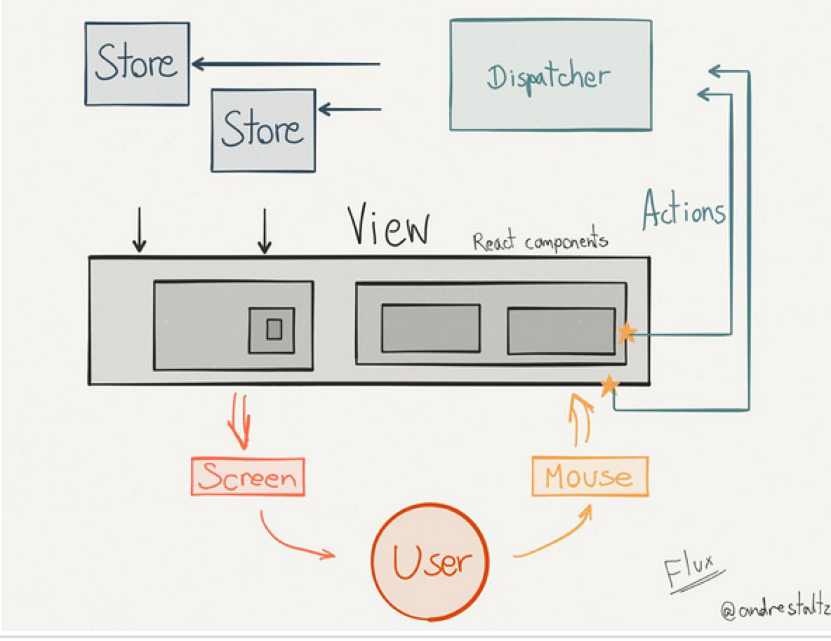
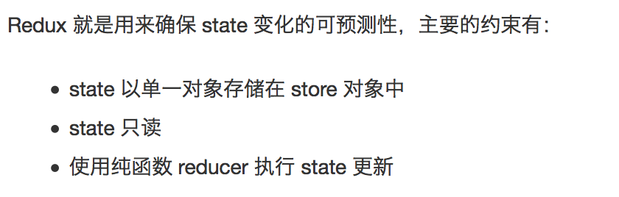
Redux

Slide 9
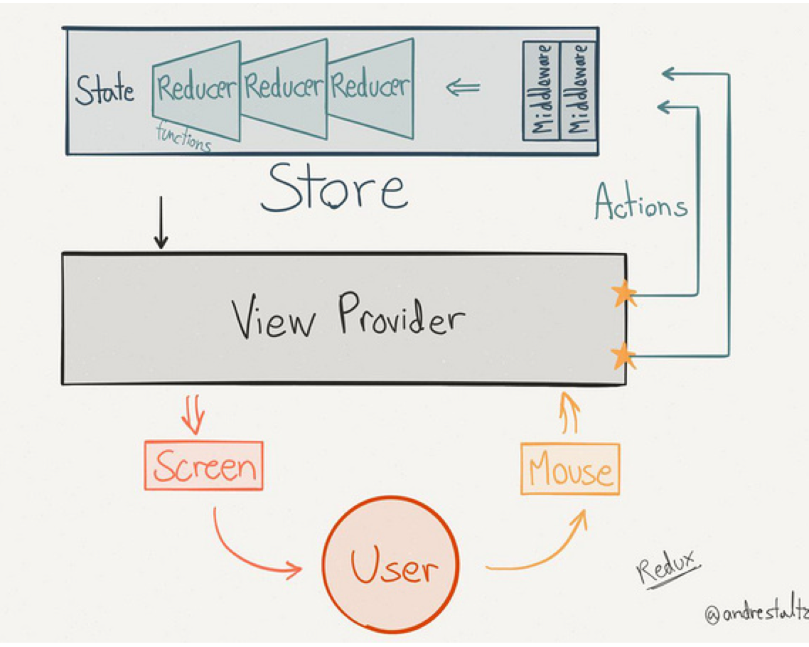

Slide 10



View
Reducer
StateChange

Slide 11

THANKS FOR YOUR ATTENTION

