Slide 1

前端快报
悟空
2016年03月11日

Slide 2
NEWS IN THIS WEEK
· Announcing Marko v3: From HTML to HTML-JS
· Safari Technology Preview
·changes to npm’s unpublish policy

Slide 3

A high performance templating engine and UI component building library
Marko has been shown to be one of the fastest templating engines with almost 2x the speed of Handlebars and 5x the speed of Jade and nunjucks. In addition, in a real-world benchmark, Marko (paired with Marko Widgets) was shown to be 10x faster than React when rendering a search results page on the server using a very similar UI components architecture.
http://markojs.com/

Slide 4
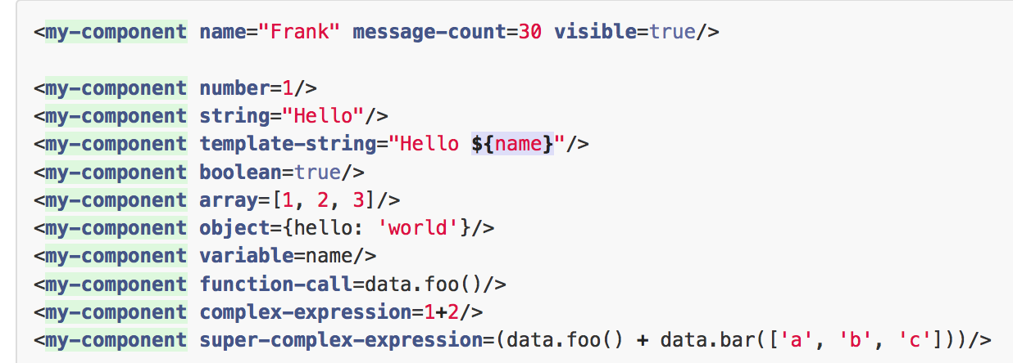
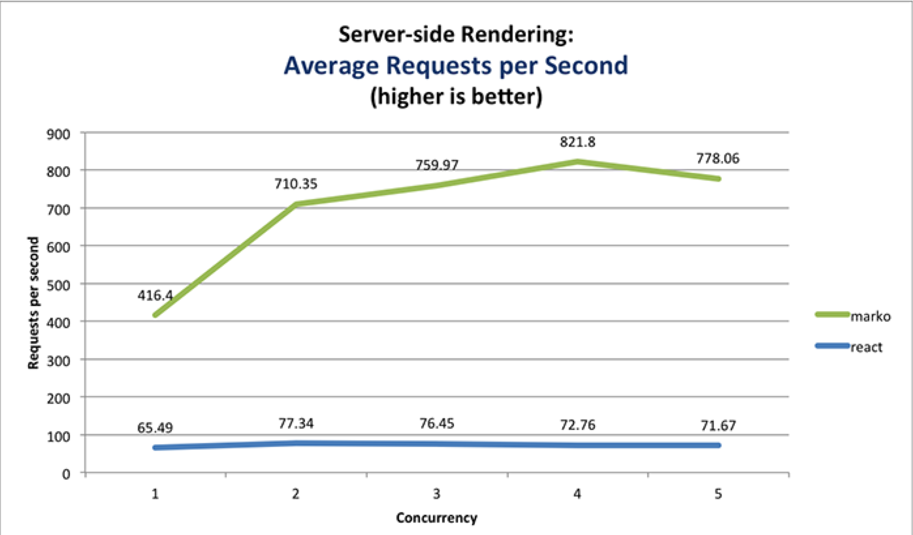
HTML-JS syntax
These characteristics have resulted in Marko (combined with Marko Widgets) being 10x faster than React on the server in a real-world benchmark.
In the browser, our benchmark showed no significant difference in performance when comparing Marko Widgets and React (although Marko Widgets seemed to have an edge in the mobile iOS browser).

Slide 5


Safari Technology Preview
a new, convenient way to see what features and improvements are coming to Safari and other applications that use WebKit.
Safari Technology Preview is a version of Safari for OS X, distributed by Apple, that includes a cutting-edge, in-development version of the WebKit browser engine. It’s a great way to test upcoming WebKit features and give feedback to the people building them when it’s most useful — early in development.
https://developer.apple.com/safari/download/

Slide 6

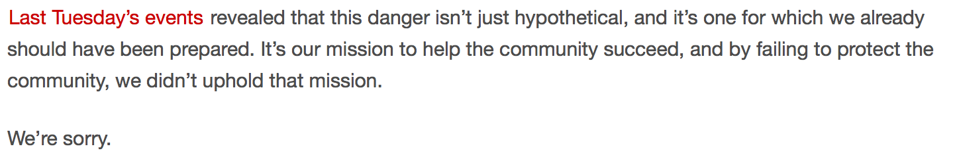
Changes to npm’s unpublish policy
new policy
If the version is less than 24 hours old, you can unpublish it. The package will be completely removed from the registry. No new packages can be published using the same name and version.
If the version is older than 24 hours, then the unpublish will fail, with a message to contact support@npmjs.com.

Slide 7
new policy (more)
If you contact support, they will check to see if removing that version of your package would break any other installs. If so, we will not remove it. You’ll either have to transfer ownership of the package or reach out to the owners of dependent packages to change their dependency.
If every version of a package is removed, it will be replaced with a security placeholder package, so that the formerly used name will not be susceptible to malicious squatting.
If another member of the community wishes to publish a package with the same name as a security placeholder, they’ll need to contact support@npmjs.com. npm will determine whether to grant this request. (Generally, we will.)

Slide 8

THANKS FOR YOUR ATTENTION

