Slide 1
This slide was added last, but inserted into the first position. Additionally it has FontName property set to FixedWidth, which causes it use fixed width font.
Notes:
FontName property can also be used in the notes field.
It is useful for adding code type output.
To view text formatting changes that you make in the Notes pane, do the following
On the View tab, in the Presentation Views group, click Outline View.
Right-click the Outline pane, and then select Show Text Formatting in the popped up menu.

Slide 2
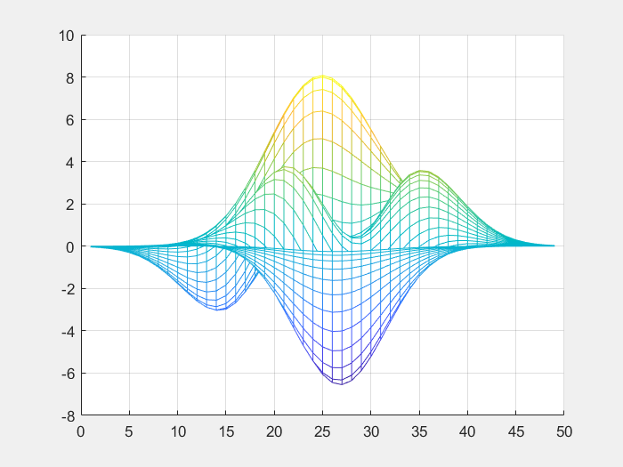
Slide Number 1
Notes:
Notes data: slide number 1

Slide 3

Slide Number 2
Notes:
Notes data: slide number 2

Slide 4

Slide Number 3
Notes:
Notes data: slide number 3

Slide 5
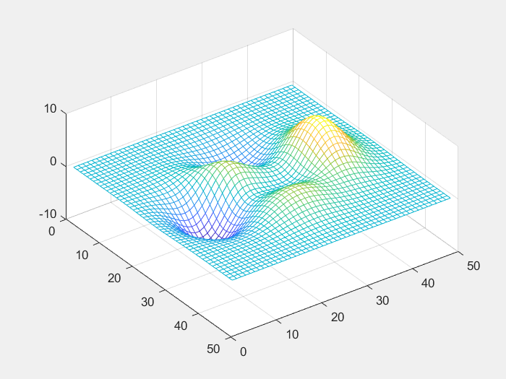
Slide Number 4
Notes:
Notes data: slide number 4

Slide 6

Slide Number 5
Notes:
Notes data: slide number 5

Slide 7

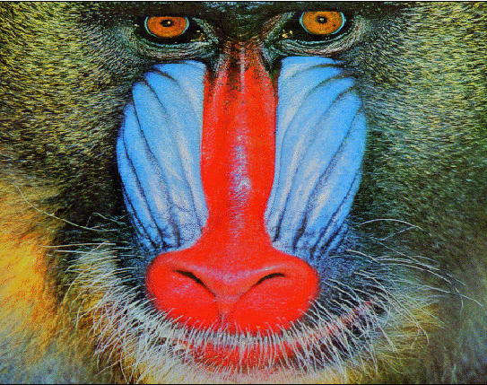
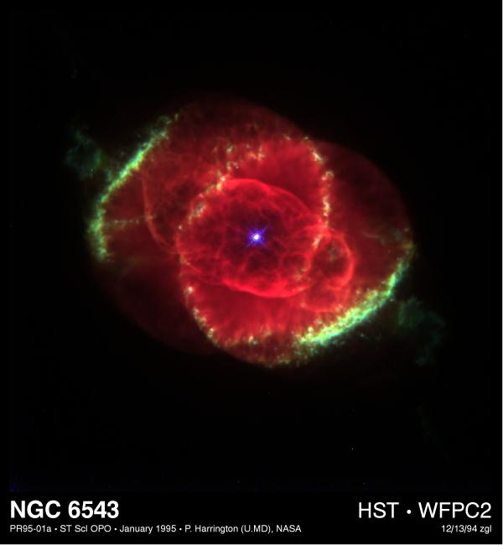

Inserted via figure handle
Inserted via axes handle
Inserted via image CDATA
Inserted via filename, no aspect ratio
Notes:
Repeated addnote calls on the same slide overwrite existing comments.

Slide 8

Scale = maxfixed

Slide 9
Scale = max

Slide 10
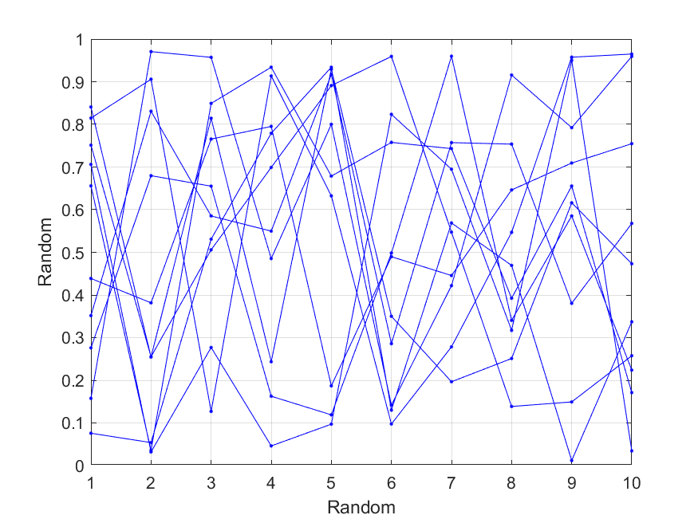

Slide 12
-Red Left-top
Green Center-top
Right-top and bold italics
Soft Blue Left-middle
Center-middle and bold on light red background
With Multiple
Lines
Right-middle
Left-bottom and italics
Center-bottom size 10
Right-bottom size 30

Slide 13
Textbox rotated by 45 degrees

Slide 14
This slide has a blue background

Slide 15
Standard XML entities such as
& and < and > and ' and "
are properly escaped
Notes:
Standard XML entities such as
& and < and > and ' and "
are properly escaped

Slide 16
Numbered items:
Each numbered line must start with a "#" symbol
Use \n to start new line
Last item is a very, very, very, very, very long one, so that when the text wraps to the new line a proper hanging line can be observed
#No space between # and text so it does not become a list item.
Bulleted items:
Each bulleted line must start with a "-" symbol
Use cell arrays to add multiple lines of text
Last item is a very, very, very, very, very long one, so that when the text wraps to the new line a proper hanging line can be observed.
-Last item does not have a space between the hyphen and the text so it does not become a list item.

Slide 17
The following in-text markdown formatting options are supported:
Words can be bolded by surrounding them with "**" symbols
Words can be italicized using "*"
Words can also be underlined by using "_" symbol
Various types of formatting can be combined together
Variable NAMES_WITH_UNDERSCORES are not underlined
Markdown formatting can span multiple words
Markdown symbol * or ** or _ that is followed by a non-alphanumeric character is not used to format * or ** or _
- It can even be tabbed (if using printable \t sequence)
- Further subtabbing is allowed as well
Markdown with non-alphanumeric characters: 1**, 2**, 3**, 4**
Example of markdown without escaping literal asterisks and with escaping *literal asterisks*
Example of markdown without escaping literal double-asterisks and with escaping **literal double-asterisks**
Example of markdown without escaping literal underscores and with escaping _literal underscores_
Escape character \ can be itself escaped \

Slide 18
This shows the ability to use markdown characters without the actual markdown formatting by using 'markdown',false input property-value pair
The following in-text markdown formatting options are supported:
- Words can be **bolded** by surrounding them with "**" symbols
- Words can be *italicized* using "*"
- Words can also be _underlined_ by using "_" symbol
- **Various** types of formatting *can be* combined _together_
- Variable NAMES_WITH_UNDERSCORES are not underlined
- _Markdown_ formatting *can span multiple* words
- Markdown symbol * or ** or _ that is followed by a non-alphanumeric character is not used to format * or ** or _
- It can even be tabbed (if using printable \t sequence)
- Markdown with non-alphanumeric characters: 1**, 2**, 3**, 4**
- Example of markdown without escaping *literal asterisks* and with escaping \*literal asterisks\*
- Example of markdown without escaping **literal double-asterisks** and with escaping \**literal double-asterisks\**
- Example of markdown without escaping _literal underscores_ and with escaping \_literal underscores\_
- Escape character \ can be itself escaped \\

Slide 19
Click here to jump to slide with different image insertion methods

Slide 21
Header 1 | Header 2 | Header 3
Row 1 | Data A | Data B
Row 2 | 10 | 20
Row 3 | Data C | Click here to jump to slide with different image insertion methods
Row 4 | NaN | N/A

Slide 22
