Slide 1
Sales & Financial Dashboard
Internship Task 4 – Dashboard Design
Het Brahmbhatt
Date : 30/05/2025
Tool Used: Power BI

Slide 2
Objective
Goal:
To design an interactive dashboard for business stakeholders using a Sales/Financial dataset.
Key Purpose:
Provide actionable insights through KPIs, filters, and time-series visualizations.

Slide 3
Dataset Overview
Source: Kaggle Sales/Financial dataset
Key Columns Used:
- Order Date
- Sales
- Profit
- Quantity
- Country/Product
Time Period: Monthly

Slide 4
Dashboard Design Highlights
Tool: Power BI
Pages Created:
- Dashboard Overview (with KPIs and time-series)
- Product Analysis (detailed view of performance by product)

Slide 5
Key KPIs Displayed
✅ Total Sales
✅ Total Quantity
✅ Average Order Value
✅ Monthly Growth %
Visuals Used:
- KPI Cards
- Line Charts
- Filters (Country, Product)

Slide 6
Interactivity Features
Slicers Used: Country, Product
Time-Series Chart: Sales trend by month
Navigation Menu: Between pages using button actions
Color Theme: Colorblind-safe for accessibility

Slide 7
Insights & Conclusion
Trends Observed:
- Sales peaked in August; steady growth in Q3.
- Top-selling countries include USA, UK, and Canada.
Conclusion:
The dashboard helps stakeholders track performance and take data-driven decisions.

Slide 8
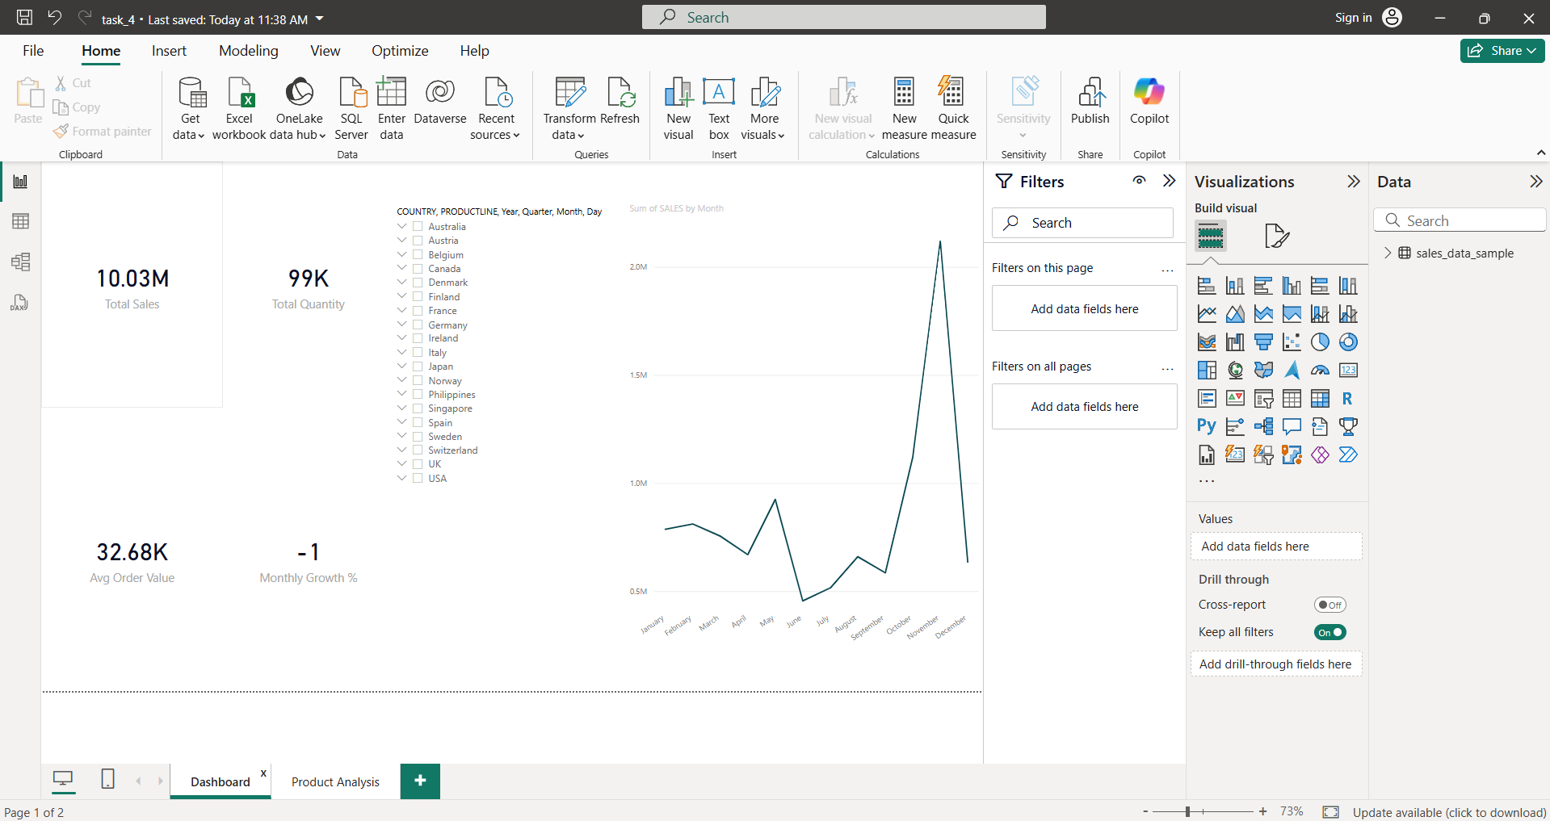
1st Page

Slide 9
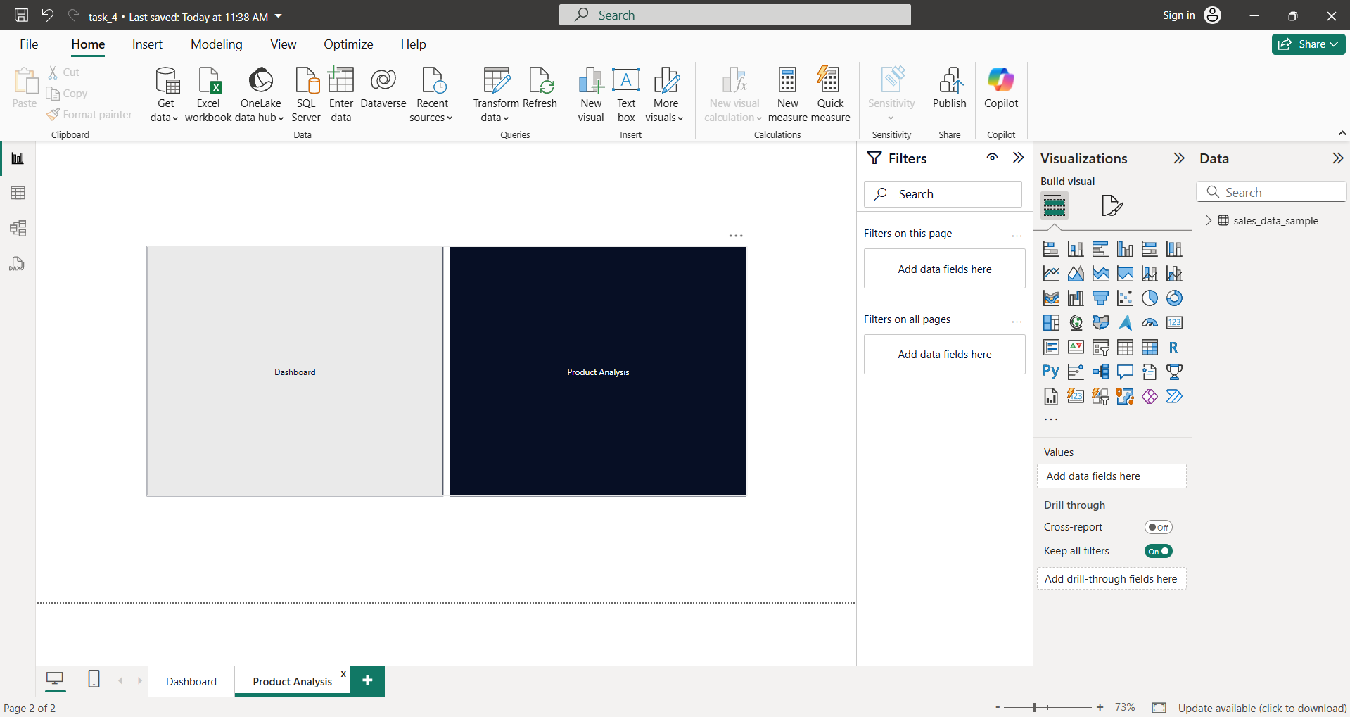
2nd Page

Slide 10
Top Insights for Stakeholders
• USA, UK, and Canada are the top-performing countries by sales.
• Sales peaked in August and Q3 overall showed strong growth.
• 'Classic Cars' and 'Motorcycles' are the top-selling product lines.
• Most profits came from high-volume regions; low-margin products need review.
• Dashboard interactivity helps filter insights by product and region.

Slide 11
Thank you

