Slide 1



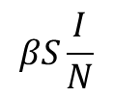

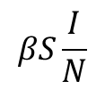

$$sR$$
S
I
R
$$βS\frac{I}{N}$$
$$γI$$
Modified SIR model for the first year of pandemic
$$sR$$
S
I
R
$$βS\frac{I}{N}$$
$$γI$$
$$eV$$
V
Modified SIR model for the second year of pandemic

Slide 2




$$sR$$
S
I
R
$$βS\frac{I}{N}$$
$$γI$$
$$eV$$
V

