Slide 1


PublicisSapient Hiring Challenge
Participant Name: Siddharth Sharma

Slide 2
Brief Summary of Project:
I have made the shopping cart app based on react.
Basically there are 4 components :
--Header.js
--Button.js
--App.js
--ItemCard.js
I have used useContext React Hook for the data which we obtained from the API so that it is being calculated with the price.

Slide 3
Technology/Tool Stack Used:
React
Nodejs

Slide 4
Github URL for source code:
https://github.com/pao0318/cart_app

Slide 5
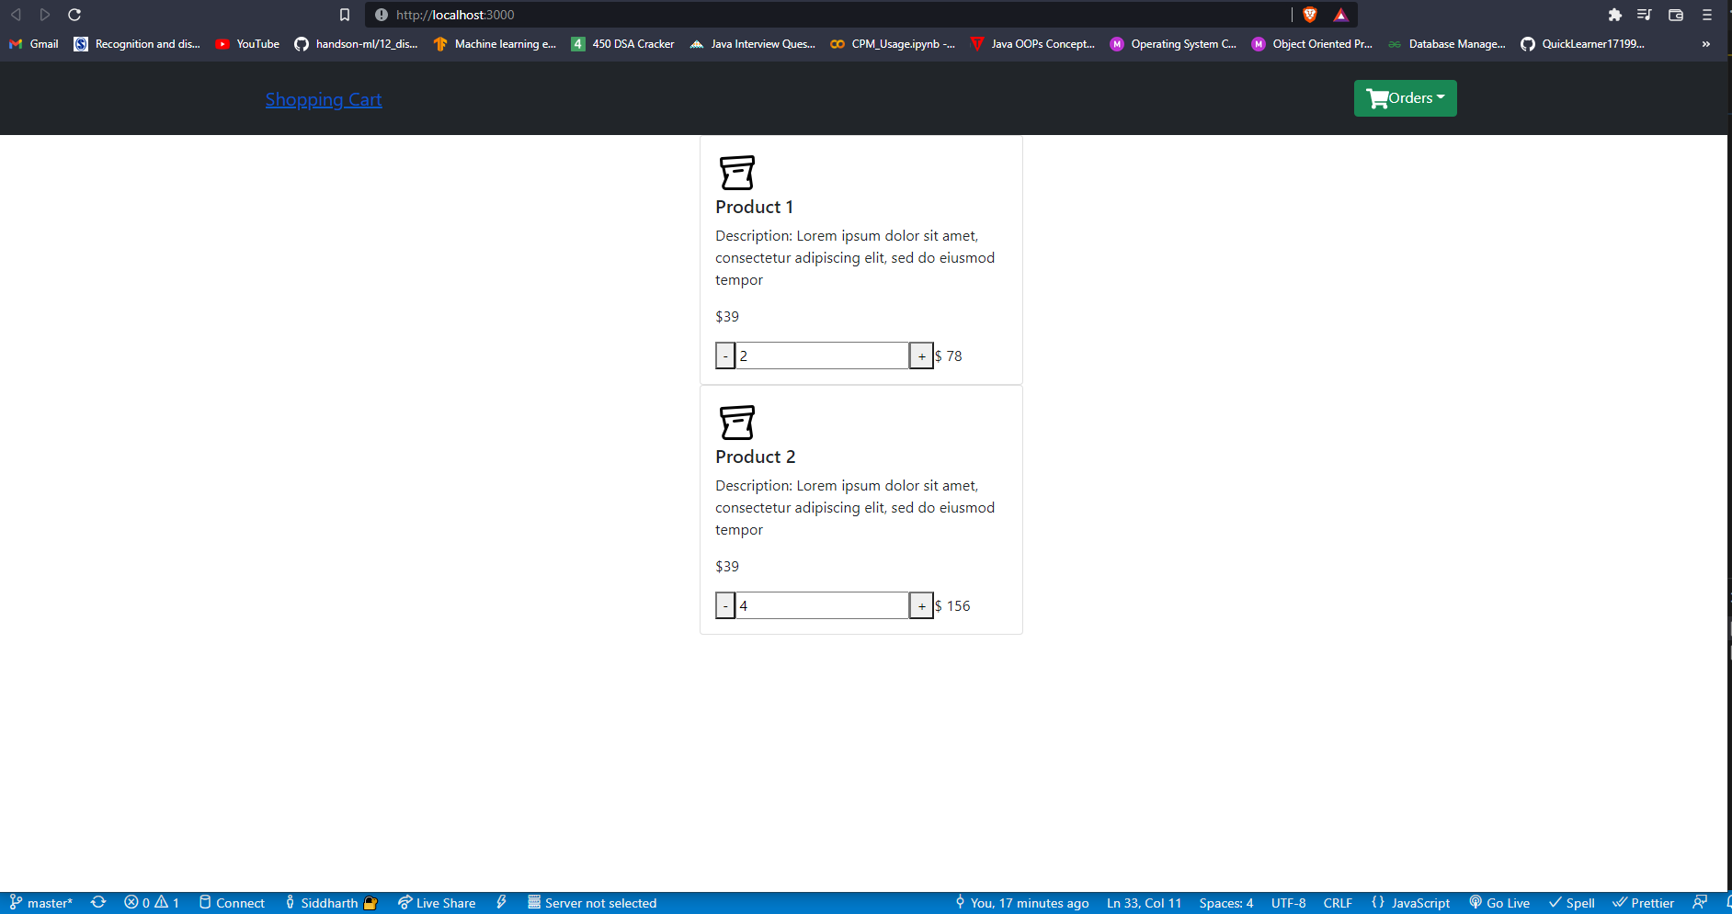
Screenshots/Video Demo of Application:

Slide 6
Any Additional Information:

Slide 7
Thank You

