Slide 1

一般均衡模型理论及其结构
杨 军
对外经济贸易大学国际经济贸易学院
经济政策研究中心（CETP）

Slide 2
报告主要内容
均衡模型的简要理论介绍
一般均衡模型
部门均衡模型
均衡模型具体构建中的部分关键问题
供需模块构建（标准模型）
静态和动态模型
应用案例
多哈贸易自由化谈判对农业生产和贫困影响
基于CAPSiM模型对未来我国农业供需预测分析
生物能源发展对农业生产和贫困影响

Slide 3
均衡（equilibrium）的意义
产品的市场均衡（market equilibrium）系指一组满足以下条件的交易量与交易价格（Q*, P*）：
消费者的效用最大化
生产者的利润最大化
D = S = Q*，或
边际愿付价格 (MWTP)
=边际愿受价格(MWTA)
= P*
P
D(P)
S(P)
E
P*
Q
Q*

Slide 4
一般均衡(general equilibrium)
The economy is in general equilibrium when prices have fully adjusted so that supply equals demand in all markets. That is, for all j = 1, 2, …, N,
with
for goods j such that

Slide 5
CGE模型发展过程简要回顾
脱胎于瓦尔拉斯(Walras)的一般均衡理论。1874年，瓦尔拉斯提出了一般均衡的理论模型，用抽象的数学语言表述了一般均衡的思想。
1936年，列昂节夫首次引入投入-产出模型，并假定成本是线性的、技术系数是固定的。不过，这些理论一般均衡模型的解的存在性至此还一直没有解决；
理论一般均衡模型解的存在性、唯一性、优化性和稳定性直到50年代才由阿罗(Arrow，1951)、阿罗和德布鲁(Arrow and Debru，1954)给予证明。

Slide 6
CGE模型发展过程简要回顾
尽管理论一般均衡模型的研究取得了如此的进步，但是，要将其应用于实际问题，还需解决相应模型解的算法问题。约翰森(Johansen，1960)构建了一个包括20个成本最小化的产业部门和一个效用最大化的家庭部门的实际一般均衡模型，并给出了相应的均衡价格的具体算法。由于约翰森模型的可计算性质，人们普遍把约翰森模型看作第一个CGE模型。
1967年，斯卡夫(Scarf)研制了一种开创性的算法，用于对数字设定的一般均衡模型进行求解。斯卡夫关于均衡价格开创性的算法使得一般均衡模型从纯理论结构转化为可计算的实际应用模型成为可能，并大大地促进了大型实际CGE模型的开发和应用。

Slide 7
两大促进因素
上世纪70年的石油危机，对系统计量经济模型的反思和否定。
上世纪90年代以来，计算机技术和优化软件的发展。

Slide 8
一般均衡(General Equilibrium)
消费理论
（选择理论）
消费者
q^{d}
x^{s}
均衡条件
Q^{d} = Q^{s}
要素供给理论
产品市场
一般均衡
（general equilibrium）
生产理论
（厂商理论）
均衡条件
X^{d} = X^{s}
q^{s}
要素市场
生产者
要素需求理论
x^{d}

Slide 9
CGE模型数据库-社会核算矩阵（SAM）
各种中间投入
运输成本和各种间接税
劳动力、资本和土地等初级要素
生产税

Slide 10
CGE模型数据库-社会核算矩阵（SAM）
产出的流向——使用情况
各种要素的使用情况

Slide 11
所有价格的链接关系

Slide 12

Value Linkages
Notes:
Please change background throughout to darker brown.

Slide 13
Distribution of Sales: Quantity Form
VOA(i,r) = PS(i,r) * QO(i,r)
+ PTAX(i,r)
= VOM(i,r) = PM(i,r) * QO(i,r)
= VDM(i,r)
+ VST(i,r)
+ sum(s,VXMD(i,r,s)) = PM(i,r) * QXS(i,r,s)
VXMD(i,r,s) + XTAXD(i,r,s)
= VXWD(i,r,s) = PFOB(i,r,s) * QXS(i,r,s)
+ VTWR(i,r,s)
= VIWS(i,r,s) = PCIF(i,r,s) * QXS(i,r,s)
+ MTAX(i,r,s)
= VIMS(i,r,s) = PMS(i,r,s) * QXS(i,r,s)
VIM(i,s) = PIM(i,s) * QIM(i,s)
= VIPM(i,s) = PIM(i,s) * QPM(i,s)
+ VIGM(i,s) = PIM(i,s) * QGM(i,s)
sum(j,VIFM(i,j,s)) = PIM(i,s) * QFM(i,j,s)

Slide 14
全球模型GTAP理论框架

Slide 15
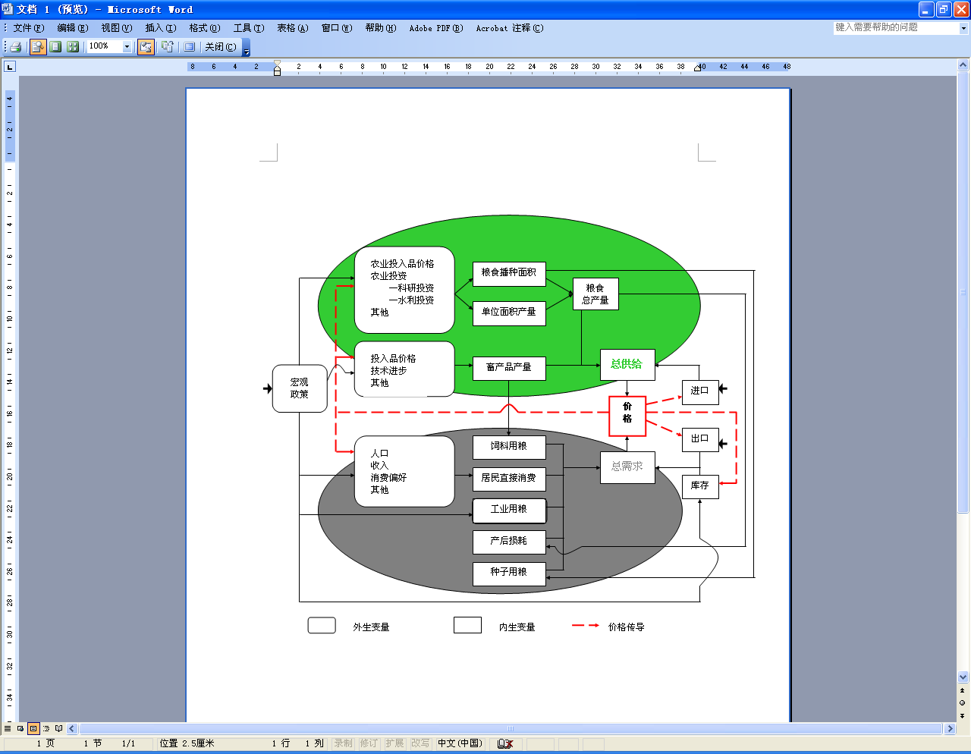
中国农业政策分析与预测模型 （CAPSiM）
CAPSiM的生产模型中包括的农作物产品有水稻、小麦、玉米、红薯、土豆、其它粗粮、大豆、棉花、油料作物、糖料作物、蔬菜、水果、瓜果和其它作物等14种类农作物产品；猪肉、牛肉、羊肉、家禽、蛋类、奶类、鱼、虾和其它水产品等9类畜产品和水产品。在需求系统中，消费品分成23类，它们分别为大米、小麦、玉米、红薯、土豆、其它粗粮、大豆、食用油、食糖、蔬菜、水果、瓜果、猪肉、牛肉、羊肉、家禽、蛋类、奶类、鱼、虾、其它水产品、其它食品和所有非食品。
最新的CAPSiM模型数据库已经更新到2015年。

Slide 16
中国农业政策分析与预测模型 （CAPSiM）

Slide 17
部门均衡模型使用的前提条件
产业部门很小
产出变化对其他产品市场价格影响很小
产出变化对中间投入价格影响很小
产出变化对要素需求影响很小

Slide 18
报告主要内容
均衡模型的简要理论介绍
一般均衡模型
部门均衡模型
均衡模型具体构建中的部分关键问题
供需模块构建（标准模型）
静态和动态模型
应用案例
多哈贸易自由化谈判对农业生产和贫困影响
基于CAPSiM模型对未来我国农业供需预测分析
生物能源发展对农业生产和贫困影响

Slide 19
生产模块
阿明顿假设
阿明顿假设

Slide 20
GTAP能源模型: GTAP-E
GTAP标准生产模块 + energy substitution (inter-KE and inter-fuel)
产出
产出
Value Added
中间投入 (能源产品，非能源产品）
Value Added
中间投入 (非能源产品)
Skilled Lab.
Unskilled Lab.
Capital-Energy
Land
Nat. Resources
Skilled Lab.
Unskilled Lab.
Capital
Land
Nat. Resources
Capital
Energy
Electricity
Non-Electricity
GTAP
Coal
Non-Coal
Oil
Gas
Petroleum prods
GTAP-E

Slide 21
多投入-多产出模型 Muti outputs and muti inputs model

Slide 22
需求（ GTAP）模块

Slide 23
效用
最终需求
消费
C
投资
I
政府
G
存货
INV
中间需求
INT
……
复合产品
CES
阿明顿假设
进口
内销
出口
转换函数 (CET)
国内总产出
Leontief
增加值部分
X_{1int}
X_{2int}
……
X_{nint}
CES
中间投入
劳动
资本
初级要素

Slide 24
从上面模型结构，在资源和技术不变的情况下，经济运行有有以下两个特点：
生产资源是有限的，生产资源将配置给生产效益更好的部门：
即便一个部门的收益不变，但是由于其他部门收益提高，它也将间接受损
即便一个部门的收益不变，但是由于其他部门受损，它也将间接受益
经济系统有负反馈的自我修复机制：当一个产品的价格上升，
需求将降低（负的自价格弹性，正的交叉价格弹性）；
更多供给。生产资源被配给过来，生产提高；或者进口增加，都导致供给增长。
供需再次达到新的平衡状态。

Slide 25
上面所讲述的静态情况下的经济变化，即不考虑技术、资本和劳动力变化情况下，资源分配和经济系统的调整变化。显然，这是不够的，这就是动态经济模型所要考察的内容。

Slide 26
资本的动态调整

Slide 27
资本收益率（RORC）变化 →投资变化 →改变资本 →对生产系统产生影响

Slide 28
投资方程
(E1)资本（t年初）增长方程
(E2) 资本（t年末）增长方程
(E3) 资本增长率
(E4) 资本供给方程
(E5) 资本预期收益率

Slide 29
定义预期收益率 （2代表投资部门，1代表生产部门）

Slide 31
劳动力供给变化

Slide 32
工资和就业在模型分析中的设置
长期就业情况取决于人口变化.
静态分析:
短期：名义工资不变，就业调整（失业）.
长期：充分就业，工资进行调整
动态分析:
短期存在工资刚性，长期可以充分调整，实现充分就业。

Slide 33
也就是说就业在长期将回到其基期情况
L
Policy path for employment
Base rerun employment path
2007

Slide 34
工资和就业相对于基准方案的偏离
Allow favourable (unfavourable) shocks to be expressed as:
short-run positive (negative) deviations in employment;
long-run positive (negative) deviations in wages.
Adjustment coefficient (0.50)
Policy (P) and base (B) wage rates, current
Policy (P) and base (B) wage rates, lagged
Policy (P) and base (B) employment, current

Slide 36
动态分析与静态分析的差异
静态分析：假设资源要素和技术不发生改变的情况下，经济政策冲击所导致的生产调整及资源配置变化，可以较好地分析政策变化对经济福利、产业发展、贸易和资源利用等影响。
动态分析：经济政策变化将导致资源和技术进行调整，一国的资源总量会发生改变，从而对一国经济增长、产业发展、经济福利和贸易等影响将更为显著。

Slide 37
报告主要内容
均衡模型的简要理论介绍
一般均衡模型
部门均衡模型
均衡模型具体构建中的部分关键问题
供需模块构建（标准模型）
静态和动态模型
3. 应用案例
多哈贸易自由化谈判对农业生产和贫困影响
基于CAPSiM模型对未来我国农业供需预测分析
生物能源发展对农业生产和贫困影响

Slide 38
报告主要内容
均衡模型的简要理论介绍
一般均衡模型
部门均衡模型
均衡模型具体构建中的部分关键问题
供需模块构建（标准模型）
静态和动态模型
应用案例
多哈贸易自由化谈判对农业生产和贫困影响
基于CAPSiM模型对未来我国农业供需预测分析
生物能源发展对农业生产和贫困影响

Slide 39
中国进口关税和出口面临关税的比较(%)
来源: GTAP数据库和中国加入WTO文件

Slide 40
美国、欧盟和G20集团 多哈贸易自由化提案
G20 |  |  |  | 美国 |  |  |  | 欧盟
关税区间(%) |  | 削减幅度(%) |  | 关税区间(%) |  | 削减幅度(%) |  | 关税区间(%) |  | 削减幅度(%)
下限 | 上限 |  |  | 下限 | 上限 |  |  | 下限 | 上限
- | 20 | 45 |  | - | 20 | 65 |  | - | 30 | 45
20 | 50 | 55 |  | 20 | 40 | 75 |  | 30 | 60 | 45
50 | 75 | 65 |  | 40 | 60 | 85 |  | 60 | 90 | 50
75 | - | 75 |  | 60 | - | 90 |  | 90 | - | 60

Slide 41
Macro impacts on China by different proposals in 2015 不同自由化方案的宏观影响
 | EU Proposal | G20 Proposal | USA Proposal
Real GDP growth (%) | 0.05 | 0.05 | 0.05
Term of trade (%) | 0.46 | 0.43 | 0.44
Total export (%) | 3.89 | 3.92 | 4.01
Total import (%) | 5.56 | 5.6 | 5.7
Trade balance (million USD) | 2293 | 2286 | 2492
Unskilled labor wage (%) | 1.47 | 1.46 | 1.45
Skilled labor wage (%) | 1.3 | 1.29 | 1.26
Capital price (%) | 1.26 | 1.25 | 1.22
Land price (%) | 3.3 | 3.38 | 3.95
Agricultural income (%) | 2.04 | 2.05 | 2.24
Agricultural export (%) | 10.31 | 10.99 | 19.89
Agricultural import (%) | 6.83 | 7.41 | 9.08

Slide 42
Impacts on China’s import of major agricultural commodities under Doha proposals in 2015 (%) 多哈贸易自由化提案对中国主要农产品进口的影响(%)

Slide 43
Impacts on China’s export of major agricultural commodities under Doha proposals in 2015 (%) 多哈贸易自由化提案对中国主要农产品出口的影响(%)

Slide 44
Impacts on China’s net export of major agricultural commodities under Doha proposals in 2015 多哈贸易自由化提案对中国主要农产品净出口的影响 (thousand ton, 1000吨）

Slide 45
Impacts on China’s production of major agricultural commodities under Doha proposals in 2015 (%) 多哈贸易自由化提案对中国主要农产品生产的影响(%)

Slide 46
Impacts on China’s production of major agricultural commodities under Doha proposals in 2015 多哈贸易自由化提案对中国主要农产品生产的影响 (thousand ton, 1000吨）

Slide 47
不同自由化提案下，
对农业产值影响（元/农户,2015）
我国在Doha贸易谈判需要同时关注关税消减
和发达国家国内农业支持减让等两个方面

Slide 48
美国贸易提案下，对我国不同收入组农户产值的影响（元，2015）

Slide 49
Impacts on per capita agricultural income in rural area under Doha proposals in 2015 (yuan/person) 多哈不同贸易提案对农民人均收入的影响（元/人，2015）
 | EU proposal | G20 proposal | USA proposal
National average | 22.06 | 23.05 | 24.02
Under poverty | 8.29 | 8.72 | 9.21
Income group 1 | 15.41 | 16.06 | 17.19
Income group 2 | 23.45 | 24.19 | 25.47
Income group 3 | 38.45 | 39.76 | 41.30
Income group 4 | 54.15 | 55.73 | 56.51
Income group 5 | 69.55 | 71.38 | 71.62
Farmers in plain area | 33.72 | 34.99 | 35.68
Farmers in hill area | 18.74 | 19.93 | 21.45
Farmers in mountain | 9.32 | 9.59 | 10.07
Farmers: Han | 22.3 | 23.32 | 24.37
Farmers: Minority | 8.4 | 7.48 | 3.71

Slide 50
Shares of output values of benefited and non-benefited agricultural products under baseline in 2015 (%)

Slide 51
Shares of output values of benefited and non-benefited agricultural products under baseline in 2015 (%)

Slide 52
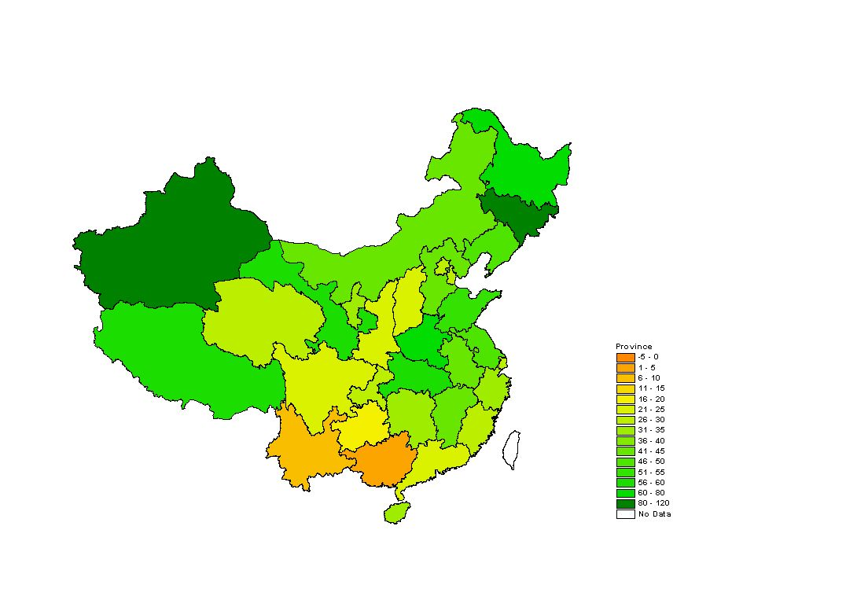
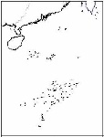
美国贸易自由化提案(降低关税+国内减让） 对不同区域农户农业产值的影响（元/人,2015）
Doha与WTO影响有显著差异。大部分地区（包括中西部地区）是受益的。但是前期受到保护的部分农产品将面临挑战。反映在区域上，集中生产这些产品的区域，农民人均收入会减少

Slide 53
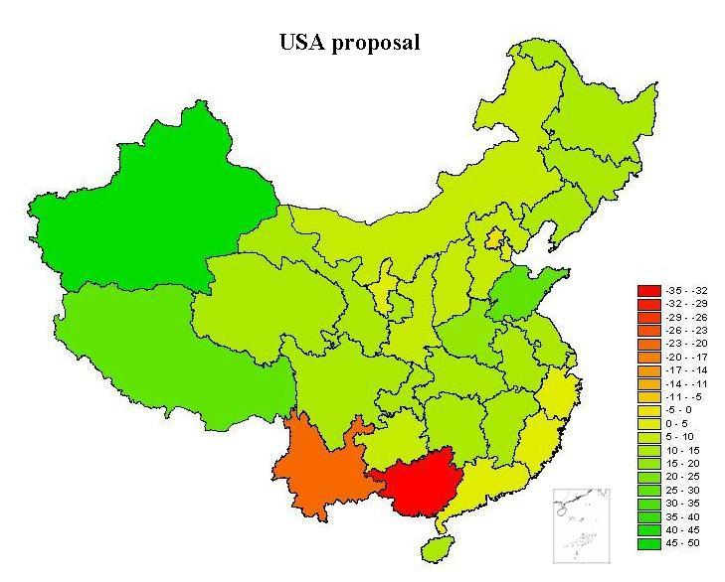
Impacts on per capita agri. income for the farmers under poverty by province under USA proposals in 2015 (yuan/person)

Slide 54
（2）基于CAPSiM模型的预测分析

Slide 55
采用中国农业政策分析与预测模型 （CAPSiM）
CAPSiM的生产模型中包括的农作物产品有水稻、小麦、玉米、红薯、土豆、其它粗粮、大豆、棉花、油料作物、糖料作物、蔬菜、水果、瓜果和其它作物等14种类农作物产品；猪肉、牛肉、羊肉、家禽、蛋类、奶类、鱼、虾和其它水产品等9类畜产品和水产品。在需求系统中，消费品分成23类，它们分别为大米、小麦、玉米、红薯、土豆、其它粗粮、大豆、食用油、食糖、蔬菜、水果、瓜果、猪肉、牛肉、羊肉、家禽、蛋类、奶类、鱼、虾、其它水产品、其它食品和所有非食品。
最新的CAPSiM模型数据库已经更新到2015年。

Slide 56
预测分析基本假设
GDP增长率：在2016-2020年间，年均GDP增长6.5%；在2021-2025期间，年均GDP增长率为5.5%；2026-2030年增长4.5%。
未来城乡收入差距逐渐减小：设定在2016-2030年间，虽然城乡居民年均收入率也呈现下降的趋势，但这时期的农村居民年均收入增长为5.5%，城市居民年均收入增长为5.0%。
人口增长率：在2016-2020年间，年均增长0.44%；在2021-2025年，年均增长0.22%；在2026-2030年，年均增长0.06%。
城镇化率：城镇化率将由2015年的55%，提高到2020年的60%、2025年的64%和2030年的67%。城镇化率在模型中是通过农村和城镇人口比率体现的。
农业劳动力工资和土地租金变化：设定农村劳动力实际工资在2016-2030年间年均增长5.0%，土地租金在2016-2030年间年均增长约2.5%。
农业科技进步：假设国家在未来将继续加大农业科技投入，但是随着提高单产提高的边际成本增加，科技投入对单产提高的贡献率呈下降趋势。科技进步在不同年份对不同农产品单产增长的贡献率假设查考Huang et al.（2015）。

Slide 57
主要农作物未来进出口变化（万吨）

Slide 58
主要畜产品未来进出口变化（千吨）

Slide 59
农产品自给率（%）未来变化

Slide 60
（3）生物能源发展对农业生产和贫困影响

Slide 61

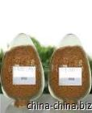
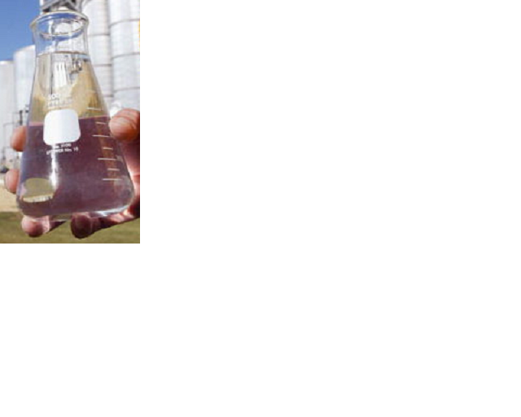




Output of ethanol productions and distributions of DDGs usage in USA
1 bushel (25.4 kg)
8.2kg DDGs
10.2 liters
46%
42%
11%
4%
dairy
Beef
Swine
Poultry
Source: Renewable Fuel Association (RFA, 2003-2010). The share used for swine and poultry keep rising, which means DDGs is getting popularly used in livestock sectors.

Slide 62
Historical Ethanol and DDGs production in US
Data source: RFA(2010)

Slide 63
Usage of DDGs in USA
According to RFA, DDGs production had increased from 2.7 million tons in 2000 to about 26.3 million tons in 2009, average annual growth rate about 30%.
The 30.5 million metric tons (including distillers grains and corn gluten feed and meal ) of feed generated by the ethanol industry in 2009 is equivalent to the total amount of grain fed to cattle

Slide 64
Model Structure for Biofuel By-products
Livestock production
Substitute for fossil fuel
Compound feedstuff
Fossil fuel
Ethanol or
bio-diesel
DDGs or BDDP
Maize or
Processed feed
Biofuel sectors
(ethanol+biodiesel industries)

Slide 65
Improvements on modeling Biofuel by-products
Refine the model and database …
New production function of multi-inputs and multi-outputs. Ratio of output between ethanol vs. DDGs and Diesel vs. BDBP is the key.
Substitution between by-products and other feedstuffs (maize, processed feed etc.) and the degree of substitution.
Trade flows of By-products (DDGs+BDBP)

Slide 66
Strategy for identifying global impact pathways: Reference scenario
Biofuels production in all countries in the world are kept at their 2006 level (in other words, we are simulating the effect of a world-wide ban of not allowing any expansion over what was already in place)

Slide 67
Two Key Alternative Scenarios
Market Scenario: In the market scenario, governments do not intervene into the production decisions of biofuels producers … Biofuels production is carried out purely on the basis of international energy prices
Policy Intervention Scenario: In the policy intervention scenario, governments intervene into the production decisions of biofuels producers by offering subsidies (which are equivalent to those actually being considered as of 2008) …

Slide 68
Targets of Biofuel Production in 2020 of Selected Countries
 | 2006 | Target in 2020 | Growth (%)
Ethanol (million tons)
USA | 15.9 | 49.1 | 209
EU | 1.5 | 21.0 | 1300
Brazil | 14.7 | 43.2 | 194
Diesel (million tons)
USA | 0.8 | 6.9 | 763
EU | 4.9 | 46.4 | 847
Source: Yang et al., 2009
Notes:
68

Slide 69
Sensitive analysis on crude oil prices (US dollars per barrel) in 2006-2020
This is consistent with other modelers (e.g.,Hertel et al., 2008)
High energy price assumption
High (2020) = 2 x Low (2006)
Low energy price assumption
This is from the 2008 report from the International Energy Association … it is what most GTAP analyst use as their baseline

Slide 70
Sensitive analysis on elasticities of substitution between Gasoline and biofuel
This (“3”) means that when the price of gasoline goes up, there is little impetus to substitute into ethanol
Low elasticity: 3
This is about the same level as used in the analyses by Hertel et al. (2-4) and the LEI Banse et al. (5)
High elasticity: 10
This (“10”) means that when the price of gasoline goes up, there is a lot of impetus to substitute into ethanol [note: “infinity” is perfect substitution]

Slide 71
Analytical plan (to help understand what really matters)
Low Energy Price Projections
High Energy Price Projections
Low Elast. Of Substitution: Gas and Ethanol
High Elast. Of Substitution: Gas and Ethanol
Low Elast. Of Substitution: Gas and Ethanol
High Elast. Of Substitution: Gas and Ethanol
Reference Scenario
Market Scenario
Policy Intervention Scenario
Notes:
Low Energy Price from IEA; High Energy Price = (2 x Low Energy Price)
Low Elast. of Sub., Gas and Ethanol = 3; High Elasticity = 10

Slide 72
Scenario Results

Slide 73
Ethanol production (% change) in 2020 over 2006 under policy intervention scenario in USA
Reference Scenario
Almost 0, by assumption
Almost 0, by assumption
Market Scenario
US target
Policy Intervention
636
Low Energy Price Projections
High Energy Price Projections

Slide 74
Diesel production (%) in 2020 over 2006 under policy intervention scenario in EU27
Reference Scenario
Almost 0, by assumption
Almost 0, by assumption
Market Scenario
901
Policy Intervention Scenario
847
Low Energy Price Projections
High Energy Price Projections

Slide 75
Maize prices, production and exports in US under assumptions of oil price and elas. of substitution (comparing to reference,2020)
 | Market |  | Policy intervention
 | Low Price | High Price | Low Price | High Price
Price
High subst. | 0.7 | 49.6 | 15.0 | 49.6
Low subst. | 1.4 | 12.8 | 15.0 | 13.9
Production
High subst. | 1.0 | 54.0 | 17.0 | 54.0
Low subst. | 2.1 | 19.8 | 17.0 | 18.6
Export
High subst. | 1.2 | -24.5 | -16.6 | -24.5
Low subst. | -0.3 | -8.0 | -16.6 | -16.4
`

Slide 76
Soybean prices, production and exports in US under assumptions of oil price and elas. of substitution (comparing to reference,2020)
 | Market |  | Policy intervention
 | Low Price | High Price | Low Price | High Price
Price
High subst. | 0.4 | 24.2 | 12.5 | 24.2
Low subst. | 0.7 | 6.7 | 12.5 | 11.7
Production
High subst. | 0.0 | 5.7 | 8.5 | 5.7
Low subst. | 0.3 | 2.8 | 8.5 | 8.7
Export
High subst. | 0.7 | -14.5 | -13.3 | -14.5
Low subst. | 0.1 | -3.9 | -13.3 | -13.3
`

Slide 77
Rapeseeds prices, production and exports in EU under various assumptions of oil price and elas. of substitution (comparing to reference,2020)
 | Market |  | Policy intervention
 | Low Price | High Price | Low Price | High Price
Price
High subst. | 1.2 | 36.8 | 33.0 | 36.8
Low subst. | 1.4 | 10.9 | 33.0 | 30.5
Output
High subst. | 3.9 | 89.4 | 81.6 | 89.4
Low subst. | 4.5 | 35.7 | 81.6 | 84.6
Export
High subst. | -4.9 | -61.3 | -62.8 | -61.3
Low subst. | -5.3 | -32.1 | -62.9 | -62.3
`

Slide 78
Sugarcane prices, production and exports in Brazil under various assumptions of oil price and elas. of substitution (comparing to reference,2020)
 | Market |  | Policy intervention
 | Low Price | High Price | Low Price | High Price
Price
High subst. | 6.5 | 89.3 | 50.6 | 89.3
Low subst. | 9.1 | 43.6 | 50.6 | 45.7
Output
High subst. | 16.3 | 148.8 | 94.1 | 148.8
Low subst. | 22.6 | 100.1 | 94.3 | 99.1
Export
High subst. | -28.7 | -94.3 | -87.5 | -94.3
Low subst. | -36.4 | -82.4 | -87.5 | -85.3
`

Slide 79
Government subsidy (billion US$) in 2020 under policy intervention scenario
Under lower price, subsidy is substantially higher … it is ZERO (0%) under hi / hi scenario
USA
Zero
EU
Zero
If there is high price, but, low substitutability between ethanol and gasoline, gov’t s still need subsidy to meet targets … because ethanol is less responsive to energy prices …
Brazil
Zero
Low Energy Price Projections
High Energy Price Projections

Slide 80
Part II: Impacts of Global biofuel development on China’s agriculture and poverty

Slide 81
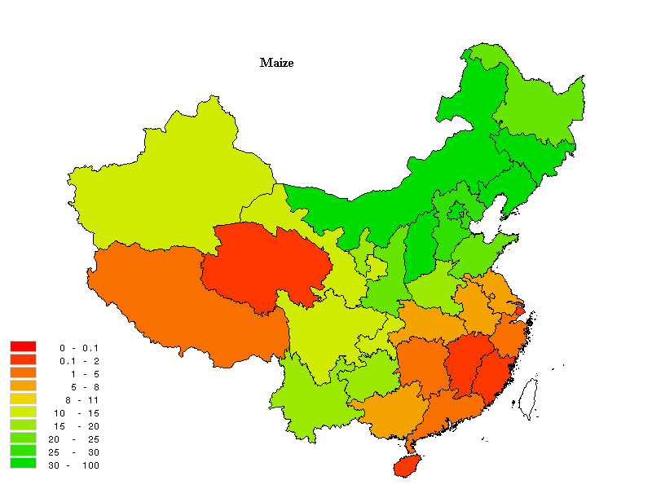
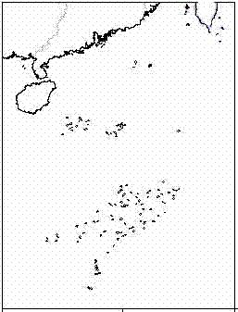
China is a big country, production differs largely among regions The share of maize in total crop areas by province (%)

Slide 82
Income from agricultural sector in different income groups (per capita)
Agricultural activities (especial planting crops) are more important for income of poor farmers in China…
Notes:
82
Poor farmers depend much heavily on agricultural production to get more income…

Slide 83
Share of farmer’s income from agriculture by different income groups in 2005
Income group | Total income (Yuan/person, year) | Share of agricultural Income (%) | Share of crop income (%)
National Average | 3522 | 49.5 | 39.1
Income group 1 (Under poverty*) | 757 | 59 | 57
Income group 2 | 1659 | 57 | 47
Income group 3 | 2477 | 53 | 42
Income group 4 | 3421 | 50 | 39
Income group 5 | 5048 | 44 | 32
Income group 6 (Highest income ) | 9253 | 28 | 16
Source: Estimated based on rural income and expenditure survey conducted by National Bureau of Statistics of China in 2005

Slide 84
Farmer’s income from agriculture by different income groups in 2005
Income group | Total income (Yuan/person, year) | Agricultural Income (Yuan/person) | Crop income (Yuan/person)
National Average | 3522 | 1743 | 1377
Income group 1 (Under poverty*) | 757 | 447 | 431
Income group 2 | 1659 | 946 | 780
Income group 3 | 2477 | 1313 | 1040
Income group 4 | 3421 | 1711 | 1334
Income group 5 | 5048 | 2221 | 1615
Income group 6 (Highest income ) | 9253 | 2591 | 1480
many reasons: Lower technology, less education, sterile soil, poor natural condition etc.
Source: Estimated based on rural income and expenditure survey conducted by National Bureau of Statistics of China in 2005

Slide 85
Methodologies
GTAP (Global Trade Analysis Program)
Simulate the world price changes
China’s Agricultural Policy Simulation and Projection Model (CAPSiM)
Partial equilibrium model
Commodities:
12 crops or crop groups
7 livestock and aquatic products
31 provinces
11 farmer groups per region (10 group+1 average)

Slide 86
Outputs from GTAP
Impacts of biofuel on international food prices
CAPSiM
Aggregate impacts:
by commodity
at national level
Price transmission models
Impacts by region:
Production
Consumption
Income ….
Impacts on poor/richer:
Production
Consumption
Income ....

Slide 87
Targets of biofuel production of different countries/regions
 | 2006 | 2020
Ethanol Production
USA (billion gallon) | 4.86 | 15.0
EU27 (billion gallon) | 0.79 | 6.42
Brazil (billion gallon) | 4.50 | 13.20
China (billion gallon) | 0.39 | 3.06
Diesel Production
USA (billion gallon) | 0.25 | 2.1
EU27 (billion gallon) | 1.75 | 14.19

Slide 88
Scenarios
Baseline (similar as before…)
Mandate Scenario (I)
Realized the government targets (Low energy and low substitutability)
Market Scenario (II)
H-H scenario (High energy and high substitutability)

Slide 89
Impacts on production, trade and domestic market price

Slide 90
Impacts on output, export and domestic price by realizing biofuel targets (relative to baseline, 2020)
 | Market price (%) | Absolute change (1,000tons) |  |  | Percentage change (%)
 |  | Output | Export | Import | Output | Export | Import
Rice | 1.2 | 60 | 138 | -12 | 0.1 | 2.8 | -4.1
Wheat | 2.0 | -30 | 60 | -291 | 0.0 | 5.7 | -6.2
Maize | 5.1 | 4124 | 230 | -5525 | 2.1 | 10.9 | -32.0
Other grain | 1.6 | -132 | 16 | -21 | -0.7 | 9.4 | -9.1
Soybean | 6.8 | 579 | 50 | -2609 | 3.2 | 5.7 | -4.0
Other oilseed | 7.5 | 294 | 48 | -696 | 3.3 | 21.6 | -27.2
Cotton | 3.8 | 101 | 0 | -101 | 1.2 | -0.1 | -1.4
Sugar | 2.5 | 9 | -7 | -96 | 0.1 | -3.0 | -1.7
Vegetable | 0.9 | -604 | 658 | -11 | -0.2 | 7.7 | -6.0
Fruit | 1.0 | -73 | 134 | -120 | -0.1 | 14.8 | -11.6
Pork | 1.7 | -525 | -2 | 1 | -0.9 | -0.4 | 0.4
Beef | 1.3 | -48 | 0 | 0 | -0.6 | 0.1 | -0.3
Poultry | 1.9 | -225 | -3 | 5 | -1.1 | -0.7 | 0.8

Slide 91
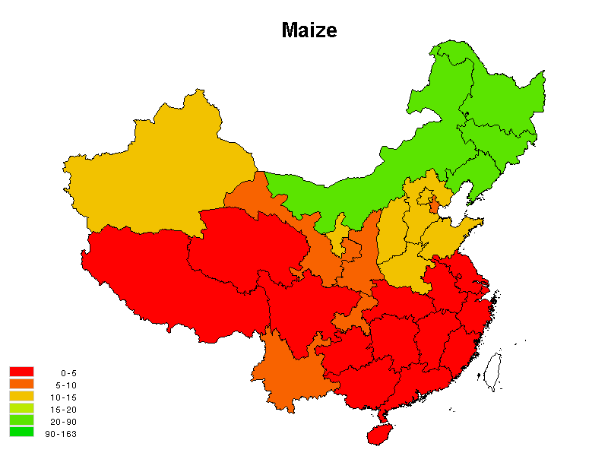
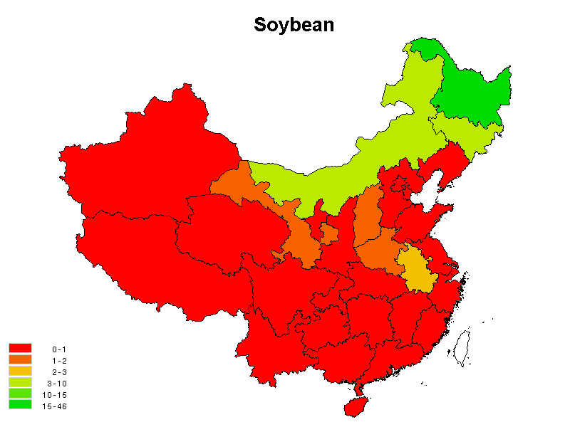


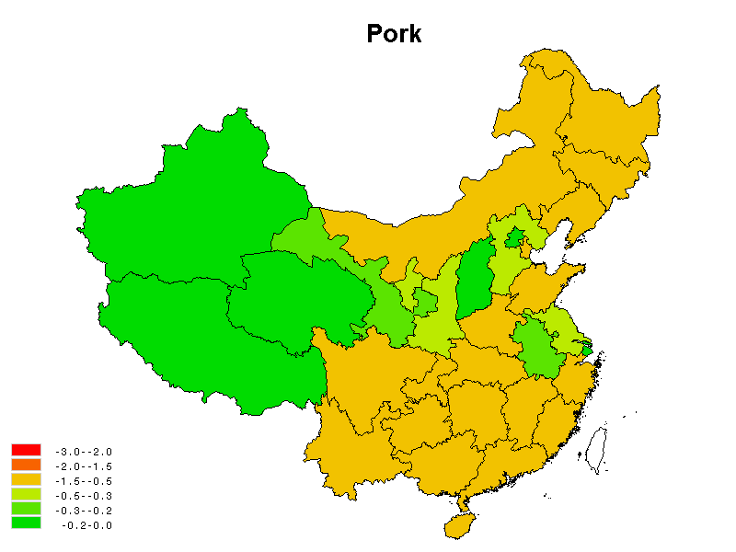
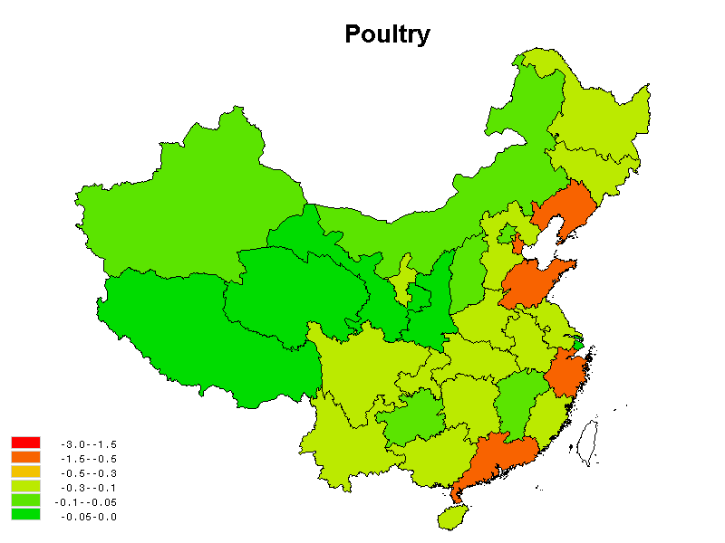
Impacts on production of diff. commodities in diff. provinces under mandate scenario (kg/ household, 2020)

Slide 92
Impacts on output, export and domestic price under H-H (relative to baseline, 2020)
 | Market price (%) | Absolute change (1,000tons) |  |  |  | Percentage change (%)
 |  | Output | Export | Import | Output |  | Export | Import
Rice | 2.0 | 136 | 319 | -24 | 0.1 |  | 8.2 | -7.5
Wheat | 3.4 | -128 | 113 | -465 | -0.1 |  | 10.7 | -10.8
Maize | 11.0 | 9676 | 1169 | -11922 | 4.8 |  | 58 | -70.5
Other grain | 2.7 | -274 | 29 | -38 | -1.5 |  | 17.4 | -17.8
Soybean | 12.1 | 999 | 122 | -4874 | 5.4 |  | 15.9 | -7.8
Other oilseed | 9.2 | 325 | 55 | -792 | 3.7 |  | 28.3 | -31.1
Cotton | 0.0 | 239 | 0 | -240 | 2.9 |  | -1.8 | -3.3
Sugar | 3.8 | 121 | 13 | -327 | 1.2 |  | 5.2 | -6
Vegetable | 1.4 | -958 | 1063 | -16 | -0.3 |  | 16.7 | -9.3
Fruit | 1.6 | -130 | 211 | -176 | -0.2 |  | 31.6 | -17.2
Pork | 3.5 | -1086 | -7 | 5 | -1.9 |  | -1.4 | 1.6
Beef | 2.7 | -96 | 0 | 0 | -1.2 |  | 0.6 | 0.1
Poultry | 3.7 | -471 | -8 | 15 | -2.2 |  | -2 | 2.5

Slide 93
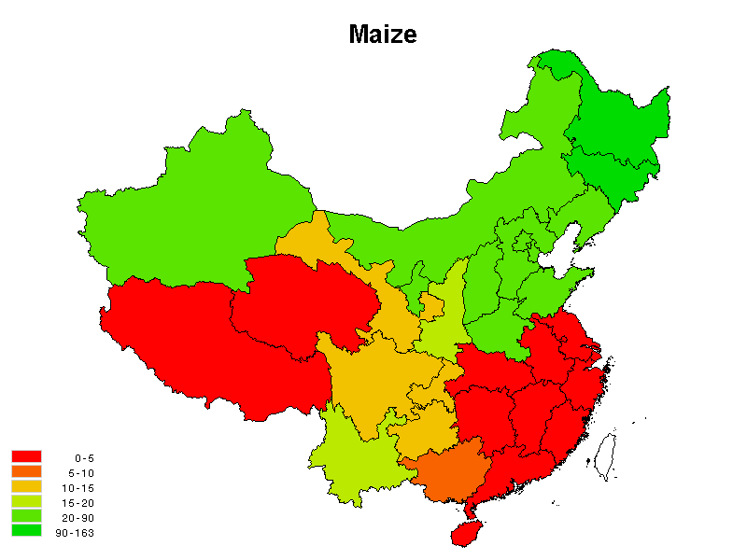
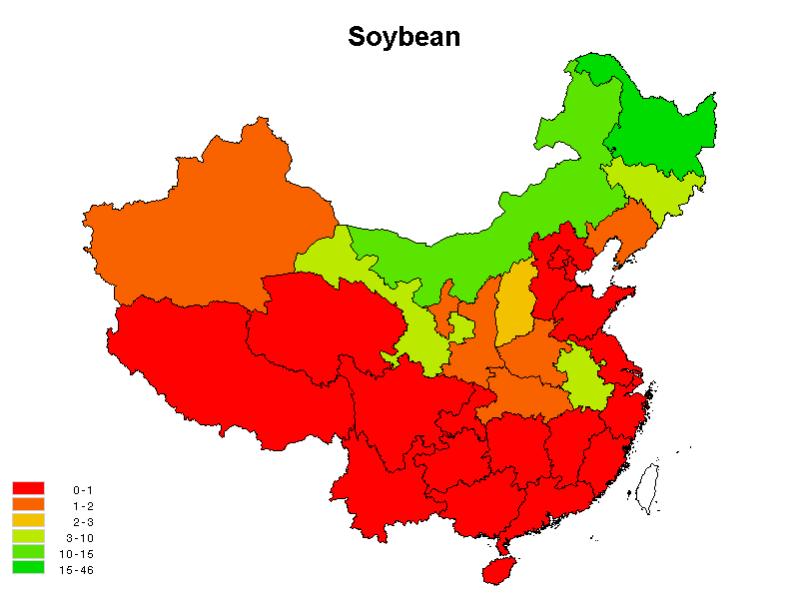
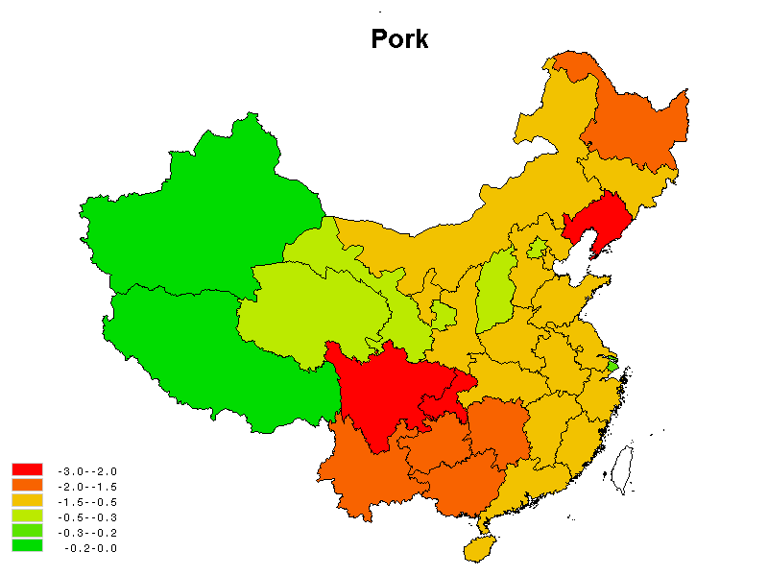
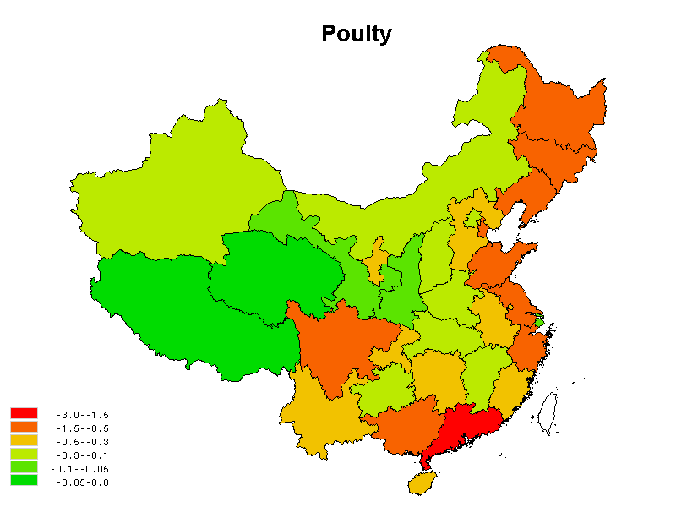
Impacts on production of diff. commodities in diff. provinces under H-H scenario (kg/ household, 2020)

Slide 94
Impacts of biofuel development on farmers’ agricultural income by income groups under different scenario in 2020
Income group | Mandate Scenario |  | HH Scenario
 | (Yuan) | (%) | (Yuan) | (%)
National Average | 62.3 | 2.6 | 115.6 | 4.88
Income group 1 (Under poverty) | 25.4 | 3.3 | 47.5 | 6.23
Income group 2 | 43.8 | 2.8 | 81.8 | 5.28
Income group 3 | 56.9 | 2.7 | 106.3 | 5.24
Income group 4 | 71.2 | 2.6 | 131.6 | 4.91
Income group 5 | 89.0 | 2.4 | 163.9 | 4.51
Income group 6 (Highest income ) | 85.3 | 2.4 | 157.4 | 4.42

Slide 95
Impacts of biofuel development on farmers’ agricultural income under dif. scenarios in 2020

Slide 96
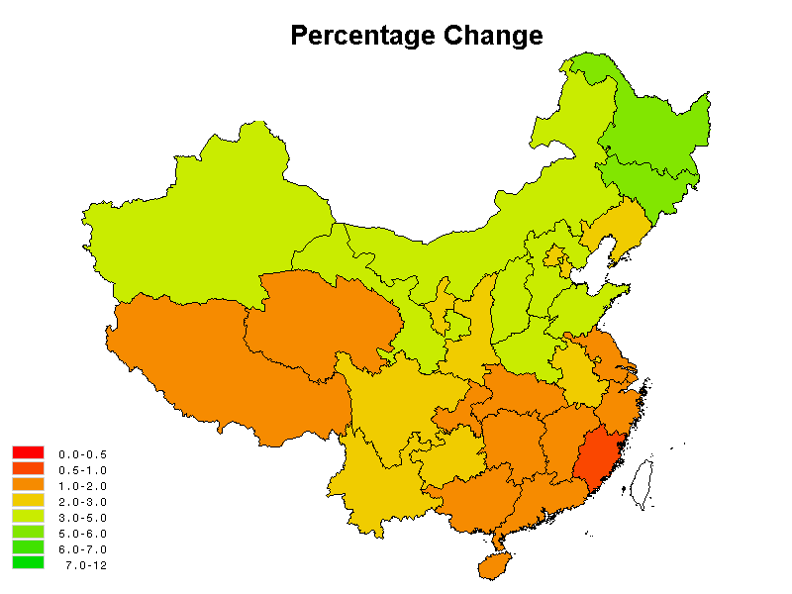
Impacts of biofuel development on Chinese farmers’ agr. income by dif. provinces under mandate scenario (relative to baseline, 2020)

Slide 97
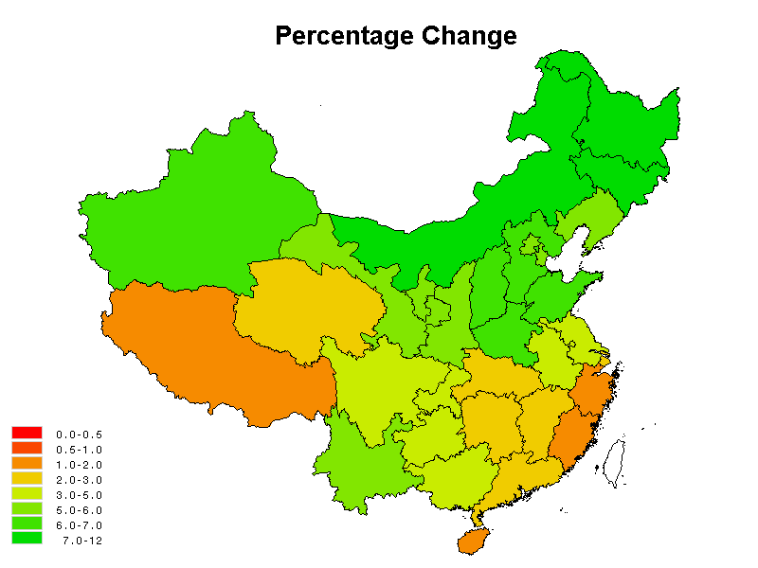
Impacts of biofuel development on Chinese farmers’ agricultural income by different provinces in 2020 under H-H scenario

Slide 98
模型发展情况及规划

Slide 99
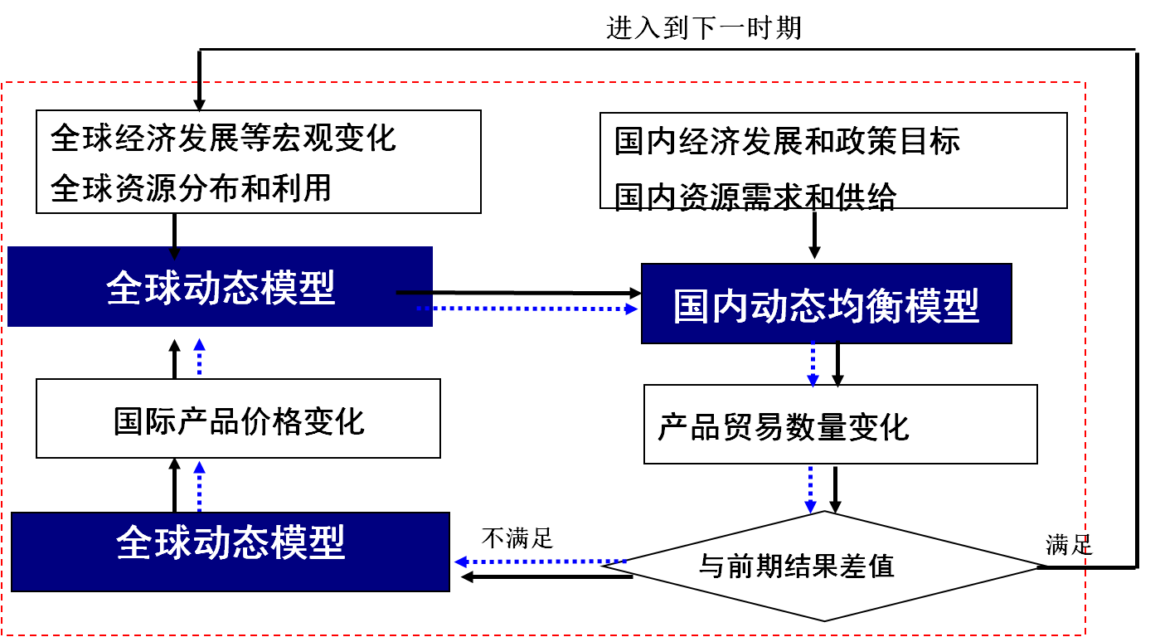
政策决策模型构建计划(2015-2017)
在构建多尺度决策模型的基础上，探讨模型动态联接方法，实现全球+国家+区域三个层次上的全面经济评估

Slide 100




与澳大利亚政策研究中心（CoPS）构建联合中心——经济贸易政策研究中心
中心宗旨：通过经济模型的应用和传播，成为经济问题研究和政策决策支持领域世界领先的研究中心，研究侧重于中国问题。

