Slide 1
投入产出表→一般均衡模型 两个方法的紧密关系、各自特点和问题

Slide 2
Topics
Input-output economics, the foundation of CGE & GSC
(a) the input-output table
(b) national accounts
(c) the one-country input-output model
(d) the Leontief paradox
2. CGE modelling
(a) Johansen’s model of Norway
(b) Johansen’s solution matrix versus Leontief’s inverse

Slide 3
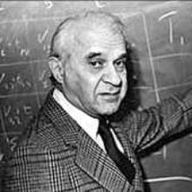
1. Input-output economics
Wassily Leontief
1905-1999
Nobel prize for economics
in 1973

Slide 4
Input-output database for USAGE, a detailed CGE model of the US
相对于没有考虑Margin的IO表，这里可能会增加大家理解的难度，但是加入后让大家更为清楚了IO表的关系。这里只需要将Mar也看作一个产业部门就可以了。
企业出厂房价计算的使用
企业生产成本
使用的运输量

Slide 5
Input-output database for USAGE, a detailed CGE model of the US
我们可以看到，方格内的加总就是用户购买产品时，支付的价格。
但是我们在纵向和横向平衡时，都是以企业的出场价格（即生产企业的市场销售价格）来计算的。
企业生产成本

Slide 6
National accounts: value of inputs equals value of output
所有的生产成本
所有销售
Simplifying:

Slide 7
Income and expenditure measures of GDP
一国所有收入
投资者支付成本
消费者支付成本
出口FOB价格
政府支付成本
这是CIF价格，也就是说没有交税前的完税价格

Slide 8
One-country input-output model
大家要充分理解上述特征的经济学含义，以及IO分析存在的问题

Slide 9
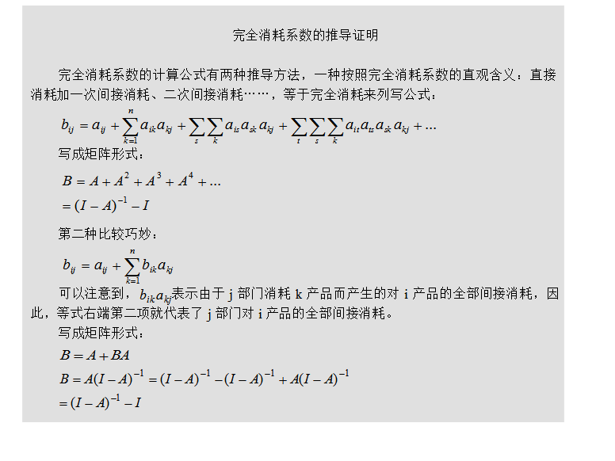
完全消耗矩阵的含义

Slide 10
Leontief paradox
for the US in 1947

Slide 11
2. CGE modelling
What makes a CGE model: defining features
Computable: real world data
General: explicit agents with optimizing behaviour
Equilibrium: price determination through the interaction of demand and supply for commodities and factors (introduces resource constraints)
Popular - 15,000 practitioners from 150 countries in the GTAP network
Versatile - the effects on
macro, welfare, industry, regional, labour-market, distributional and environmental variables
of
taxes, public consumption and social security payments; tariffs and other interferences in international trade; environmental policies; technology; international commodity prices; interest rates; wage setting arrangements and union behaviour; mineral discovories (the Dutch disease); immigration; micro- economic reform; and major projects

Slide 12
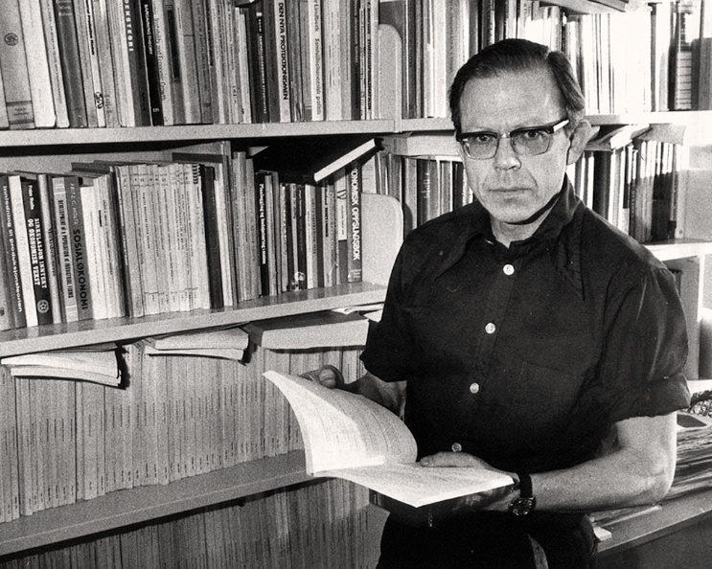
The first CGE model: Johansen for Norway
Leif Johansen
1930-1982

Slide 13
Johansen put equations in linear percentage change form

Slide 14

Johansen’s T matrix 46 by 86

Slide 15
Johansen’s CGE model versus Leontief’s I-O model:
Effects of demand stimulation
Leontief: X=(I-A)⁻¹*y Johansen: v₁ = T*v₂
all ≥ 0
mainly > 0
all ≥ 0
mainly > 0
complementary
all ≥1
mainly < 0
mainly < 0
competition
all ≥0 but mainly <1
T(x,z) is the 22 by 22 sub-matrix of T showing elasticities of outputs with respect to exogenous demands

