Slide 3
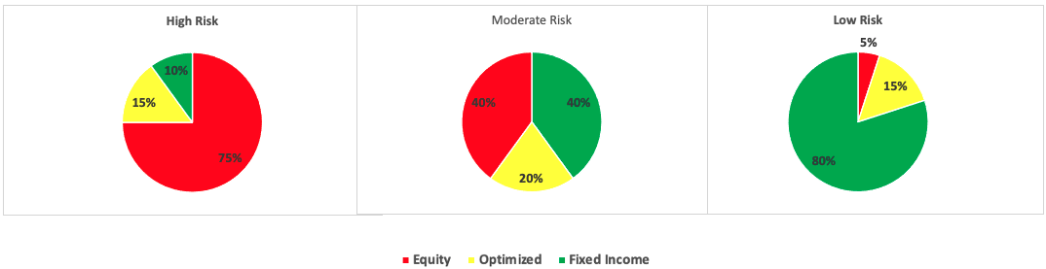
Optimization: Maximize Sharpe Ratio
Given the user risk profile (high, moderate, low risk)
We optimize allocation in individual securities
Data inputs: Alpaca API, data from 2008.
Optimization function used: minimize from scipy.optimize

Slide 4
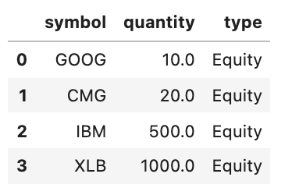
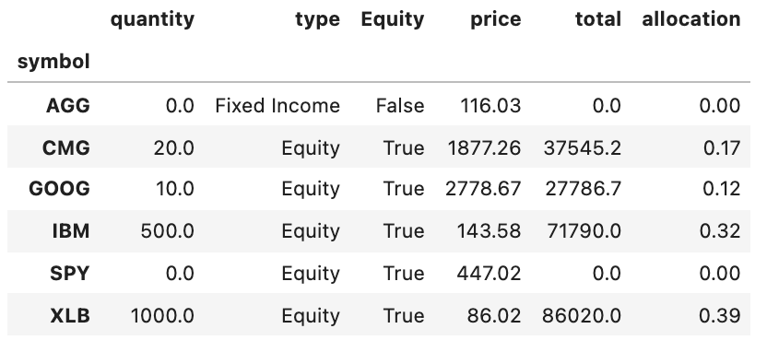
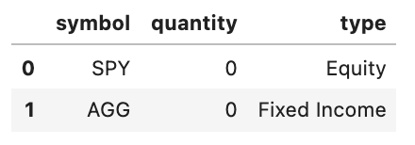
Optimization steps sample
Look for the combination of weights which maximizes Sharpe Ratio subject to Equity restrictions
Initial Portfolio
Diversification addition

Slide 5
Initial versus optimized allocation
AGG : iShares Core US Aggregate Bond ETF
CMG : Chipotle Mexican Grill Inc.
GOOG: Alphabet Inc. Class C
IBM : IBM Common Stock
XLB : Materials Select Sector SPDR Fund
SPY : SPDR S&P 500 ETF Trust

Slide 6
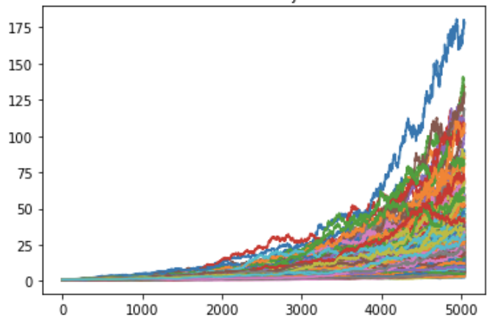
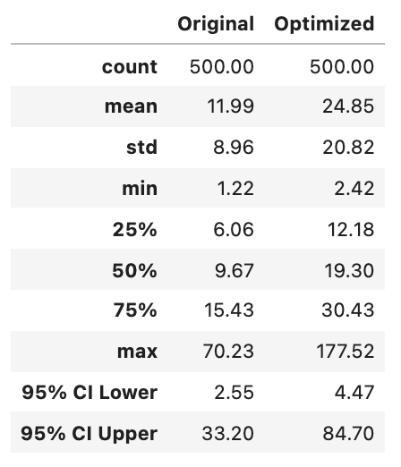
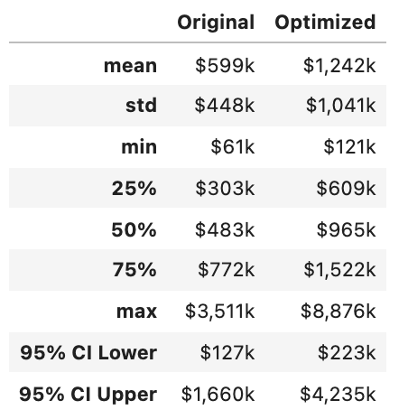
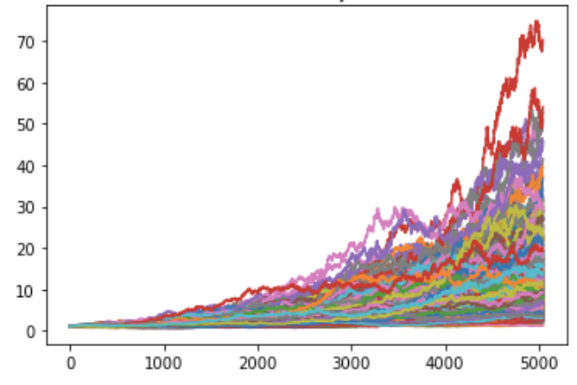
Montecarlo Simulation results
500 Simulations
Over 20 years
500 Simulated Trajectories over 5040 Trading Days
Initial Investment:
$50,000.-
High Risk Profile
Simulation
Summary Statistics
Optimized portfolio
Original portfolio

