Slide 1
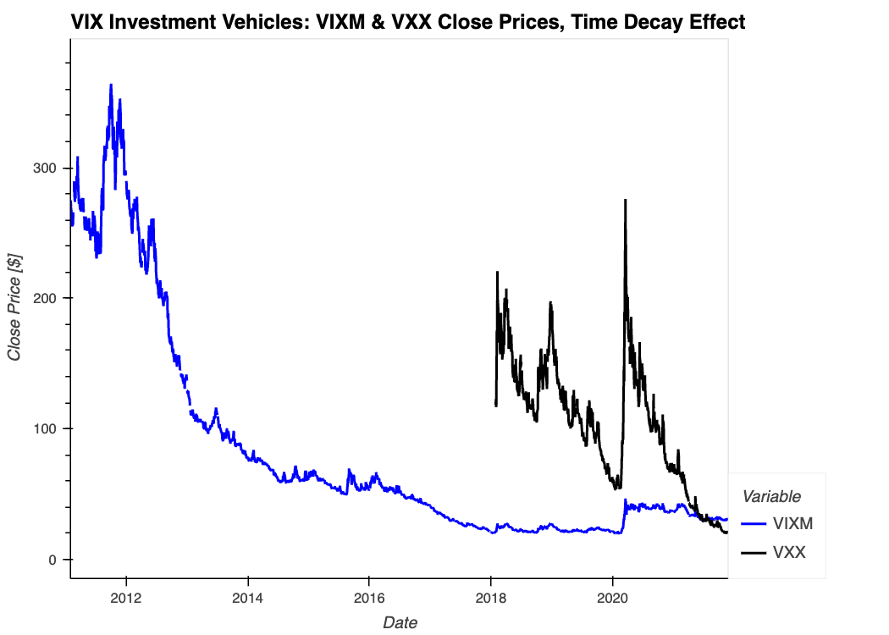
Machine Learning Model
+
AVOID
-
INVEST ON THESE DAYS
Daily Investment Strategy

Slide 2
Thank you [ ]. I’m going to talk about our ML model.
In the line plot you can see two investment vehicles for volatility: VIXM and VXX .
If you invest money in any of those securities, and hold it for a year, you are going to lose money for sure. Those instruments are suitable only for professional investors, because of the time decay effect that Prateek just explained.
To create a volatility token that is suitable for regular people and regular buy-and-hold strategies, we need to overcome that decay.
To overcome it, we are using the latest technology, and created a ML model that predicts, every day, whether the return tomorrow is going to be positive or negative with 55% accuracy.
VIXM is our underlying security, because it has the longer history available
When we avoid negative returns, we avoid time decay, and we also make profit.

Slide 3
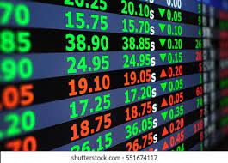
Machine Learning Model
Guessing the sign
of the return tomorrow
Securities and indexes
+
ADABOOST machine learning model
Model Training
Model Tuning
-
Signals
0: Not to Invest
1: Invest
Returns
Volatility
Return Squared
Volume
Month & DayOfWeek
PCA
Daily
Features Calculations

Slide 4
The ML model uses several market indexes and individual securities, domestic and International, from diverse asset classes.
We automatically collect close prices and volume data using an API, and transform them into features, such as rolling volatility, returns, return squared, and GARCH models. We include also seasonal patterns for daily and monthly effects. And last, but not least, we calculate Principal Components on historical data to include past and current patterns for the prediction of tomorrow’s return.
We selected an Adaboost model, which we trained and tuned
The model give us signals 0 and 1, and we buy VIXM when the signal is 1, and sell it when the signal comes back to 0.

Slide 5
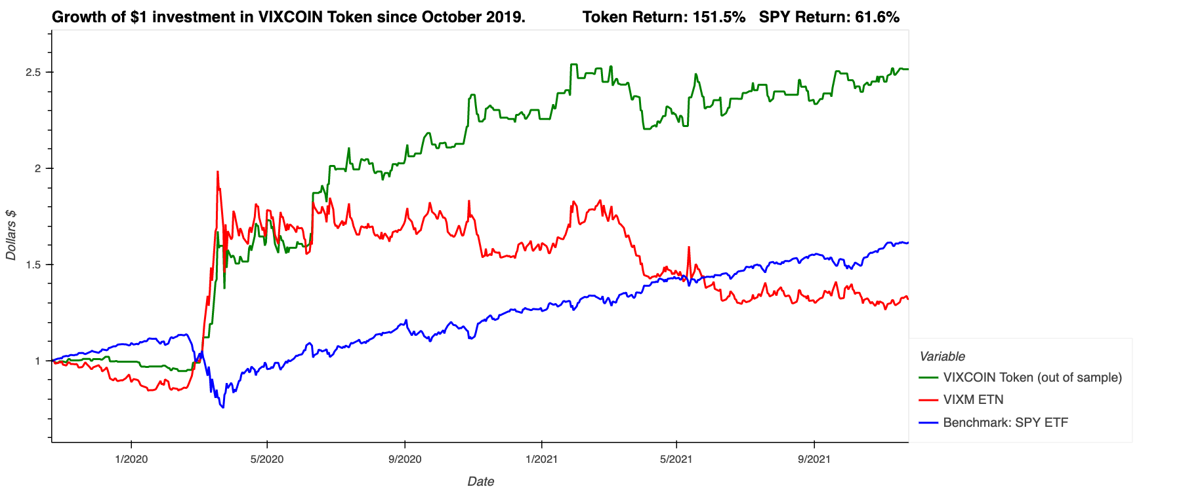
Machine Learning Model

Slide 6
The profitability of the strategy out-of-sample results in more than 150% return. As a reference, the SPY, which is an ETF of the S&P500, returned around 60% in that same window of about 2Years.

Slide 7
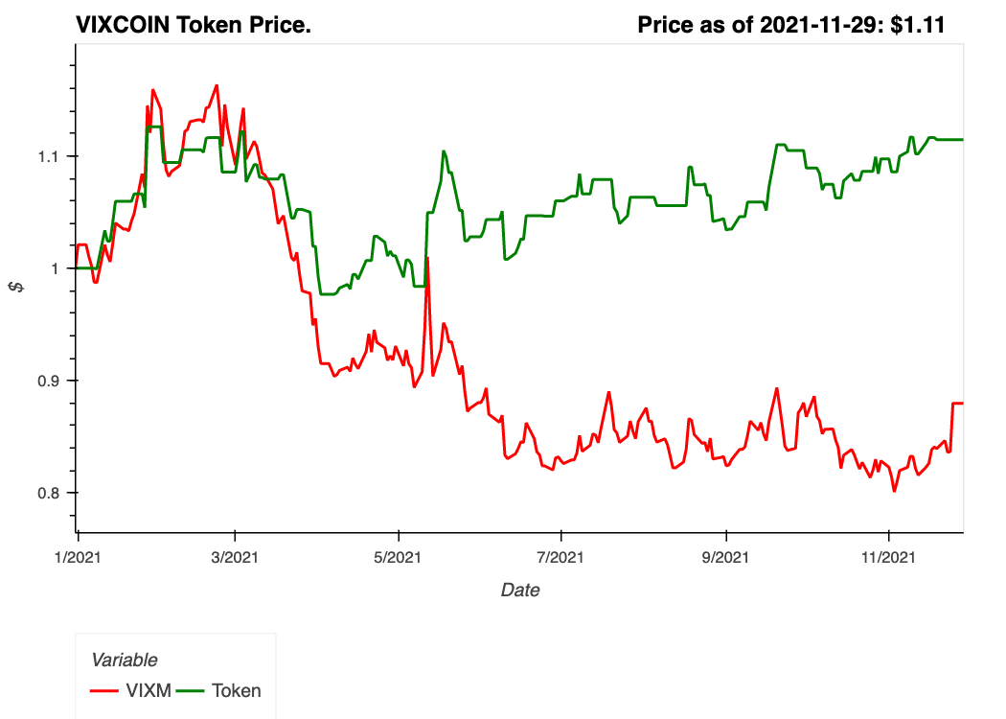

VixCoin Token Valuation
The price is linked to the performance of the investment strategy.
Token priced as $1.00 at the beginning of 2021.
Price as of Nov 29th: $1.11

Slide 8
The price of the VixCoin token is linked to the performance of the investment strategy.
The token priced at $1.00 at the beginning of 2021, and since then have had a cumulative return of 11%, so the current price of the token is of $1.11 as of November 29th.

Slide 10
