Slide 1
Meet Our Kappa Team
Streaming Platforms
Data analysis
Paola E. Vazquez
Edgar Alejo
Jose Luis Duarte
Joaquin Osio
Pedro Terrazas

Slide 2




KAPPA TEAM
About Our Project
Background
The COVID-19 (Coronavirus Disease) has resulted in increased demand for online streaming and entertainment services.
Video streaming services have experienced a rise of around 10% in viewership during the lockdown.
Our project is based on using the past projects Data Analysis insights and complete them by integrating all TV shows information to the same process.
All of this by using different tolls, some of them are:
Pandas
PG Admin
DATA SOURCE:
https://www.kaggle.com/ruchi798/movies-on-netflix-prime-video-hulu-and-disney
https://www.kaggle.com/ruchi798/tv-shows-on-netflix-prime-video-hulu-and-disney
Source: https://www.grandviewresearch.com/industry-analysis/video-streaming-market

Slide 3




FEATURES
Project Process
Obtain
Explain what happens in this industry and why, by answering a series of questions that we previously elaborated for this Database
Analyze
Discovered and Identify relations, behavior, comparisons and tendencies between the data.
Clean
Determine the quality of the data, as well as the number of nulls regarding the relevance for the entire database.
Create
Known the structure, shape and conditions about our Database, identify each columns, data type and general information.

Slide 4
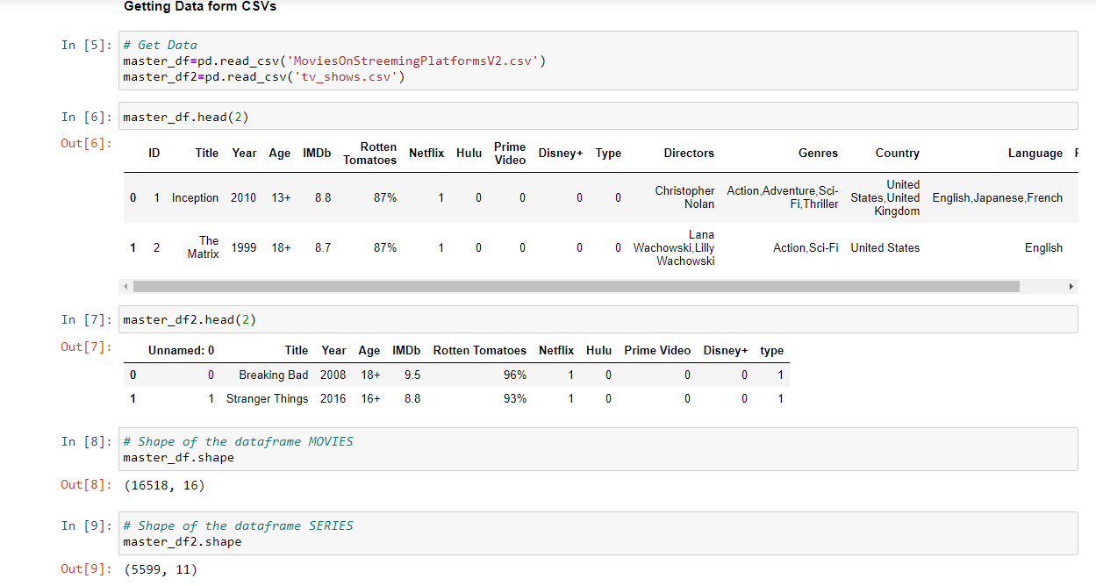
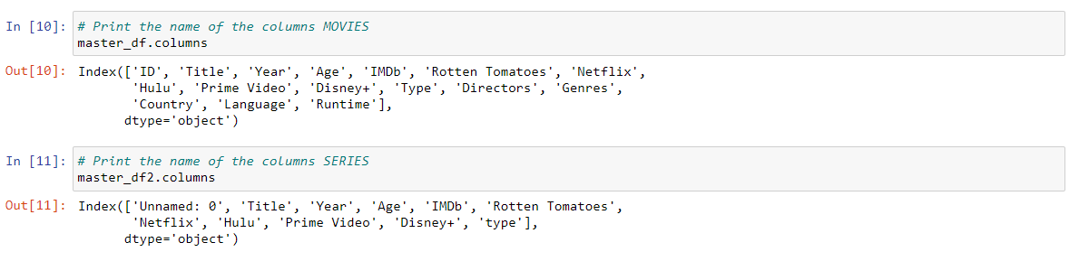
PROJECT PROCESS
Analyze
Main Insights
Both data-bases use numeric structure to identify streaming platforms.
Movies data-base used multiple identifiers for movies like gender and age.
TV shows does not present any additional information besides of streaming platforms and ratings.
Movies data-base contains +40% more data than Tv shows data-base.

Slide 5
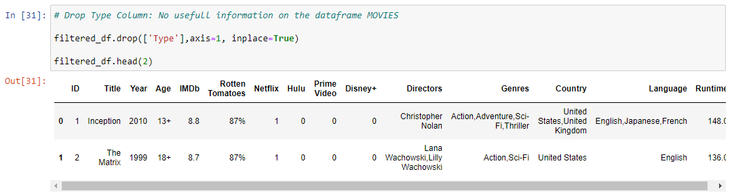
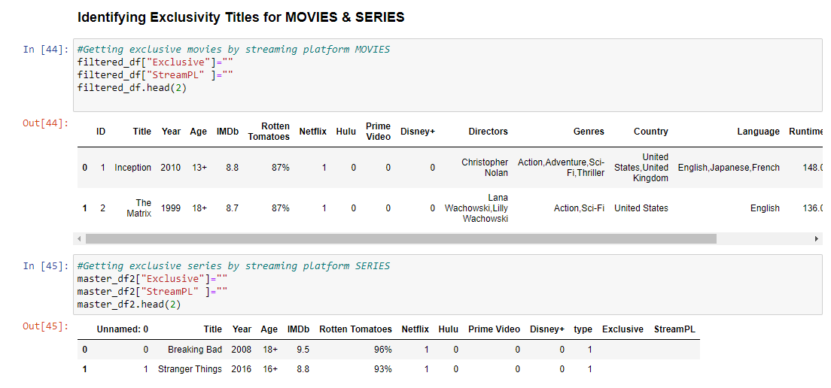
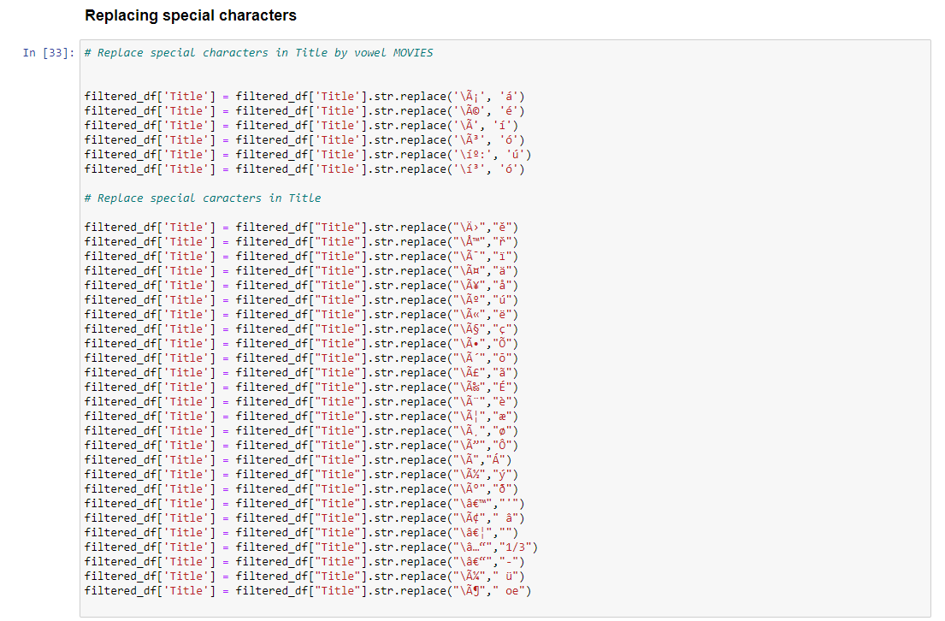
PROJECT PROCESS
Clean
Main Insights
Both data-bases contained unidentified columns (type), this were discarded for cleaning purposes.
Rotten Tomatoes ratings continues to be the least reliable source of information in both data-bases.
Only exclusive movies and Tv shows by platform were selected to be used as viable information.

Slide 6
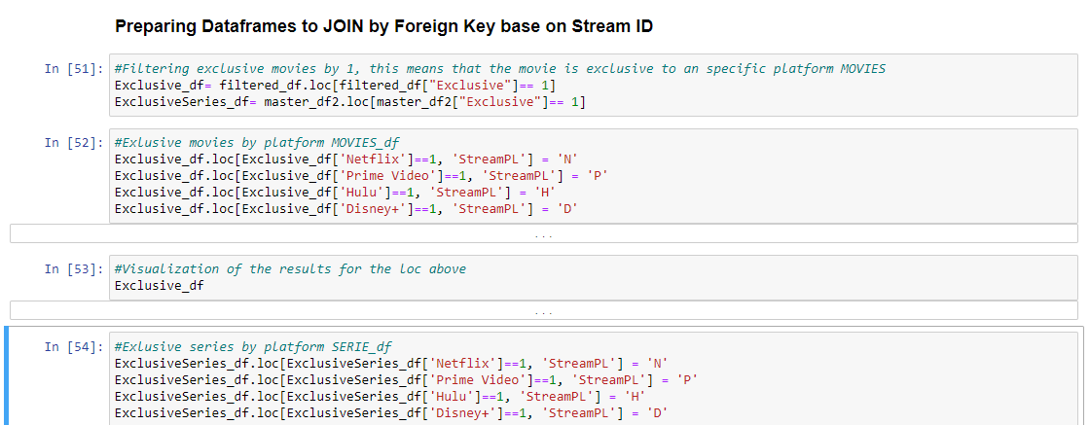
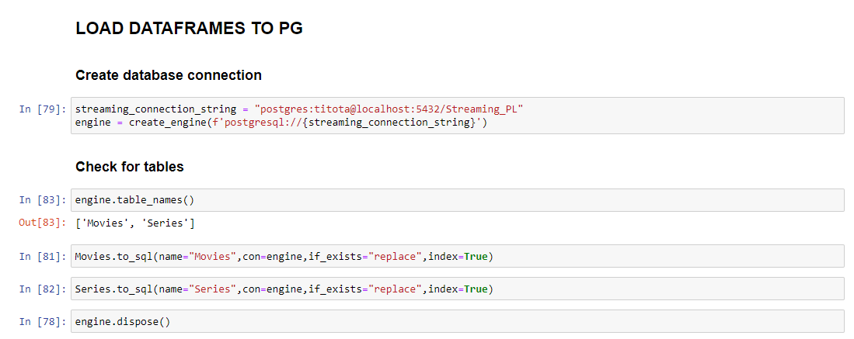
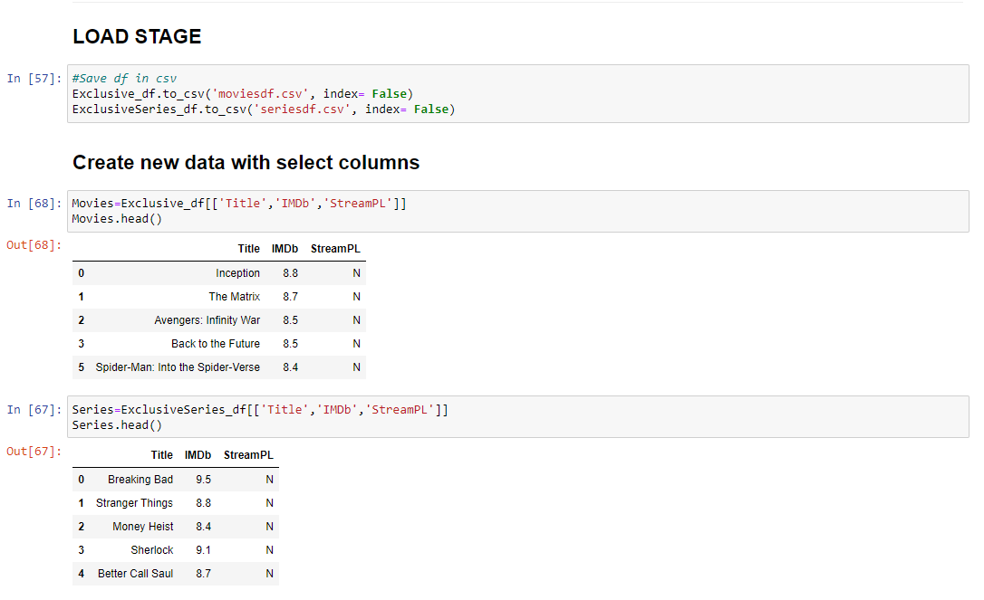
PROJECT PROCESS
Create
Main Insights
Exclusivity markers were created depending on the streaming platform:
N (Netlfix), D (Disney), P (Prime video), H (Hulu)
Exclusivity markers were used to create the interlink between both databases.
New exclusivity data-base contained more than 20k records, using the next parameters:
Tittle
IMDb ranking
Streaming platform identifier

Slide 7
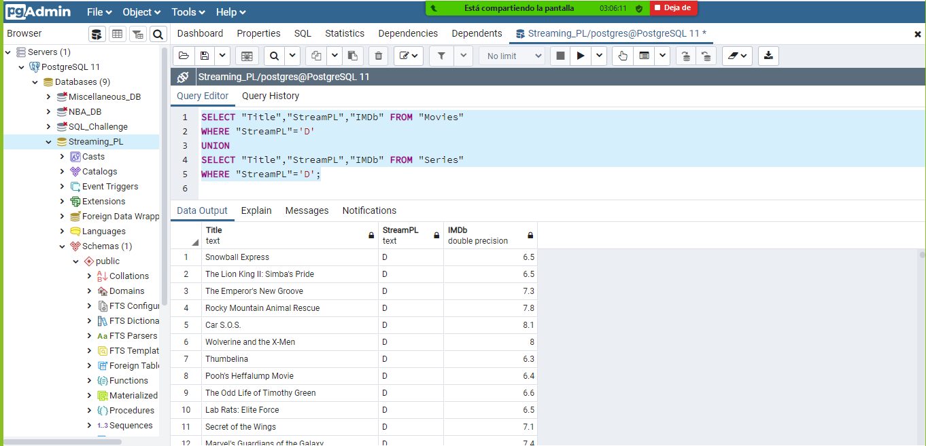
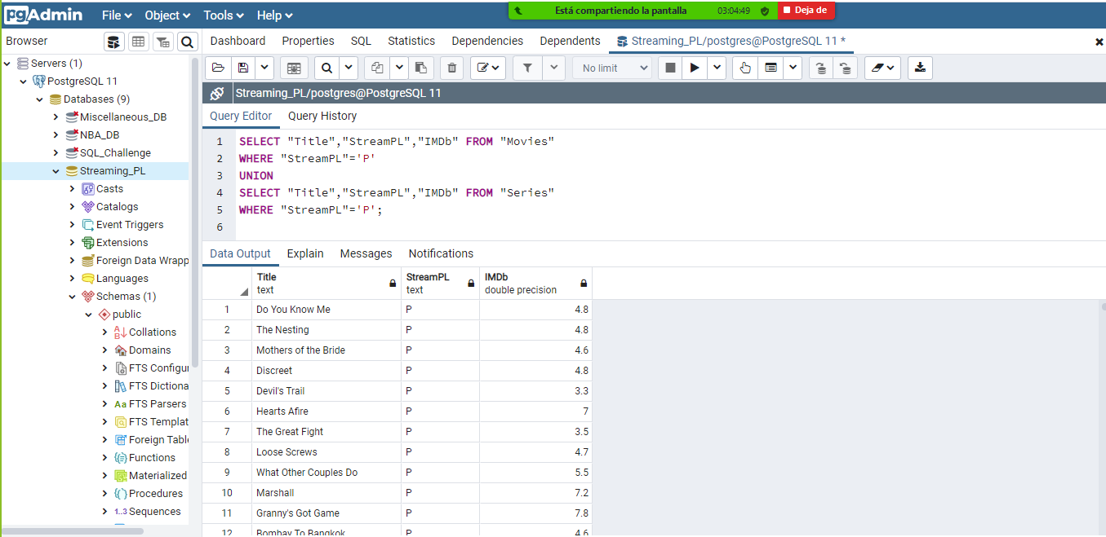
PROJECT PROCESS
Results & Conclusions
Data-base links were successful by combining Pandas and PG Admin forces.
The results were showed as a list to improve the reader accessibility to the information.
The use and creation of exclusivity streaming platform markers was the main driver to conclude the project and obtain a completely formed database.
Main Challenge: The use of Admin PG conflicted the connection between our databases due to the column names and exclusive platform markers, making it challenging to move though the information without the use of “” with each column title.
Tank you for your time

