Slide 1
MODELING FOR MEDICAID Planning for uncertain times
PD WAGGONER & ASSOCIATES
PAOLA GOMÉZ | ISHANI TIKKU | JOSEFINA RODRÍGUEZ | MERCEDEZ GONZALEZ MAYNEZ

Slide 2
What is Medicaid?
Medicaid provides health coverage to millions of Americans, including eligible low-income adults, children, pregnant women, elderly adults and people with disabilities. Medicaid is administered by states, according to federal requirements. The program is funded jointly by states and the federal government. [i]
HOW CAN WE PLAN FOR THE HEALTH CHALLENGES OF THE FUTURE?
HOW CAN POLICYMAKERS HELP PREDICT MEDICAID REQUIREMENTS ACCURATELY?
[i] https://www.medicaid.gov/medicaid/index.html
Notes:
Medicaid provides health coverage to millions of Americans, including eligible low-income adults, children, pregnant women, elderly adults and people with disabilities. Medicaid is administered by states, according to federal requirements. The program is funded jointly by states and the federal government. [i]
With millions of people losing their jobs and becoming unemployed… it can be expected that the requirements from Medicaid would Increase exponentially! But By how much??
Which brings us to two main questions!

Slide 3
Health Policy needs a robust predictive tool…
A TOOL THAT CAN HELP
Policymakers and governments at the federal and state level need decision making tools, to estimate the health requirements of the population
Efficiency in managing unforeseen costs that arise from overestimating or underestimating of the health budget.
Predicting for a sustainable health policy in the long run.
Notes:
Governments regardless of their size, level or context; and the policymakers can agree that serve them can

Slide 4
So… we explored it!
THIS TOOL is specifically designed for governments at the federal state and city level and policy makers
We want to predict the number of people that would be eligible for Medicaid in 2021
We want to see how machine learning can help us predict Medicaid and which are techniques are most effective or suitable, given the data we have.
We will explore the advantages and disadvantages of each of the techniques

Slide 5

THE DATA AVAILABLE
Source: https://www.census.gov/programs-surveys/acs
Selected variables based on research on Medicaid eligibility requirements as per the Medicaid policy
OUR MEDICAID DATASET
Notes:
The first dataset we used is the American Community Survey.
The (ACS) is an ongoing survey that helps local officials, community leaders, and businesses understand the changes taking place in their communities.
It is the premier source for detailed population and housing information about the United States.

Slide 6


FACTORS TO CONSIDER
“A MORE DEMOCRATIC STATE, WOULD LIKELY HAVE A MORE LIBERAL HEALTH POLICY AND THEREFORE WOULD HAVE A LOWER THRESHOLD FOR MEDICAID ELIGIBILITY.”
THROUGH OUR RESEARCH WE FOUND THAT
MEDICAID ELIGIBILITY DEPENDS ON THE POLITICAL AFFILIATION OF STATE AUTHORITIES
STATES HAVE DIFFERENT THRESHOLDS AND DIFFERENT ELIGIBILITY CRITERIA.
THE STATE CRITERIA And FUTURE ELIGIBILITY ALSO DEPENDS ON THE LOCAL POLITICS OF THE STATE
[ii] Tausanovitch, Chris, and Christopher Warshaw, 2013. “Measuring Constituent Policy Preferences in Congress, State Legislatures, and Cities.” The Journal of Politics 75 (2): 330-342.
Notes:
The first dataset we used is the American Community Survey.
The (ACS) is an ongoing survey that helps local officials, community leaders, and businesses understand the changes taking place in their communities.
It is the premier source for detailed population and housing information about the United States.

Slide 7
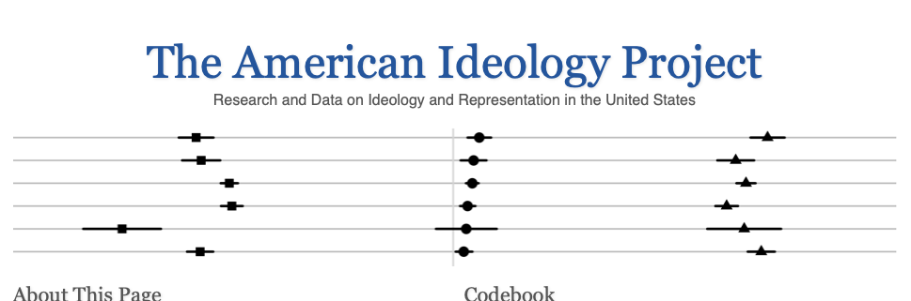
THE MEDICAID DATASET
Source: https://www.census.gov/programs-surveys/acs
Source: https://americanideologyproject.com [ii]
Selected variables based on research on Medicaid eligibility requirements as per the Medicaid policy
We supplemented our data with more data from the American Ideology Project to ensure that we have data on political Ideologies per congressional district.
OUR MEDICAID DATASET
[ii] Tausanovitch, Chris, and Christopher Warshaw, 2013. “Measuring Constituent Policy Preferences in Congress, State Legislatures, and Cities.” The Journal of Politics 75 (2): 330-342.
Notes:
The first dataset we used is the American Community Survey.
The (ACS) is an ongoing survey that helps local officials, community leaders, and businesses understand the changes taking place in their communities.
It is the premier source for detailed population and housing information about the United States.

Slide 8
RESEARCH PROCESS
Collecting ACS data, Data Wrangling & Variable selection
Including T & W's measures of ideology based on congressional district
Scaling the variables for Lasso
Using Lasso Regression
Findings
Analysis
Scope for Future Research
Data wrangling :
Processing &
Feature Selection
Conducting Cross Validation
Best Lambda, the penalty we impose on the estimates
Predict with Train and Test with OOT Data
Data Preparation : Applying the Lasso Technique
Notes:
Jo and Paola
Jo explains Data Wrangling part
Processing. The components of data processing are pre-processing, profiling, cleansing, pulling together data from different internal and external sources.
Feature engineering. You need to transform raw data into features that can represent the underlying problem to the predictive models. It helps to improve accuracy and get the desired results faster.
Pao explains:
But there are various other things that might affect the choice of a model:
Accuracy of the model;
Interpretability of the model;
Complexity of the model;
Scalability of the model;
Time it takes to build, train, and test the model;
Time it takes to make predictions using the model
Because we were trying to make a prediction and to enhance the future ability to predict, we are trying to find out the relationship
between two or more continuous variables which is a typical regression task. Since we had many variables, we could use either multivariate regression algorithms, Ridge Regression, and LASSO regression which are used when you need to model a relationship between more than two variables.

Slide 9
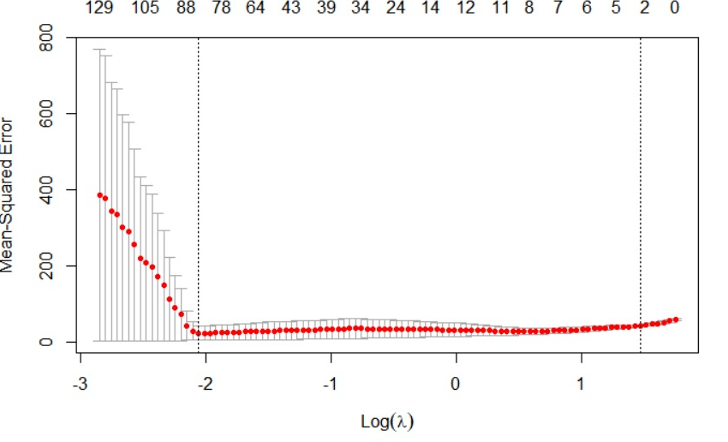
FINDINGS…
Mean squared error is the lowest at -2.
Notes:
The objective of the linear regression is to make the mean squared error as small as possible, So this graph shows us that the mean squared error is the lowest at (-2)

Slide 10
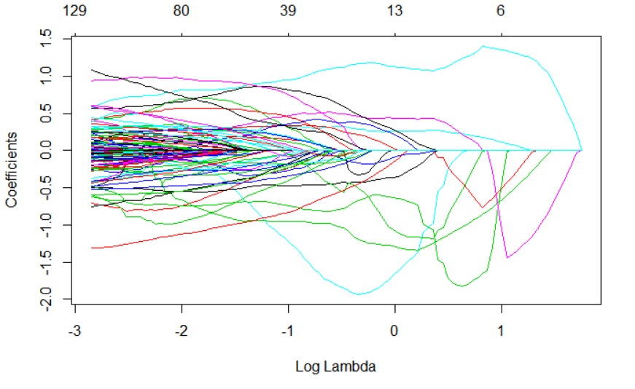
FINDINGS…
Notes:
The lasso tunes parameter estimates to 0 for those features that are exerting relatively minimal influence on the outcome. In this graph, if we read it from left to right, the penalty is getting progressively stronger, as it gets stronger and thus the variance of all betas is tuned towards 0 simultaneously.
Features start to drop off as they are tuned. So, if we position ourselves at -2, all the coefficients that are different from 0 are the ones that are exerting some influence over the outcome.

Slide 11
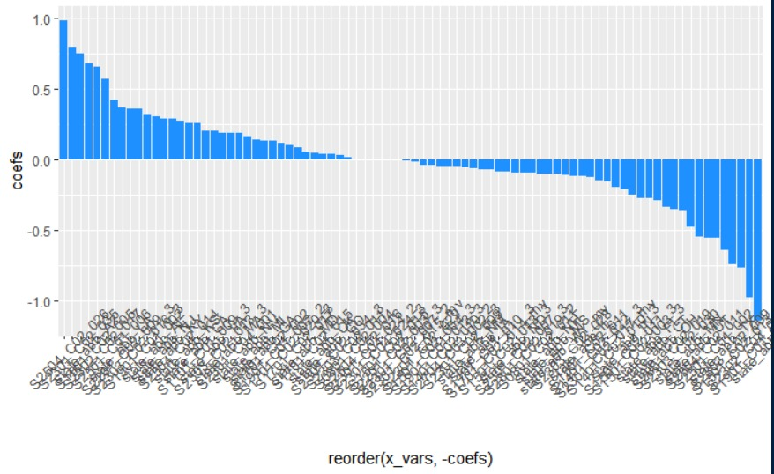
FINDINGS…
Notes:
This graph shows the values of the coefficient of each feature at the optimal Lambda. Therefore, the higher the bar, the more influence is being exerted on the model by that particular coefficient.

Slide 12
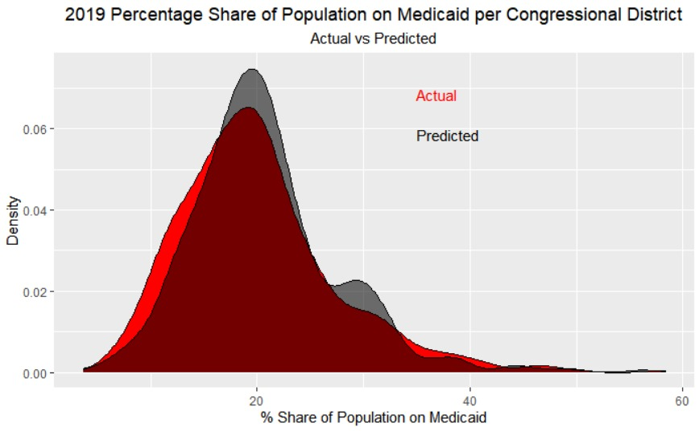
ANALYSIS

Slide 13
ANALYSIS
 | SAMPLE | MSE | SSE | SST | R²
1 | TEST | 3.886234 | 680.091 | 10265.51 | 0.9337499
2 | TRAIN | 3.205239 | 2240.462 | 41889.15 | 0.9465145
3 | OOT (OUT OF TIME) | 3.962175 | 1731.471 | 24608.99 | 0.9296407
@1 PP TOLERANCE
0.6887872
@2.5PP TOLERANCE
0.7459954
@ 5 PP TOLERANCE
0.8489703

Slide 14
SCOPE FOR FUTURE WORK
With more time and a larger team, we can deliver a robust product to the government that can help undertake further research and can apply several more techniques to improve the prediction.

Slide 15
THANK YOU
PD WAGGONER & ASSOCIATES
PAOLA GOMÉZ | ISHANI TIKKU | JOSEFINA RODRÍGUEZ | MERCEDEZ GONZALEZ MAYNEZ

