Slide 1
SCORUS
Scheme Recommendation

Slide 2










Aspect feature model (${fm}_{a}$) associated to 1…* relation in a universal model
$$E_{i}$$
rolEi
$$r_{n}$$
rolEj
$$E_{j}$$
1
*
cardO
cardD
schemaX
$$tEi_l_{0}∧¬tEi_l_{0}_ext→{tE}_{i}{tE}_{j}refs ∨r_{n}_{rolE}_{i}$$
colByClass
colByAssoc
$$tEj_l_{0}∧¬{tE}_{j}_l_{0}_ext→{tE}_{i}{tE}_{j}refs∨r_{n}_{rolE}_{j}$$
2classes
$${tE}_{i} {ref}^{∗}{ tE}_{j} → colEj$$
$${tE}_{j} ref{ tE}_{i} → colEi$$
$$colEi$$
$$colEj$$
$$colEiEj$$
$$tEi_l_{0}$$
$$tEj_l_{0}$$
$tEi$ id
$tEj$ id
${tE}_{i} {ref}^{∗}{ tE}_{j} →$ $¬ {tE}_{j} {emb}^{∗}{ tE}_{i}$
${tE}_{j} ref{ tE}_{i} →$ $¬ {tE}_{i} emb {tE}_{j}$
$$tEi_l_{0}_ext$$
$${tE}_{j}_l_{0}_ext$$
$${tE}_{i} {ref}^{∗}{ tE}_{j} → ¬ {tE}_{j} ref{ tE}_{i}$$
$$r_{n}_{rolE}_{j}$$
$$r_{n}_{rolE}_{i}$$
$tEi$ ${\text{emb}}^{∗}$ $tEj$
$tEi$ ${\text{ref}}^{∗}$ $tEj$
$tEj$ ${\text{emb}}^{}$ $tEi$
$tEj$ ${\text{ref}}^{}$ $tEi$
${tE}_{i}tE_{j}refs →$ $\left(colEi ∧ ¬r_{n}_{rolE}_{j}\right)∧(colEj ∧ ¬r_{n}_{rolE}_{i})$
$⟦{fm}_{a}⟧$ =
$$E_{j}$$
$$E_{i}$$
{
[schemax, r1_bLines, reltA_l0, tB_l0, colByClass, colB, tA_refMany_tB, colA]
[schemax, tB_emb_tA, reltB_l0, r1_ag, colByClass, colB]
[schemax, reltB_l0, tA_l0, r1_ag, colByClass, colB, tB_ref_tA, colA]
[schemax, tA_embMany_tB, r1_bLines, reltA_l0, tB_l0, colByClass, colB, colA]
[tA_embMany_tB, schemax, r1_bLines, reltA_l0, colByClass, colA]
[schemax, SView, ABrefs, refs2, tB_l0, tA_l0, colByClass, colB, colA]
[schemax, tA_embMany_tB, r1_bLines, tB_emb_tA, reltB_l0, reltA_l0, r1_ag, colByClass, colB, colA]
[schemax, tB_emb_tA, reltB_l0, tA_l0, r1_ag, colByClass, colB, colA]
}
$$E_{j}$$
$$E_{i}$$
$$E_{j}$$
$$E_{j}$$
$$E_{i}$$
$$E_{i}$$
$$E_{j}$$
Derivation
$$E_{i}$$
$$E_{j}$$
$$E_{i}$$
$$E_{i}$$
$$E_{j}$$
$$E_{i}$$
$$E_{j}$$
$$E_{i}$$
$$E_{j}$$
$$E_{i}$$
$$E_{i}E_{j}$$
$$E_{j}$$

Slide 3
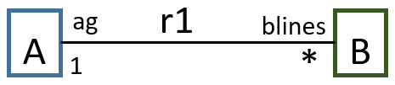
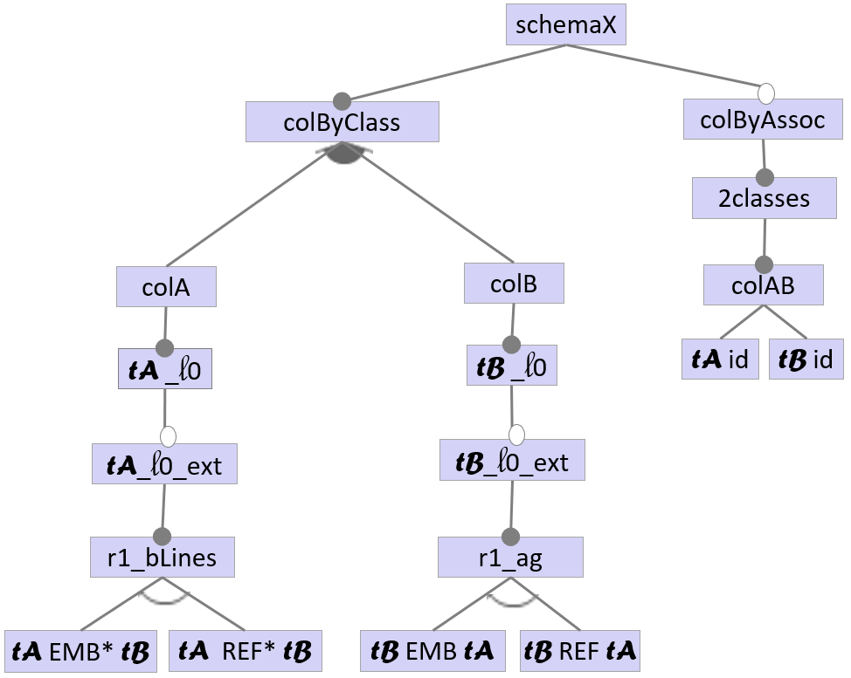
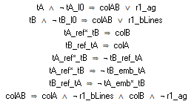

$⟦{fm}_{a}⟧$ =
{
[schemax, r1_bLines, reltA_l0, tB_l0, colByClass, colB, tA_refMany_tB, colA]
[schemax, tB_emb_tA, reltB_l0, r1_ag, colByClass, colB]
[schemax, reltB_l0, tA_l0, r1_ag, colByClass, colB, tB_ref_tA, colA]
[schemax, tA_embMany_tB, r1_bLines, reltA_l0, tB_l0, colByClass, colB, colA]
[tA_embMany_tB, schemax, r1_bLines, reltA_l0, colByClass, colA]
[schemax, SView, ABrefs, refs2, tB_l0, tA_l0, colByClass, colB, colA]
[schemax, tA_embMany_tB, r1_bLines, tB_emb_tA, reltB_l0, reltA_l0, r1_ag, colByClass, colB, colA]
[schemax, tB_emb_tA, reltB_l0, tA_l0, r1_ag, colByClass, colB, colA]
}

Slide 4



$$E_{i}$$
rolEi
$$r_{n}$$
rolEj
$$E_{j}$$
A
ag
r1
blines
B
bline
r2
crs
1
*
1
*
1
*
C
schemaX
schemaX
schemaX
colByClass
colByAssoc
colByClass
colByAssoc
colByClass
colByAssoc
2classes
2classes
2classes
colEi
colEj
colAB
colA
colB
colAB
colB
colC
colBC
tEi_l0
tEj _l0
tEi id
tEj id
tA _l0
tB _l0
tA id
tB id
tB _l0
tC _l0
tB id
tC id
tEi_l0_ext
tEj_l0_ext
tA_l0_ext
tB_l0_ext
tB_l0_ext
tC_l0_ext
r1_rolEj
r1_rolEi
r1_bLines
r1_ag
r2_crs
r2_bLine
tEi EMB* Ej
tEi REF* Ej
tEi EMB Ej
tEi REF Ej
tA EMB* tB
tA REF* tB
tB EMB tA
tB REF tA
tB EMB* tC
tB REF* tC
tC EMB tB
tC REF tB
+ constaints
schemaX
colByClass
colByAssoc
2classes
3classes
colA
colB
colC
colAB
colBC
colABC
tA _l0
tB _l0
tC _l0
tA id
tB id
tB id
tC id
tA id
tB id
tC id
tA_l0_ext
tB_l0_ext
tC_l0_ext
r1_bLines
r1_ag
r2_crs
r2_bLine
tA EMB* tB
tA REF* tB
tB EMB tA
tB REF tA
tB EMB* tC
tB REF* tC
tC EMB tB
tC REF tB
tB_l1_ext_1
tB_l1_ext_2
r2_crs_1
r1_ag_1
tB EMB* tC _1
tB REF* tC _1
tB EMB tA _1
tB REF tA _1

Slide 5
A
ag
r1
blines
B
bline
r2
crs
C
1
*
1
*
schemaX
colByClass
colByAssoc
colA
colB
colC
tA_l0
tA _l0-U
tB_l0
tB _l0-U
tC_l0
tC _l0_l0-U
r1_bLines
r1_ag
r2_crs
r2_bLine
tA EMB* tB
tA REF* tB
tB EMB tA
tB REF tA
tB EMB* tC
tB REF* tC
tC EMB tB
tC REF tB
tB_l1_1
tB_l1_2
r2_crs_1
r1_ag_1
tB EMB* tC _1
tB REF* tC _1
tB EMB tA _1
tB REF tA _1
+ constaints

Slide 6
A
ag
r1
blines
B
bline
r2
crs
C
1
*
1
*
schemaX
colByClass
colByAssoc
colA
colB
colC
tA_l0
tA _l0-U
tB_l0
tB _l0-U
tC_l0
tC _l0_l0-U
r1_bLines
r1_ag
r2_crs
r2_bLine
tA EMB* tB
tA REF* tB
tB EMB tA
tB REF tA
tB EMB* tC
tB REF* tC
tC EMB tB
tC REF tB
tB_l1_1
tB_l1_2
r2_crs_1
r1_ag_1
tB EMB* tC _1
tB REF* tC _1
tB EMB tA _1
tB REF tA _1

Slide 7

A
ag
r1
blines
B
bline
r2
crs
C
1
*
1
*
schemaX
schemaX: colByClass ;
colByClass: colA colB colC ;
colA: "tA_l0" ;
colB: "tB_l0-U" ;
colC: "tC_l0" ;
"tA_l0" : "r1_bLines" ;
"tC_l0" : "r2_bLine" ;
"r1_bLines": "tA EMB* tB" ;
"r2_bLine": "tC EMB tB" ;
"tA EMB* tB": "tB_l1_1" ;
"tC EMB tB": "tB_l1_2" ;
"tB_l1_1" : "r2_crs_1" ;
"tB_l1_2" : "r1_ag_1" ;
"r2_crs_1": "tB EMB* tC_1" ;
"r1_ag_1 ": "tB EMB tA_1" ;
colByClass
colA
colB
colC
tA_l0
tB _l0-U
tC_l0
r1_bLines
r2_bLine
tA EMB* tB
tC EMB tB
tB_l1_1
tB_l1_2
r2_crs_1
r1_ag_1
tB EMB* tC _1
tB EMB tA _1
s$chema$1
$$Agencies$$
$$Business$$
$$Creatives$$
$$tAgency@l_{0}$$
$$tBusiness@l_{0}$$
$$tCreative@l_{0}$$
$${r1}_{bLines}$$
$${r2}_{bLine}$$
$tAgenc$y
$${EMB}_{[ ]}$$
$$tBusiness$$
$$tCreative$$
$$EMB$$
$$tBusiness$$
$$tBusiness@l_{1}$$
$$tBusiness@l_{1}$$
$${r2}_{crs}$$
$${r1}_{ag}$$
$$tBusiness$$
$${EMB}_{[ ]}$$
$$tCreative$$
$$tBusiness$$
$$EMB$$
$$tAgency$$
Agencies :
{
id: Integer ,
agencyName: String ,
bLines:
[ {
id: Integer,
businessName: String,
standards: [ Integer ],
crs:
[ {
id: Integer,
creativeName: String
} ]
} ] ,
}
Business :
{
id: Integer,
businessName: String
}
Creatives :
{
id: Integer,
creativeName: String,
bLine:
{
id: Integer,
businesName: String,
standards: [ Integer ],
ag:
{
id: Integer,
agencyName: String
}
}
}

