Slide 1
Capitolo 1 – Introduction to Computers and C++ Programming
Outline
1.1 Introduction
1.2 What is a Computer?
1.3 Computer Organization
1.4 Evolution of Operating Systems
1.5 Personal Computing, Distributed Computing
and Client/Server Computing
1.6 Machine Languages, Assembly Languages,
and High-level Languages
1.7 History of C and C++
1.8 C++ Standard Library
1.9 Java and Java How to Program
1.10 Other High-level Languages
1.11 Structured Programming
1.12 The Key Software Trend: Object Technology
1.13 Basics of a Typical C++ Environment
1.14 Hardware Trends
1.15 History of the Internet

Slide 2
Capitolo 1 – Introduction to Computers and C++ Programming
Outline
1.16 History of the World Wide Web
1.17 General Notes About C++ and This Book
1.18 Introduction to C++ Programming
1.19 A Simple Program: Printing a Line of Text
1.20 Another Simple Program: Adding Two Integers
1.21 Memory Concepts
1.22 Arithmetic
1.23 Decision Making: Equality and Relational Operators
1.24 Thinking About Objects: Introduction to Object Technology
and the Unified Modeling Language

Slide 3
1.1 Introduction
In this course you will learn
  C and C++
  Structured programming and object oriented programming

Slide 4
1.2 What is a Computer?
Computer
  A device capable of performing computations and making logical decisions
Computer programs
  Sets of instructions that control a computer’s processing of data
Hardware
  Various devices comprising a computer
    Examples: keyboard, screen, mouse, disks, memory, CD-ROM, and processing units
Software
  Programs that run a computer

Slide 5
1.3 Computer Organization
Six logical units in every computer:
  Input unit
    Obtains information from input devices (keyboard, mouse)
  Output unit
    Outputs information (to screen, to printer, to control other devices)
  Memory unit
    Rapid access, low capacity, stores input information
  Arithmetic and logic unit (ALU)
    Performs arithmetic calculations and logic decisions
  Central processing unit (CPU)
    Supervises and coordinates the other sections of the computer
  Secondary storage unit
    Cheap, long-term, high-capacity storage, stores inactive programs

Slide 6
1.4 Evolution of Operating Systems
Batch processing
  Do only one job or task at a time
Operating systems
  Manage transitions between jobs
  Increased throughput
    Amount of work computers process
Multiprogramming
  Many jobs or tasks sharing a computer’s resources
Timesharing
  Perform a small portion of one user’s job then moves on to service the next user

Slide 7
1.5 Personal Computing, Distributed Computing, and Client/Server Computing
Personal computers
  Economical enough for individual
Distributed computing
  Organizations computing is distributed over networks
Client/server computing
  Sharing of information, across computer networks, between file servers and clients (personal computers)

Slide 8
1.6 Machine Languages, Assembly Languages, and High-level Languages
Three types of programming languages
  Machine languages
    Strings of numbers giving machine specific instructions
    Example:
        +1300042774
        +1400593419
        +1200274027
  Assembly languages
    English-like abbreviations representing elementary computer operations (translated via assemblers)
    Example:
        LOAD BASEPAY
        ADD OVERPAY
        STORE GROSSPAY

Slide 9
1.6 Machine Languages, Assembly Languages, and High-level Languages
  High-level languages
    Similar to everyday English, use mathematical notations (translated via compilers)
    Example:
      grossPay = basePay + overTimePay

Slide 10
1.7 History of C and C++
C++ evolved from C
  C evolved from two other programming languages, BCPL and B
ANSI C
  Established worldwide standards for C programming
C++ “spruces up” C
  Provides capabilities for object-oriented programming
    Objects are reusable software components that model things in the real world
    Object-oriented programs are easy to understand, correct and modify

Slide 11
1.8 C++ Standard Library
C++ programs
  Built from pieces called classes and functions
C++ standard library
  Provides rich collections of existing classes and functions for all programmers to use

Slide 12
1.9 Java and Java How to Program
Java used to
  Create web pages with dynamic and interactive content
  Develop large-scale enterprise applications
  Enhance the functionality of web servers
  Provide applications for consumer devices (such as cell phones, pagers and personal digital assistants)
Java how to program
  Closely followed the development of Java by sun
  Teaches first-year programming students the essentials of graphics, images, animation, audio, video, database, networking, multithreading and collaborative computing

Slide 13
1.10 Other High-level Languages
Other high-level languages
  FORTRAN
    Used in scientific and engineering applications
  COBOL
    Used to manipulate large amounts of data
  Pascal
    Used to teach structured programming

Slide 14
1.11 Structured Programming
Structured programming
  Disciplined approach to writing programs
  Clear, easy to test and debug, and easy to modify
Multitasking
  Many activities to run in parallel

Slide 15
1.12 The Key Software Trend: Object Technology
Objects
  Reusable software components that model real world items
  Meaningful software units
    Date objects, time objects, paycheck objects, invoice objects, audio objects, video objects, file objects, record objects, etc.
    Any noun can be represented as an object
  More understandable, better organized and easier to maintain than procedural programming
  Favor modularity

Slide 16
1.13 Basics of a Typical C++ Environment
Phases of C++ Programs:
  Edit
  Preprocess
  Compile
  Link
  Load
  Execute
Program is created in
the editor and stored
on disk.
Editor
Disk
Preprocessor
Disk
Preprocessor program
processes the code.
Compiler
Compiler creates
object code and stores
it on disk.
Disk
Linker links the object
code with the libraries,
creates a.out and
stores it on disk
Linker
Disk
Primary
Memory
Loader
Loader puts program
in memory.
Disk
.
.
.
.
.
.
Primary
Memory
CPU
CPU takes each
instruction and
executes it, possibly
storing new data
values as the program
executes.
.
.
.
.
.
.

Slide 17
1.14 Hardware Trends
Every year or two computers approximately double
  The amount of memory they contain
    Memory used to execute programs
  The amount of secondary storage they contain
    Secondary storage (such as disk storage) is used to to hold programs and data over time
  Their processor speeds
    The speed at which computers execute their programs

Slide 18
1.15 History of the Internet
The Internet enables
  Quick and easy communication via e-mail
  International networking of computers
Packet switching
  Transfers digital data via small packets
  Allows multiple users to send and receive data simultaneously
No centralized control
  If one part of the Internet fails, other parts can still operate
Bandwidth
  Carrying capacity of communications lines

Slide 19
1.16 History of the World Wide Web
World Wide Web
  Allows users to locate and view multimedia-based documents on almost any subject
  Makes information instantly and conveniently accessible worldwide
  Makes it possible for individuals and small businesses to get worldwide exposure
  Is changing the way business is done

Slide 20
1.17 General Notes About C++ and This Book
Book is geared toward novice programmers
Programming clarity is stressed
C and C++ are portable languages
  Programs written in C and C++ can run on many different computers

Slide 21
1.18 Introduction to C++ Programming
C++ language
  Facilitates a structured and disciplined approach to computer program design
Following are several examples
  The examples illustrate many important features of C++
  Each example is analyzed one statement at a time.

Slide 22
1 // Fig. 1.2: fig01_02.cpp
2 // A first program in C++
Comments
Written between /* and */ or following a //.
Improve program readability and do not cause the computer to perform any action.
3 #include <iostream>
1. Comments
2. Load <iostream>
3. main
3.1 Print "Welcome to C++\n"
3.2 exit (return 0)
Program Output
4
5 int main()
6 {
preprocessor directive
Message to the C++ preprocessor.
Lines beginning with # are preprocessor directives.
#include <iostream> tells the preprocessor to include the contents of the file <iostream>, which includes input/output operations (such as printing to the screen).
7 std::cout << "Welcome to C++!\n";
8
9 return 0; // indicate that program ended successfully
10 }
C++ programs contain one or more functions, one of which must be main
Parenthesis are used to indicate a function
int means that main "returns" an integer value. More in Chapter 3.
Welcome to C++!
Prints the string of characters contained between the quotation marks.
The entire line, including std::cout, the << operator, the string "Welcome to C++!\n" and the semicolon (;), is called a statement.
All statements must end with a semicolon.
return is a way to exit a function from a function.
return 0, in this case, means that the program terminated normally.
A left brace { begins the body of every function and a right brace } ends it.

Slide 23
1.19 A Simple Program:
Printing a Line of Text
std::cout
  Standard output stream object
  “Connected” to the screen
  std:: specifies the "namespace" which cout belongs to
    std:: can be removed through the use of using statements
<<
  Stream insertion operator
  Value to the right of the operator (right operand) inserted into output stream (which is connected to the screen)
  std::cout << “Welcome to C++!\n”;
\
  Escape character
  Indicates that a “special” character is to be output

Slide 24
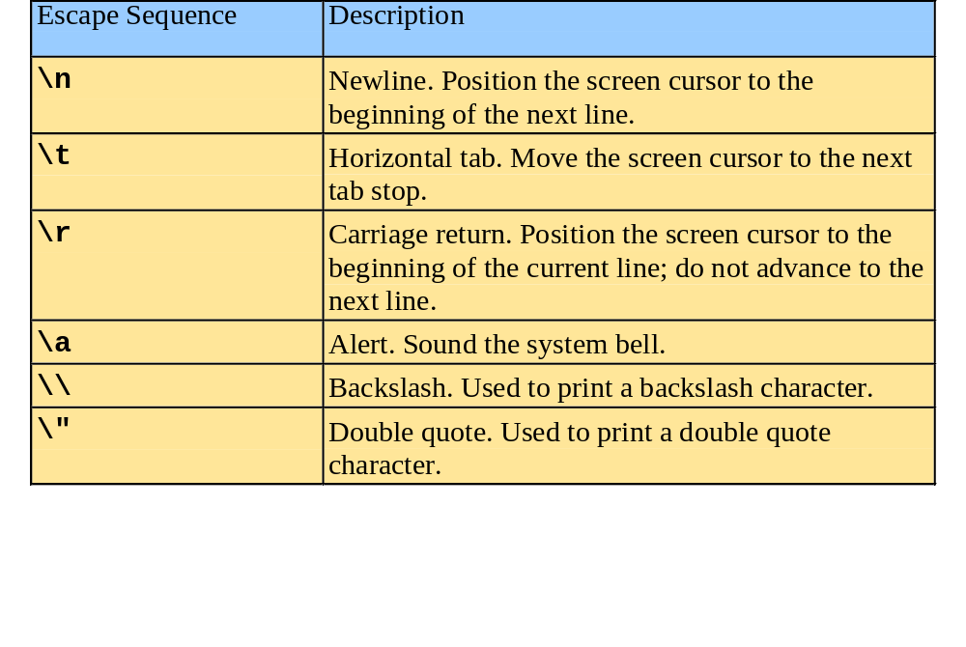
1.19 A Simple Program:
Printing a Line of Text
There are multiple ways to print text
  Following are more examples

Slide 25
1 // Fig. 1.4: fig01_04.cpp
2 // Printing a line with multiple statements
3 #include <iostream>
1. Load <iostream>
2. main
2.1 Print "Welcome"
2.2 Print "to C++!"
2.3 newline
2.4 exit (return 0)
Program Output
4
5 int main()
6 {
7 std::cout << "Welcome ";
8 std::cout << "to C++!\n";
9
10 return 0; // indicate that program ended successfully
11 }
Welcome to C++!
Unless new line '\n' is specified, the text continues on the same line.

Slide 26
1 // Fig. 1.5: fig01_05.cpp
2 // Printing multiple lines with a single statement
3 #include <iostream>
1. Load <iostream>
2. main
2.1 Print "Welcome"
2.2 newline
2.3 Print "to"
2.4 newline
2.5 newline
2.6 Print "C++!"
2.7 newline
2.8 exit (return 0)
Program Output
4
5 int main()
6 {
7 std::cout << "Welcome\nto\n\nC++!\n";
8
9 return 0; // indicate that program ended successfully
10 }
Welcome
to
C++!
Multiple lines can be printed with one statement.

Slide 27
1.20 Another Simple Program:
Adding Two Integers
Variables
  Location in memory where a value can be stored for use by a program
  Must be declared with a name and a data type before they can be used
  Some common data types are:
    int - integer numbers
    char - characters
    double - floating point numbers
  Example: int myvariable;
    Declares a variable named myvariable of type int
  Example: int variable1, variable2;
    Declares two variables, each of type int

Slide 28
1.20 Another Simple Program:
Adding Two Integers
>> (stream extraction operator)
  When used with std::cin, waits for the user to input a value and stores the value in the variable to the right of the operator
  The user types a value, then presses the Enter (Return) key to send the data to the computer
  Example:
      int myVariable;
      std::cin >> myVariable;
    Waits for user input, then stores input in myVariable
= (assignment operator)
  Assigns value to a variable
  Binary operator (has two operands)
  Example:
      sum = variable1 + variable2;

Slide 29
1 // Fig. 1.6: fig01_06.cpp
2 // Addition program
3 #include <iostream>
4
Load <iostream>
2. main
2.1 Initialize variables integer1, integer2, and sum
2.2 Print "Enter first integer"
2.2.1 Get input
2.3 Print "Enter second integer"
2.3.1 Get input
2.4 Add variables and put result into sum
2.5 Print "Sum is"
2.5.1 Output sum
2.6 exit (return 0)
Program Output
5 int main()
6 {
7 int integer1, integer2, sum; // declaration
8
9 std::cout << "Enter first integer\n"; // prompt
Notice how std::cin is used to get user input.
10 std::cin >> integer1; // read an integer
11 std::cout << "Enter second integer\n"; // prompt
12 std::cin >> integer2; // read an integer
13 sum = integer1 + integer2; // assignment of sum
14 std::cout << "Sum is " << sum << std::endl; // print sum
15
16 return 0; // indicate that program ended successfully
std::endl flushes the buffer and prints a newline.
17 }
Enter first integer
45
Enter second integer
72
Sum is 117
Variables can be output using std::cout << variableName.

Slide 30
1.21 Memory Concepts
Variable names
  Correspond to locations in the computer's memory
  Every variable has a name, a type, a size and a value
  Whenever a new value is placed into a variable, it replaces the previous value - it is destroyed
  Reading variables from memory does not change them
A visual representation
integer1
45

Slide 31
1.22 Arithmetic
Arithmetic calculations
  Use * for multiplication and / for division
  Integer division truncates remainder
    7 / 5 evaluates to 1
  Modulus operator returns the remainder
    7 % 5 evaluates to 2
Operator precedence
  Some arithmetic operators act before others (i.e., multiplication before addition)
    Be sure to use parenthesis when needed
  Example: Find the average of three variables a, b and c
    Do not use: a + b + c / 3
    Use: (a + b + c ) / 3

Slide 32
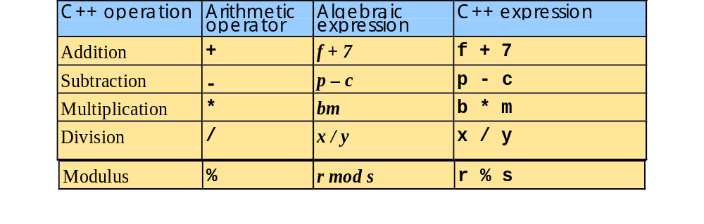
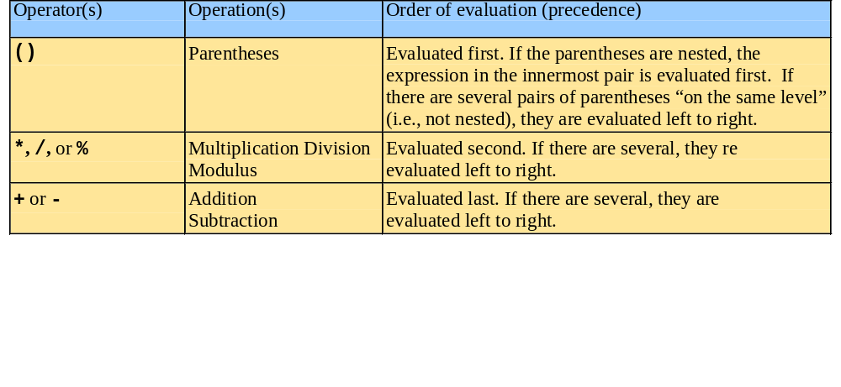
1.22 Arithmetic
Arithmetic operators:
Rules of operator precedence:

Slide 33
1.23 Decision Making: Equality and Relational Operators
if structure
  Test conditions truth or falsity. If condition met execute, otherwise ignore
Equality and relational operators
  Lower precedence than arithmetic operators
Table of relational operators on next slide

Slide 34
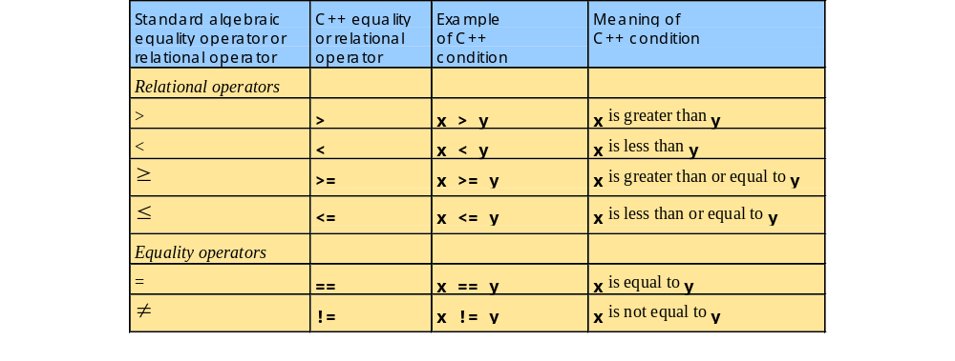
1.23 Decision Making: Equality and Relational Operators

Slide 35
1.23 Decision Making: Equality and Relational Operators
using statements
  Eliminate the need to use the std:: prefix
  Allow us to write cout instead of std::cout
  To use the following functions without the std:: prefix, write the following at the top of the program
        using std::cout;
        using std::cin;
        using std::endl;

Slide 36
1 // Fig. 1.14: fig01_14.cpp
2 // Using if statements, relational
3 // operators, and equality operators
4 #include <iostream>
5
1. Load <iostream>
2. main
2.1 Initialize num1 and num2
2.1.1 Input data
2.2 if statements
6 using std::cout; // program uses cout
Notice the using statements.
7 using std::cin; // program uses cin
8 using std::endl; // program uses endl
9
10 int main()
11 {
12 int num1, num2;
13
14 cout << "Enter two integers, and I will tell you\n"
15 << "the relationships they satisfy: ";
16 cin >> num1 >> num2; // read two integers
Enter two integers, and I will tell you
the relationships they satisfy: 3 7
17
18 if ( num1 == num2 )
19 cout << num1 << " is equal to " << num2 << endl;
The if statements test the truth of the condition. If it is true, body of if statement is executed. If not, body is skipped.
To include multiple statements in a body, delineate them with braces {}.
20
21 if ( num1 != num2 )
22 cout << num1 << " is not equal to " << num2 << endl;
3 is not equal to 7
23
24 if ( num1 < num2 )
25 cout << num1 << " is less than " << num2 << endl;
3 is less than 7
26
27 if ( num1 > num2 )
28 cout << num1 << " is greater than " << num2 << endl;
29
30 if ( num1 <= num2 )
31 cout << num1 << " is less than or equal to "
3 is less than or equal to 7
32 << num2 << endl;
33

Slide 37
34 if ( num1 >= num2 )
35 cout << num1 << " is greater than or equal to "
36 << num2 << endl;
2.3 exit (return 0)
Program Output
37
38 return 0; // indicate that program ended successfully
39 }
Enter two integers, and I will tell you
the relationships they satisfy: 3 7
3 is not equal to 7
3 is less than 7
3 is less than or equal to 7
Enter two integers, and I will tell you
the relationships they satisfy: 22 12
22 is not equal to 12
22 is greater than 12
22 is greater than or equal to 12
Enter two integers, and I will tell you
the relationships they satisfy: 7 7
7 is equal to 7
7 is less than or equal to 7
7 is greater than or equal to 7

Slide 38
1.24 Thinking About Objects: Introduction to Object Technology and the Unified Modeling Language
Object orientation
  Natural way to think about the world and to write computer programs
  Attributes - properties of objects
    Size, shape, color, weight, etc.
  Behaviors - actions
    A ball rolls, bounces, inflates and deflates
    Objects can perform actions as well
  Inheritance
    New classes of objects absorb characteristics from existing classes
  Information hiding
    Objects usually do not know how other objects are implemented

Slide 39
1.24 Thinking About Objects: Introduction to Object Technology and the Unified Modeling Language
Abstraction - view the big picture
  See a photograph rather than a group of colored dots
  Think in terms of houses, not bricks
Class - unit of programming
  Classes serve as a “Blueprint" of objects
    Objects are created from a class
  Classes contain functions
    Used to implement behaviors
  Classes contain data
    Used to implement attributes
  Classes are reusable

Slide 40
1.24 Thinking About Objects: Introduction to Object Technology and the Unified Modeling Language
Unified Modeling Language (UML)
  Used to model object-oriented systems and aid with their design
  Complex, feature-rich graphical language

