Slide 1

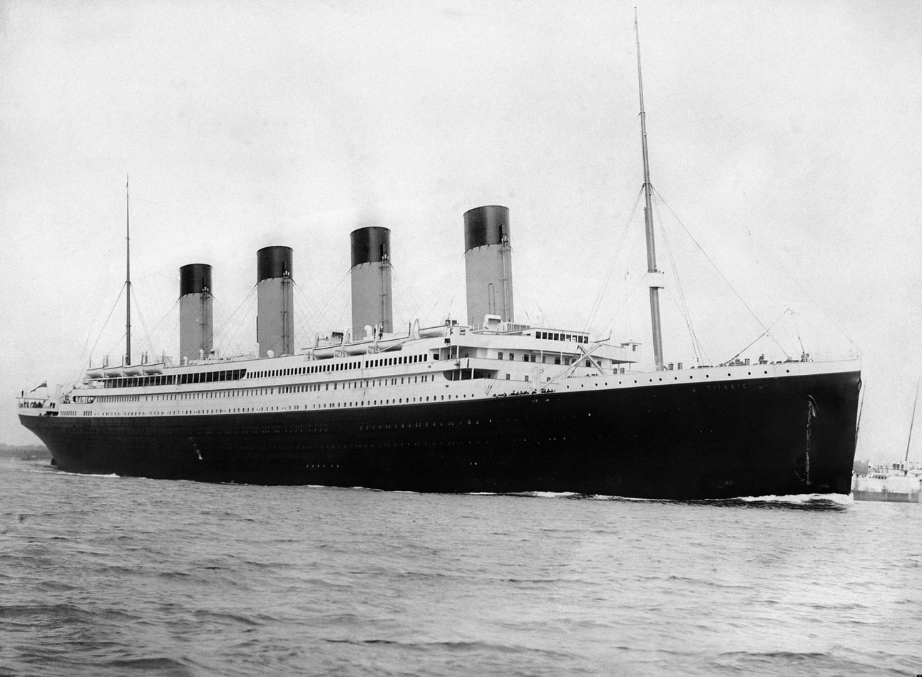
Titanic
MACHINE LEARNING FROM DISASTER

Slide 2



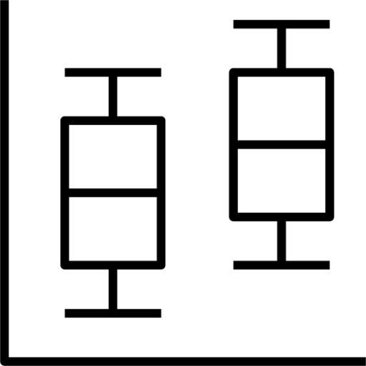

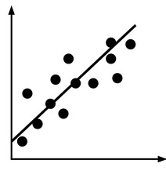






INTRODUCTION
LOAD
THE DATA
Missing data
Handling Missing data
STEP 1:
DATA
DISCOVERY
STEP 2:
DATA
PREPROCESSING
STEP 3:
EXPLORATORY ANALYSIS
STEP 4:
DATA MINING
MODEL

Slide 3
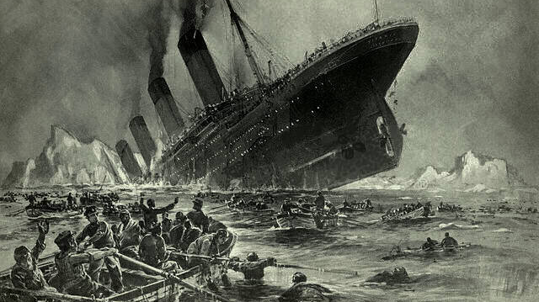
GoAL
to use the available data to build a machine-learning model that predicts which passengers survived the shipwreck of the Titanic in 1912.

Slide 4












OVERVIEW OF THE TITANIC DATASET
Source: Kaggle (https://www.kaggle.com/c/titanic/data)
The original data was divided into two groups:
training (891 observations) and testing (419 observations)
ATTRIBUTES EXPLAINED:
Sibsp: Number of Siblings/Spouses Aboard
Fare: the amount of money paid for ticket
PassengerID
Name
Survival
(0 = No; 1 = Yes)
Parch: Number of Parents/Children Aboard
Cabin: where the passengers stayed
Sex
Pclass
((1 = 1st; 2 = 2nd ; 3 = 3rd )
Embarked: Port of Embarkation (C ,Q, S)
Age
Ticket: Ticket Number
There are 891 passengers and 12 attributes

Slide 5
DATA PREPROCESSING
MISSING DATA
RAW DATA
STRUCTURE DATA
Training Dataset: Age(177), and Embarked(2)
Test Dataset: Age (86), and Fare (1)
DATA PREPROCESSING
EXPLORATION DATA ANALYSIS
HANDLING MISSING DATA
VISUALIZATION
MISSING AGES: median age to replace missing age values
MISSING FARE: filled with the rounded mean fare for 3rd class passengers that embarked from Scottland
MISSING EMBARKED: The two missing data points may have the following characteristics:
survived a disaster, females with the same fare, stayed at the same cabin at Pclass.
Based on a box plot of travelers who stayed in Pclass 1 and paid $80 for their tickers, both training and testing data indicate that these two missing data points are most likely related to Embarked C.

Slide 6



Feature engineering
EXTRACT INFORMATION FROM THE NAME VARIABLE
SibSb
There are different kinds of titles in names, which could be divided into different groups. The majority of titles are Mr., Miss., Mrs., and Master. The rest of the titles are Dr. and nobility titles (Jonkheer, colonel, etc.).
ownself
Family Size
Parch
To ensure uniqueness among families on the small ship, we combine the passengers' surnames with their family sizes. By extracting the last names from the names and appending the family size, we create a new identifier called FamilyID.

Slide 7
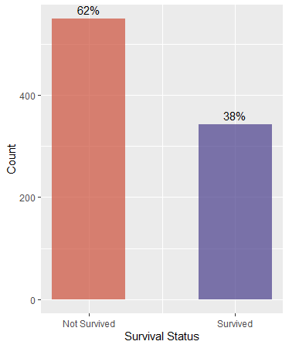
Exploratory Data Analysis
OUTCOME VARIABLE
ASSUMPTION
ALL FEMALES SURVIVED AND ALL MALES DIED.
In the test dataset, there were 314 women and 577 men.
Among the women, 233 survived, accounting for a survival rate of 72.2%, while among the men, 109 survived, resulting in a survival rate of 18.89%.
It can be concluded that the assumption of all women surviving and all men dying is incorrect.

Slide 8
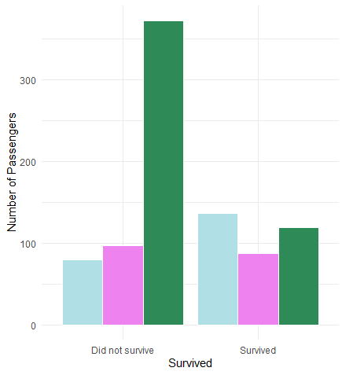
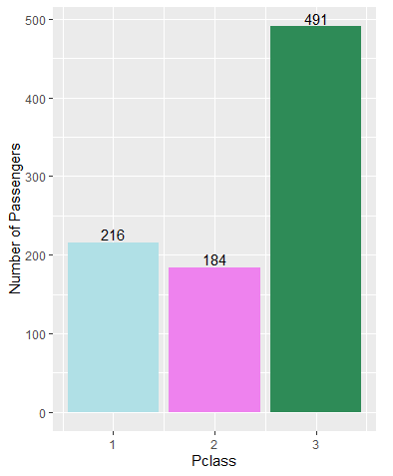
Survival by ticket classes
Passengers from the first class have a higher chance of surviving, while those from the third class have a lower chance of surviving.

Slide 9
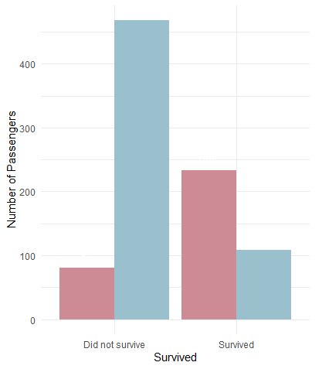
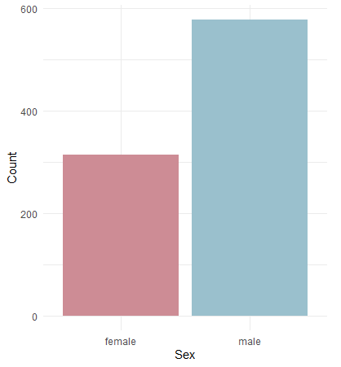
Survival Rate by sex
The percentage of female survivors was higher than the number of male survivors. More than 80% of male commuters died, as compared to around 70% of female commuters.

Slide 10
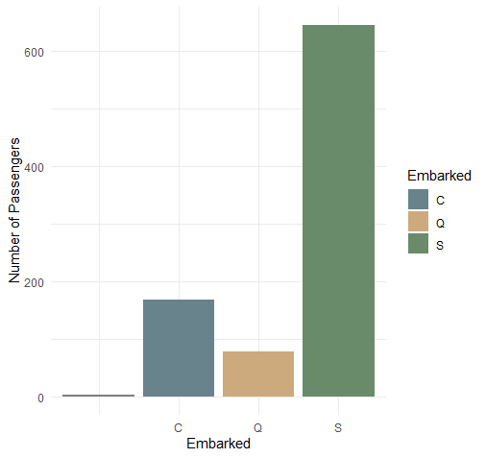
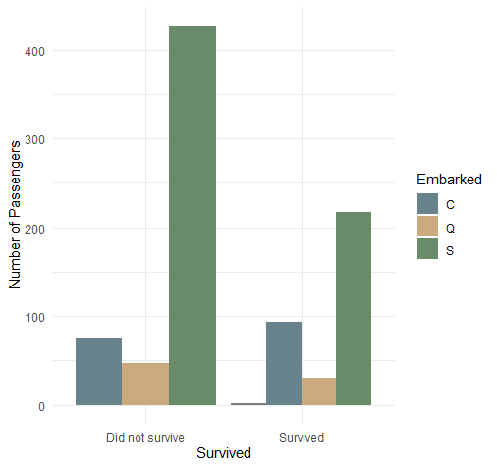
Survival by embarked
There are more people dead compared to people who survived generally.
However, people who embarked from Cherbourg are more likely to survive.

Slide 11
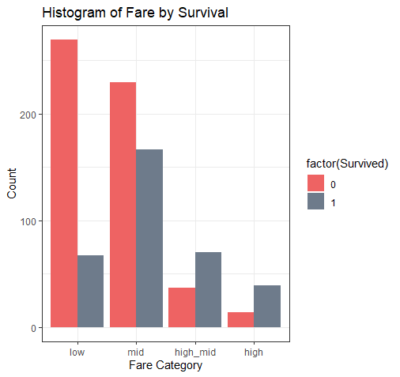
Survival Rate by fare
By splitting the fare amount into four categories, it is obvious that there was a strong association between the charge and survival. The higher a tourist paid, the higher would be his chances to survive.

Slide 12
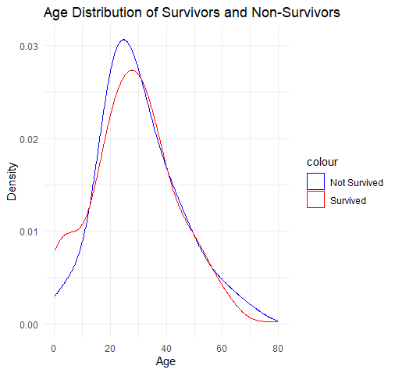
Survival by age
By observing the distribution, it becomes apparent that the center of the age distribution for those who did not survive is shifted more towards the left compared to the overall age group distribution.
This indicates that a higher proportion of young adults died in the given population.
Additionally, there is a small peak in the age range of 0-10 for the survivors, suggesting that a greater number of children or infants managed to survive.

Slide 13
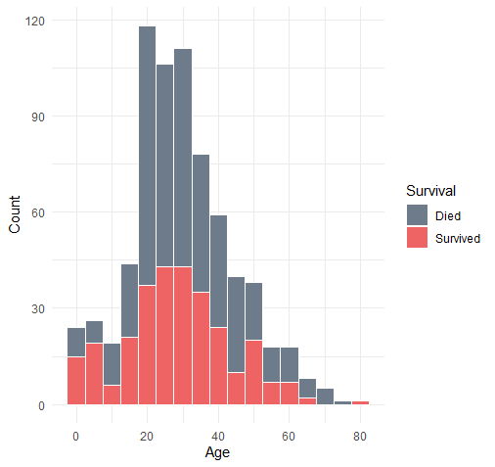
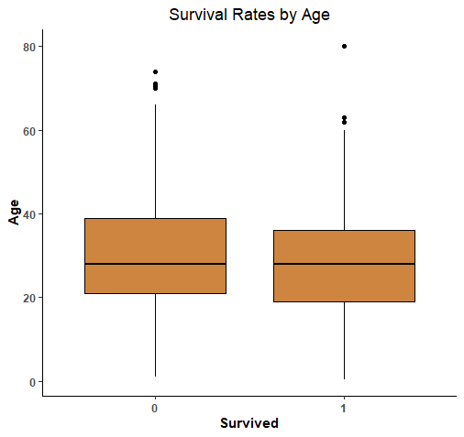
Children less than 5 years had higher survival chances. Passengers aged 20-40 were more likely to die. Passengers aged about 65 - 75 had almost 0 survival chance. One passenger aged 80 years survived.
Passengers who survived seems to have a lower median age.

Slide 14
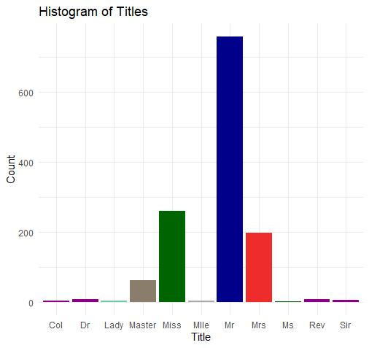
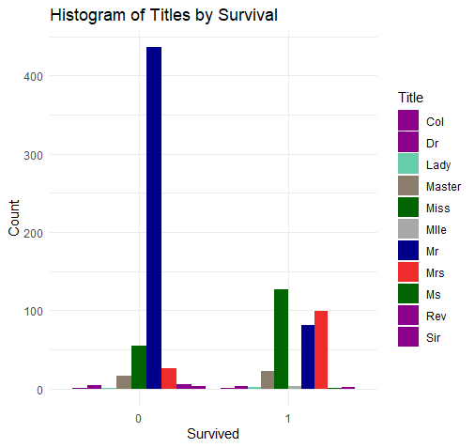
Survival by title
Compared to Mr. and Dr. with nobility titles, Mrs., Miss, and Master (boys younger than 18 years old) are more likely to survive. The conclusion gave us that females and children are more likely to survive

Slide 15
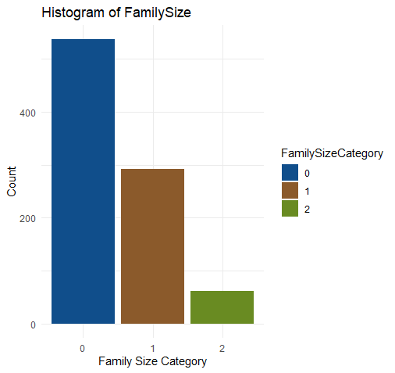
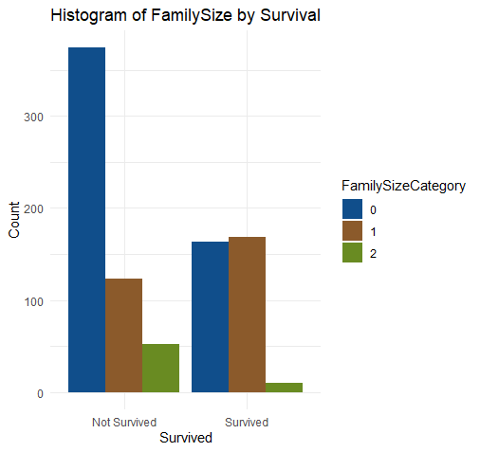
Survival RATE by Family Size
Passengers with smaller family sizes had a higher survival rate. Those with no family members aboard had a survival rate of 30%, while those with a family size of 3 had a survival rate of 72%.

Slide 16
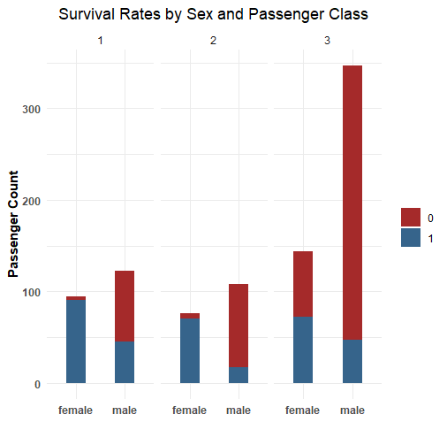
Survival rates by Sex and Pclass
Females in 1st ,2nd and 3rd class had 90%, 90%, and 50% survival chances respectively compared to 45%, 20%, and 20% respectively for their male counterparts.

Slide 17
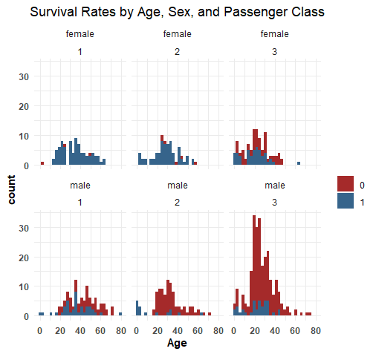
Survival rates by Age, Sex and Passenger Class
Females in higher classes had the highest survival rate (97.8%), while males in lower classes had the lowest survival rate (13.5%).

Slide 18
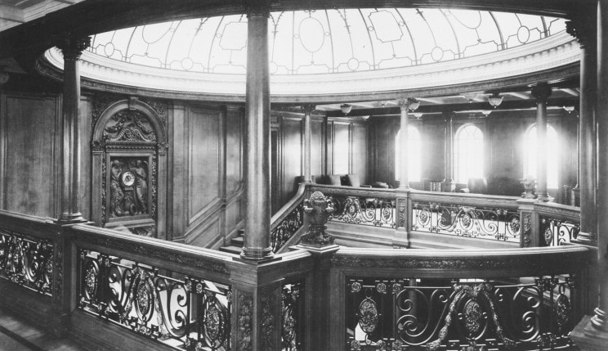
EXPLORATORY RESULTS
1.
4.
7.
Survival Rate by Passenger Class
Embarked Port and Survival
Factors Affecting Survival
2.
5.
8.
Age and Survival
Interesting Outcomes
Fare and Survival
3.
6.
Family Size and Survival
Title and Survival

Slide 19




Data mining model
INTERPRETABLE AND EXPLAINABLE
FEATURE IMPORTANCE
HANDLING MISSING VALUES
FAST TRAINING AND PREDICTION
LIMITED PREPROCESSING
easily visualized and understood
can identify which features are the most influential in making decisions
allowing the algorithm to make decisions even when some data points have missing values
fast to train and make predictions compared to more computationally intensive algorithms
Decision trees handle categorical and numerical features without preprocessing

Slide 20
Data Mining Technique Question
How effectively can a decision tree model capture and represent the complex relationships between different attributes/features in the Titanic dataset to predict passenger survival?"
Handle categorical and numerical variables, missing values, and potentially nonlinear relationships.
By recursively splitting the data based on features with the highest information gain, decision trees can identify relevant patterns and create branches that reflect distinct survival outcomes.
What are the most influential attributes/features in the decision tree model for predicting passenger survival in the Titanic dataset?
Variables such as Title and Family ID have a high impact on determining the passengers’ survival status. Nonetheless, other variables such as Gender, Class are found to be quite influential

Slide 21
HYPOTHESIS
IS A RELATIONSHIP BETWEEN PCLASS AND SURVIVAL?
IS A RELATIONSHIP BETWEEN SEX AND SURVIVAL?
IS A RELATIONSHIP BETWEEN THE CABIN AND SURVIVAL?
CORRELATION COEFFICIENT: 0.3398174
There is a moderate POSITIVE RELATIONSHIP
CORRELATION COEFFICIENT:0.5409359
There is a moderate POSITIVE RELATIONSHIP
CORRELATION COEFFICIENT: 0.5200759
There is a moderate POSITIVE RELATIONSHIP
To determine if the relationship is statistically significant:
If the chi-squared statistic is greater than the critical value, we can reject the null hypothesis

Slide 22
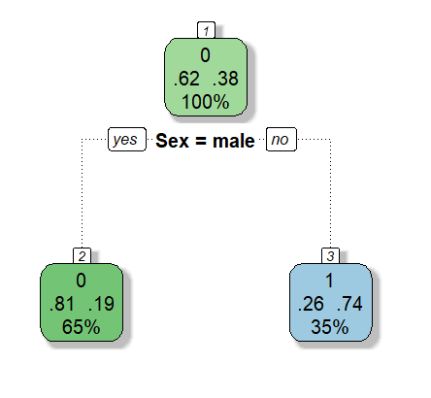
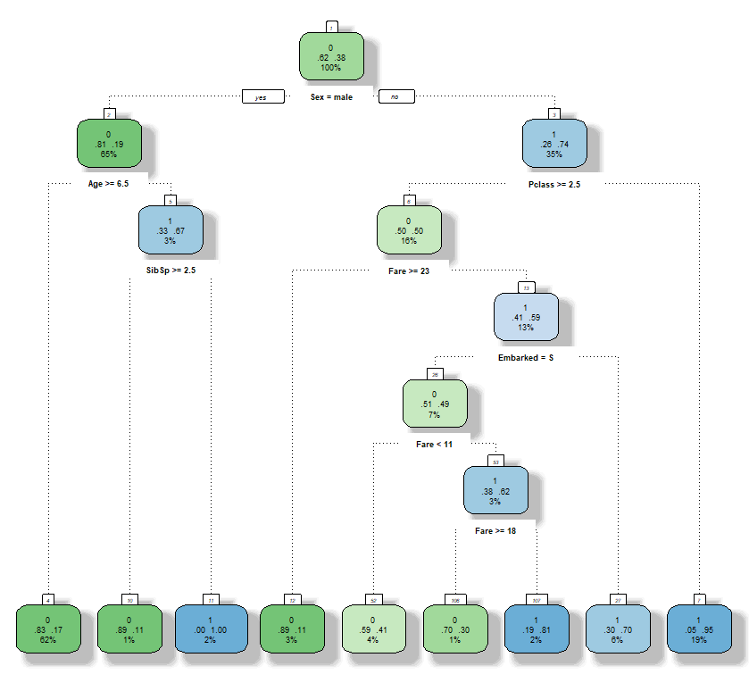
Decision tree MODEL
GENDER MODEL
FIRST DECISION TREE

Slide 23
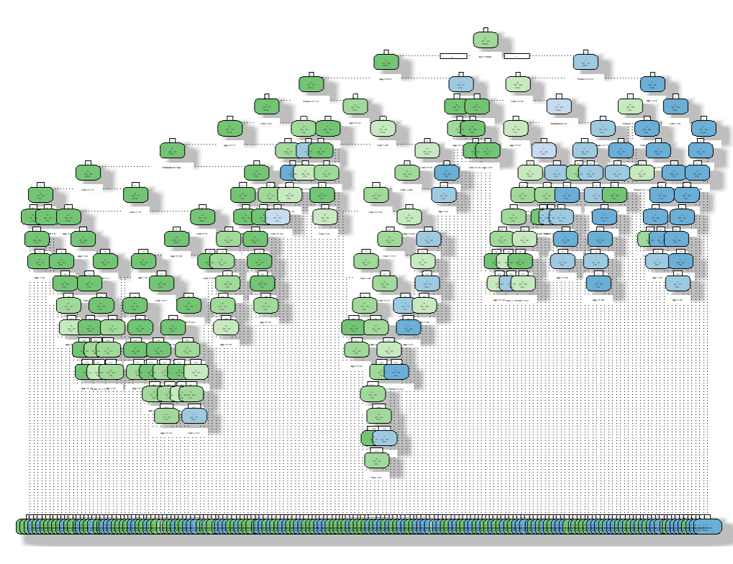
FULL DECISION TREE

Slide 24
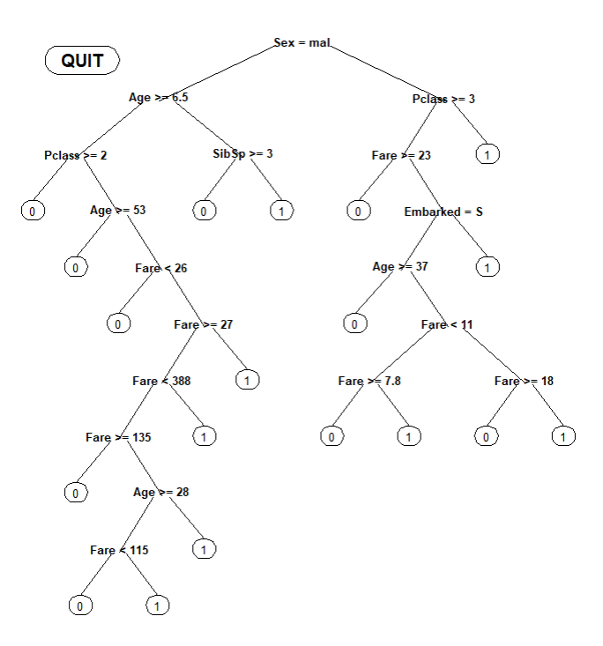
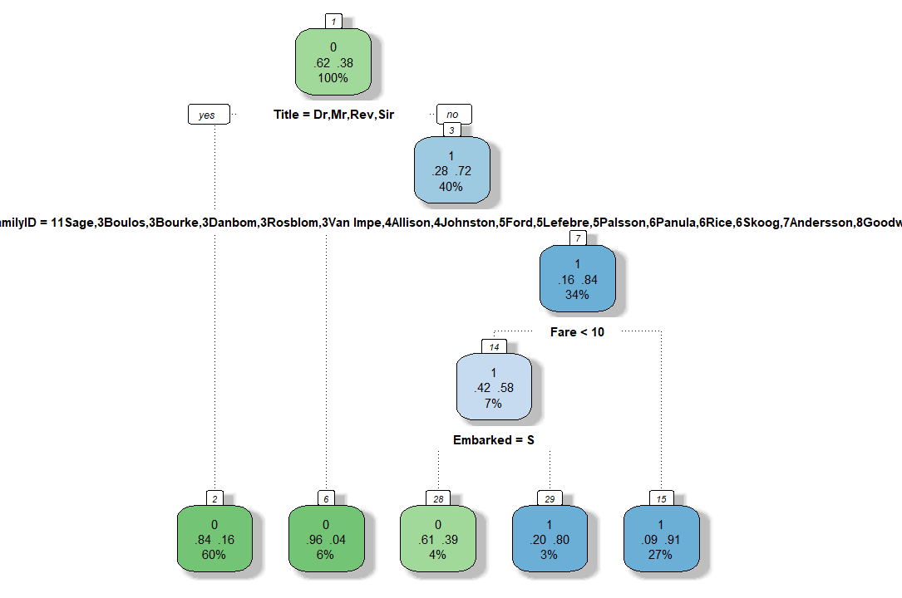
manually editable decision tree
NEW decision tree

Slide 25
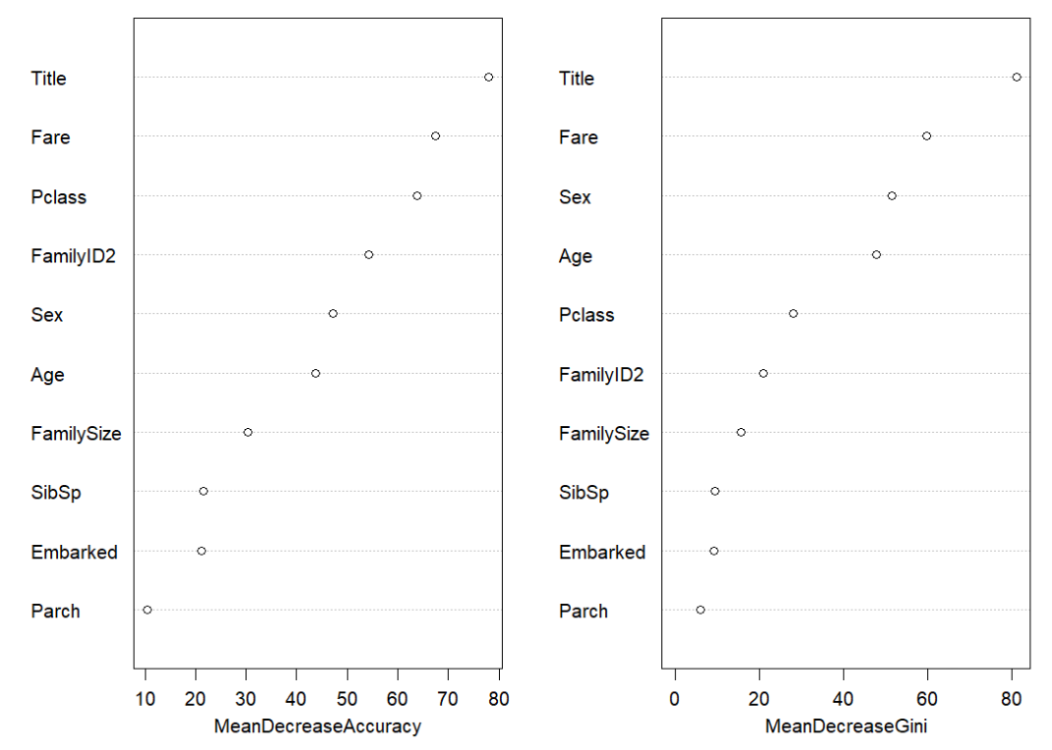
RANDOM FOREST
MEAN DECREASE ACCURACY:
Indicates how much the model's accuracy decreases when a particular variable is randomly permuted. A greater decrease in accuracy suggests that the variable carries more information or predictive power. Variables with higher mean decrease accuracy are considered more important in the model's decision-making process.
MEAN DECREASE GINI :
How much the Gini index of the nodes in the decision trees changes when the variable is used for splitting. Mean decrease Gini measures the impact of a variable on the purity of nodes in decision trees within the random forest. A larger decrease in the Gini index indicates that the variable is more effective at separating the classes and is thus considered more important in the model's decision-making process.

Slide 26
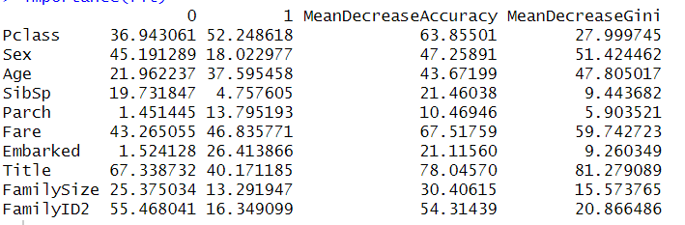
RANDOM FOREST 2
In the "1" column, the number 52.248618 represents the variable importance measure for class "1" (did survive). This means that the variable "Pclass" also contributes significantly to predicting passengers who did survive.

Slide 27
EVALUATION
GENDER MODEL
FULL DECISION TREE
76.55%
74.64%
GENDER CLASS MODEL
NEW DECISION TREE
77.75%
77.27%
1ST DECISION TREE
RANDOM FOREST
77.51 %
76.07%

Slide 28
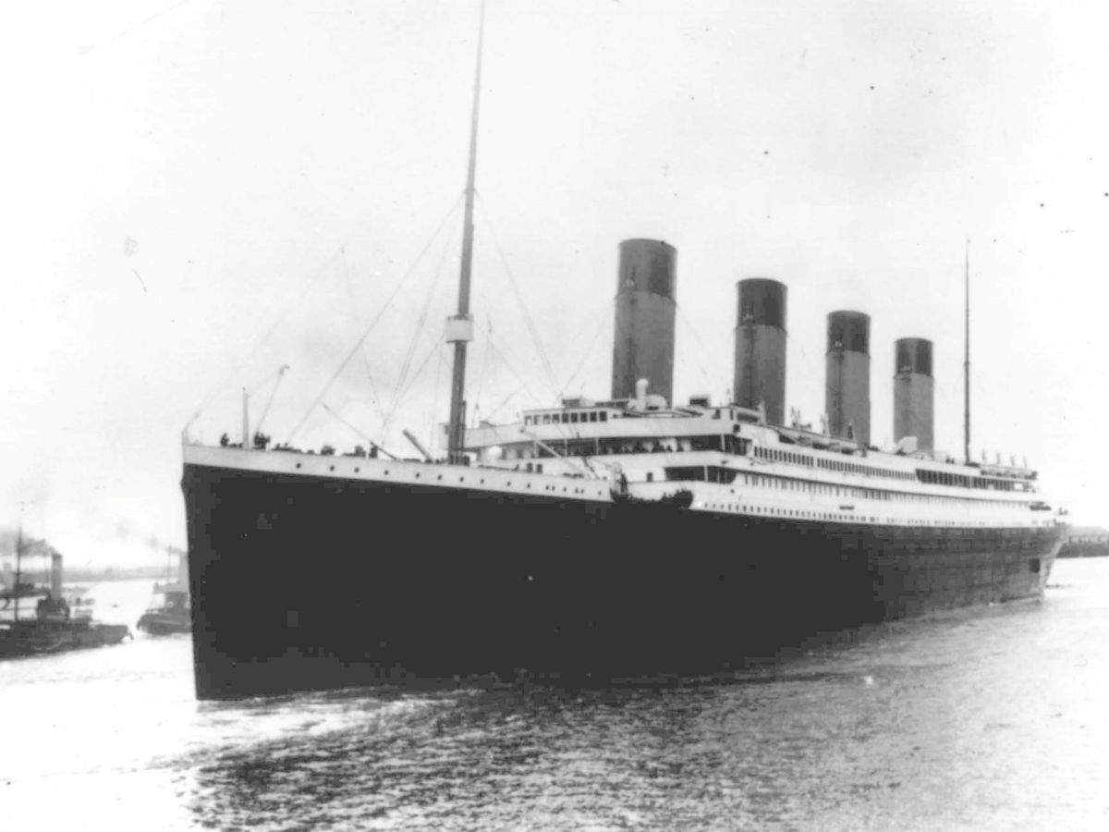
EVALUATION
CONCLUSIONS

Slide 29
THANK YOU!
Acknowledgement
We thank Dr. Adriola Faqolli for their assistance.
Worked in this study
E-mail: megi.menga@cit.edu.al
paola.mallkas@cit.edu.al
Faculty of Engineering, Canadian Institute of Technology

