Slide 1
Kubernetes: Production-based container orchestration
Distributed computing – Lab Session.
Paola Soto

Slide 2
Agenda
What is Kubernetes
Architecture
Type of clusters
Exercises

Slide 3
What is Kubernetes?
According to its own definition:
“Kubernetes (k8s) is an open-source system for automating deployment, scaling, and management of containerized applications.”
Think about what do you have to do to deploy your application in a cluster once it’s containerized.
Push the image to a private/public repository.
In the machine (physical or virtual) pull the image, build it, run it.
Does the application needs another applications to work properly?
Repeat the steps before.
What happen if the application crush? Or the machine dies? – How do you handle failures?

Slide 4
K8s architecture
In a simple cluster creation we have a hierarchical infrastructure.
Master node is in charge of the control plane of the cluster (decisions like scheduling, failure handling, scaling in/out).
Workers/ nodes are responsible for keeping the containerized applications running.
Master
Node/Worker
Node/Worker

Slide 5
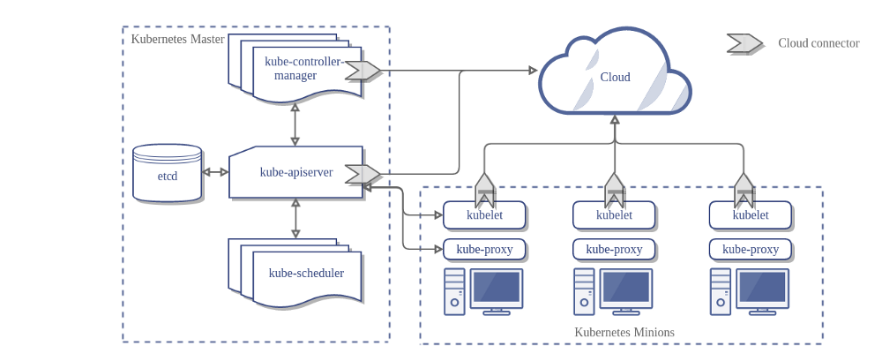
K8s architecture – Master Components¹
Apiserver: exposes the k8s API to interact with the cluster.
Etcd: key, value store for storing cluster data.
Controller manager: centralizes information and take decisions.
Scheduler: selects where the containers will run.

Slide 6
K8s architecture – Node Components²
Kubelet: agent that makes sure the containers run.
Proxy: handles cluster networking.
Container runtime: responsible for running containers.

Slide 7
Clusters in Kubernetes³
Kick the tires:
- Single-node k8s cluster with minikube.
- Multi-node k8s cluster with docker-in-docker (dind)
Hosted solutions:
- Amazon Elastic Container Service for Kubernetes.
- Azure Kubernetes Service (AKS).
- Google Kubernetes Engine (GKE)
Custom solutions:
- kubeadm: multi-node, single-master cluster.
- kubefed: Manage multiple clusters

Slide 8
Kubernetes objects⁴
Persistent entities that describe the state of the cluster.
ObjectSpec:
- Specifies the desired state of an object.
- Normally written in .yaml.
- Provided by user.
The Kubernetes system deploys the desired state and update the cluster status accordingly.

Slide 9
Exercises
Install Minikube⁵
Deploy an app⁶
Create a service⁷
Pull an image from private repository⁸

Slide 10
More Resources
Kubernetes documentation. Available online: https://kubernetes.io/docs/home/ [accessed: 04/03/2019]
Borg, omega and Kubernetes. B. Burns et al. Available online: https://storage.googleapis.com/pub-tools-public-publication-data/pdf/44843.pdf [accessed: 04/03/2019]
Containers and cloud: From LXC to Docker to Kubernetes. D. Bernstein. Available online: http://www.ce.uniroma2.it/courses/sdcc1617/articoli/bernstein_cc2014.pdf [accessed: 04/03/2019]

