Slide 1

ML 2023 Project
Nunzio Canduci (n.canduci@studenti.unipi.it),
Paolo Junior Mollica (p.mollica@studenti.unipi.it),
Andrea Marino (a.marino47@studenti.unipi.it).
ShrimPropagation team
Master degree in Computer Science (Artificial Intelligence curriculum),
Masters degree in Data Science and Business Informatics
Date: 01/02/2023
Type of project: B

Slide 2
Objectives
Our aim for this project was to test various models, built with the help of some libraries (see bibliography), on the Monk and ML23 CUP tasks.
In particular, we were interested in seeing how various combinations of both standard and nonstandard techniques would perform in the tasks at hand (expecially in the ML23 CUP).
Ultimately, we aimed at achieving the best possible result for the blind competition, while also learning more about the impact that our choices have on such results. Therefore, a broad exploration of the performance of various models and hyperparamenters' configurations was performed, as this is necessary to achieve such goals.
We implemented three classes of models: SVR, Neural Network, Random Forest. The latter was not part of the program for the ML exam.

Slide 3
Code structure, models overview
Basic structure of the code:
GitHub repo in which we stored the datasets, images, notebooks and saved models.
A notebook for each of the three classes of models, for each of the tasks.
In each notebook: import and process the data, create the model (often by calling a function provided by the library), set up the grid search and training process, select best hyperparameters and plot the learning curve, assess the error, save the model
Extra notebooks for data exploration and models comparison
Extra notebooks for utils (NeuralNetwork classes, save/load models and plots…)
We used the Random Forests and SVMs from Scikit-Learn, and implemented a multilayer feedforward Neural Network using Keras. The NeuralNetwork classes in our code are designed to be seamless integrated with Scikit-Learn while also be usable without it.
For the Neural Networks, we have 2 models, given by the choice of the strategy for the exploration of the hyperparameters space (full grid search/Optuna). So we compared 4 models in total.
For all these models we tried out many configurations of hyperparameters, as detailed in the next sections.

Slide 4
Models details & contributions – 1
MONK tasks models: Scikit-Learn’s SVC, Scikit-Learn’s RandomForestClassifier, a custom python class implementing a Sequential Neural Network with Keras.
All of the models used for the ML23 CUP task are in Pipeline with a RobustScaler.
RobustScaler preprocesses the input data by rescaling it. Rescaling of data is a common procedure that improves the performance of many ML models. (The preprocessing is done after the internal test set is isolated).
A Pipeline groups together many steps of a ML process into a single estimator. It helps to make the code cleaner and safer.
Structure of the Neural Networks:
Sequential model from Keras
Dense (hidden) layers are interleaved by Dropout layers. The dropout rate (for input and hidden layer) is a hyperparameter selected by grid search
As a further form of regularization, the weights of the Dense layers are constrained through Keras’ MaxNorm().

Slide 5
Models details & contributions – 2
Weight initialization for the Neural Networks: HeNormal() from keras.initializers [2][7]. This strategy is tailored for layers that use the ReLU activation function, like the ones in our neural network.
Stop conditions for the Neural Networks: we decided to keep the number of epoch fixed during training in the grid search (the n° of epochs is an hyperparameter), but to use early stopping in the retraining of the best model. Precisely, early stopping has been implemented by using EarlyStopping() from keras.callbacks.
Further discussion in the model selection part, and details in the Appendix.
Preliminary trials and constraints in terms of time and computational resources led us to make choices in model’s features. Noticeably, for ML23 CUP Neural Networks:
N° layers: we opted for a 2 layer architecture to make the grid search feasible (for Optuna the range is increased)
Activation function: we only used ReLU as is the most used in state-of-the-art NN
Learning algorithm: we focused our effort on SGD, but varied the batch size
For further details on design choices, see the Appendix.

Slide 6
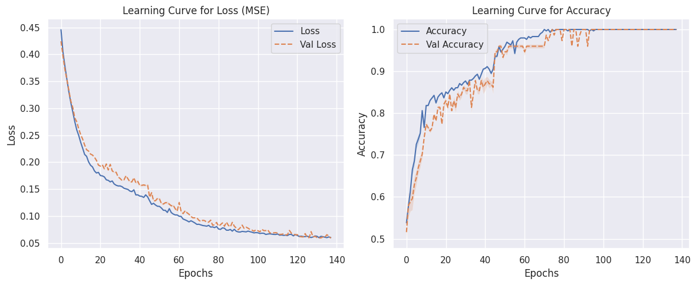
MONK 1 Results
Table 1: Average prediction results obtained for the MONK’s task, with a Neural Network
Task | Architecture / learning alg / act. f / η / α / λ / epochs / batch_size / patience | MSE (TR/VL) | Accuracy (TR/VL) | Accuracy (TS)
Monk 1 | (8,8) / SGD / ReLU / 0.1 / 0.6 / 0.01 / 200 / 8 / 6 | 0.060 / 0.059 | 100% / 100% | 100%
Figure 1: MSE and accuracy plots for the model in Table 1, MONK 1 task

Slide 7
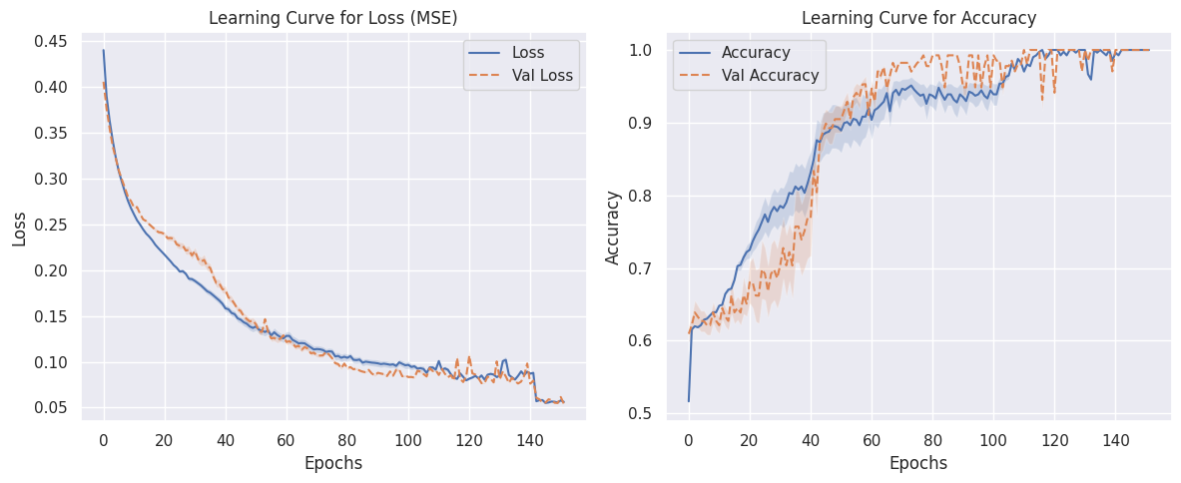
MONK 2 Results
Table 2: Average prediction results obtained for the MONK’s task, with a Neural Network
Task | Architecture / learning alg / act. f / η / α / λ / epochs / batch_size / patience | MSE (TR/VL) | Accuracy (TR/VL) | Accuracy (TS)
Monk 2 | (8,8) / SGD / ReLU / 0.1 / 0.6 / 0.01 / 200 / 8 / 6 | 0.056 / 0.054 | 100% / 100% | 100%
Figure 2: MSE and accuracy plots for the model in Table 2, MONK 2 task

Slide 8
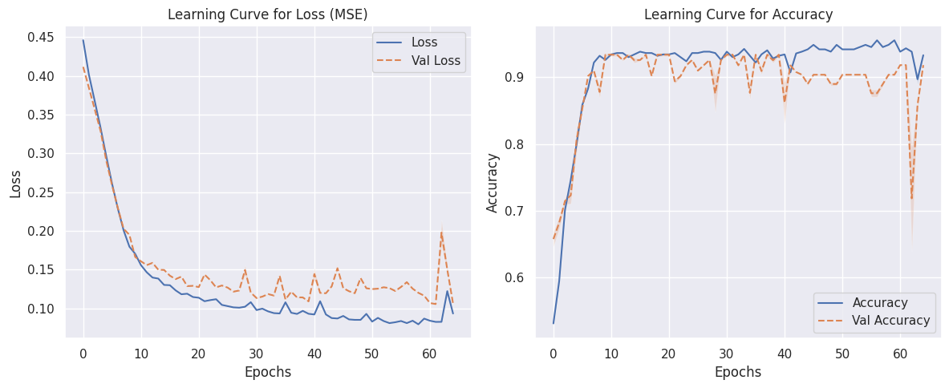
MONK 3 Results
Table 3: Average prediction results obtained for the MONK’s task, with a Neural Network
Task | Architecture / learning alg / act. f / η / α / λ / epochs / batch_size / patience | MSE (DS) | Accuracy (TR/VL) | Accuracy (TS)
Monk 3 | (8,8) / SGD / ReLU / 0.1 / 0.6 / 0.01 / 200 / 8 / 6 | 0.093 / 0.106 | 93,32% / 91,83% | 97,22%
Figure 3: MSE and accuracy plots for the model in Table 3, MONK 3 task

Slide 9
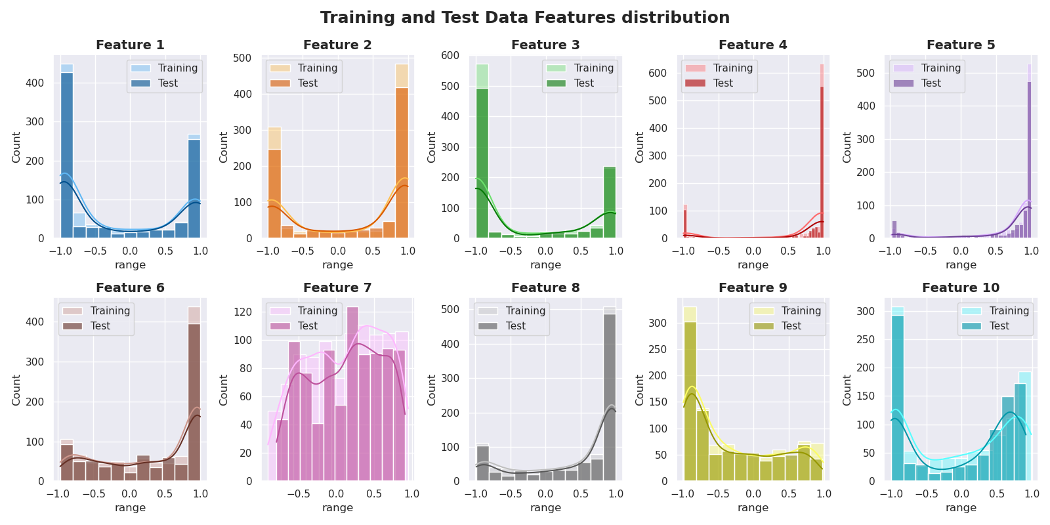
CUP Dataset exploration
It is a good practice to explore the dataset before making choices that concern ML models.
The test set and the training set show similar features distribution, as Figure 4 shows.
Furthermore, there aren’t cluster of test datapoints that are separated from the test set. That is, the test set is well represented by the training set.
Our exploration also focused on the detection of possible outliers (see Appendix for all the details).
Figure 4: Features distribution for training and test data

Slide 10
Hardware resources & Computing times[da riempire]
All the models were fitted using Google Colaboratory using the standard CPU, which has 8 cores (physical and logical) according to python’s multiprocessing.cpu_count().
Table 4: hardware resources and computing times for the compared models
Model | HW resources | Grid search time | (Re)training time
SVR | Google Colaboratory’s CPU | 2h26m (with an average of 0.60s/fit and a total of 1800 fits) | 13.6s
RF | Google Colaboratory’s CPU | (with an average of 3.99s/fit and a total of 2400 fits) | 12m10s
NN, grid search | Google Colaboratory’s CPU |  | 14s (with an average of 8,6epoch/s)
NN, Optuna | Google Colaboratory’s CPU | 4h40m | 9s (with an average of 8,6epoch/s)

Slide 11
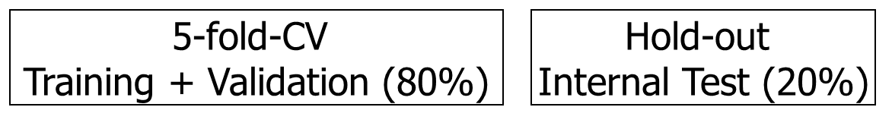
CUP Validation schema
We held out 20% of the data (randomly sampled by fixing the seed for reproducibility) to use it as an internal test set. Since the seed is fixed, all of the models use the same internal test set.
On the remaining part of the data the model is trained and validated following a 5-fold Cross Validation schema. This is done by Scikit-Learn’s GridSearchCV, when the grid search is performed.
We ran a full grid search for all the three classes of considered models.
In addition to that, we used Optuna (a hyperparameter optimization software. See [6] and Appendix) for the exploration of the Neural Network’s space of hyperparameters. The range of hyperparameters explored by Optuna is in the Appendix.
Range of hyperparameters in the grid search: for most of the hyperparameters, we followed the advice in [8] and considered an uniform sampling in the log-domain. That is, the ratio between two consecutive values to explore is constant.

Slide 12
CUP Validation schema
The best model returned by the grid search is then retrained. In all cases (SVM, RF and NN) a 5-fold Cross-Validation is performed, to get accurate learning curves (details for SVM and RF learning curves are in the Appendix).
For the NN, a further consideration can be made: retraining uses early stopping, so a validation set was needed. We decided not to hold out a validation set for this purpose, as the training data well represents the test set (as also noticed in our data exploration). As a consequence of this choice, an ensemble is created. Further details on early stopping are in the Appendix.
After retraining, we measure the test error (of the ensemble) on the TS that was previously held out. After this model assessment phase, the ensemble is retrained on the whole dataset. This retraining uses the same 5-fold schema as earlier.
RF and SVM follow an analogous idea: an ensemble is created using the same split that was used for the learning curve. Full details are in the Appendix.
In the following slides, ranges and values of hyperparameters for the grid search. For the NN, we ran the experiment multiple times, and previous runs made us reduce the hyperparameter’s range. The original one is in the Appendix.

Slide 13
Random Forest
Table 5: range of explored hyperparameters in the grid search, Random Forest
Hyperparameter | Values | Hyperparameter | Values
N° of estimators (aka trees) | 100, 150, 200, 300 | Maximum depth of the tree | None, 4, 6, 8, 10
Minimum n° of samples to split an internal node | 2, 8, 10 | Minimum n° of samples required to be a leaf node | 1, 3, 4
Hyperparameter |  | Values
N° of features to consider when looking for the best split |  | sqrt(), log_2()
The best hyperparameters found in the grid search are in bold. Table 6 shows the error of this model.
The learning curve of the best Random Forest can be found in the Appendix.
Table 6: MEE of the best Random Forest selected by grid search on the datasets
Dataset | TR | VL | TS
MEE | 1.033 | 2.734 | 2.489
stdev | 0.005 | 0.094 | n.d.

Slide 14
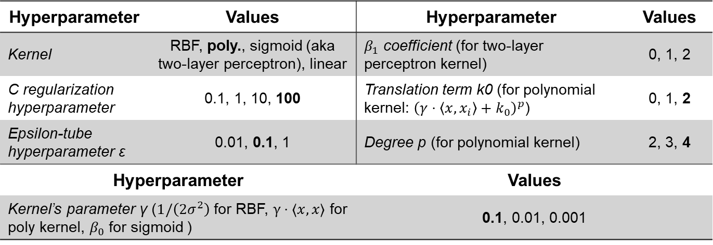
Support Vector Regressors
Table 7: range of explored hyperparameters in the grid search, SVM
Hyperparameter | Values | Hyperparameter | Values
Kernel | RBF, poly., sigmoid (aka two-layer perceptron), linear | $β_{1}$ coefficient (for two-layer perceptron kernel) | 0, 1, 2
C regularization hyperparameter | 0.1, 1, 10, 100 | Translation term k0 (for polynomial kernel: ${\left(γ⋅\left\langle x\right.,\left.x_{i}\right\rangle +k_{0}\right)}^{p}$) | 0, 1, 2
Epsilon-tube hyperparameter ε | 0.01, 0.1, 1 | Degree p (for polynomial kernel) | 2, 3, 4
Hyperparameter |  | Values
Kernel’s parameter γ ($1/\left(2σ^{2}\right)$ for RBF, $γ⋅⟨x,x⟩$ for poly kernel, $β_{0}$ for sigmoid ) |  | 0.1, 0.01, 0.001
Table 8: MEE of the best SVM
The best hyperparameters found in the grid search are in bold. Table 8 shows the error of this model.
The learning curve of the best SVM can be found in the Appendix.
Dataset | TR | VL | TS
MEE | 0.472 | 0.804 | 0.813
stdev | 0.006 | 0.031 | n.d.

Slide 15
Neural Network
Table 9: range of explored hyperparameters in the grid search, Neural Network
Hyperparameter | Values | Hyperparameter | Values
Learning rate η | 10⁻³, 10⁻² | L2 regularization hyperparameter λ | 10⁻³, 10⁻²
Nesterov’s momentum | True, False | Activation function (hidden layers) | ReLU
Momentum hyperp. α | 0.5, 1 | Dropout hyperp. (input layer) | 0, 0.1
Learning algorithm | SGD | epochs | 50, 100, 150
Batch size | 16, 32
Hyperparameter |  | Values
Architecture ( (x₁,…,x_{n}): n hidden layers, layer i has x_{i} units) |  | (128,64), (128,128), (256,128)
Dropout hyperparameter (hidden layers, (x₁,…,x_{n}): layer i has dropout hyperparameter i) |  | (0.1,0.1), (0.2,0.2)
Best hyperparameters are in bold. The learning curves for the best NN is in the Appendix. Results concerning Optuna are in the Appendix as well.

Slide 16
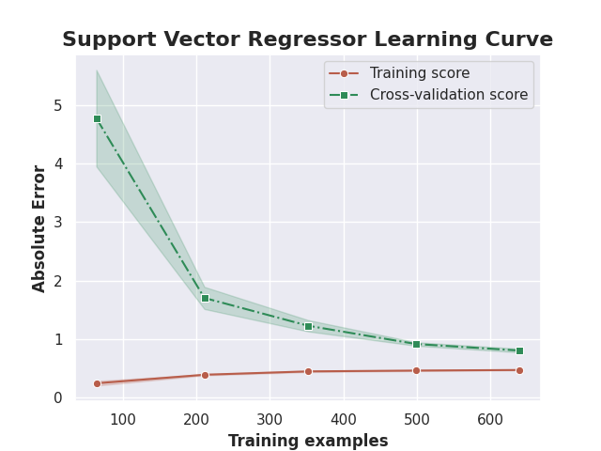
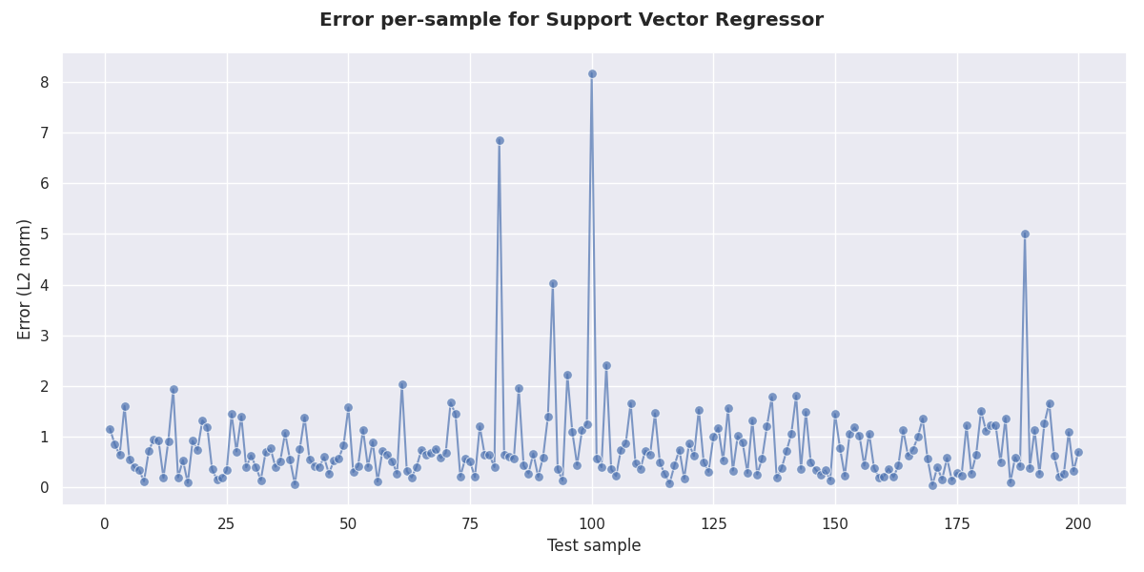
CUP Results: final model – 1
We chose the ensemble of SVRs as our final model, because it is the one that achieves the best result on the internal test set.
Figure 5: Learning curve for the final model (the measured error is the MEE on the design set. See the Appendix for details)
Figure 6: Euclidean distance between the true and predicted value, for each point in TS, for the final model

Slide 17
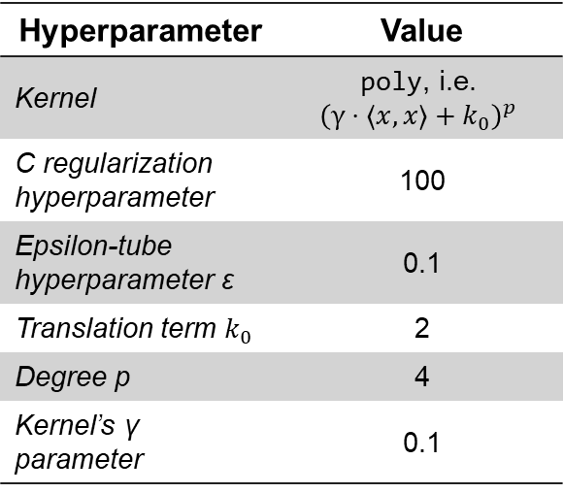
CUP Results: final model – 2
Table 10 reports a summary of the chosen model’s hyperparameters. The results achieved by this model can be seen in Table 11.
Table 10: Final model’s summary
Hyperparameter | Value
Kernel | poly, i.e. $${\left(γ⋅⟨x,x⟩+k_{0}\right)}^{p}$$
C regularization hyperparameter | 100
Epsilon-tube hyperparameter ε | 0.1
Translation term $k_{0}$ | 2
Degree p | 4
Kernel’s γ parameter | 0.1
Table 11: Final model’s MEE on the datasets
Dataset | TR | VL | TS
MEE | 0.472 | 0.804 | 0.813
stdev | 0.006 | 0.031 | n.d.
Because of our validation schema, the standard deviation has been assessed on the TR and VL sets but not on the TS.

Slide 18
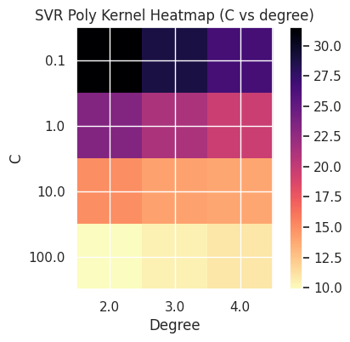
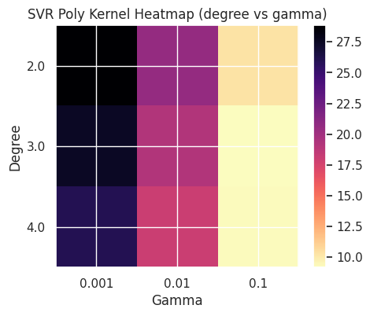
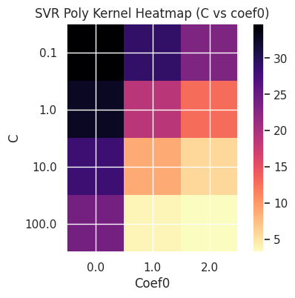
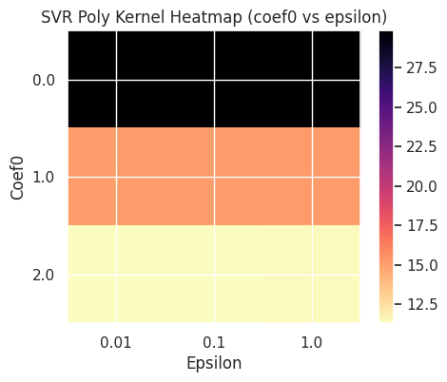
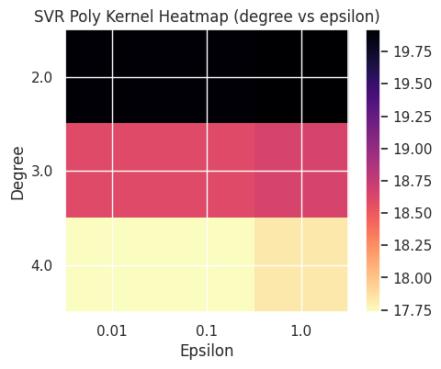
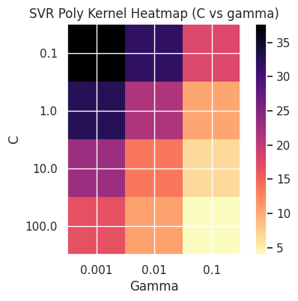
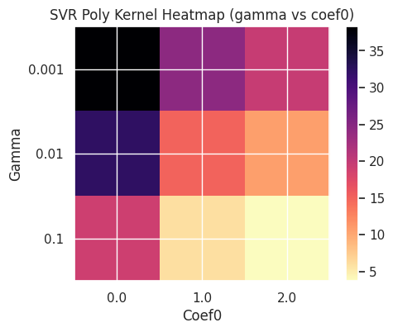
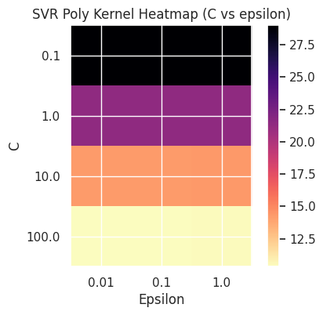
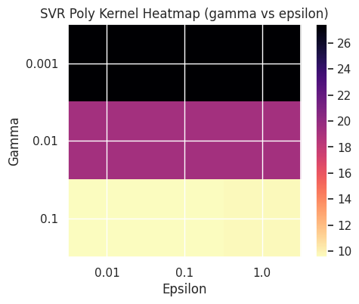
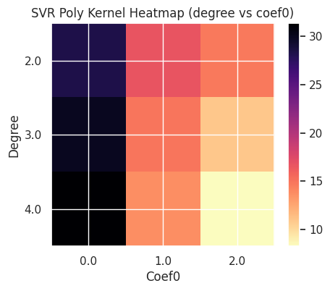
CUP Results: hyperparameters’ impact on the error – 1
The following figures present the mean (validation) MEE achieved across all combinations of hyperparameters’ values, while two hyperparameters are held constant. Specifically, for each combination where the fixed hyperparameters maintain their values, the average MEE is calculated (over the other, “free” values).
Figure 7: heatmaps showing the impact on the MEE of various combinations of hyperparameters, SVR

Slide 19
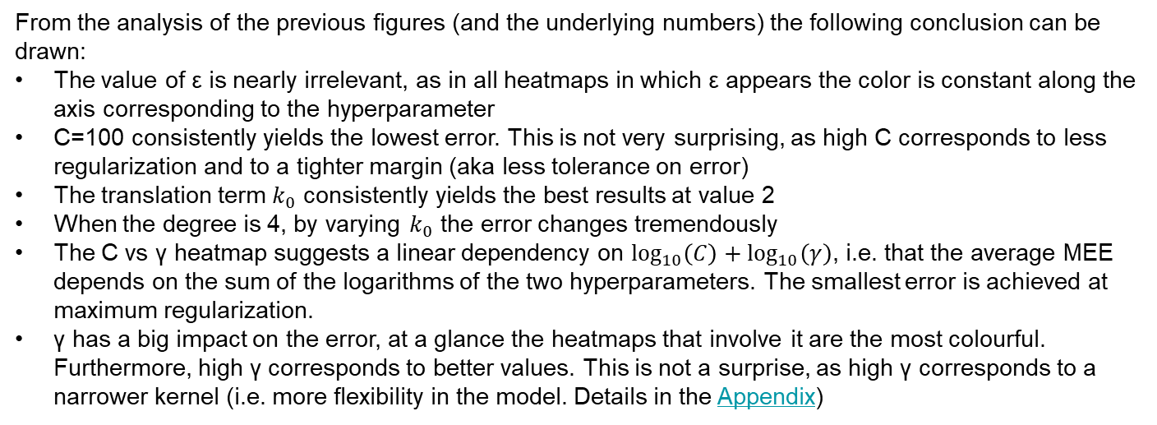
CUP Results: hyperparameters’ impact on the error – 2
From the analysis of the previous figures (and the underlying numbers) the following conclusion can be drawn:
The value of ε is nearly irrelevant, as in all heatmaps in which ε appears the color is constant along the axis corresponding to the hyperparameter
C=100 consistently yields the lowest error. This is not very surprising, as high C corresponds to less regularization and to a tighter margin (aka less tolerance on error)
The translation term $k_{0}$ consistently yields the best results at value 2
When the degree is 4, by varying $k_{0}$ the error changes tremendously
The C vs γ heatmap suggests a linear dependency on $\log_{10}\left(C\right)+\log_{10}\left(γ\right)$, i.e. that the average MEE depends on the sum of the logarithms of the two hyperparameters. The smallest error is achieved at maximum regularization.
γ has a big impact on the error, at a glance the heatmaps that involve it are the most colourful. Furthermore, high γ corresponds to better values. This is not a surprise, as high γ corresponds to a narrower kernel (i.e. more flexibility in the model. Details in the Appendix)
Similar heatmaps have been printed for Neural Networks, in our exploration notebook. The’re discussed in the Appendix.

Slide 20
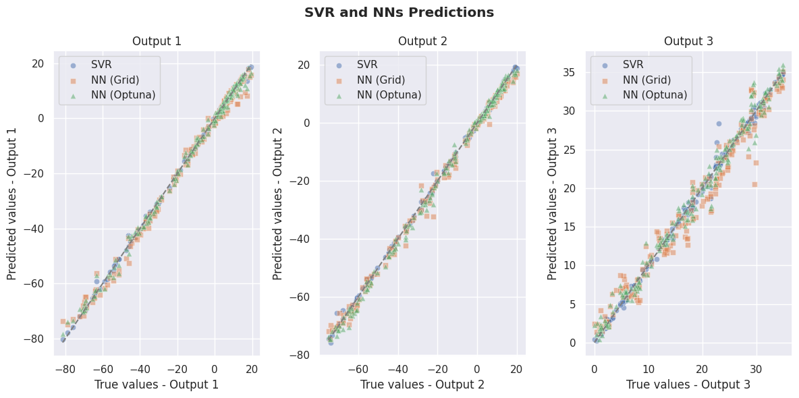
Discussion: comparisons between models – 1
Figure 8: true and predicted values of the three best models
Figure 8: comparison between the predictions of the three best models on the internal test set. The comparisons are done component-wise, each shown in a different subplot.
The comparison shows how the SVR’s predictions are consistently aligned to the diagonal (perfect prediction), with a lower dispersion than the other two.
On the third coordinates all the three models struggle more, and a few points show substantial discrepancies between predicted and true values. Noticeably, the third coordinate is the one in which the range of values is smaller.
More such comparisons can be found in the Appendix, and in our exploration notebook.

Slide 21
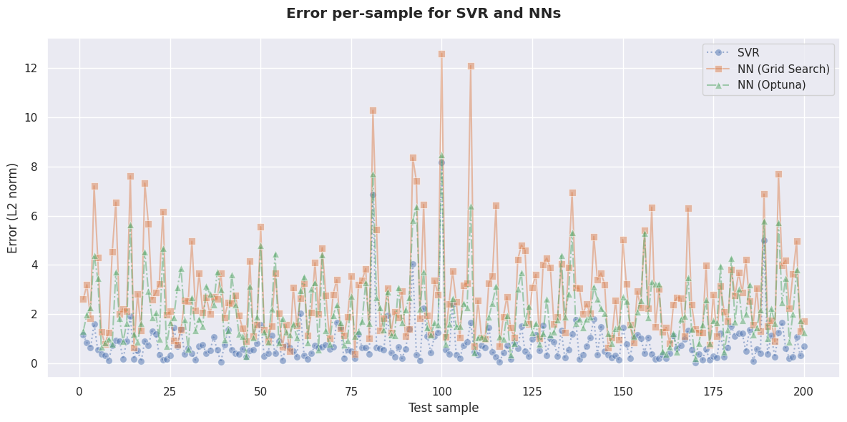
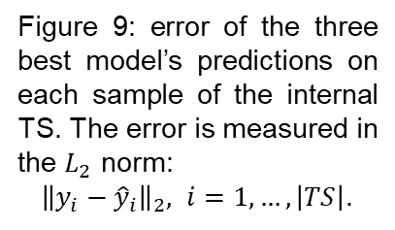
Discussion: comparisons between models – 2
Figure 9: error per test sample for the the three best models
Figure 9: error of the three best model’s predictions on each sample of the internal TS. The error is measured in the $L_{2}$ norm:
${\left\|y_{i}−{\hat{y}}_{i}\right\|}_{2}, i=1,…,\left|TS\right|$.
The SVR consistently makes less mistakes, and the neural network constructed with Optuna yields lower prediction errors than those made by the one built with grid search, on all samples.
The three models struggle to predict the same samples: the curves show similar peaks, but with different values. The SVR and Optuna NN show narrower error spreads than the grid search NN. For this latter model, a few outlier ruin the average (MEE on the TS).
More such comparisons can be found in the Appendix, and in our exploration notebook.

Slide 22
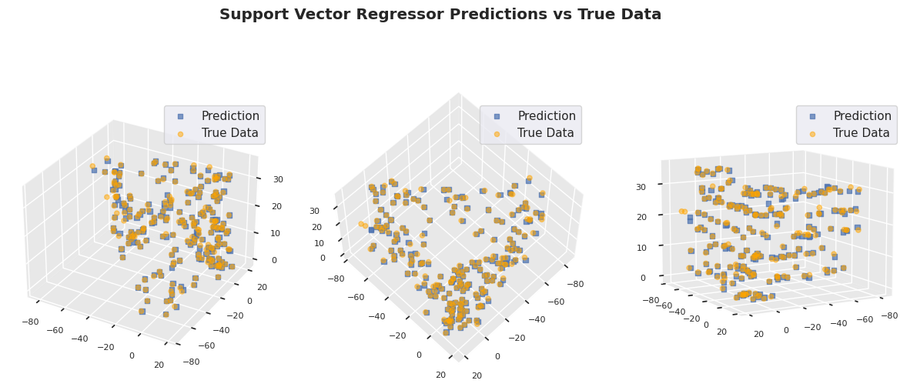
Discussion: comparisons between models – 3
Figure 10: different views of the SVR predictions and true outputs in $ℝ^{3}$
Figure z+2 shows the spatial collocations of the true output features, and of the SVR’s predictions, for each sample in the internal test set. The predictions and the true outputs are very close. This figure shows how the data density is not homogeneous in the output space.
Similar plots, for other models, can be found in the Appendix, and in in the exploration notebook.

Slide 23
Final discussion
Random Forests: we noticed that the best values for the hyperparameters are always at the extrema.
SVM: the values of the hyperparameters, expecially C and γ, greatly impact the training time.
Neural Networks: we were puzzled at the discovery that Optuna and Scikit-Learn (in the grid search) made radically different choices for the hyperparameters. Optuna’s architecture – despite having the same n° of layers – is more complex as it has more units. The chosen hyperparameters’ values are all closer to the ones that were discarded in the grid search. Since the two ensembles behave so differently in (re)training, a direct comparison is hard. What is certain is that the errors are of the same magnitude, according to the metrics, but they’re far from the error achieved by the best model
Despite our best efforts, the NN results weren’t very satisfactory. We achieved good results, but not very competitive.
The creation of ensembles revealed itself to be convenient, as we have high variance among models.
Però, potendo come extra ma anche no, c’è da osservare quanto l’inizializzazione dei pesi contribuisca alla varianza.

Slide 24
Conclusions & Acknowledgments [fare]
In this report we’ve compared three different models: Neural Networks, Random Forests and SVR. Finire
The predictions on the blind test set made by the SVR ensemble (aka our best model) are stored in the file shrimPropagation_ML-CUP23-TS.csv
We agree to the disclosure and publication of our names, and of the results with preliminary and final rankings.

Slide 25
Bibliography – 1
Main libraries and software tools used for this project, with documentation:
F. Chollet, Keras, GitHub, GitHub Repository, (2015) version 3.0.2
Keras 3 documentation
M. Abadi, A. Agarwal et al., TensorFlow: Large-scale machine learning on heterogeneous systems (2015). www.tensorflow.org
F. Pedergosa, G. Varoquaux et al, Scikit-learn: Machine Learning in Python, JMLR, 12(Oct), (2011), pp.2825-2830
Scikit-learn API reference
T. Akiba, S. Sano, T. Yanase, T. Ohta, M. Koyama, Optuna: A Next-generation Hyperparameter Optimization Framework, KDD, (2019), pp.2623-2631
Bibliographical sources:
K. He, X. Zhang, S. Ren, J. Sun, Delving Deep into Rectifiers: Surpassing Human-Level Performance on ImageNet Classification, 2015 IEEE International Conference on Computer Vision (ICCV), Santiago, Chile, 2015, pp. 1026-1034,
Bengio, Y. Practical Recommendations for Gradient-Based Training of Deep Architectures. In: Montavon, G., Orr, G.B., Müller, KR. (eds) Neural Networks: Tricks of the Trade. Lecture Notes in Computer Science, vol 7700 (2012). Springer, Berlin, Heidelberg.
S. Thrun. J. Bala, E. Bloedorn, I. Bratko et al. (1992). The MONK's Problems: A Performance Comparison of Different Learning Algorithms.

Slide 26
APPENDICES

Slide 27
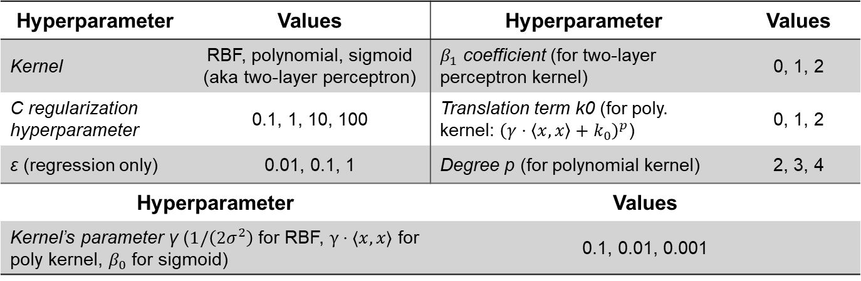
Appendix – 1 Full grid search for the MONK tasks: SVM
Table 12: Hyperparameter’s values for the SVMs used for the three MONK tasks
Hyperparameter | Values | Hyperparameter | Values
Kernel | RBF, polynomial, sigmoid (aka two-layer perceptron) | $β_{1}$ coefficient (for two-layer perceptron kernel) | 0, 1, 2
C regularization hyperparameter | 0.1, 1, 10, 100 | Translation term k0 (for poly. kernel: ${\left(γ⋅\left\langle x\right.,\left.x\right\rangle +k_{0}\right)}^{p}$) | 0, 1, 2
ε (regression only) | 0.01, 0.1, 1 | Degree p (for polynomial kernel) | 2, 3, 4
Hyperparameter |  | Values
Kernel’s parameter γ ($1/\left(2σ^{2}\right)$ for RBF, $γ⋅⟨x,x⟩$ for poly kernel, $β_{0}$ for sigmoid) |  | 0.1, 0.01, 0.001

Slide 28
Appendix – 2 Full grid search for the MONK tasks: Random Forests
Table 13: Hyperparameter’s values for the Random Forests used for the three MONK tasks
Hyperparameter | Values | Hyperparameter | Values
N° of estimators (aka trees) | 20, 50, 100, 200 | Maximum depth of the tree | None, 10, 20 (not for MONK 3), 30
Minimum n° of samples to split an internal node | 2, 4, 6 | Minimum n° of samples required to be a leaf node | 1, 2, 4
Bootstrap | True, False | Criterion to evaluate split quality | gini, entropy
Hyperparameter |  | Values
Number of features to consider when looking for the best split |  | Sqrt(), log_2(), None

Slide 29
Appendix – 3 Full grid search for the MONK tasks: Neural Networks
Table 14: Hyperparameter’s values for the Neural Networks used for the three MONK tasks
Hyperparameter |  | Values
Architecture ( (x₁,…,x_{n}): n hidden layers, layer i has x_{i} units) |  | (8), (8,8), (8,8,8), (8,8,8,8)
Hyperparameter | Values | Hyperparameter | Values
Learning rate η | 0.1, 0.3, 0.5 | Learning algorithm | SGD
L2 regularization hyperparameter λ | 0.01 | Activation function (hidden layers) | ReLU
Momentum hyperparameter α | 0.6, 0.8, 0.9 | epochs | 200
Batch size | 8

Slide 30
Appendix – 4 Further comparisons on MONK tasks: grid search results for RF and SVM
Table 15: Prediction results obtained for the MONK’s task, with a SVM
Task | Kernel / C / γ / p / k0 | Accuracy (TR/VL) | Accuracy (TS)
MONK 1 | Poly / 1 / 1 / 2 / 0.5 | 100%±0% / 80,43%±17,95% | 100%
MONK 2 | Poly / 10 / 1 / 2 / 0.0 | 100%±0% / 71,71%±10,20% | 100%
MONK 3 | RBF / 1 / 0.1 / n.d. / n.d. | 93,40%±1,05% / 93,40%±4,23% | 97,22%
Table 16: Average prediction results obtained for the MONK’s task, with a Random Forest
Task | # trees / maxDepth / min_samples_split / min_samples_leaf / maxFeatures / bootstrap / criterion | Accuracy (TR/VL) | Accuracy (TS)
MONK 1 | 20 / None / 4 / 1 / None / True / gini | 100%±0% / 78,03%±15,44% | 95,37%
MONK 2 | 100 / None / 2 / 1 / None / False / gini | 100%±0% / 65,17%±9,91% | 81,94%
MONK 3 | 50 / None / 6 / 1 / sqrt() /True / gini | 95,88%±1,13% / 92,57%±4,07% | 96,99%

Slide 31
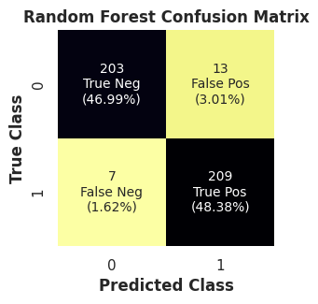
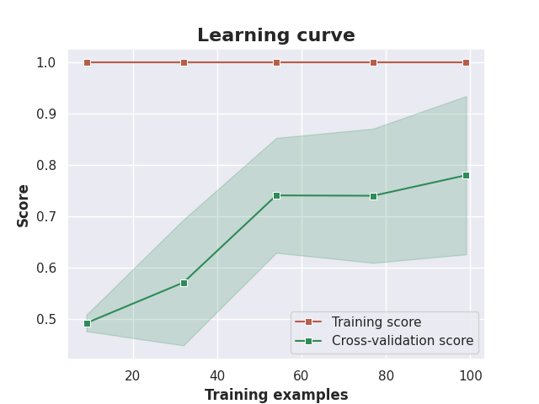
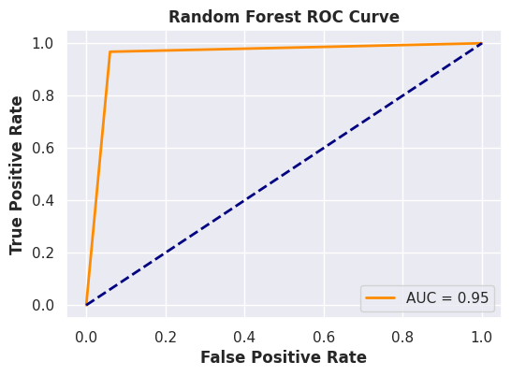
Appendix – 5 In-depth analysis of Random Forest’s performance on MONK 1 task
Figure 11: Confusion matrix, learning curve and ROC curve for the Random Forest, MONK 1 task
Interestingly, all models but the Random Forests perform well in the MONK 1 task.
We ran similar comparisons in our comparison notebook for the other models.

Slide 32
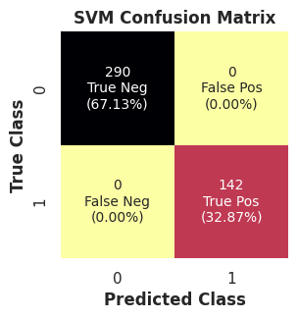
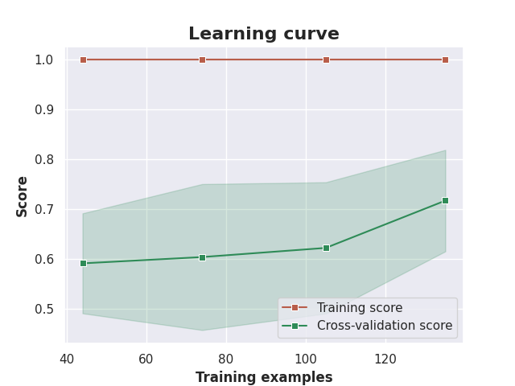
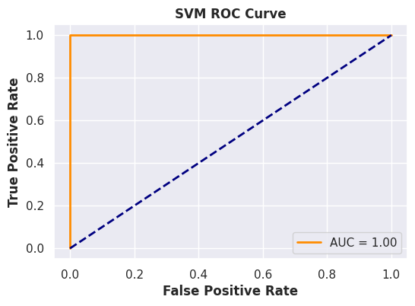
Appendix – 6 In-depth analysis of SVM’s performance on MONK 2 task
Figure 12: Confusion matrix, learning curve and ROC curve for the SVM, MONK 2 task
The TR set is included in TS (already noticed in class). Furthermore, the latter is really unbalanced.
The SVM reaches 100% accuracy in test. In case it didn’t we thought about using undersampling (Condensed Nearest Neighbour) or oversampling (SMOTE) techniques.

Slide 33
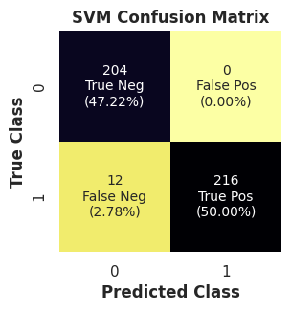
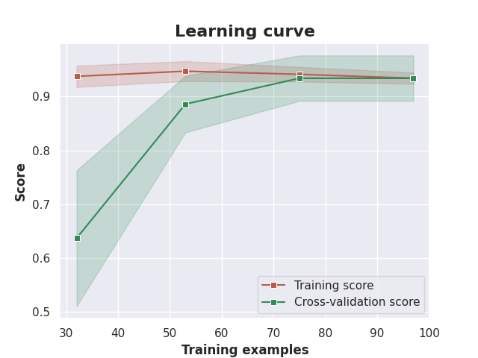
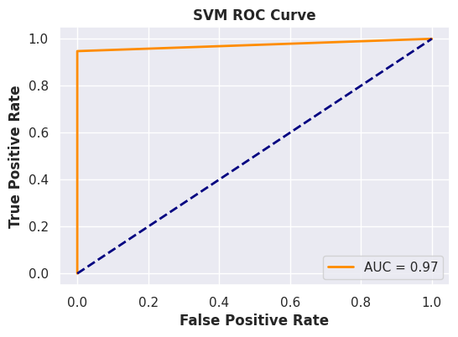
Appendix – 7 In-depth analysis of SVM’s performance on MONK 3 task
Figure 13: Confusion matrix, learning curve and ROC curve for the SVM, MONK 3 task
Neither model can reach 100% accuracy on this task. This is to be expected, as the in MONK 3 there is a 5% noise in TR set (aka 5% of patterns are misclassified) [10].

Slide 34
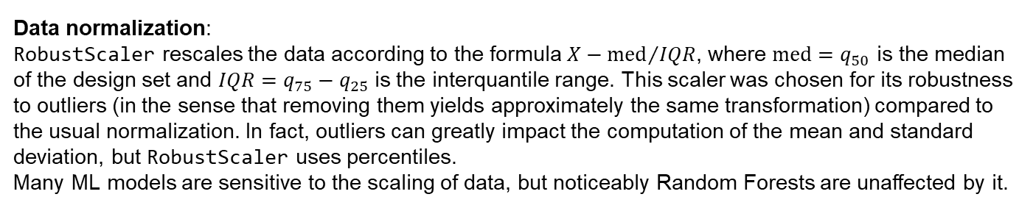
Appendix – 8 Further specifications on model details & contributions
Data normalization:
RobustScaler rescales the data according to the formula ${X−\text{med}}/{IQR}$, where $\text{med}=q_{50}$ is the median of the design set and $IQR=q_{75}−q_{25}$ is the interquantile range. This scaler was chosen for its robustness to outliers (in the sense that removing them yields approximately the same transformation) compared to the usual normalization. In fact, outliers can greatly impact the computation of the mean and standard deviation, but RobustScaler uses percentiles.
Many ML models are sensitive to the scaling of data, but noticeably Random Forests are unaffected by it.
Pipeline:
A Pipeline is a tool provided by Scikit-Learn to chain together multiple steps of a machine learning process. Pipelines helps to create a clean, simple model in which data is transformed and fitted in one go. Predictions have the same scale of the original data, so a post-processing phase is not needed. Furthermore, it prevents TR and VL sets to contaminate each other in cross-validation, by making sure that the same samples are used to train the RobustScaler and the model.

Slide 35
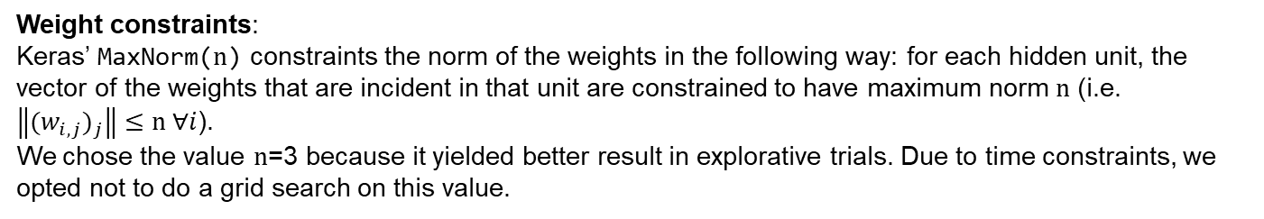
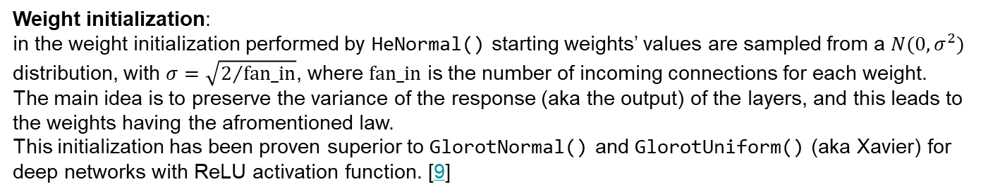
Appendix – 9 Further specifications on model details & contributions
Weight initialization: in the weight initialization performed by HeNormal() starting weights’ values are sampled from a $N(0,σ^{2})$ distribution, with $σ=\sqrt{2/{\text{fan}\text{_}\text{in}}}$, where fan_in is the number of incoming connections for each weight.
The main idea is to preserve the variance of the response (aka the output) of the layers, and this leads to the weights having the afromentioned law.
This initialization has been proven superior to GlorotNormal() and GlorotUniform() (aka Xavier) for deep networks with ReLU activation function. [7]
Weight constraints: Keras’ MaxNorm(n) constraints the norm of the weights in the following way: for each hidden unit, the vector of the weights that are incident in that unit are constrained to have maximum norm n (i.e. $\left\|{(w_{i,j})}_{j}\right\|≤\text{n} ∀i$).
We chose the value n=3 because it yielded better result in explorative trials. Due to time constraints, we opted not to do a grid search on this value.

Slide 36
Appendix – 10 Further specifications on early stopping
Early stopping 1/2: When doing model selection, in both the full grid search and Optuna, the number of epochs is an hyperparameter. We opted to not do early stopping at this stage, following the advice in [8]: early stopping at this stage implies that the hyperparameters’ values are tested for different number of epochs. As a consequence, the effect that these values have is hidden. This makes the grid search less reliable and hampers the analysis of the effect of individual hyperparameters.
When the final model is retrained, we decided to put early stopping. A validation set is therefore necessary, to monitor the validation loss and decide when to stop.
We didn’t want to hold out data on which the model would’t be trained. We thought that would have been a waste, expecially since our exploration highlighted how the training data well represents the blind test set, and we already held out some data for the internal test set.
Hence the design set is split in 5 folds, each used in turn by a different model (set up with the best hyperparameters found in the grid search) to monitor the validation loss while training on the remaining part.
These 5 models make up an ensemble which is used for the assessment on the internal test set.

Slide 37
Appendix – 11 Further specifications on early stopping
Early Stopping 2/2:
The prediction of the ensemble is just the average of the predictions of the models in the ensemble.
The models in the ensemble have different random weight initializations. This is because in our code we set a global seed (for reproducibility purposes, as already mentioned), but we don’t set a «local» seed for the weight initializer (nor we .enable_op_determinism() in the tensorflow backend at the beginning of the notebook).
Anyway, each of the five models will have the same random weight initialization in any run of the notebook cells.
The value of the patience hyperparameter has been set to 9, because it looked like a reasonable value to put, considering that the number of epochs selected in the grid search was 150.
Early stopping halts training at epoch 17, but we saw that even by letting the models in the ensemble run for more epochs (without ES) the performance doesn’t improve by much (see discussion later).

Slide 38
Appendix – 12 Further specifications on model detils & contributions
Optuna: Optuna is an hyperparameter optimization software that follows the define-by-run principle (i.e., allows the user to dynamically construct the search space). Key characteristics:
The hyperparameter optimization is formulated as a process of maximizing an objective function that takes a set of hyperparameters as input.
The objective function is built gradually: the search space is constructed dynamically at runtime.
A trial object represents an evaluation of the objective function. Hyperparameters are dynamically generated by calling suggest methods inside the objective function, with the desired range specified as arguments.
Upon the invocation of a suggest method, an hyperparameter is statistically sampled based on the history of previously evaluated trials.
Optuna embeds pruning mechanisms, that terminate unpromising trials.
Optuna has efficient strategies for both searching (i.e. determining the sets of parameters to investigate next) and performance estimation
Optuna has the ability to identify evaluations of the objective function that are informative about the concurrence relations between hyperparameters

Slide 39
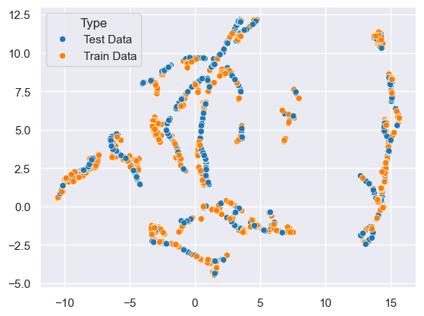
Appendix – 13 Further details on data exploration – 1
Figure 14 shows the effect of applying the UMAP dimensionality reduction technique to the ML23 training and blind test sets.
This technique preserves data locality, therefore we can safely conclude that there aren’t clusters of data in the test set that are separated from the training data (since there are none in the mapping).
This property motivates our choice of retraining the final model on the whole training dataset, as it well represents the test data.
Figure 14: UMAP of the training and test sets
In the exploration notebook, in our GitHub repo, further analysis of this kind (e.g. PCA) can be found.

Slide 40
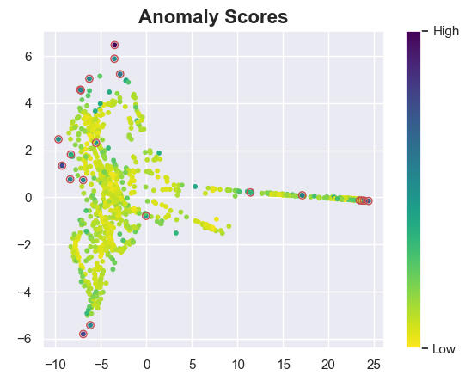
Appendix – 14 Further details on data exploration – 2
For the outlier detection we applied the LOF algorithm to the original 10-dimensional training data. This algorithm assigns a score to each datapoint, based on the ratio between its local density and the local density of its neighbours.
Figure 15 shows the effect of the IsoMap embedding of the 10-dimensional training data in the plane, for a easier visualization that also puts all the outliers in the outer region.
The points are colored based on their score.
Figure 15: IsoMap embedding and LOF score of the training data
The algorithm detected 50 outliers, the highest LOF score is 1.815, and the lowest is 0.946. The contamination parameter was set to 0.05.
We concluded that there aren’t many outliers in the dataset.
The presence of outliers (albeit very few), motivated us in the introduction of the RobustScaler, which is a good scaling technique anyway.

Slide 41
Appendix – 15 Original hyperparameters’ range for the grid search
Table 17: original range of explored hyperparameters in the grid search, Neural Network
Hyperparameter | Values | Hyperparameter | Values
Learning rate η | 10⁻⁴, 10⁻³, 10⁻² | L2 regularization hyperparameter λ | 10⁻⁵, 10⁻⁴, 10⁻³, 10⁻²
Usage of Nesterov’s momentum | True, False | Activation function (hidden layers) | ReLU
Momentum hyperparameter α | 0, 0.1, 0.2, 0.3, 0.4, 0.5 | Dropout hyperparameter (input layer) | 0, 0.1, 0.2, 0.3, 0.4, 0.5
Optimization algorithm | SGD | epochs | 400
Batch size | 16, 32, 64
Hyperparameter |  | Values
Architecture |  | (64,64), (128,64), (128,128), (256,128), (256,256)
Dropout hyperparameter |  | (0,0), (0.2,0.2), (0.3,0.3), (0.3,0.4), (0.4,0.4), (0.5,0.5)

Slide 42
Appendix – 16 Optuna model selection schema: hyperparameters’ range
Table 18: range of hyperparameters explored by Optuna
Hyperparameter | Range | Hyperparameter | Range
Learning rate η | [10⁻⁴, 10⁻²] 0.002 | L2 regularization hyperp. λ | [10⁻⁵, 10⁻²] 0.001
Nesterov’s momentum | [True, False] | Activation function (hidden layers) | ReLU
Momentum hyperp. α | [0, 1] 0.095 | Dropout hyperp. (input) | [0, 0.5] 0.022
N° (hidden) layers | [1,5] 2 | Dropout hyperp. (hidden) | [0, 0.5] (0.091, 0.267)
Optimization algorithm | SGD | epochs | [5, 400]
Batch size | [16, 128] 40 | Patience hyperparameter | [5, 10] 5
Hyperparameter |  | Range
N° units per layer |  | [32, max_units] with a step of 32 (480,480)
max_units=512 for the first hidden layer, then is equal to the n° of units of the previous layer. The chosen hyperparameters are in bold

Slide 43
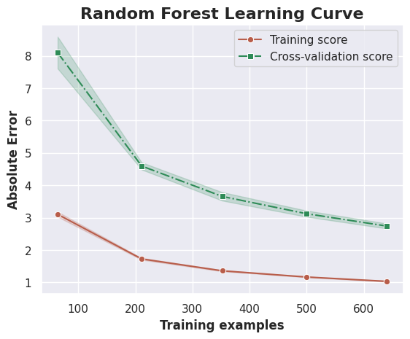
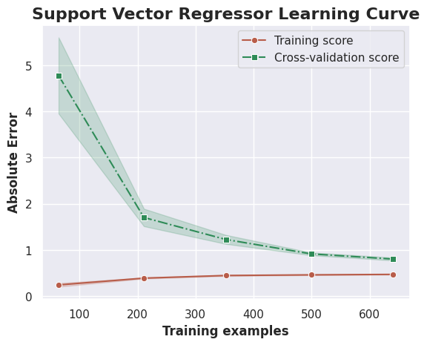
Appendix – 17 Learning curves for best SVM and best Random Forest
Figure 16: learning curves displaying the MEE for the SVM (right) and RF (left) with the best hyperparameters found in their respective grid searches.
The learning curves are obtained through Scikit-Learn’s learning_curve function. The function performs 5-fold CV on increasingly big portions of the design set, to determine cross-validated training and validation scores. The curve tells how well the model scales as the amount of data increases.
With this approach, we have the mean and the standard deviation over the folds, for each point (corresponding to the loss of the model on amount of data on which it is trained).

Slide 44
Appendix – 18 ML23 CUP Validation schema for SVM and Random Forest
After the TR and VL error of the best SVM/RF has been assessed, as well as the scalability, with the learning curve (see previous slide), 5 copies of the best models (i.e. with the best hyperparameters) are created, forming an ensemble. The training data is split in 5 folds, using the same split (controlled by the random seed) as the one used for the learning curve. Each model of the ensemble is trained on (the complement of) one of the split. Hence the drawn learning curve really is the learning curve of this last ensemble model, rather than of one single SVM/RF.
The test error of the ensemble is measured on the TS that was held out at the beginning. Again, it is computed as the average of the predictions of each member.
After the test error has been assessed, the ensemble is retrained on the whole dataset (TR + TS) in the same way as before: the data is split in 5 folds, 5 copies of the best models are created, each of which is trained on (the complement of) a portion of the dataset.

Slide 45
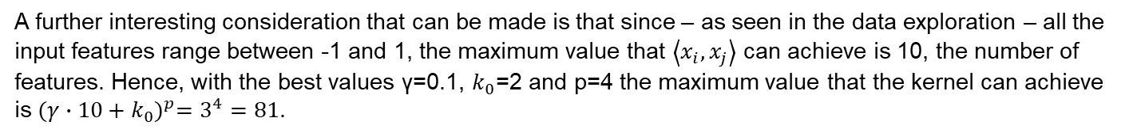
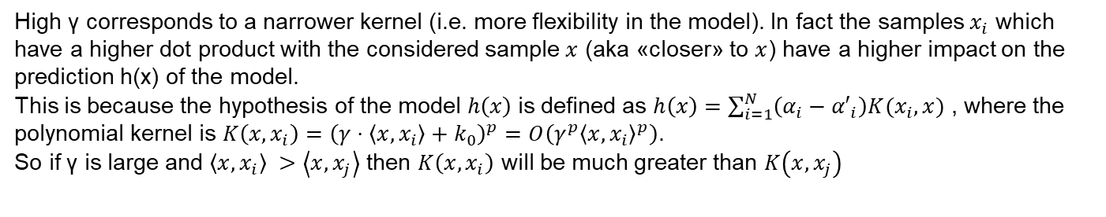
Appendix – 19 Furhter remarks on the hyperparameters’ impact on the error
High γ corresponds to a narrower kernel (i.e. more flexibility in the model). In fact the samples $x_{i}$ which have a higher dot product with the considered sample $x$ (aka «closer» to $x$) have a higher impact on the prediction h(x) of the model.
This is because the hypothesis of the model $h\left(x\right)$is defined as $h\left(x\right)=\sum_{i=1}^{N}{\left(α_{i}−{α′}_{i}\right)K(x_{i},x)}$ , where the polynomial kernel is $K\left(x,x_{i}\right)={\left(γ⋅\left\langle x\right.,\left.x_{i}\right\rangle +k_{0}\right)}^{p}=O\left(γ^{p}{\left\langle x\right.,\left.x_{i}\right\rangle }^{p}\right)$.
So if γ is large and $\left\langle x,x_{i}\right\rangle >\left\langle x,x_{j}\right\rangle$ then $K\left(x,x_{i}\right)$ will be much greater than $K\left(x,x_{j}\right)$
A further interesting consideration that can be made is that since – as seen in the data exploration – all the input features range between -1 and 1, the maximum value that $\left\langle x_{i},x_{j}\right\rangle$ can achieve is 10, the number of features. Hence, with the best values γ=0.1, $k_{0}$=2 and p=4 the maximum value that the kernel can achieve is ${(γ∙10+k_{0})}^{p}=3^{4}=81$.

Slide 46
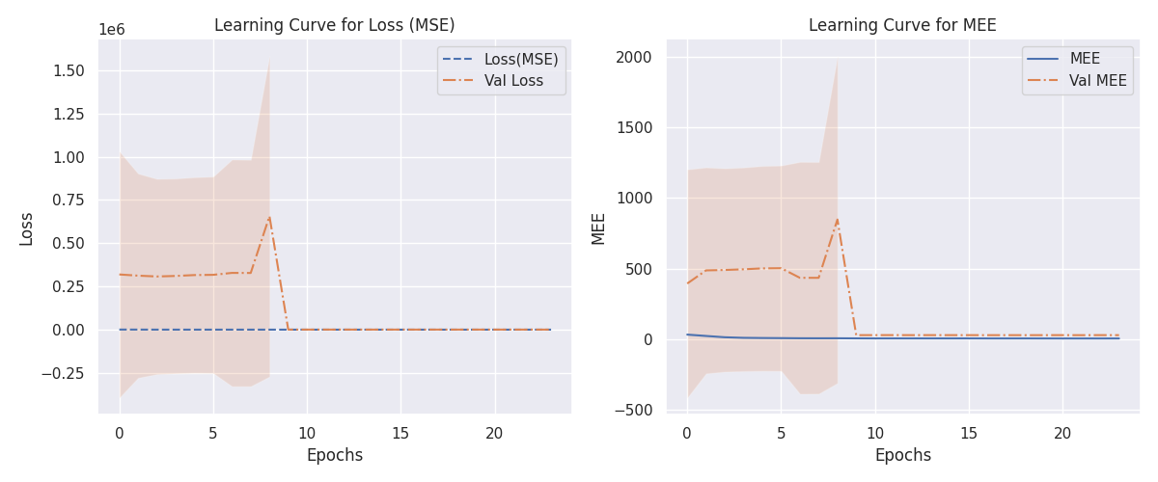
Appendix – 20 TODO? Neural Networks learning curves
Figure 17: Learning curve (MSE, left) and MEE (right) for the NN ensemble with hyperparameters selected by grid search
Table 19: MEE on the datasets, best NN ensemble (grid search, with ES)
Dataset | MSE | MEE
TR | 8.213 | 4.071
VL | 312 | 28.00
TS | 1.303 | 1.486
The variance on the final result (MEE at the last epoch) can’t be assessed because the members of the ensemble are trained for a different number of epochs. The variance among the models in the enseble is very high. This is due to the different weight initialization, and the different training sets.

Slide 47
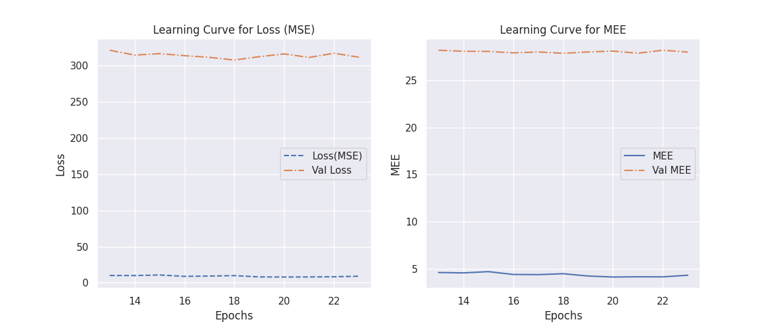
Appendix – 21 Neural Networks learning curves
Figure 18: Learning curve (MSE, left) and MEE (right) for the (grid search) NN ensemble, last 11 epochs
Figure 18 restricts the view on the last 11 epochs. Both the training and the validation losses are stable, with the latter being significantly higher than the former.
The initial error is big, but the model rapidly converges to lower values. The variance didn’t shrink much in the epochs in which it was monitorable, so we think it’s still high at this stage. A high variance is physiological to the ensembles, though.

Slide 48
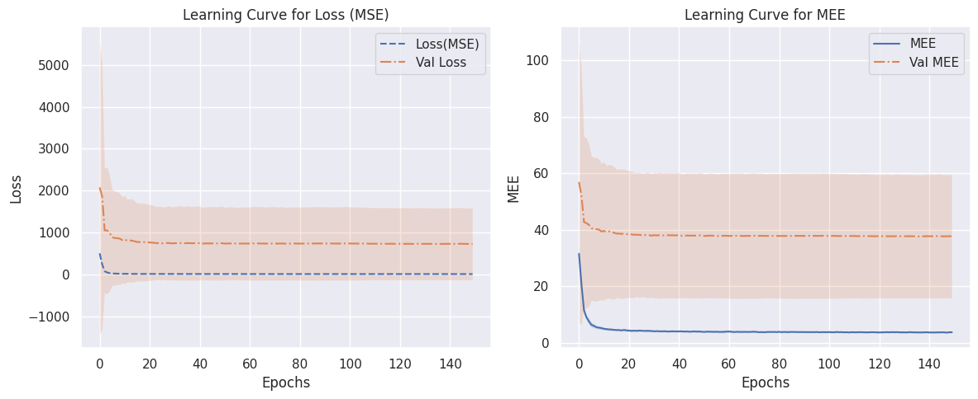
Appendix – 22 Neural Networks learning curves, no early stopping
Figure 19: Learning curve (MSE, left) and MEE (right) for the (grid search) NN ensemble, without early stopping
Table 20: MEE and loss on the datasets of the NN ensemble (grid search, no ES)
Dataset | MSE | MEE
TR | 6.399 ± 1.112 | 3.663 ± 0.293
VL | 727.8 ± 865.2 | 37.69± 21.96
TS | 1.303 | 1.486
The variance of the ensemble is really high in the first epochs, stdev for the VL error maxes out at ~3490 for MSE and ~50 for MEE, but quickly stabilizes at ~20 for MEE and ↨~920 for MSE.
After around 20 epochs there is no tangible improvement, and Early Stopping effectively halts the training where appropriate, allowing to save time and computational resources.

Slide 49
Appendix – 23 TODO? Heatmaps for the Neural Network (grid search) – 1
In the exploration notebook we generated heatmaps such as those used to compare the impact on the (mean VL) MEE of various combinations of hyperparameters for the SVR.
By observing them (see Figure 20 in the next slide for some selected results) the following conclusions can be drawn:
Not using the Nesterov’s momentum always has a configuration with high error. That is, for every other hyperparameter there is a value such that the average MEE achieved by fixing use_nesterov=False and the value for such hyperparameter is the highest possible. Despite this, the best configuration found in the grid search doesn’t use Nesterov’s momentum. In fact, for (almost) every other hyperparameter, the value at which the maximum MEE is achieved isn’t selected in the grid search. The only exceptions are the dropout hyperparameter for the hidden layer and the batch size.
The same analysis can be made for the batch_size and dropout_hidden_rate hyperparameters. It turns out that these three are the only hyperparameters for which this phenomenon occurs.
A higher value for the L2 regularization hyperparameter corresponds to lower average (VL) MEE for every combination of the other hyperparameters. Quindi?

Slide 50
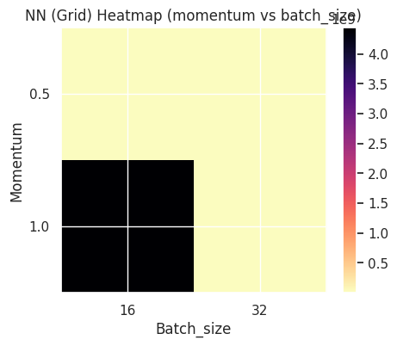
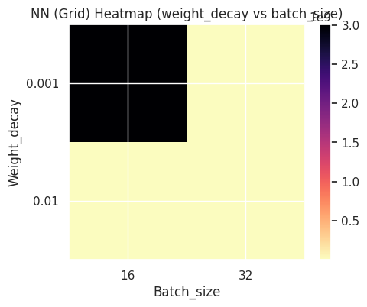
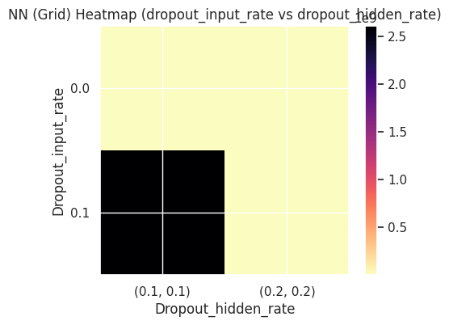
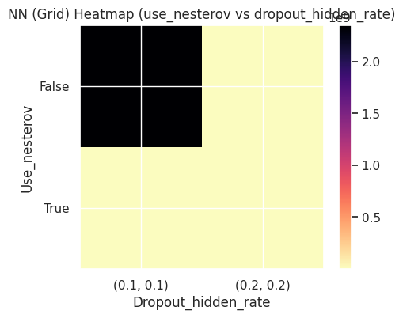




Appendix – 24 Heatmaps for the Neural Network (grid search) – 2
Figure 20: heatmaps showing the impact on the (VL) MEE of various combinations of hyperparameters, for the Neural Network’s hyperparameters in the grid search

Slide 51

Appendix – 25 TODO Neural Networks learning curves, Optuna
Figure 21: Learning curve (MSE, left) and MEE (right) for the NN ensemble with hyperparameters selected by Optuna
Table 21: Error of Optuna’s best NN on the datasets
Dataset | MSE | MEE
TR | 4.369 | 3.037
VL | 185.2 | 22.87
TS | 2.200 | 2.162
The variance on the final result (MEE at the last epoch) can’t be assessed because the members of the ensemble are trained for a different number of epochs.
We notice how, with early stopping, the Optuna ensemble’s (re) training is halted at even less epochs, achieving better results in TR and VL, but worse results in the internal test set.

Slide 52

Appendix – 26 Further comparisons among models: predictions on individual coordinates
Figure 22: true and predicted values on the internal test set
Figure 22 shows how the models exhibit no systematic bias towards underestimation or overestimation, their inaccuracies are evenly distributed across predictions. This holds true also in the NN. More comparisons like this (for each model) can be found in the comparisons notebook.

Slide 53

Appendix – 27 Further comparisons among models: error on each prediction of the TS
Figure 23: error per test sample, SVR and Random Forest
Figure 23 shows how the SVM performed much better than the RF on all the samples in the test set. The RF makes very inaccurate predictions on many samples. Whenever SVM’s predictions are inaccurate, the RF’s predictions are inaccurate as well.

Slide 54

Appendix – 28 Further comparisons among models: spatial collocation of predictions & true values
Figure 24: true and predicted values on the internal test set, Random Forest
Figure 24 shows how the RF’s predictions are farther away from the true values, compared to the SVR’s. The predicted values describe a similar distribution, but one can easily tell that the predictions are off by a small error. In our exploration notebook there are similar comparisons for the Neural Networks.

