Slide 1

ML 2023 Project
Nunzio Canduci, Paolo Junior Mollica, Andrea Marino.
Team name Master degree in Computer Science (Artificial Intelligence curriculum).
a.marino47@studenti.unipi.it,
Altra
altra
Date 01/02/2023
Type of project: B

Slide 2
Objectives and contributions
Our aim for this project is to test various models, built with the help of some libraries (see bibliography), on the Monk and ML23 CUP tasks.
We implemented three classes of models: SVR, Neural Network, Random Forest. The latter was not part of the program for the ML exam.

Slide 3
Random Forest
We used the Random Forests from Scikit-Learn, in particular: RandomForestClassifier for the Monk task; Scikit-Learn’s RandomForestRegressor, in pipeline with a RobustScaler.
Hyperparameter’s choice: full grid search on the following values (for the ML23 Cup): aggiustare
N° of estimators: 100, 150
Maximum depth: 8,10
Minimum samples split: 2, 8, 10
Minimum samples leaves: 1, 3, 4
Maximum features: squared_root, log2

Slide 4
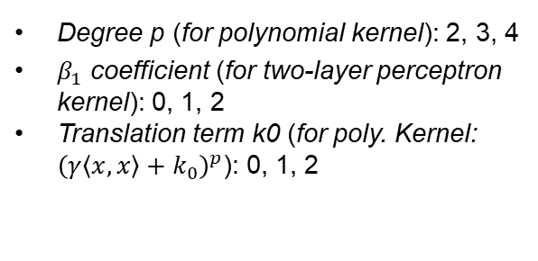
Support Vector Regressors
We used the SVMs from Scikit-Learn, in particular: SVC for the Monk task; Scikit-Learn’s MultiOutputRegressor applied to a SVR, in pipeline with a RobustScaler.
Hyperparameter’s choice: full grid search on the following values:
Kernel: RBF, polynomial, sigmoid (aka two-layer perceptron), linear (only for regression)
C regularization hyperp.: 0.1, 1, 10, 100
Epsilon-tube hyperp. ε: 0.01, 0.1, 1
Degree p (for polynomial kernel): 2, 3, 4
$β_{1}$ coefficient (for two-layer perceptron kernel): 0, 1, 2
Translation term k0 (for poly. Kernel: ${\left(γ\left\langle x\right.,\left.x\right\rangle +k_{0}\right)}^{p}$): 0, 1, 2
Kernel’s parameter γ ($1/\left(2σ^{2}\right)$ for RBF, $γ⋅⟨x,x⟩$ for poly kernel, $β_{0}$ for sigmoid): 0.1, 0.01, 0.001

Slide 5
Neural Network Da finire
We implemented a multilayer feedforward Neural Networks using Keras. We used the SciKeras [4] library to interface this model with Scikit-Learn. For the CUP task we implemented a RobustScaler in pipeline with the Neural Network.
Inizializzazione dei pesi (direi si descrive nel dettaglio nella prox slide). Cfr checklist di ML-23-Report-info
Criterio di arresto (se necessario si descrive nel dettaglio nella prox slide). Cfr checklist di ML-23-Report-info
Hyperparameter’s choice: full grid search on the following values (for the ML23 Cup): aggiustare
Architecture (meaning of (x₁,…,x_{n}): n hidden layers. Layer i has x_{i} units): (64, 64), (128,64), (128,128)
Learning rate η: 0.01, 0.001
Momentum parameter α: 0.7, 0.8, 0.9
Usage of Nesterov’s momentum: True, False
Activation function for the hidden layers: ReLU
Dropout hyperparameter (input layer): 0.1, 0.2, 0.3
Dropout hyperparameter (hidden layers): (0.2, 0.2), (0.3,0.3), (0.3, 0.4)
L2 regularization hyperparameter λ: 10⁻⁴, 10⁻⁵

Slide 6
Models novelties (may be more slides)
Qualche parola sul RobustScaler, e in generale sul preprocessing che si fa.
Inoltre, se sono stati fatti dei test preliminari, delle esplorazioni, possiamo parlarne in maniera molto sintetica (magari qualche esplorazione un po’ random ha aiutato a restringere il dominio della grid search)
Abbiamo usato SciKeras per interfacciare con Scikit-Learn la NN fatta con Keras. Questo perché anche per le NN abbiamo usato Scikit-Learn per la grid search e la scelta degli iperparametri migliori (ottenuti dalla grid search)

Slide 7
Monk Results – Tables 1/2
Table 1: Average prediction results obtained for the Monk’s task, with a SVM
Task | Kernel / C / γ / p / k0 | MSE (TR/TS) | Accuracy (TR/TS)
Monk 1 | Best hyperparameters values |  | Media su diverse inizializzazioni
Monk 2 |  |  | Media su diverse inizializzazioni
Monk 3 |  |  | Media su diverse inizializzazioni
Table 2: Average prediction results obtained for the Monk’s task, with a random forest
Task | Hyperparameters | MSE (TR/TS) | Accuracy (TR/TS)
Monk 1 | Best hyperparameters values |  | Media su diverse inizializzazioni
Monk 2 |  |  | Media su diverse inizializzazioni
Monk 3 |  |  | Media su diverse inizializzazioni

Slide 8
Monk Results – Tables 2/2
Table 3: Average prediction results obtained for the Monk’s task, with a Neural Network
Task | Architecture / optimizer / η / α / λ / epochs / batch_size / … | MSE (TR/TS) | Accuracy (TR/TS)
Monk 1 | Best hyperparameters values | Escludendo penalty terms | Media su diverse inizializzazioni
Monk 2 |  | Escludendo penalty terms | Media su diverse inizializzazioni
Monk 3 |  | Escludendo penalty terms | Media su diverse inizializzazioni

Slide 9
Monk Results – Plots DA FARE
Per i tre task del monk, vuole la learning curve (su TR set e TS set) (MSE per epoca, nel caso di sgd/minibatch vuole che ogni punto corrisponda alla media sull’epoca a cui tale punto si riferisce. Mi sa che le librerie calcolano ciò da sole?)
Per i tre task del monk, bisogna anche plottare l’accuracy (su TR set e TS set) ma su un grafico diverso.
Per modelli che non sono reti neurali, ci sarà qualcosa di analogo?
Ovviamente, si può andare su più slides, senza esagerare

Slide 10
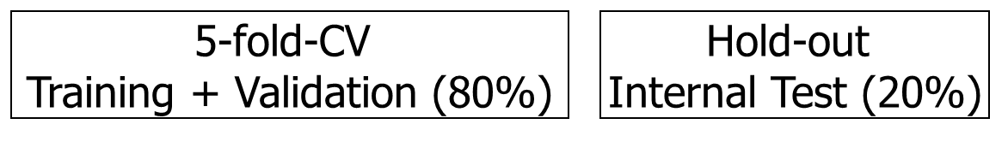
CUP Validation schema: data splitting Aggiungere?
We held out 20% of the data (randomly sampled by fixing the seed for reproducibility) to use it as an internal test set.
On the remaining part of the data we do training and validation following a 5-fold Cross Validation schema. This is done by Scikit-Learn’s GridSearchCV, when the grid search is performed.

Slide 11
CUP Validation schema: model selection
Typically the points 2-3 of the section 3.2 of file “ML-23-Report-info-...”
Schema and range of explored hyper-parameters (values used for the grid search, possibly table/tables): see the file “ML-23-Report-info-...” and also the check list note on the “Model selection”, for the CUP application
The synthesis of the hyperparameters setting must be reported on the slides, while a complete description can be inserted in a document within the code package (call it “hyperparameters-setting”) and in the Appendix slides (selecting what is more relevant).

Slide 12
CUP Results (many slides are possible)
Typically the points 4-9 of the section 3.2 of file “ML-23-Report-info-...”
In particular, do not forget:
to describe “your path” to reach your final model, i.e. the relevant choices that you made and the rational of that choices (selecting the relevant decisions & aspects that deserve to be described according to your feeling)
to specify how you selected the FINAL model (used on the blind test set). Which is it among the candidates and why? Also write the hyper-parameters of the final model
to report for the FINAL model used on the blind test set the TABLE with MEE for TR (training), VL (validation) and TS (internal TS) in the original scale
to report the plot of the learning curve of the final model

Slide 13
CUP Results: final model
We chose XYZ as the final model, with the hyperparameters in Table 4. The results achieved by this model can be seen in Table 5. We chose this model because…
Learning curve plot for the final model
Table 4: Final model’s summary
Hyperparameter | Value
λ
η
α
Nesterov
Activation function
Architecture
Dropout hyperp.
Other1
Other2
Table 5: Final model’s MEE on the datasets
TR: | VL: | TS:

Slide 14
Discussion (may be more slides)
Discuss whether any proposed techniques or novelties improved or not the results, in terms of any performance (efficacy, efficiency, …)
Don’t forget to empathize the novelties that you introduced in your model (prj A or B) or used advanced techniques (prj B) w.r.t. to the results and/or any significant/critical analyses and any interesting finding/insight
I.e: don’t forget a “Discussion/Analysis” answering “what did you learn?” on the Models/Hyperparameters/Results/Efficacy/Efficiency, selecting/highlighting what is more significant in your opinion (time and space constraints helps!)

Slide 15
Conclusions
What you have drawn and what you learned (in short)
Blind Test Results: name of the result files and your nickname

Slide 16
Bibliography - 1
Main libraries and software tools used for this project:
F. Chollet, Keras, GitHub, GitHub Repository, (2015) version 3.0.2
M. Abadi, A. Agarwal et al., 2015, TensorFlow: Large-scale machine learning on heterogeneous systems. www.tensorflow.org
F. Pedergosa, G. Varoquaux et al, Scikit-learn: Machine Learning in Python, JMLR, 12(Oct), (2011), pp.2825-2830
A. Garcia Badaracco et al, SciKeras: Scikit-Learn wrapper for Keras, GitHub, GitHub Repository, (2020) version 0.12.0

Slide 17
Appendix - not shown in the time slot
(may be many slides, but still use a reasonable number)
Material that is complementary to your presentation, but not directly presented: · Use appendix for large or other tables or plots (if needed); the slides out of the limit will be not necessarily read and therefore not necessarily evaluated!!!
Can be used to answer some questions during the oral discussion of the project
In the appendix you can use a smaller font (although readable. e.g. ≥11) and even smaller for tables

