Slide 1
(Algorithmic) Mechanism Design
Paolo Penna
Notes:
Majana Institute of Technology
Via der Canaro1100

Slide 2
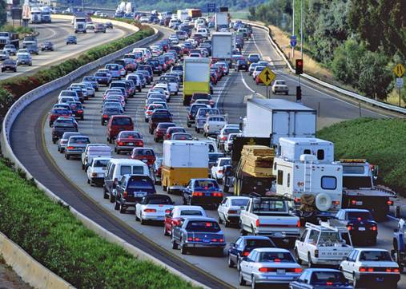
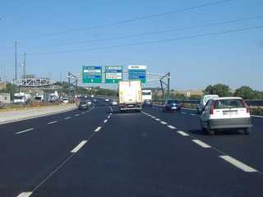

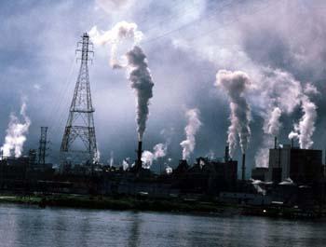
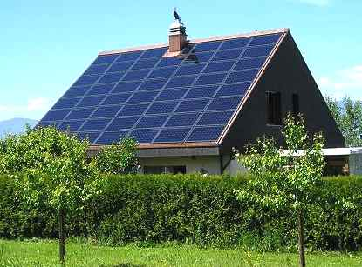
Mechanism Design
Find correct rules/incentives

Slide 3


Not in this talk
Mechanisms without money
(voting)
Fish
Meat
Vegetarian
Coordination mechanisms
This talk

Slide 4
Example: BGP
Congestion
AS1
destination
source
AS2

Slide 5
A Toy Problem
100
2
s
d
10
private costs

Slide 6
A Toy Problem
9.999
2
s
d
10
Payments:
declared cost

Slide 7
A Toy Problem
9.999
2
s
d
10
Payments:
2nd best cost
utility(“truth”) = 10 – 2 ≥ utility(“false”)
Truthful Mechanism

Slide 8
VCG Mechanisms
Algorithm: Minimize the sum of all costs
SP, MST, Steiner Tree, …
Payments:
opt
2nd best sol
Truthful Mechanism
(Vickerey'61 – Clarke'71 – Groves'73)

Slide 9
VCG Mechanisms
Algorithm: Minimize the sum of all costs
NP-hard
Min-Max?
SP, MST, Steiner Tree, …
Payments:
opt
2nd best sol
Truthful Mechanism
(Vickerey'61 – Clarke'71 – Groves'73)

Slide 10
Other Mechanisms?
Players Costs
Global Costs
any
sum
All truthful mechanisms are VCG
(Roberts'79)
“simpler”
“more”
Other mechanisms exist
(Myerson'81,..., Saks&Yu'05,...)

Slide 11
Mechanism Design ≡ Algorithm Design
Truthful
mechanism
(A, P)
Monotone
algorithm
A
t1
t1
any
problem
s
d
s
d
t2
t2
...
selectedi
worki
suitable
inequality
ti
ti
(Myerson'81,...,Bikhchandani et al'06, Saks&Yu'05,...)

Slide 12
Monotone Algorithms?
3
t1
s
d
worki
2
t2
2
ti
Greedy:
not monotone
2
2
3
3
2
2
1+ℇ
1
(1+ℇ)²
1
1+ℇ

Slide 13
Monotone Algorithms?
3
t1
s
d
worki
2
t2
2
ti
Redesign approximation algorithms:
PTAS or FPTAS still possible for related machines
(...,Andelman et al'07, Christodoulou&Kovacs'10)

Slide 14
Monotonicity
Truthful
mechanism
(A, P)
Monotone
algorithm
A
Yes monotone
c-APX algorithm
No monotone
c-APX algorithm
Unrelated machines: truthful APX is between 2 and m
(Nisan&Ronen'99)
Conjecture: m
Complexity is not an issue (PTAS)

Slide 15
Problem Classification
on/off
one-parameter
multi-parameter
arbitrary
sum,
min-max, max-min...
sum (VCG)
only this (Roberts')
VCG with polytime algos (Nisan&Ronen'00):
Can be arbitrarily bad
Feasibly-truthful (hard for mechanism ⇔ hard to cheat)

Slide 16
Problem Classification
on/off
one-parameter
multi-parameter
arbitrary
sum,
min-max, max-min...
sum (VCG)
only this (Roberts')
Polytime or truthful alone is possible, but not both together
(Papadimitriou&Schapira&Singer'08)

Slide 17
Problem Classification
on/off
one-parameter
multi-parameter
arbitrary
sum,
min-max, max-min...
sum (VCG)
only this (Roberts')
False-identities can manipulate VCG (Yokoo&Sakurai&Matsubara'04)

Slide 18
Even more problems:
Collusion
Budget

Slide 19
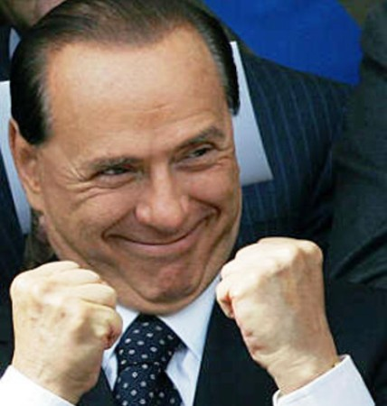
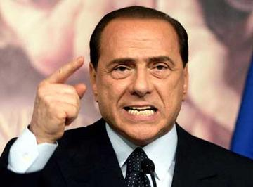
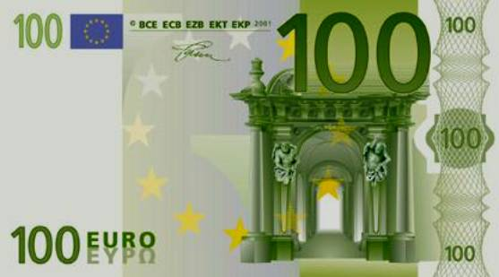
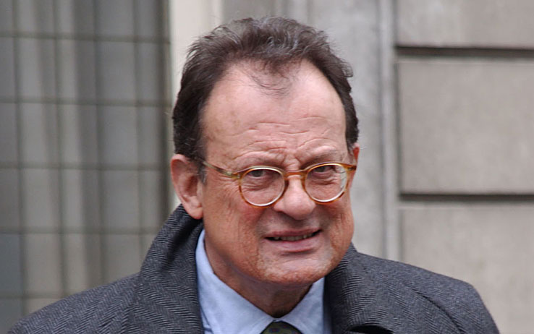
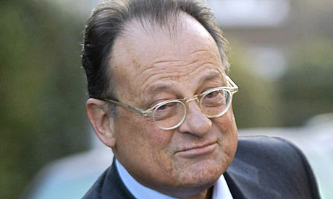
Collusion
No “useful” mechanism is collusion-resistant
(Schummer'00)
Payments:
2nd best
2
s
d
10
1000

Slide 20
Budget
Payments:
2nd best
2
s
d
10000

Slide 21
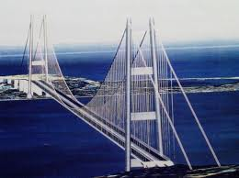
Budget
Global cost: C(S) – v1(S) - v2(S)
s
Algorithm: min Global cost
1
Payments:
d
opt
2nd best sol
v1
v2
No budget, no collusion-resistant

Slide 22
Cost-sharing
Users
service
S
C(S)
VCG
Moulin'99
max
Valuations - C(S)
Collusions
Budget-balance
Mutually exclusive
(...,Feigenbaum et al'03)

Slide 23
Cost-sharing
Moulin
Users
P(S,i)
service
S
C(S)
First the payments ∑iP(S,i) = C(S)
Algorithm: offer prices...until all accept
S0
Users
S1
S2
...

Slide 24
Cost-sharing
Moulin
Users
P(S,i)
service
S
C(S)
Monotone payments ⇒ truthful
≥ ≥
S0
S1
S2
...

Slide 25
Similarities
Moulin:
Repeated
Best-response
S0
S1
S2
...
Real BGP:
Repeated
Best-response
AS1
source
destination
AS2
BGP converges, collusion-proof, “budget-balance” (...,Gao&Rexford'01,...,Sami&Schapira&Zohar'09,...)

Slide 26
Unifying Theory
Moulin,...
BGP
Repeated
Best Response
on “nice” Game
TCP Games
Stable
Matching
Converge + Incentive Compatible
(Nisan&Schapira&Valiant&Zohar'11)

Slide 27
Unifying Theory
Moulin,...
BGP
1, 1 | 3, 0
0, 3 | 2, 2
Repeated
Best Response
on “nice” Game
TCP Games
Stable
Matching
Converge + Incentive Compatible
(Nisan&Schapira&Valiant&Zohar'11)

Slide 28
Unifying Theory
Moulin,...
BGP
2, 2 | 4, 1 | 0, 0
1, 4 | 3, 3 | 1, 3
1, 2 | 2, 2 | 0, 5
TCP Games
Stable
Matching
Converge + Incentive Compatible
(Nisan&Schapira&Valiant&Zohar'11)

Slide 29
Thank You

