Slide 1
Optimal collusion-resistant mechanisms with verification
Paolo Penna and Carmine Ventre
Università di Salerno, Italy

Slide 2
The Internet
Open, self organized, no central authority, anarchic
Different “components” which
  have their own goal
  may not follow the “protocol”
Selfish/rational agents

Slide 3
Example: BGP Routing
Link down
AS1
destination
source
AS2
An Autonomous System may report false link status to redirect traffic to another AS

Slide 4
Toy Problem
Routing cost (time/latency)
C1
∞
0
source
destination
C2
∞
0
Algorithm: smallest cost
Payment (large enough)

Slide 5
Toy Problem
Routing cost (time/latency)
C1
source
destination
C2
Algorithm: smallest cost
Payment: 2nd smallest cost

Slide 6
Toy Problem
Routing cost (time/latency)
5: 10 – 5
6: 10 – 5
11: 0 – 0
5
source
destination
10
10: 0 – 0
4: 5 – 10 = – 5
Algorithm: smallest cost
Payment: 2nd smallest cost
Truthful mechanism
A truthtelling agent maximizes his/her utility

Slide 7

Toy Problem
Routing cost (time/latency)
5: 10 – 5
5
5: 100 – 5
source
destination
10
100
Algorithm: smallest cost
Payment: 2nd smallest cost
Truthful mechanism
Collusion

Slide 8
Previous Results
Every collusion-resistant mechanism must output a fixed solution [Schummer00, Goldberg&Hartline05]
Even truthful mechanisms have some limitations
Useless (unbounded approximation)
Inapproximability results [Nisan&Ronen99]…

Slide 9
Our Contribution
VCG Payments
[Vickrey61,Clarke71,Groves78]
Verification
[Nisan&Ronen99]
Collusion-resistant mechanisms with verification
Opt solutions & resist to all coalitions
Without Verification | With Verification
Unbounded APX for collusion resistant, No truthful c-APX | Collusion-resistant (1+ε)-APX

Slide 10
Verification
5
source
10
destination
4
Algorithm: smallest cost
Observe latency “10” or larger
Ri(x) < Ci(x) ⇒ “caught lying” ⇒ no payment

Slide 11
VCG Payments
Loss
Subjective cost
+
Payment
Social cost
The mechanism and the agent have the same objective

Slide 12
VCG Payments
Subjective cost
+
Ci(x)
C1(x) +… + 0 + … + Cn(x)
Payment
C1(x) +… + Ci(x) + … + Cn(x)
The mechanism and the agent have the same objective

Slide 13
VCG Payments
Subjective cost
+
Ci(x)
C1(x) +… + 0 + … + Cn(x)
R1(x) +… + 0 + … + Rn(x)
Payment
C1(x) +… + Ci(x) + … + Cn(x)
Utility = Q – Social cost
Utility = Q – Presumed cost

Slide 14
Main Ideas
Agents
Agents
Agents
C
C
C
Truthful
None caught lying
Somebody caught lying
Looses high payment
Others cannot compensate

Slide 15
Main Ideas
Agents
Agents
C
C
Truthful
None caught lying
Cj(x) ≤ Rj(x)
“optimal” algo
Social Cost
≤
Presumed Cost
Q - Social Cost
≥
Q - Presumed Cost

Slide 16
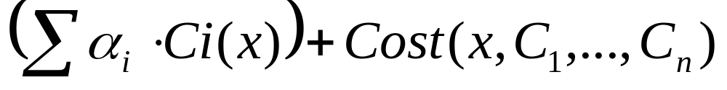
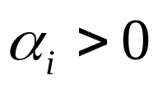
Main Result
Theorem: Collusion-resistant mechanism with verification for general social cost functions of the form
with and arbitrary bounded costs.
An extension of the VCG theorem
VCG
Any “reasonable” cost function

Slide 17
Conclusions
Power of verification:
  first collusion-resistant mechanisms
  better approximations, poly-time mechanisms
Applications:
  inter-domain routing , scheduling, min-max
Questions:
  truthful approximations (“optimal” algos)
  bounded costs

Slide 18
Thank You

