Slide 1
Optimal collusion-resistant mechanisms with verification
Paolo Penna Carmine Ventre
Università di Salerno University of Liverpool
Italy UK

Slide 2



Ideal World
In practice…

Slide 3
The Internet
Open, self organized, no central authority, anarchic
Different “components” which
  have their own goal
  may not follow the “protocol”
Selfish/rational agents

Slide 4
Example: BGP Routing
Link down
AS1
destination
source
AS2
An Autonomous System may report false link status to redirect traffic to another AS

Slide 5
Toy Problem
Routing cost (time/latency)
C1
∞
0
source
destination
C2
∞
0
Algorithm: smallest cost
Payment (large enough)

Slide 6
Toy Problem
Routing cost (time/latency)
C1
source
destination
C2
Algorithm: smallest cost
Payment: 2nd smallest cost

Slide 7
Toy Problem
Routing cost (time/latency)
7: 10 – 7
8: 10 – 7
11: 0 – 0
7
source
destination
10
Algorithm: smallest cost
Payment: 2nd smallest cost
Truthful mechanism
A truthtelling agent maximizes his/her utility

Slide 8

Toy Problem
Routing cost (time/latency)
7: 10 – 7
7
7: 100 – 7
source
destination
10
100
Algorithm: smallest cost
Payment: 2nd smallest cost
Truthful mechanism
Collusion

Slide 9
Previous Results
Every collusion-resistant mechanism must output a fixed solution [Schummer00][Goldberg&Hartline05]
  Useless (unbounded approximation)
Even truthful mechanisms have some limitations
  Inapproximability results [Nisan&Ronen99]…
  [Christodoulou&Koutsoupias&Vidali07][Mu’alem&Schapira07] [Gamzu07][Koutsoupias&Vidali07]

Slide 10
Our Contribution
VCG Payments
[Vickrey61,Clarke71,Groves78]
Verification
[Nisan&Ronen99]
Collusion-resistant mechanisms with verification
Opt solutions & resist to all coalitions
 | Without verification | With verification
Collusion resistant | ∞ | 1 + ε
Truthful | c > 2

Slide 11
Verification
7
source
10
destination
6
Algorithm: smallest cost
Observe latency “10” or larger
understate cost ⇒ “caught lying” ⇒ no payment

Slide 12
VCG Payments
Loss
Subjective cost
+
Payment
Social cost
The mechanism and the agent have the same objective

Slide 13
VCG Payments
Subjective cost
+
Ci(x)
C1(x) +… + 0 + … + Cn(x)
R1(x) +… + 0 + … + Rn(x)
Payment
C1(x) +… + Ci(x) + … + Cn(x)
Utility = Q – Social cost
Utility = Q – cost’

Slide 14
Main Ideas
Agents
Agents
Agents
C
C
C
Truthful
None caught lying
Somebody caught lying
Looses high payment
Others cannot compensate

Slide 15
Main Ideas
Agents
Agents
C
C
Truthful
None caught lying
Cj(x) ≤ Rj(x)
“optimal” algo
Social Cost
≤
Cost’
Q - Social Cost
≥
Q – Cost’

Slide 16
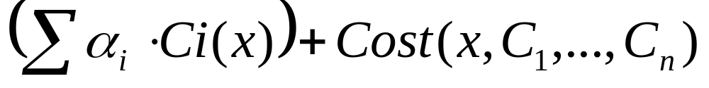
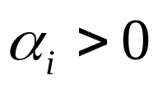
Main Result
Theorem: There exists a collusion-resistant mechanism with verification minimizing any cost function of the form
with and arbitrary bounded costs.
An extension of the VCG theorem
VCG
Any “reasonable” cost function

Slide 17
Conclusions
Power of verification:
  first collusion-resistant mechanisms
  better approximations, poly-time mechanisms
Applications:
  inter-domain routing , scheduling, min-max
Questions:
  truthful approximations (“optimal” algos)
  bounded costs

Slide 18
Thank You

