Slide 1
Energy-Efficient Broadcasting in Ad-Hoc Networks: Combining MSTs with Shortest-Path Trees
Carmine Ventre
Joint work with
Paolo Penna
Università di Salerno

Slide 2



The problem
A set of stations S located on a 2d Euclidean space
A source station s
Build a “good” multicast tree
  Broadcast (one to all)
  Unicast (one to one)
MST is a c-apx for the broadcast when α is “good” ([WCLF01], [CCPRV01])
  For α=2, c·12
SPT is the optimum for the unicast
s
MST · c ¢ OPT_{brd}

Slide 3
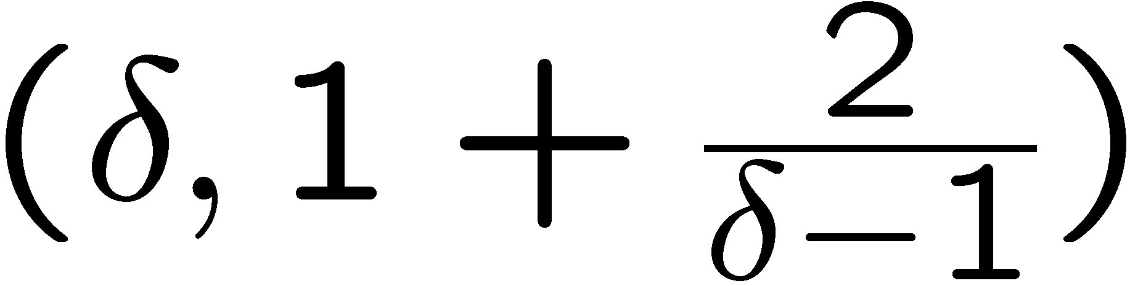
The “compromise”
Suppose we have a tree T such that:
  T is β-apx for the MST’s total edge cost
  T is β’-apx for the SPT (the path from s to every node d is at most β’ times the one in the SPT)
Using T as “multicast” tree we have:
  A 12β apx for the cost of the broadcast
  A β’ apx for every unicast
[KRY95] provides a polynomial time algorithm for such a tree (called LAST tree)
  In particular their algorithm gives us a LAST
λ_{δ}
β’
β

Slide 4
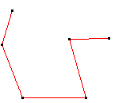
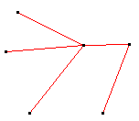
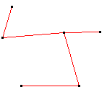
The “new” algorithm: idea
The algorithm has as input:
  The MST of the Euclidean 2d graph
  The SPT of the Euclidean 2d graph
  The approximating factor: δ
It works on the MST
Modifying the MST it obtain the LAST tree
MST
SPT
LAST with δ = 1.20

Slide 5
LASTs in practice
For δ = 2 (and α = 2) we have a (2,3)-LAST
  2-apx for the unicast cost
  (3 ¢ 12 = ) 36-apx for the broadcast cost
What about LASTs in the “real world”?
Is it possible that some “real” bound is well below the theoretical one?

Slide 6
Our work
We generate randomly (with uniform distribution) several thousands of instances
We experimentally evaluate:
  λ_{δ} := COST(LAST) / COST(MST)
  σ_{δ} := COST(SPT) / COST(MST)
    Using best ratios we provide a lower bound for MST (to be compared with the experimental bound in [CHPRV03])
  Cost of unicast (δ)
  Upper bound on the performance of SPT and LAST (comparing their cost function with the weight of the MST)

Slide 7
Cost of broadcast for δ=2, α=2
Notice that the worse λ₂^{exp} is 1.463 for this experiments
For α = 2, δ = 2 the worse λ₂^{exp} is 1.572 (obtained for small instances, i.e. from 5 to 10 stations)

Slide 8
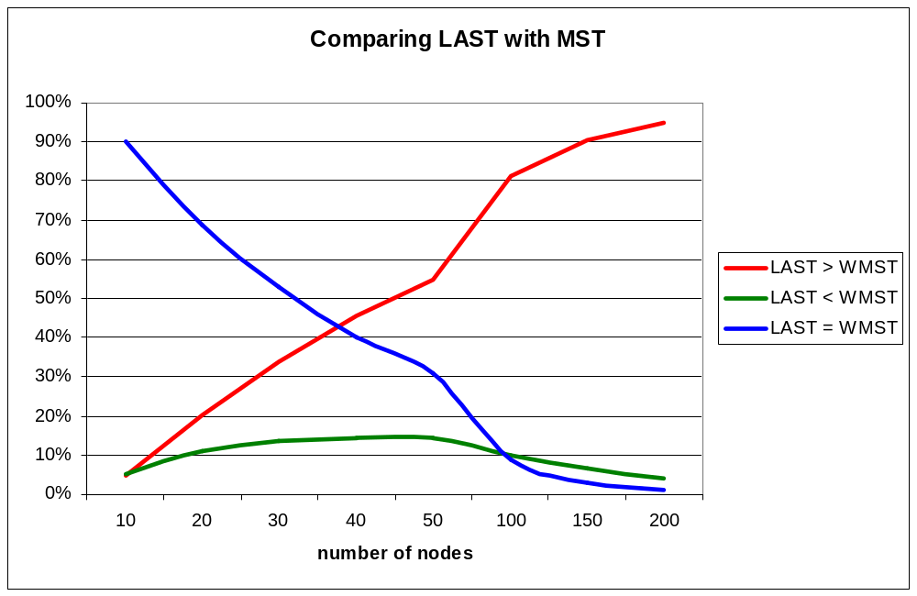
Cost of broadcast for δ=2, α=2 (2)

Slide 9
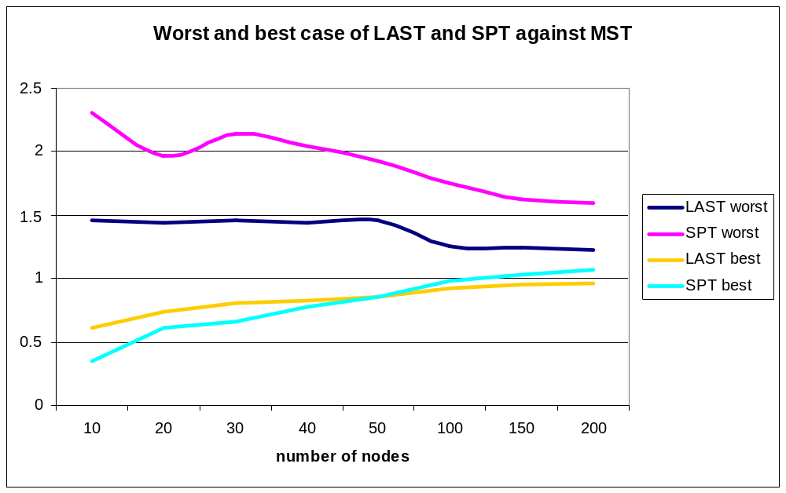
Cost of broadcast for δ=2, α=2 (3)

Slide 10
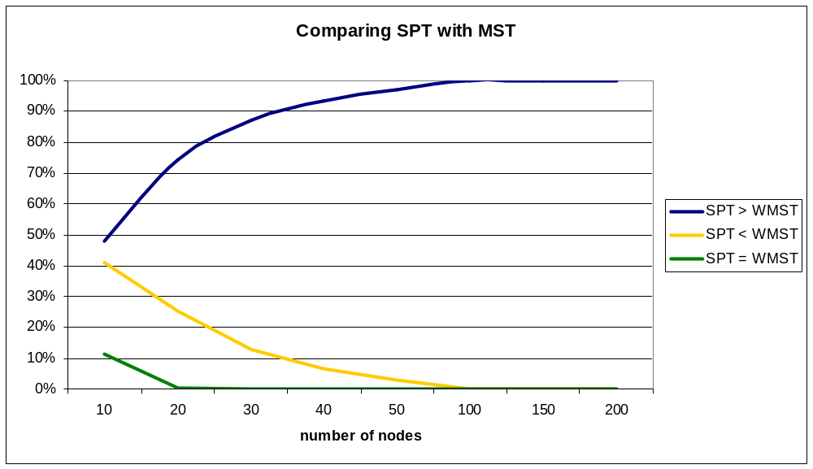
Cost of broadcast for δ=2, α=2 (4)

Slide 11
Cost of unicast for δ=2, α=2
Notice that the theoretical bound is tight
MST is always worsen then the LAST for the unicast
This results are confirmed also for different α and different network size (small instances)

Slide 12
Adjusting the parameter δ
We obtain slightly higher λ_{δ}^{exp} then before
The “gap” is important also considering the advantages for the unicast

Slide 13
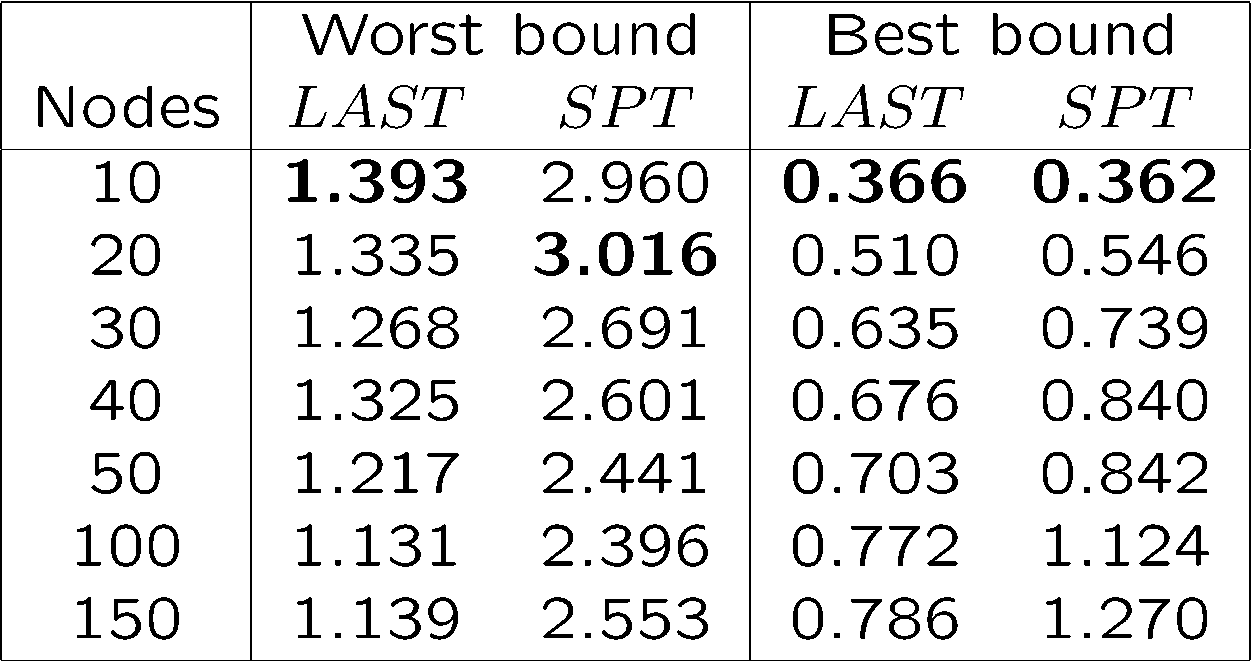
Cost of broadcast: upper bounds
Recall that this experimental values have to be multiplied by the constant factor c of MST apx
  For α = 2 LAST is a 12¢1.393-apx for the broadcast

Slide 14
Other experiments
The result showed are the output of:
  10,000 random instances for every “large” network (from 10 nodes up to 200)
  50,000 random instances for every “small” networks (from 5 nodes up to 10)
The experiments are also computed for different values of α (4 and 8)
  Similar values/results
  i.e. worst λ₂^{exp} for α = 4 is 1.453 (wrt 1.463 for α = 2)

Slide 15
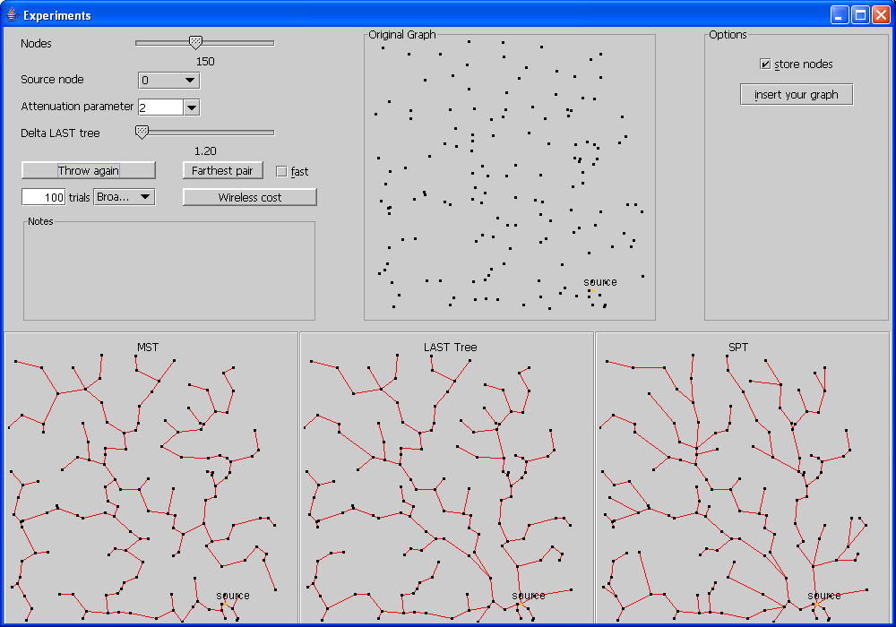
The software
Code and applet available at: www.dia.unisa.it/~ventre

Slide 16
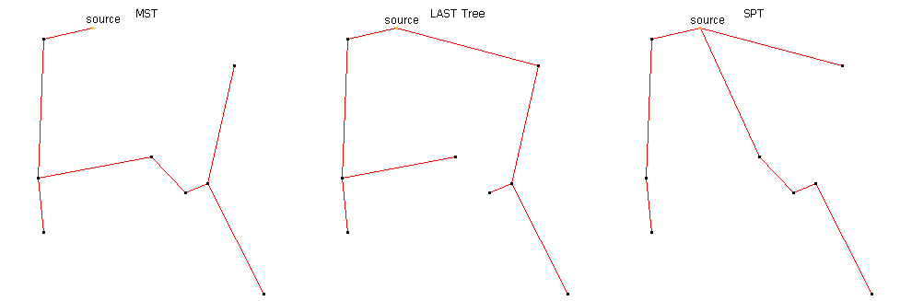
Some “nice” instance
The worst instance for LAST (α =2, δ = 2) (1.572 times the MST cost)

Slide 17
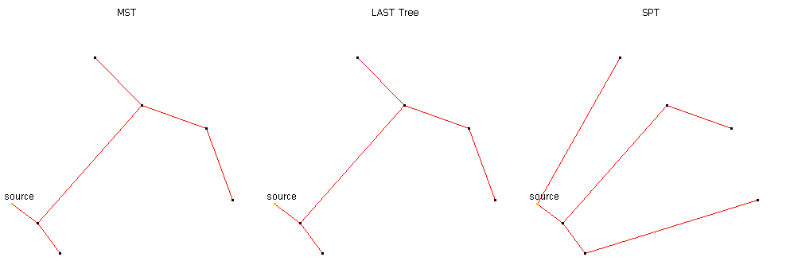
Some “nice” instance (2)
The worst instance for SPT (α =2, δ = 2) (2.493 times the MST cost)

Slide 18
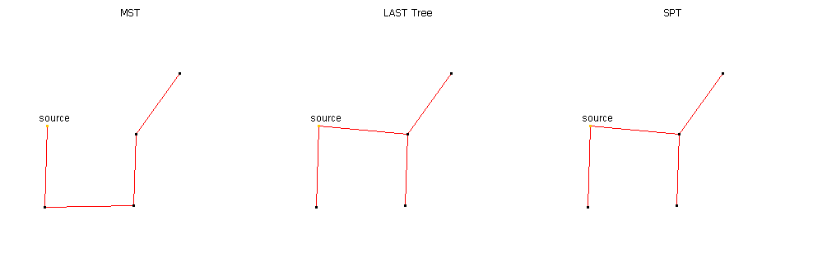
Some “nice” instance (3)
The best instance for LAST (α =2, δ = 2) (0.537 times the MST cost)

Slide 19
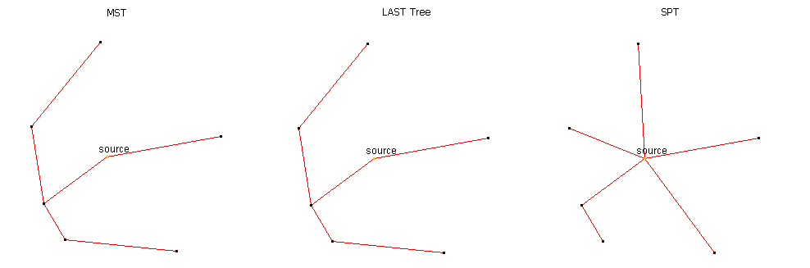
Some “nice” instance (4)
The best instance for SPT (α =2, δ = 2) (0.353 times the MST cost)

Slide 20
Open problems
Lower bounds on the apx ratio of the LAST
  Is there an instance for which the LAST is at most 6 times the OPT?
Upper bound on the apx ratio of the LAST (independent from the MST apx constant c)
Constant apx for the multicast problem

