Slide 1
Sharing the cost of multicast transmissions in wireless networks
Carmine Ventre
Joint work with
Paolo Penna
University of Salerno

Slide 2



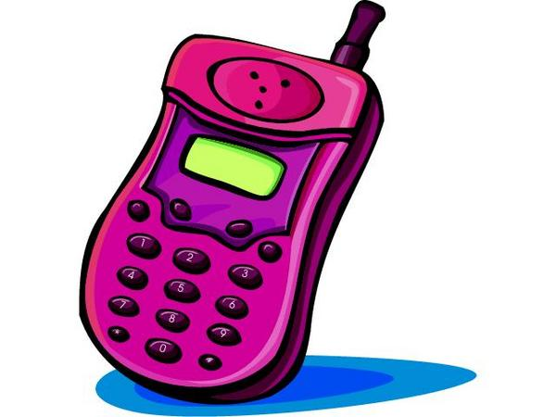
Wireless transmission
Power(i)= d(i,j)^{α} = range(i) ^{α}, α>1 (empty space α = 2)
A message sent by station i to j can be also received by every station in transmission range of i
d(i,j)^{α}
i
j

Slide 3

Wireless multicast transmission
known
10€
1€
1€
3€
source
Gennaro 1€
Carmine 1€
Alessandro 10€
Paolo 30€
Pino 50€
private
Who receives the match Lakers-Pistons
How to transmit
Goal: maximize
Benefit – Cost
i.e. the social welfare

Slide 4
Selfish agents
WYSWYP (What You Say What You Pay)
source
COST = 10 + 5 = 15
WORTH = 50 + 30 = 80
NET WORTH = 80 – 15 = 65
10
0 €
Pino 50 €
5.1 €
5
Pino says 0 € and gets
Lakers - Pistons
for free
Paolo says 5.1 €
Pino says 0 €
Paolo says 5.1 € and gets
Lakers - Pistons
for a lower price
Paolo 30 €
Nobody gets
Lakers - Pistons
10
Gennaro 9 €
NW’ = 0

Slide 5

Graph model
A complete directed weighted communication graph G=(S,E,w)
w(i,j) = cost of link (i,j)
  w(1,4) = d(1,4)^{2.1}
  w(1,2) = d(1,2)⁵
  w(2,4) = ∞
  w(4,2) = d(4,2)^{2.1}
A source node s
v_{i} = private valuation of agent i
v₁
1
2
v₂
v₄
4
3
v₃

Slide 6
Mechanism design
Mechanism: M=(A,P)
Computes a solution
X=A(b₁,b₂,…, b_{i} ,…,b_{n} )
Asks for money
P_{i}(b₁,b₂,…, b_{i} ,…,b_{n} )
v_{i} if i receives
benefit_{i}(X,v_{i})
0 otherwise
Agents’ GOAL: maximize their own utility
u_{i} (b₁,b₂,…, b_{i} ,…,b_{n} ) := benefit_{i}(X,v_{i}) - P_{i}(b₁,b₂,…, b_{i} ,…,b_{n} )

Slide 7
Mechanism’s desired properties
No positive transfer (NPT)
  Payments are nonnegative:
  P_{i} ≥ 0
Voluntary Participation (VP)
  User i is charged less then his reported valuation b_{i} (i.e. b_{i} ≥ P_{i})
Consumer Sovereignty (CS)
  Each user can receive the transmission if he is willing to pay a high price.

Slide 8
Mechanism’s desired properties: Incentive Compatibility
Strategyproof (truthful) mechanism
  Telling the true v_{i} is a dominant strategy for any agent
Group-strategyproof mechanism
  No coalition of agents has an incentive to jointly misreport their true v_{i}
  Stronger form of Incentive Compatibility.

Slide 9
Mechanism’s desired properties: Optimality
Cost Optimality (CO)
  The multicast tree is optimal w.r.t. the receivers set:
  COST(T) = min {COST(T’)| T’ reaches the same users as T}
Approximation (r-CO):
  COST(T) = r ·min {COST(T’)| T’ reaches the same users as T}

Slide 10
Mechanism’s desired properties
Budget Balance (BB)
  ΣP_{i} = COST(T) (where T is the solution)
Efficiency (NW)
  the mechanism should maximize the
  NET WORTH(T) := WORTH(T)-COST(T)
  where WORTH(T):= Σ_{i∈T} v_{j}
Mutually exclusive!!
Efficiency ⇒ No Group strategy-proof

Slide 11
Previous work
Wireless broadcast
  1-dim: COST_{opt} in polynomial time [Clementi et al, ‘03]
  2-dim: NP-hard, MST is an O(1)-apx [Clementi et al, ‘01]
  On graphs: Θ(log n)-apx [Guha et al ‘96, Caragiannis et al, ‘02]
  Many others…
Wired cost sharing (selfish receivers)
  Distributed polytime truthful, efficient, NPT, VP, and CS mechanism for trees (no BB) [Feigenbaum et al, ‘99]
  Budget balance, NPT, VP, CS and group strategy-proof mechanism (no efficiency) [Jain et al, ‘00]
  No α-efficiency and β-BB for each α, β > 1 [Feigenbaum et al, ‘02]
  polytime algorithm ⇒ no R-efficiency, for each R > 1 [Feigenbaum et al, ‘99]
Wireless cost sharing [Bilò et al, to appear in SPAA04]
  1-dim: BB, CO, NPT, VP, CS and Group strategyproof
  1-dim: Efficiency, CO, NPT, VP, CS and Strategyproof
  d-dim: 2(3^{d}-1)-BB, 2(3^{d}-1)-CO, NPT, VP and CS (no Efficiency)
  trees: Efficiency, NPT, VP, CS and Strategyproof

Slide 12
Our results
G is a tree
  NW_{opt} in polytime distributed algorithm
  Polytime distributed mechanism M=(A,P) truthful, efficient, NPT, VP and CS
  Extensions to “metric trees” graphs
G is not a tree
  2d: NP-hard to compute NW_{opt}
  1d: Polytime mechanism M=(A,P) truthful, NPT, VP, CS and efficient (i.e. NW is maximized)
  Precompute an universal multicast tree T ⊆ G
    A polytime truthful, NPT, VP and CS mechanism
    O(1) or O(n)-efficiency, in some cases
  polytime algorithm ⇒ no R-efficiency, for every R > 1

Slide 13

VCG Trick (marginal cost mechanism)
Utilitarian problem:
  ∀ X∈sol, measure(X)=Σ_{i} valuation_{i}(X)
A_{opt} computes X ∈sol maximizing measure(X)
∃P_{VCG}: M=(A_{opt}, P_{VCG}) is truthful

Slide 14
VCG Trick (marginal cost mechanism)
Making our problem utilitarian:
measure(X)
= Σ_{i}
valuation_{i}(X)
WORTH(X)-COST(X)
Σ_{i∈X}
v_{i}
- c_{i}
= WORTH(X)
- COST(X)
c_{i}
Initially, charge to every receiver i
the cost c_{i} of its ingoing connection
v_{i}
P_{i} = c_{i} + P_{VCG}

Slide 15
Free edges on Trees
recursion?
tree
graph
s
s
1
2
3
1
2
3
4
5
4
5
4
5
4
5
3
4
3
4
NO!
YES!

Slide 16
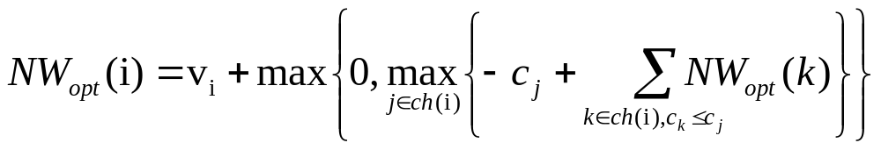
Trees algorithm: recursive equation
The best solution has an optimal substructure!
It is easy to compute NW_{opt}(s) in distributed bottom-up fashion
O(n) time, 2 msgs per link
v_{i}
i
c_{j}
j
k s.t. c_{k} ≤ c_{j}

Slide 17
Trees with metric free edges
Path(i,4)=w(i,1)+w(1,4)
w(i,3) ≥ path(i,4)
(i,4) metric free edge
i
7
5
6
1
2
3
1
5
4
5

Slide 18
Tree with metric free edge: idea
A node k reached for free gets some credit
i
k gets c_{j}-c_{k}
units of credit
c_{j}
c_{k}
j
k

Slide 19
The one dimensional Euclidean case
Stations located on a line (linear network)
1
i
s
j
n
receivers
Clementi et al algo

