Slide 1
S. No. | Module | Samples | Passed | Failed | Warnings
1 | Adapter Content | 24 | 24
2 | Basic Statistics | 24 | 24
3 | Overrepresented sequences | 24 | 24
4 | Per base N content | 24 | 24
5 | Per base sequence content | 24 |  | 22 | 2
6 | Per base sequence quality | 24 | 24
7 | Per sequence quality scores | 24 | 24
8 | Per sequence GC content | 24 | 24
9 | Per tile sequence quality | 24 | 24
10 | Sequence Duplication Levels | 24 |  | 22
11 | Sequence Length Distribution | 24 | 24

Slide 2
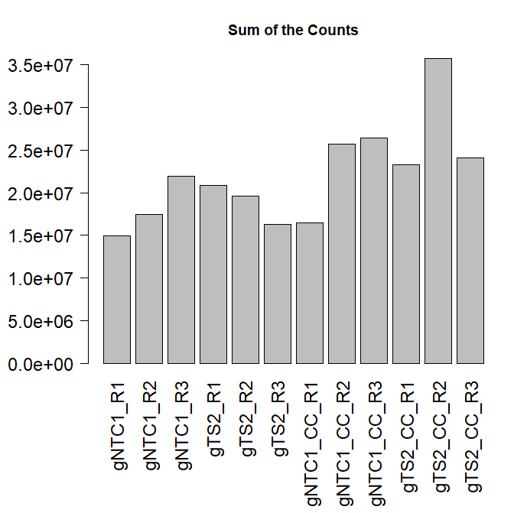
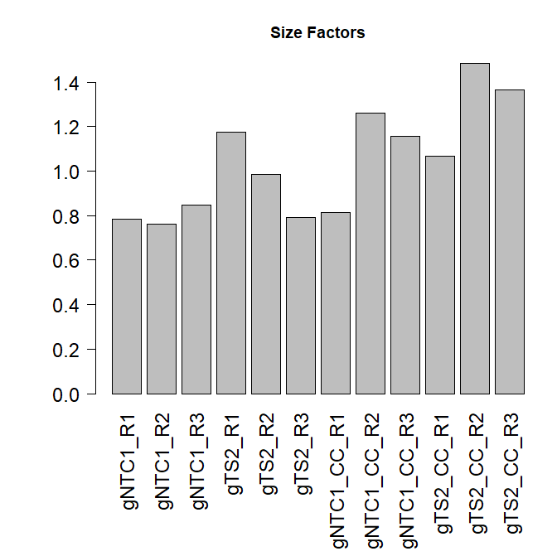
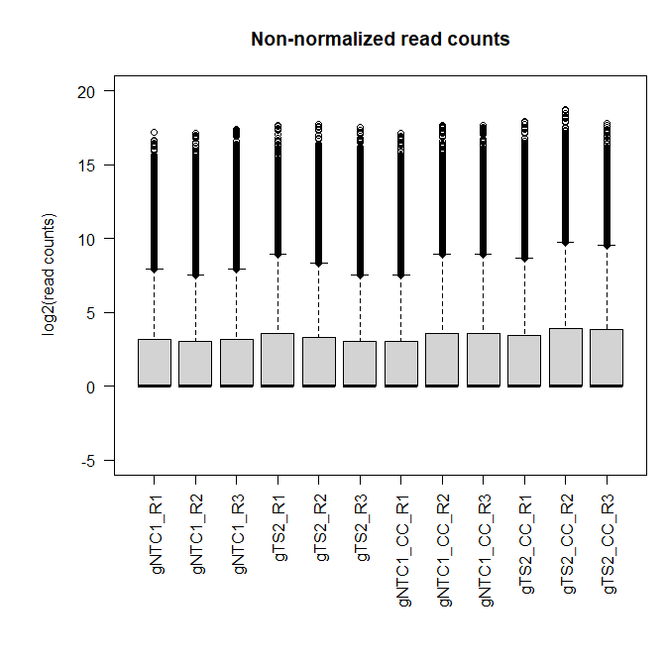
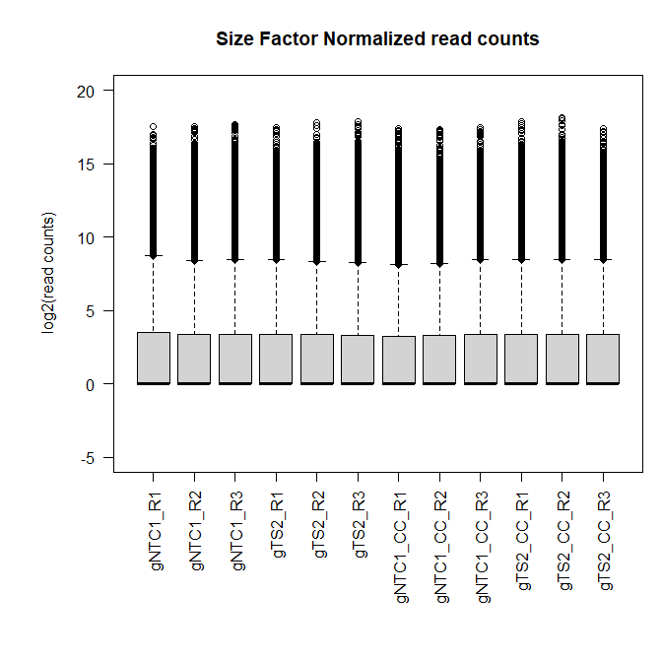

Slide 3
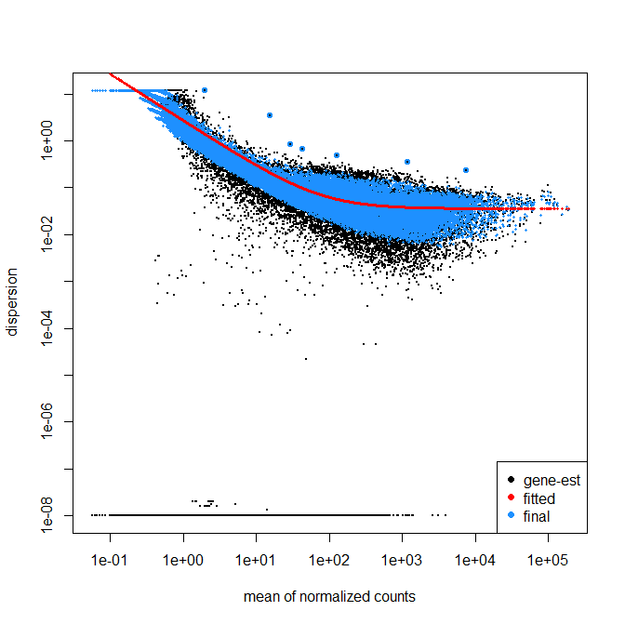

Slide 4
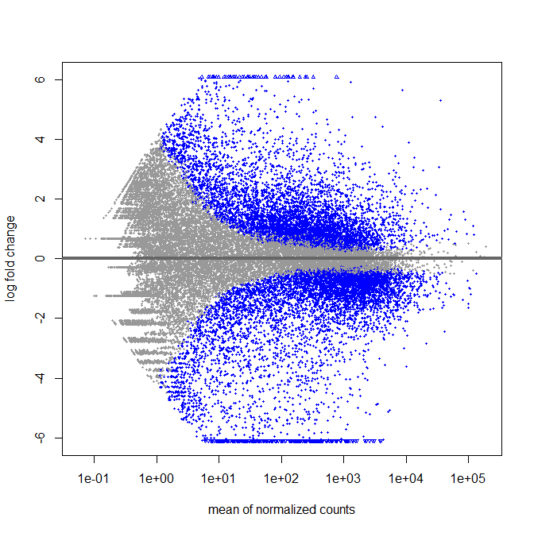
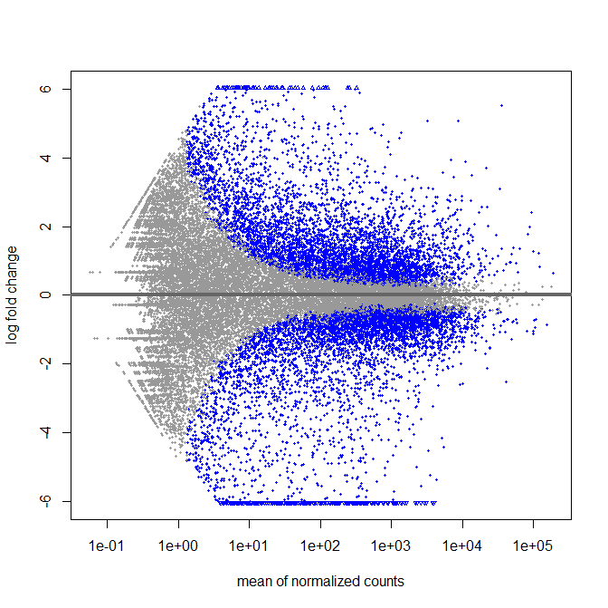
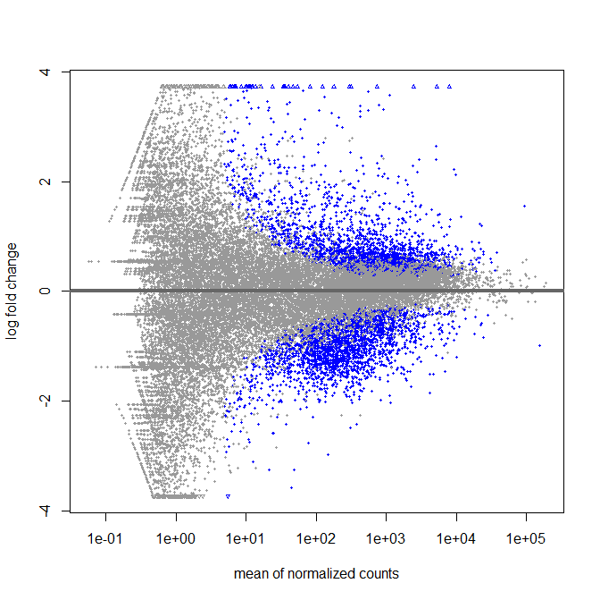
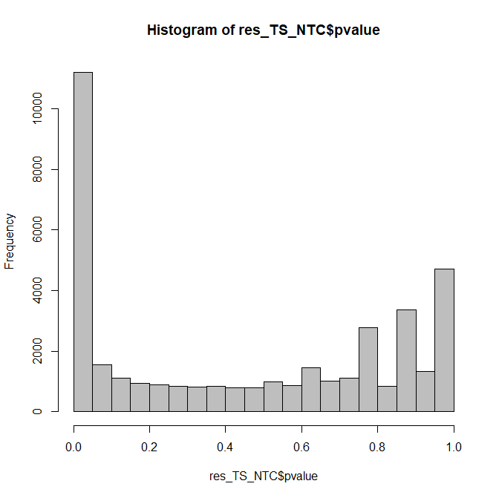
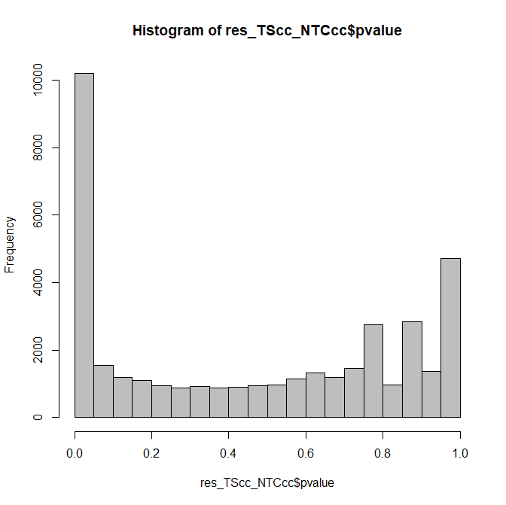
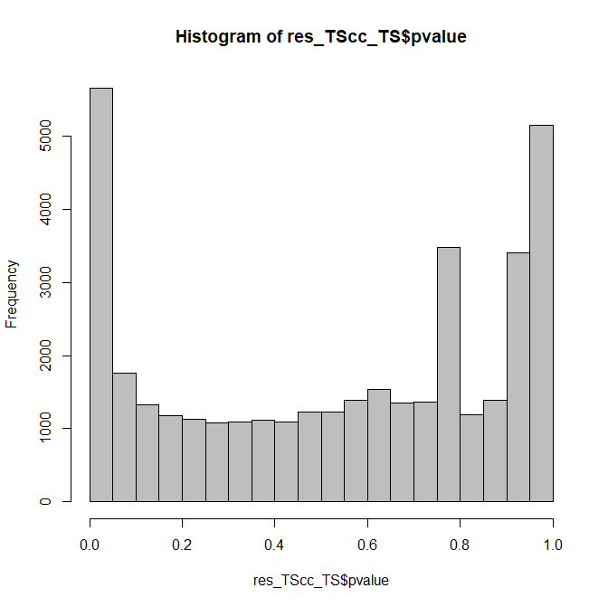
TS vs NTC
TS_CC vs NTC_CC
TS_CC vs TS

Slide 5
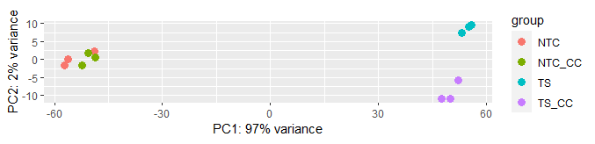
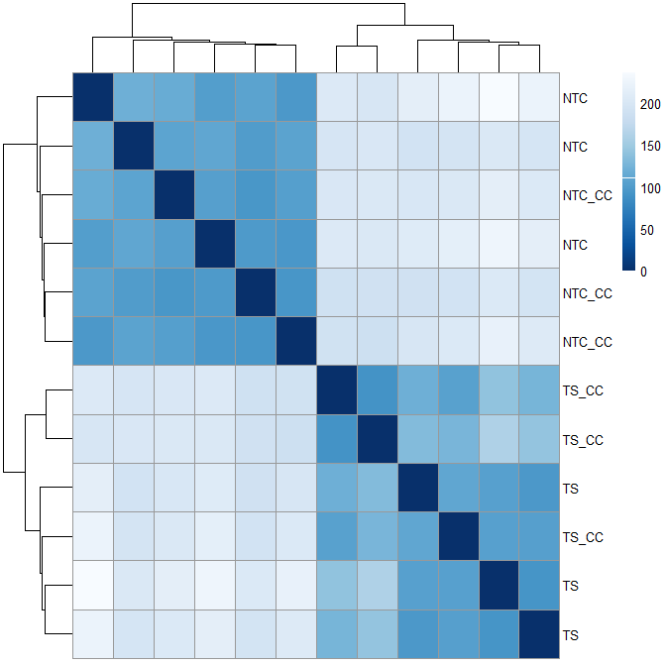
gNTC
gTS

