Slide 1
Entropy and SpMV
Paolo D’Alberto
March 2021

Slide 2
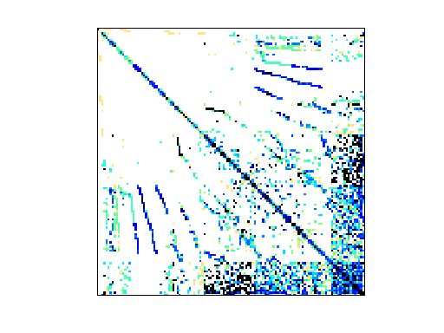
Sparsity and Patterns
Pattern is Beauty (not measurable)
Random is measurable
Pattern is useful if we can recognize it
Randomization is natural
Random Is it generally applicable?

Slide 3
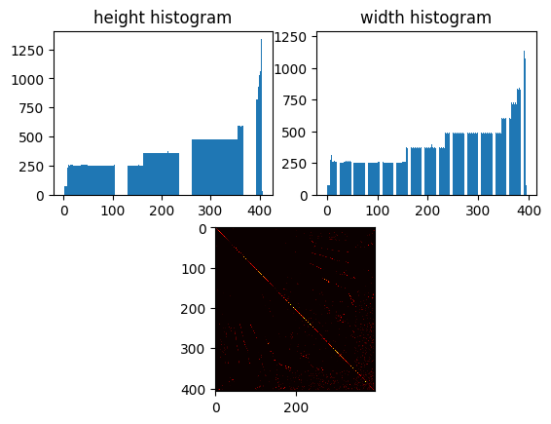
Pattern is Beauty

Slide 4
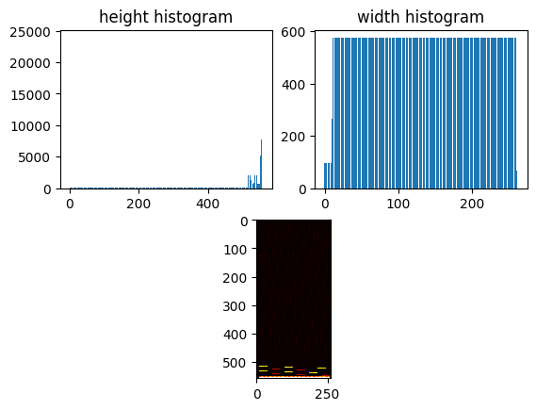

Pattern is not Beauty

Slide 5
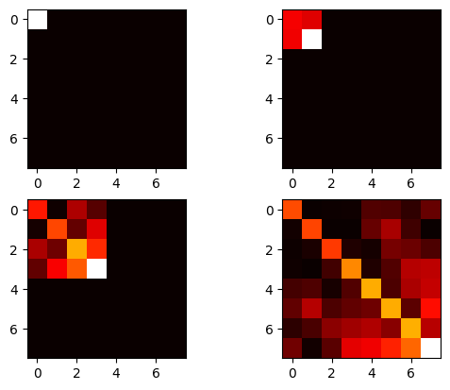
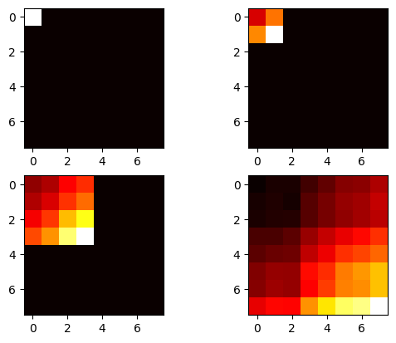
Random: Entropy can be measured
Randomization

Slide 6
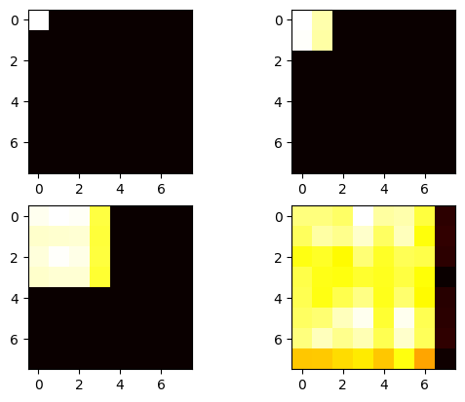
Random: Entropy can be changed
Max Entropy

Slide 7
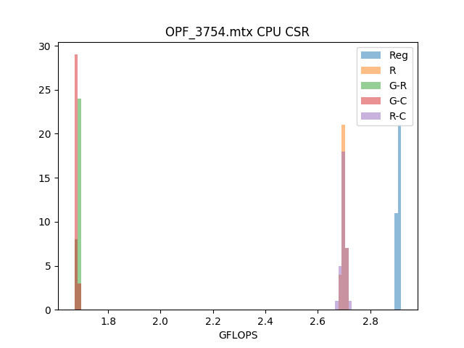
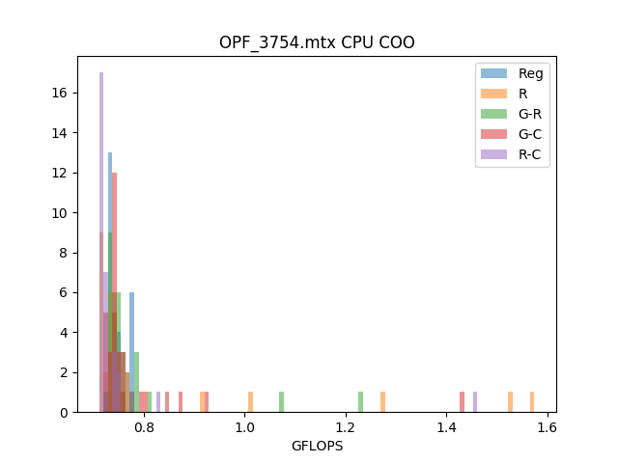
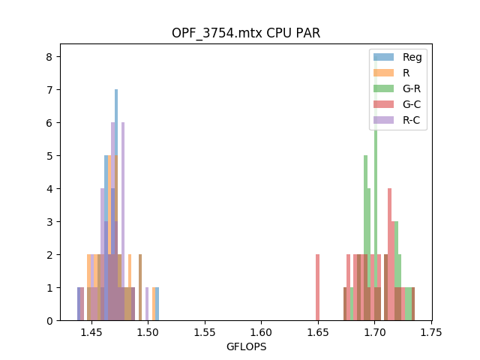
Random can be exploited

Slide 8
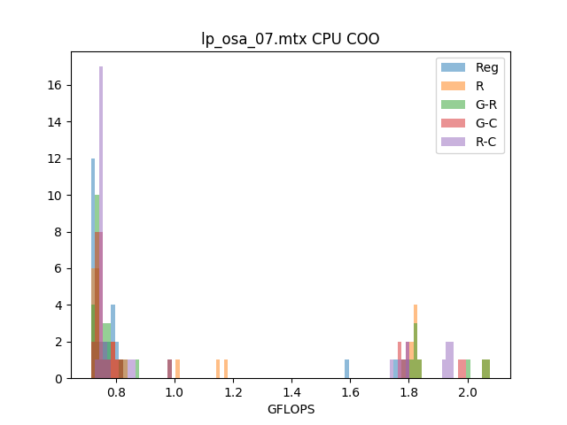
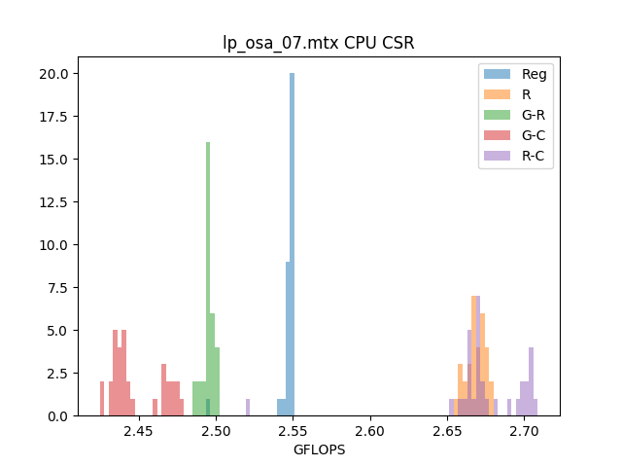
Random can be exploited

Slide 9
These are ideas from
ABHISHEK JAIN,
ISMAIL BUSTANY,
HENRI FRAISSE,
MANSIMRAN BENIPAL,
DINESH GAITONDE

