Slide 1
Entropy and SpMV
Paolo D’Alberto
March 2021

Slide 2
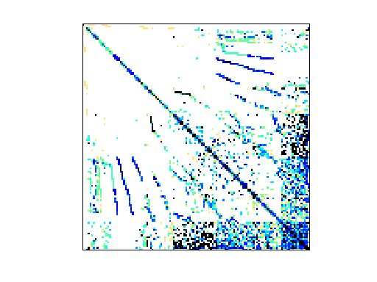
Sparsity and Patterns
Pattern is Beauty (not measurable)
Random is measurable
Pattern is useful if we can recognize it
Randomization is natural
Random Is it generally applicable?

Slide 3
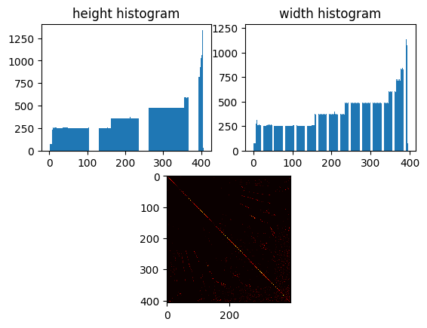
Pattern is Beauty

Slide 4
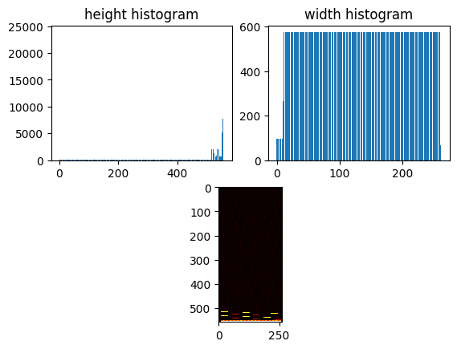

Pattern is not Beauty

Slide 5
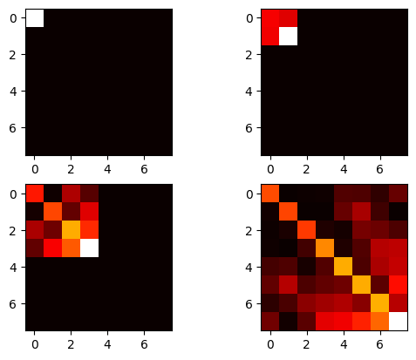
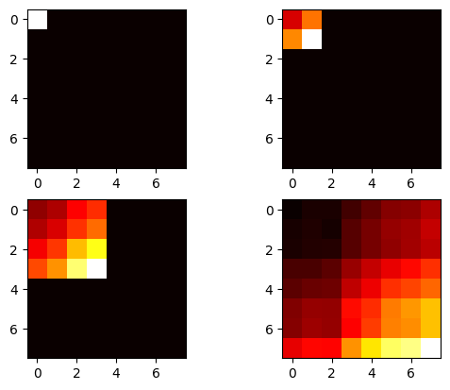
Random: Entropy can be measured
Hierarchical: 2-D Entropy measure
Randomization
Row and Column Random Permutations

Slide 6
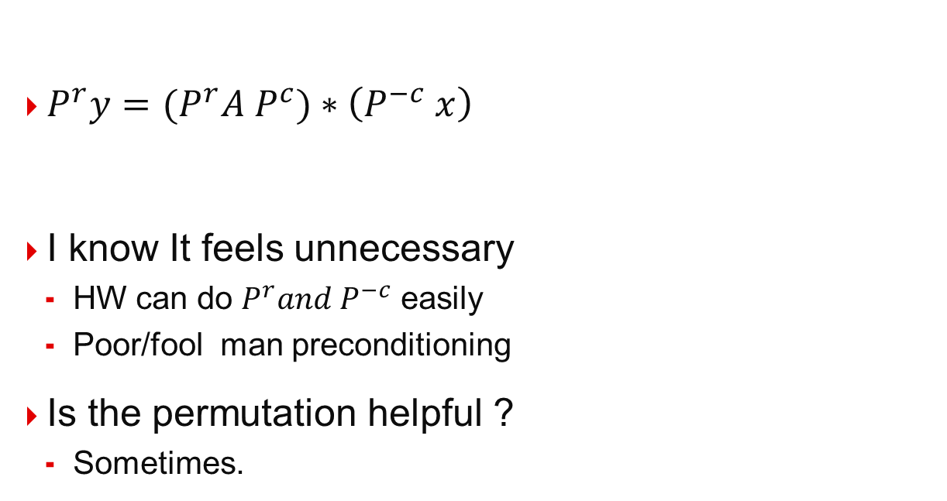
Row and Column Permutations
$P^{r}y={(P}^{r}A P^{c})∗\left(P^{−c} x\right)$
I know It feels unnecessary
HW can do $P^{r}and P^{−c}$ easily
Poor/fool man preconditioning
Is the permutation helpful ?
Sometimes.

Slide 7
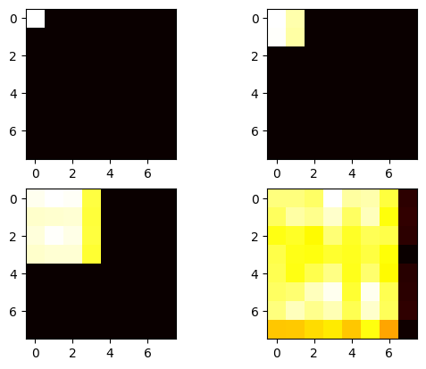
Random: Entropy can be changed
Max Entropy
With Row and Column Random Permutations

Slide 8
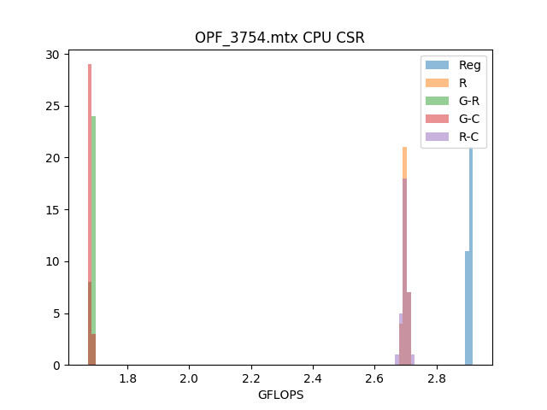
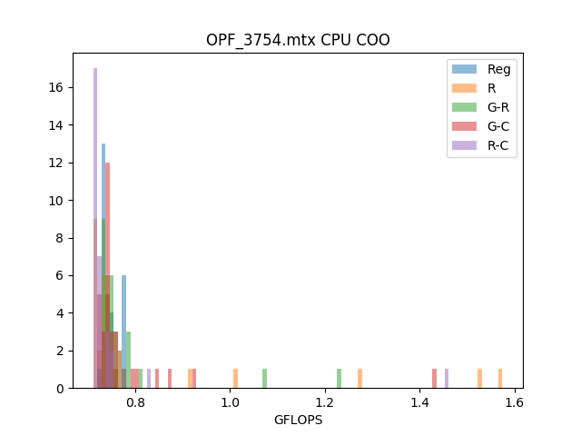
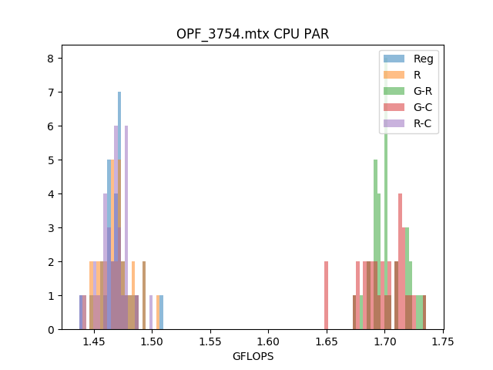
Random can be exploited

Slide 9
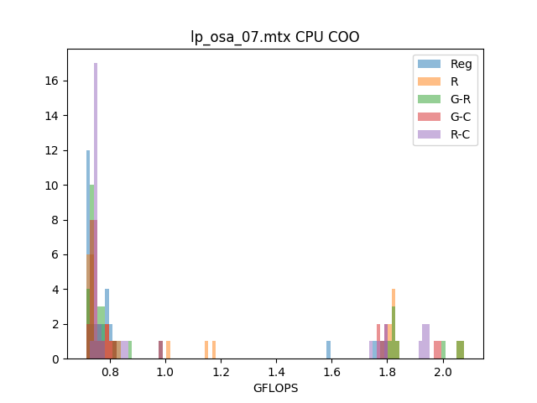
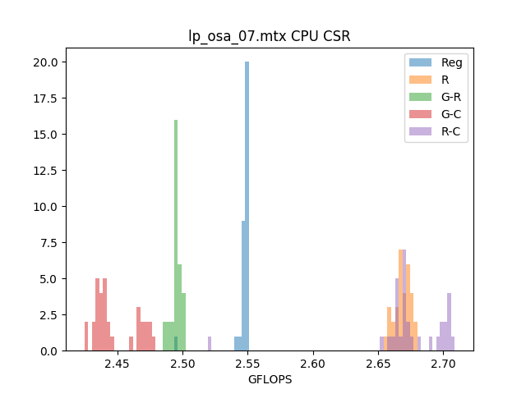
Random can be exploited

Slide 10
These are ideas from
ABHISHEK JAIN,
ISMAIL BUSTANY,
HENRI FRAISSE,
MANSIMRAN BENIPAL,
DINESH GAITONDE

