Slide 1
BLOB-FREE
CRITICAL DESIGN REVIEW (CDR)
Interdisciplinary project A.Y. 2020/21
Proposed by pROf. dovis, prof. piras and prof. di pietra

Slide 2

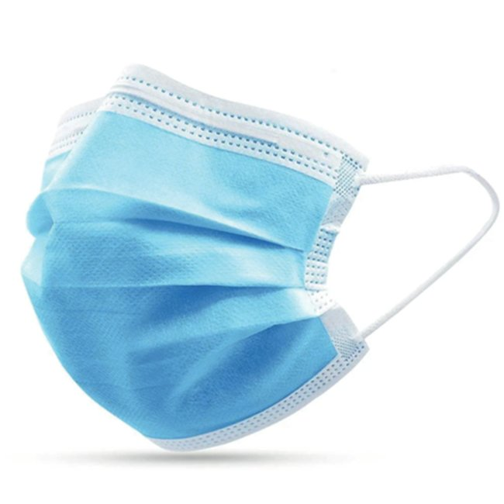
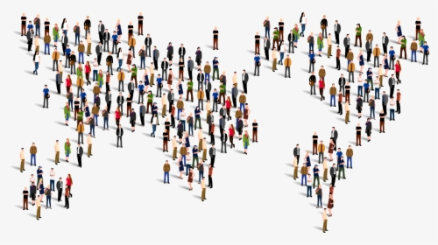
BLOB-FREE
Computer vision system for reducing Coronavirus infection risk
MASK detection
ASSEMBLAGE detection

Slide 3
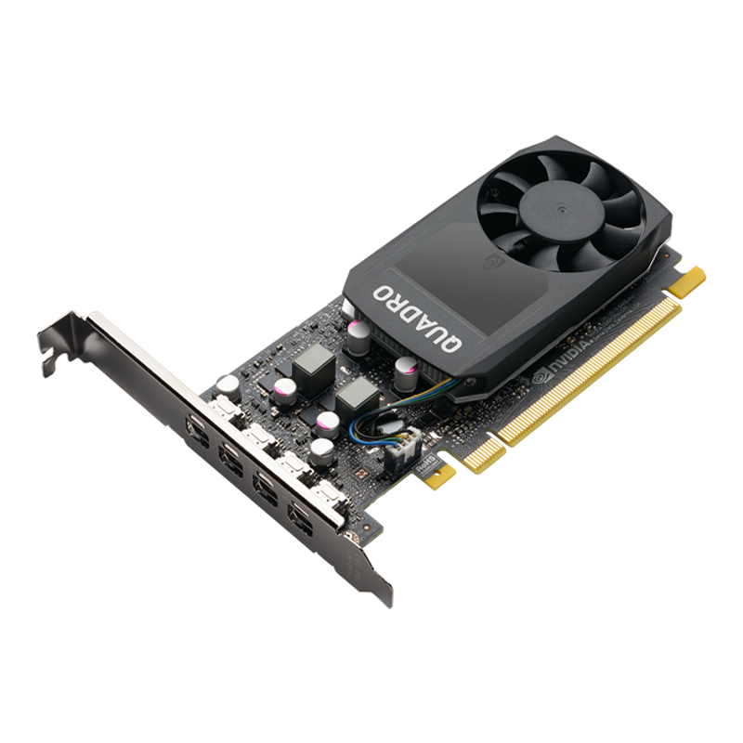
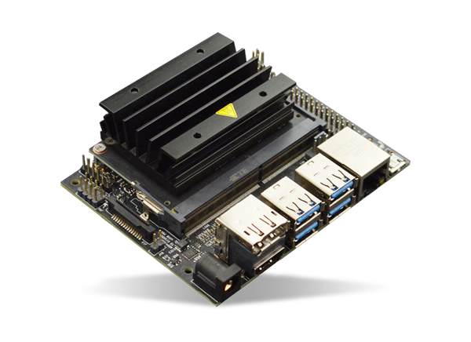

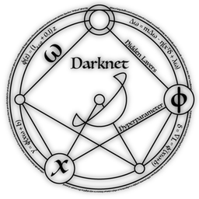
CHANGES & Performance
NVIDIA Quadro P1000
NVIDIA Jetson Nano
Tensorflow MobileNetV2
Darknet
YOLOv4-tiny
Output of object detection and tracking at 2-3 fps
Class “no mask”, ap = 75.31%
Class “mask”, ap = 91.11%
mAP@0.50 = 83.21 %

Slide 4
HIGH LEVEL DESIGN
Image acquisition
Object tracking
Object detection
Data collection
Data visualization

Slide 5
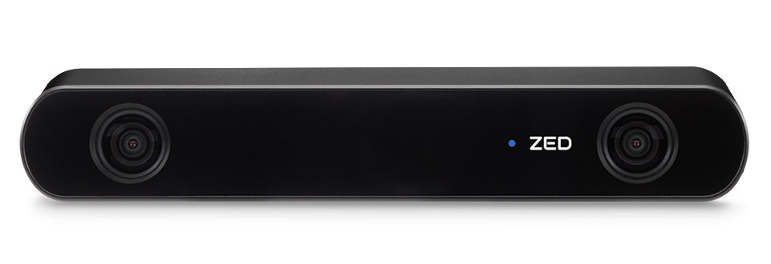
IMAGE ACQUISITION
DEPTH
B
G
R-G-B-DEPTH channels
DEPTH channel sampled at 15 Hz
1920x1080 resolution for improving face mask detection
15 fps for improving brightness
R
ZED2 Stereo Camera

Slide 6
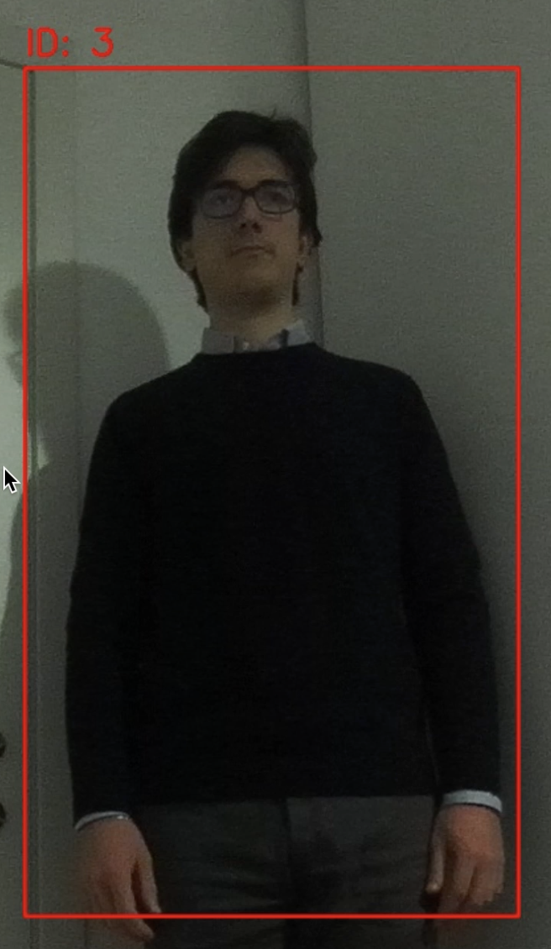
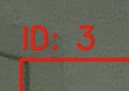
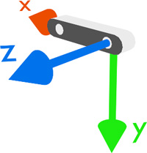
OBJECT TRACKING
ZED SDK
Person recognition with CNN
Progressive ID assignment
Relative position computation

Slide 7
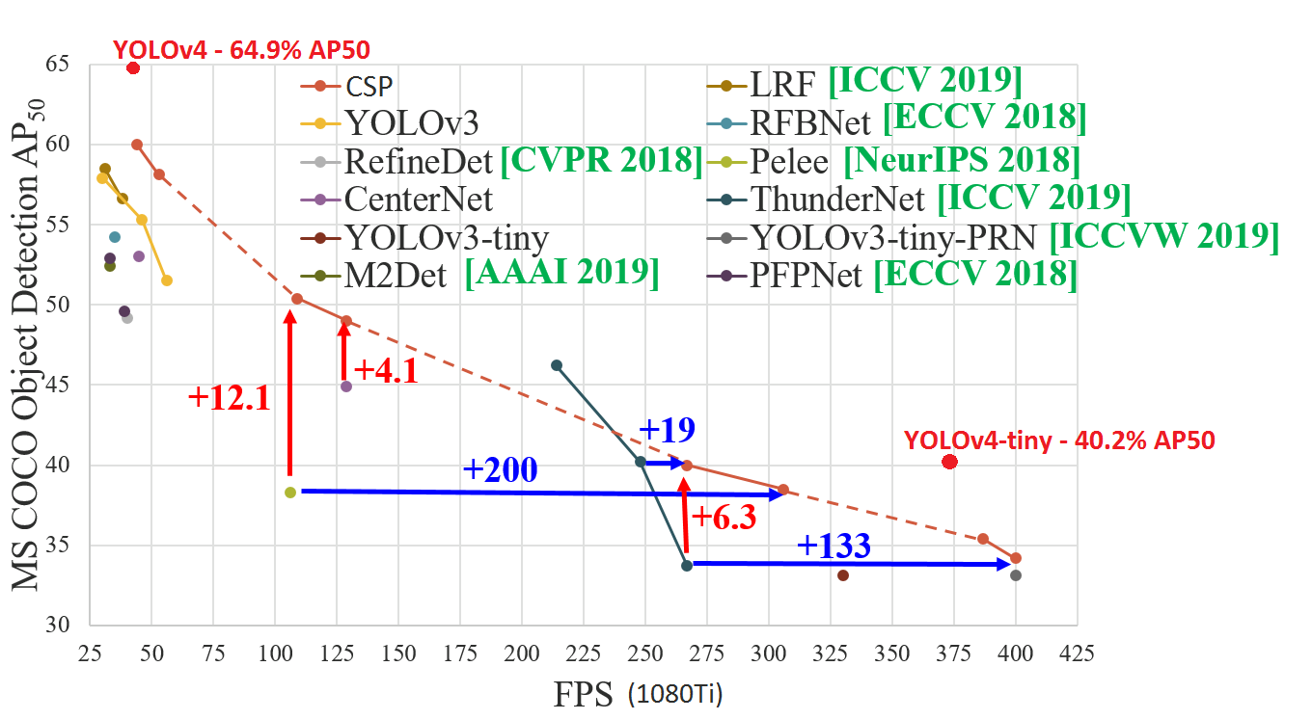
OBJECT DETECTION
Darknet framework
Face mask dataset
YOLOv4-tiny weights custom training
2 classes: “mask” and “no mask”
Single network evaluation
800x800 network resolution

Slide 8

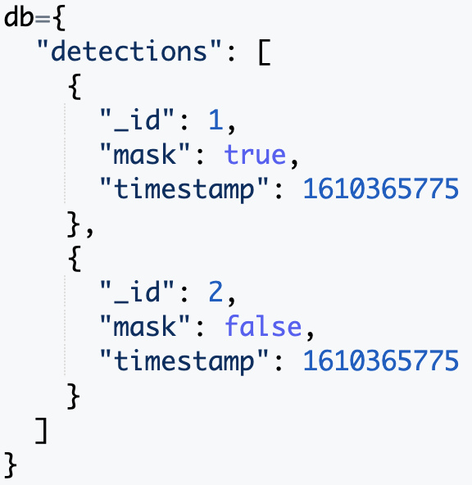
DATA Collection
Create 1 document for each person detected
Random ID
Mask detection
Timestamp
Images are not saved (data anonymity)

Slide 9
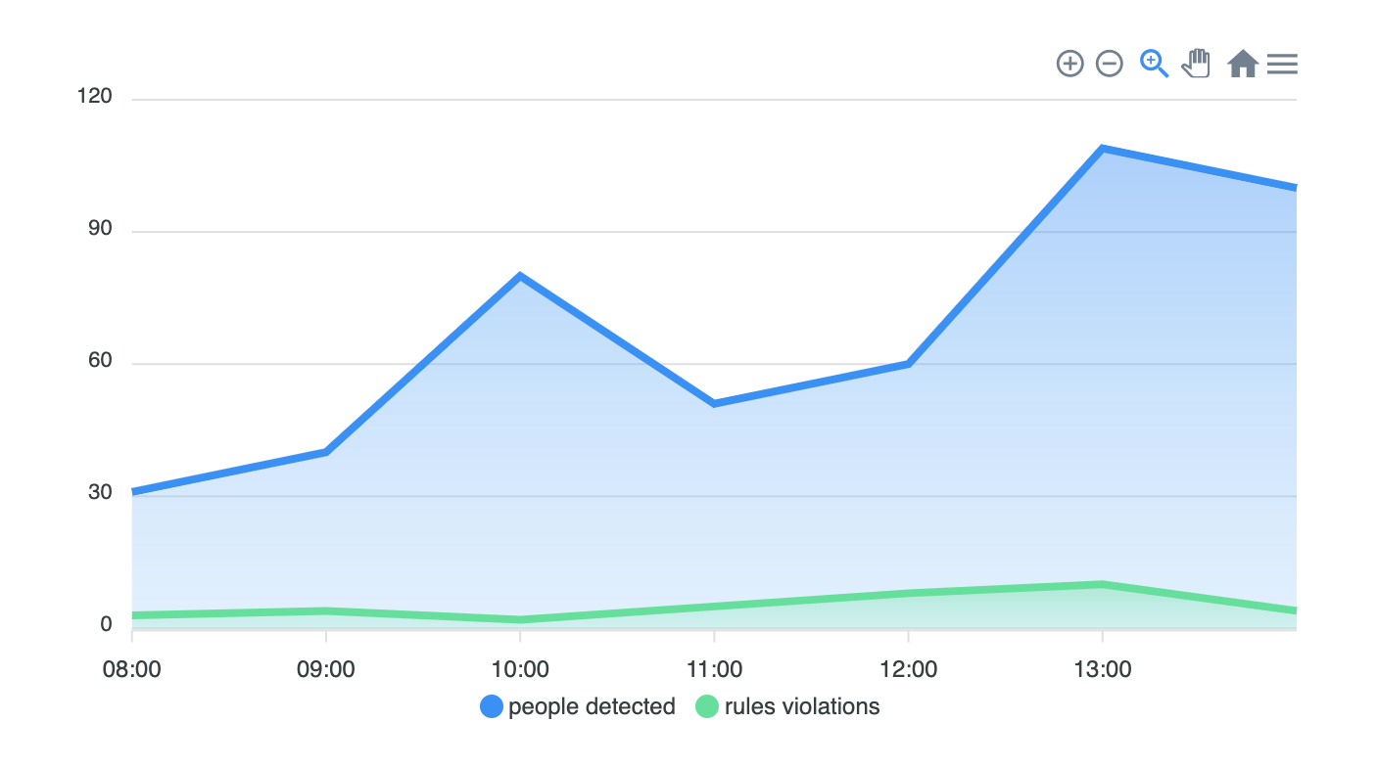


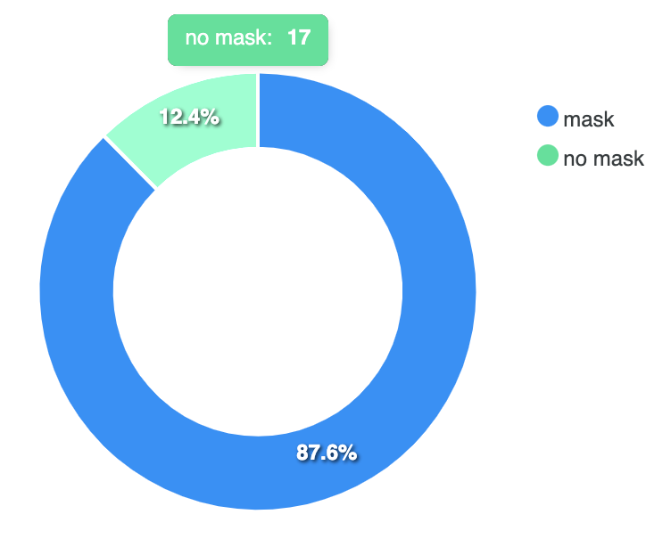

DATA VISUALIZATION
CherryPy web server for management interface hosting
Angular (JS framework) for frontend
APEXCHARTS for visualizing charts

Slide 10


DEVELOPMENT TOOLS
Jetson Nano in headless mode to save RAM
OpenCV real-time encoding
Flask web server
M-JPEG video stream on LAN visible from browser
Development-purposes only

Slide 11
Workplan
27/11
SRR
18/12
PDR
15/1
CDR
7/5
TRR
25/6
FR
16/10 – 30/10

Slide 12
Thank you for the attention!
Team members:
Can Akgol (s274948)
Paolo De Santis (s280398)

