Slide 1
BLOB-FREE
PRELIMINARY DESIGN REVIEW (PDR)
Interdisciplinary project A.Y. 2020/21
Proposed by pROf. dovis, prof. piras and prof. di pietra

Slide 2

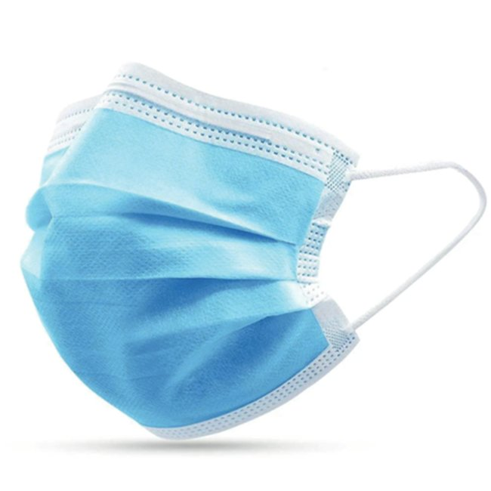

BLOB-FREE
Computer vision system for reducing Coronavirus infection risk
MASK detection
ASSEMBLAGE detection

Slide 3




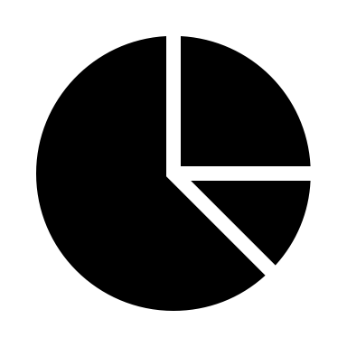



System CONCEPT
Management web interface
ZED2 Stereo Camera
NVIDIA Jetson Nano
Audio warning
Real-time head detection
Real-time face mask detection
Real-time distances computation
Real-time assemblage detection

Slide 4
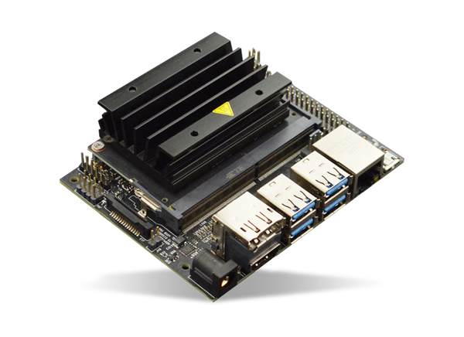
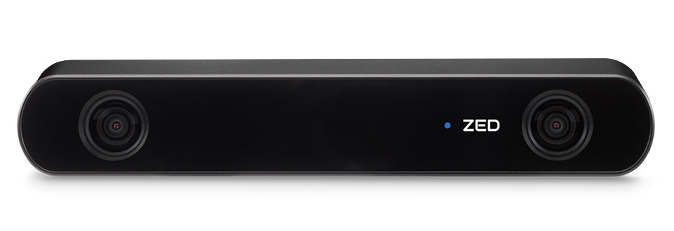
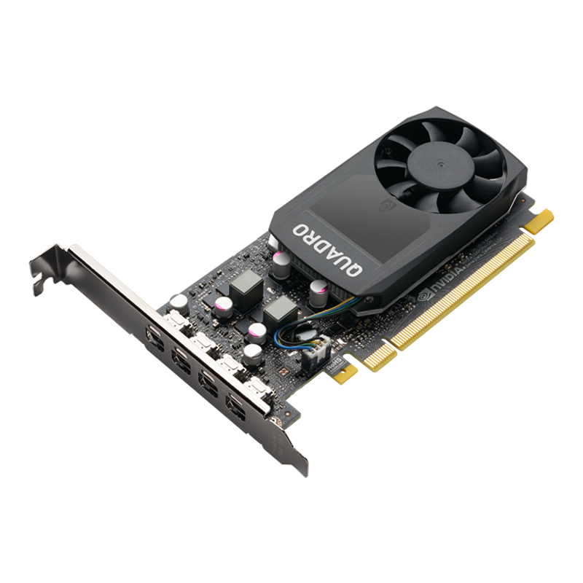
Hardware design
ZED2 Stereo Camera
NVIDIA Jetson Nano
NVIDIA Quadro P1000
Available resolution/frame rate combinations:
720p – 15, 30, 60 fps
1080p – 15, 30 fps
2K – 15 fps
Computational power:
0.5 TFLOPs (FP16)
128 CUDA cores
(not tested yet)
Computational power:
30 TFLOPs (FP16)
640 CUDA cores
Successfully tested up to 2K – 15 fps
Expected maximum resolution usable with the Jetson is 720p – 30fps but testing still needs to be performed

Slide 5
PERFORMANCE Testing
High illumination with natural lighting
Face detection up to 15m
Depth map usable up to 10m
Lighting conditions
Artificial lighting
Low illumination with natural lighting
Face detection up to 12m
Depth map usable up to 8m
FOV variation
Significant image crop at 1080p
Resolution and frame rate
Brightness variation
Lower frame rates lead to higher brightness

Slide 6
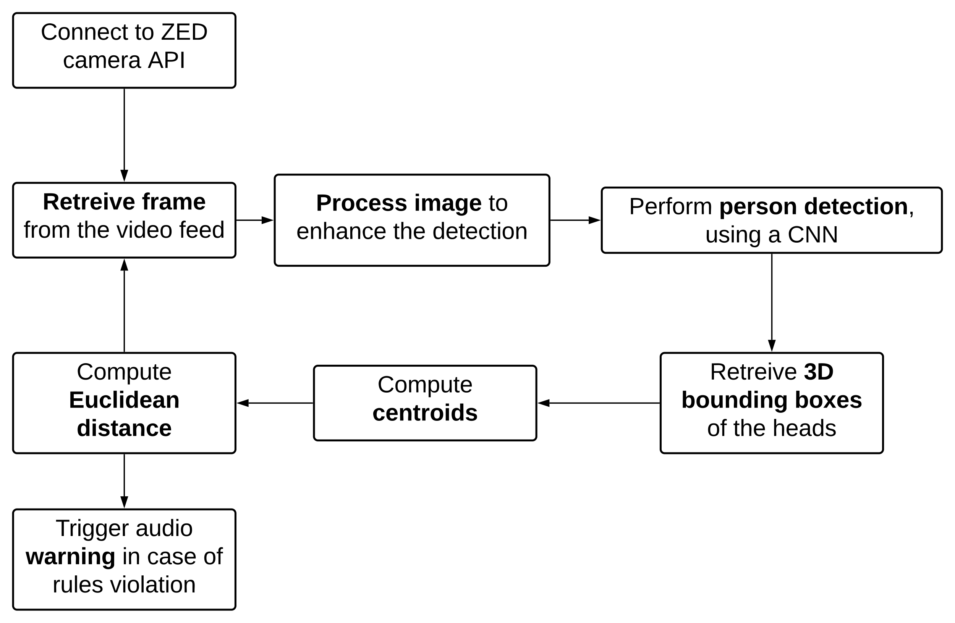
OBJECT detection & Distance computation

Slide 7
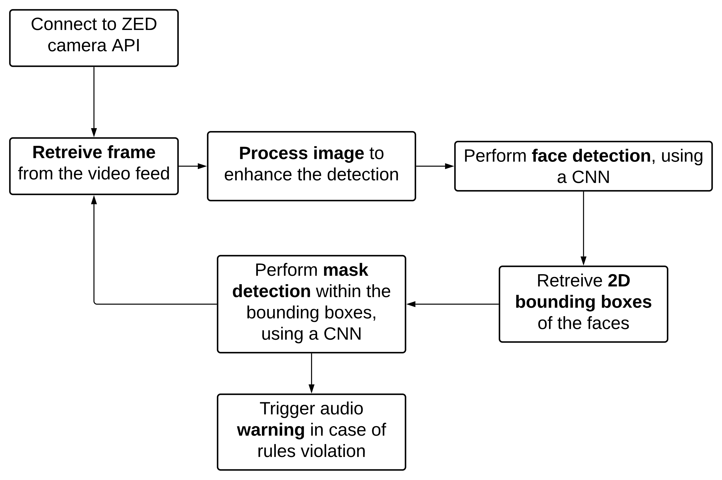
OBJECT detection & MASK RECOGNITION

Slide 8
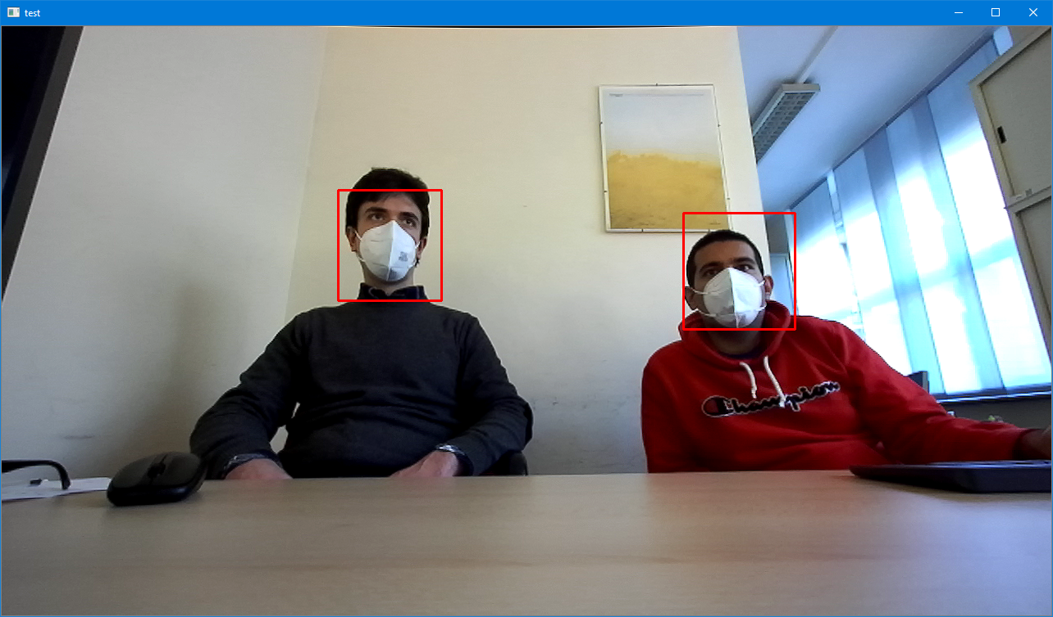
OBJECT DETECTION
ZED person/face detection model:
Built-in the SDK
High computational power requirements
Next steps:
Pre-process images to increase accuracy
Test performance of Jetson Nano

Slide 9
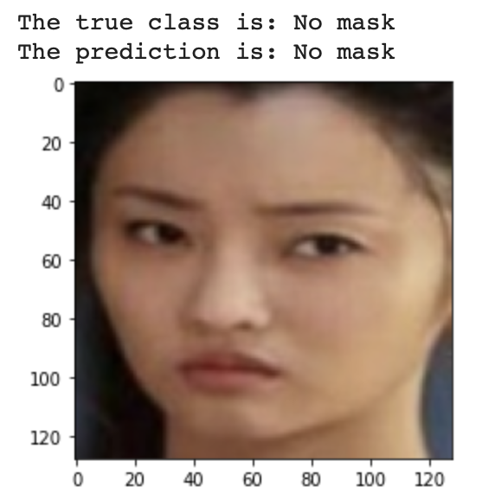
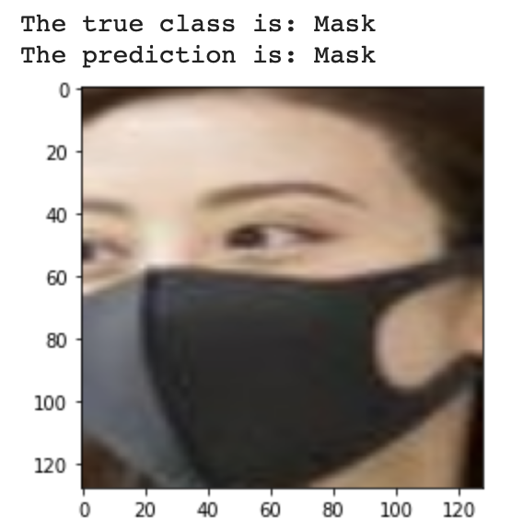
MASK RECOGNITION
Open dataset (Kaggle):
7555 images (3726 with mask, 3829 without mask)
Transfer learning:
MobileNetV2 model
Trained on Google Colab
Next steps:
Optimize the model
Export the model to work in real-time with ZED SDK

Slide 10
Management interface
Local web application:
CherryPy
MongoDB
Web UI with charts regarding aggregated statistics and system status real-time overview
Number of people detected
Number of rules violations
Percentage of rules violation

Slide 11
Workplan
27/11
SRR
18/12
PDR
15/1
CDR
7/5
TRR
25/6
FR
16/10 – 30/10

Slide 12
Thank you for the attention!
Team members:
Can Akgol (s274948)
Paolo De Santis (s280398)

