Slide 1
BLOB-FREE
Project Plan
Interdisciplinary project A.Y. 2020/21
Proposed by pROf. dovis, prof. piras and prof. di pietra

Slide 2

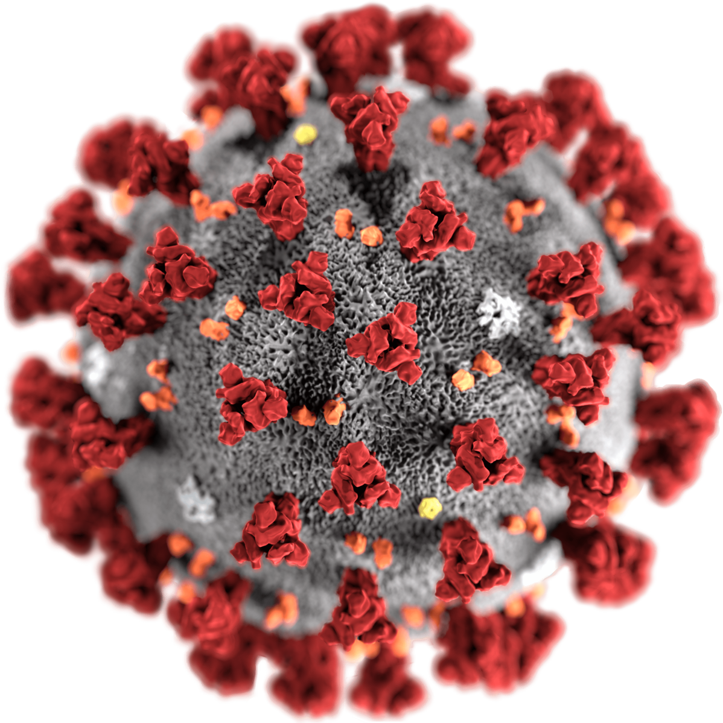
The Problem
Coronavirus is putting at risk many lives; thus some rules must be enforced in order to prevent the spreading of the infection. Two very simple but effective measures are:
Wearing face masks
Avoiding “assemblages” of people

Slide 3
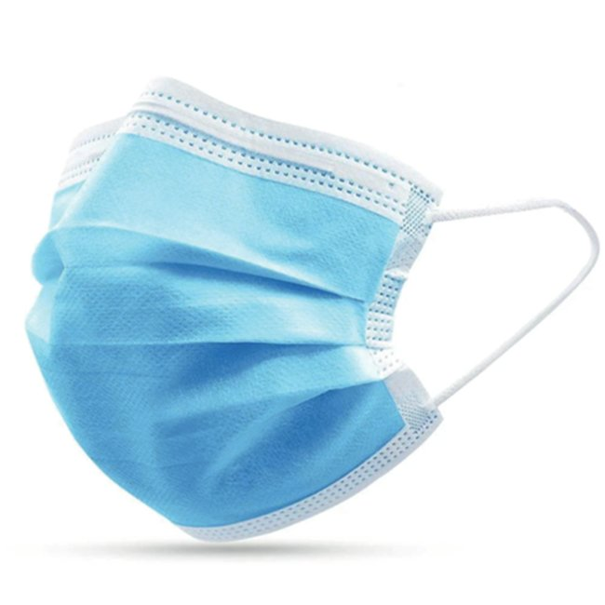
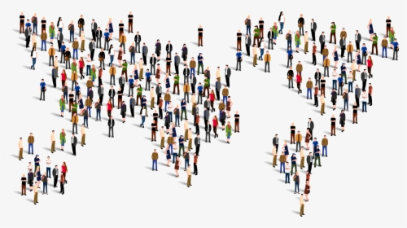
The solution
Build a computer vision system able to detect “assemblages” of people and able to verify that everyone is wearing a mask, using a cheap digital camera and range camera connected to a Raspberry Pi.
The system can warn users in case a dangerous situation is detected
The management system shows statistics about the issued warnings, so that the managers of the area can take additional preventive measures
The system can be deployed in closed spaces where “assemblages” are frequent (e.g. the corridors of a school or university)

Slide 4
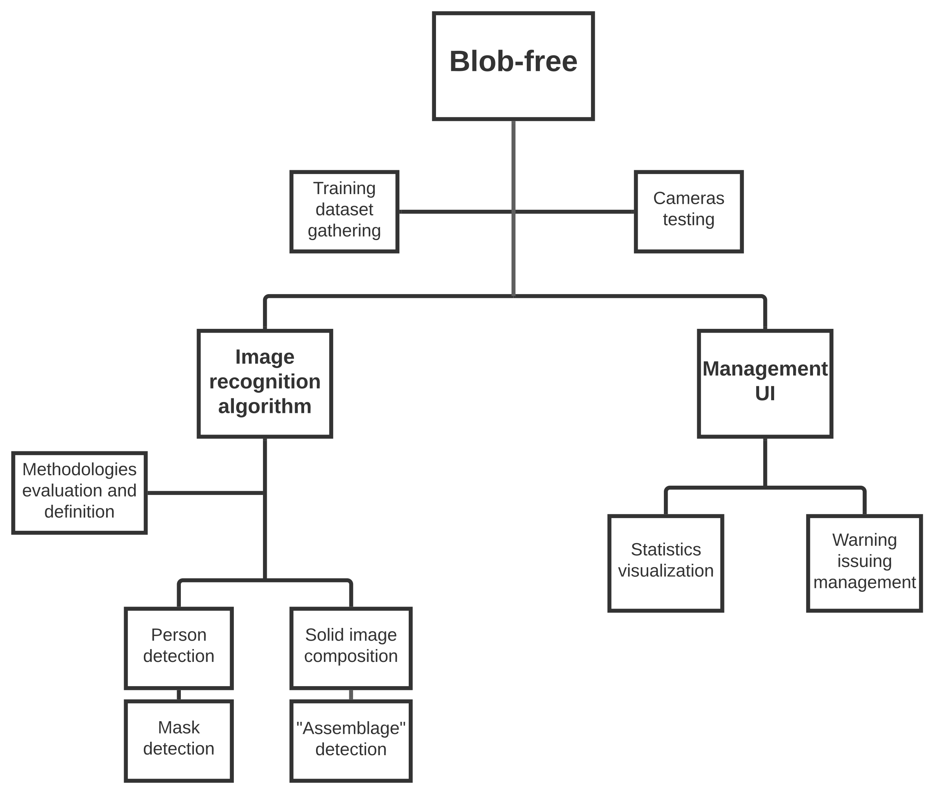
wBS

Slide 5
FIRST Steps
Gather data to use in the training of the image recognitions algorithm
Test cameras in different conditions and find the optimal setup
Evaluate the possible image recognition methodologies and choose the most suitable one for this specific task

Slide 6




Tools
Database for the statistics
RaspberryPi
Digital camera
Range camera
OpenCV library for image recognition
Python

Slide 7
Workplan
27/11
SRR
18/12
PDR
15/1
CDR
7/5
TRR
25/6
FR
16/10 – 30/10

Slide 8
Thank you for the attention!
Team members:
Can Akgol (s274948)
Paolo De Santis (s280398)

