Slide 1
BLOB-FREE
Project Plan
Interdisciplinary project A.Y. 2020/21

Slide 2

Objectives & Goals
Automate the “surveillance” of an area, in order to prevent CoViD-19 infections
Build a computer vision system able to detect “assemblages” of people and able to verify that everyone is wearing a mask
Issue warnings to the users in the area
Build a management system where the person in charge of the safety of the areas can visualize statistics about “assemblages” and mask wearing, in order to take additional preventive measures
Possibly test the system in a real-world scenario (e.g. Politecnico’s corridors) to verify its effectiveness

Slide 3
State of the art
The whole World is facing a pandemic; thus it is necessary to take preventive measures to stop infections. Two of the most important ones are:
Avoiding ”assemblages” of people
Wear face masks
Computer vision systems can recognize crowds and objects, so it is possible to detect ”assemblages” and masks

Slide 4
Workplan

Slide 5
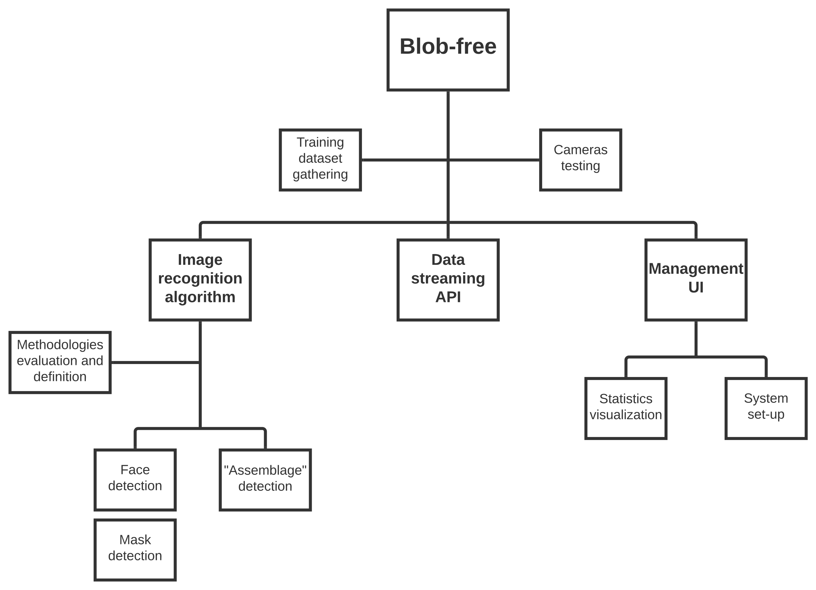
wBS

Slide 6
WBS
Blob-free
Training dataset gathering
Cameras testing
Image recognition algorithm
Data streaming API
Management UI
Methodologies evaluation and definition
Face detection
“Assemblage” detection
Statistics visualization
System set-up
Mask detection

Slide 7
Tools
Server where to store images and the output of the analysis
RaspberryPi
Digital camera
Range camera
OpenCV library for image recognition
Python

Slide 8
Thank you for the attention!
Team members:
Can Akgol (s274948)
Paolo De Santis (s280398)

