Slide 1

Classifying Fake News on Twitter:
A Machine Learning Approach
Paolo LAXAMANA, Patricia RAMOS, Derrick SIA

Slide 2

CONTEXT OF THE PROBLEM :
Fake News
News, stories or hoaxes created to
deliberately misinform or deceive readers
Isn’t simply “made-up” news
Clickbait, propaganda, hoaxes, satire or parodies, misleading headlines, even sloppy and biased journalism can be considered as fake news

Slide 3

CONTEXT OF THE PROBLEM :
The widespread circulation of fake news in the PH.
"Fake news has increased, multiplied, diversified, more pervasive than ever"
“[Fake news] has greatly influenced the way media platforms operate, the public’s perception of information, and even how governments confront its proliferation.”

Slide 4

SIGNIFICANCE OF THE STUDY :
Implications of Fake News
People are aware of fake news and consider it as a serious problem
Misuse of influence
Rising disinformation and misinformation of political campaigns
Propaganda tool

Slide 5

OBJECTIVES OF THE STUDY :
To efficiently classify news posts if its fake or not
To be able to apply the appropriate ML algorithms and methods taught in class
To analyze and identify factors that contribute to the spread of fake news
To help spread awareness in choosing what to believe in social media such as Twitter

Slide 6

DATA-DRIVEN SOLUTION:
Binary Classification
Classifying tweets as either REAL or FAKE
Only two classes

Slide 7

DATA-DRIVEN SOLUTION: DATASET
Augmented dataset of rumours and non-rumours for rumour detection
https://zenodo.org/record/3249977#.XdNNiDIzaAw
Collection of Twitter rumours and non-rumours during the 2013 Boston marathon bombings
Real-world event
3,714 fake tweets and 1,238 real tweets
4 unique features (id, text, created_at, label)

Slide 8
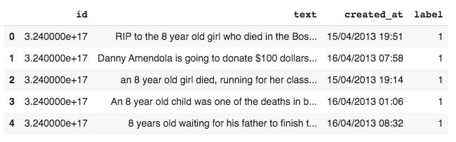
DATA-DRIVEN SOLUTION: DATASET
Augmented dataset of rumours and non-rumours for rumour detection
https://zenodo.org/record/3249977#.XdNNiDIzaAw

Slide 9

DATA-DRIVEN SOLUTION:
Potential ML Algorithms
Multinomial Naive Bayes Classifier
Neural Network
Support Vector Machine
Decision Trees
Random Forest Classifier
Logistic Regression Classifier
Natural Language Processing (NLP)
https://ieeexplore.ieee.org/document/8620051

Slide 10
DATA-DRIVEN SOLUTION:
Potential ML Algorithms
Multinomial Naive Bayes Classifier
Neural Network
Support Vector Machine
Decision Trees
Random Forest Classifier
Logistic Regression Classifier
Natural Language Processing (NLP)
https://ieeexplore.ieee.org/document/8620051

Slide 11
DATA-DRIVEN SOLUTION:
Multinomial Naive Bayes
Linear classification method
Designed more for text documents
Assumes that each of the features it uses are conditionally independent of one another
Multinomial NB explicitly models the word counts
Simple NB model documents the presence and absence of particular words

Slide 12
DATA-DRIVEN SOLUTION:
Decision Trees
Non-linear classification method
Easy to implement
Easy to understand
Able to handle both numerical and categorical data

Slide 13
FEATURE EXTRACTION:
CountVectorizer
Vectorization: General process of turning a collection of text documents into numerical feature vectors
Takes a list of sentences
Tokenizes strings (splits by whitespace, etc.) and gives an integer id for each
Counts the frequency of each term
Turns this into a matrix (sentences by terms)

Slide 14

#1 EXPLORATORY DATA ANALYSIS
Visualizing term frequency
Using WordCloud
Visualizes the frequency of words

Slide 15
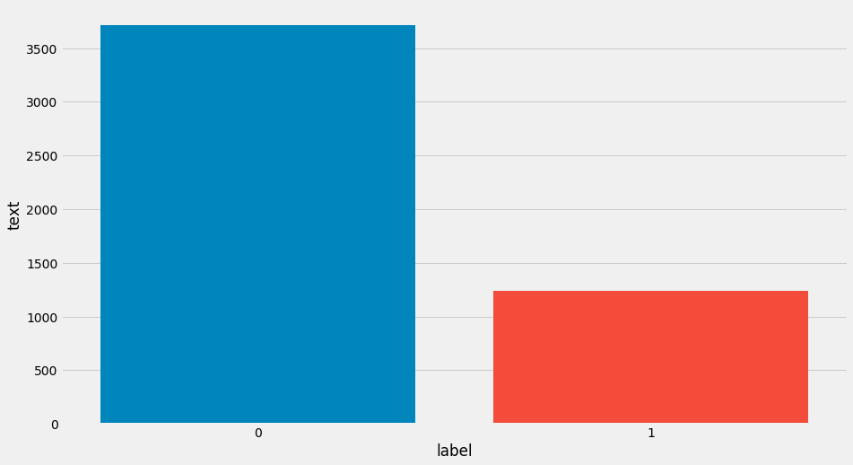

#1 EXPLORATORY DATA ANALYSIS
Get label counts

Slide 16
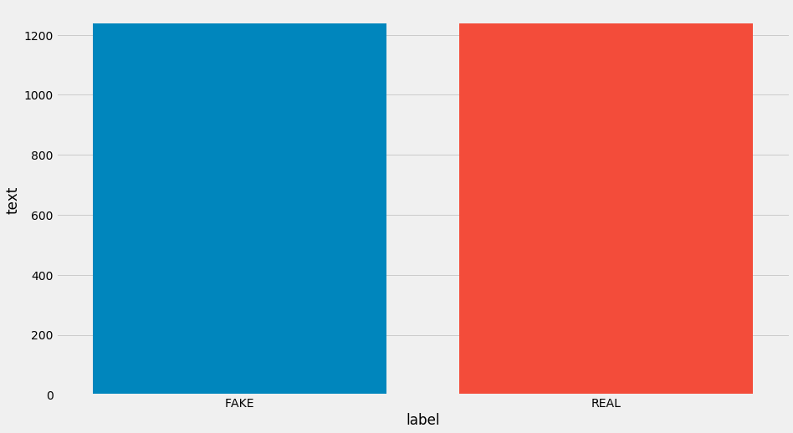

#1 DATA CLEANING
Normalizing label counts

Slide 17
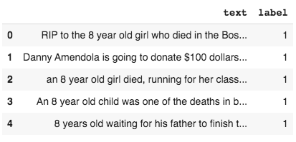
#1 DATA CLEANING
Dropping unnecessary features

Slide 18
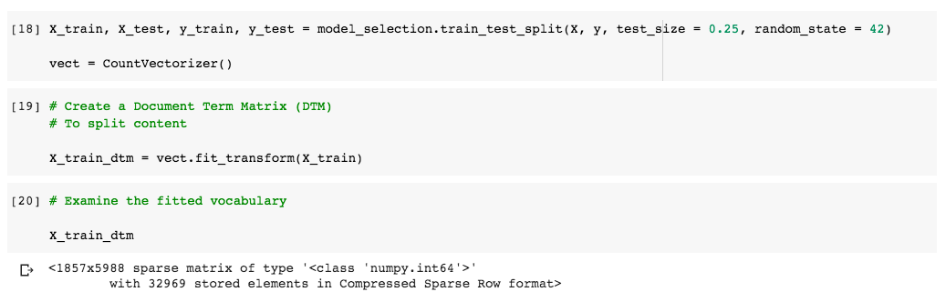
#3 FEATURE EXTRACTION
Vectorizing the dataset

Slide 19
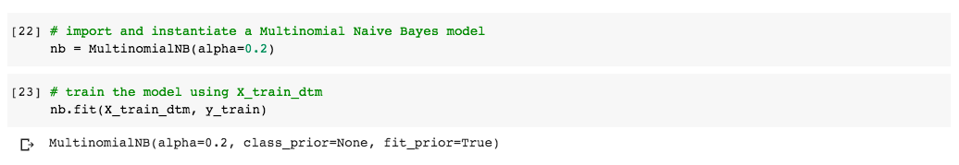
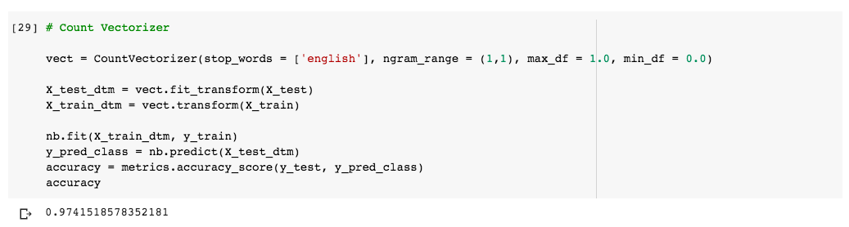
#4 MODELLING
Multinomial NB Classifier

Slide 20
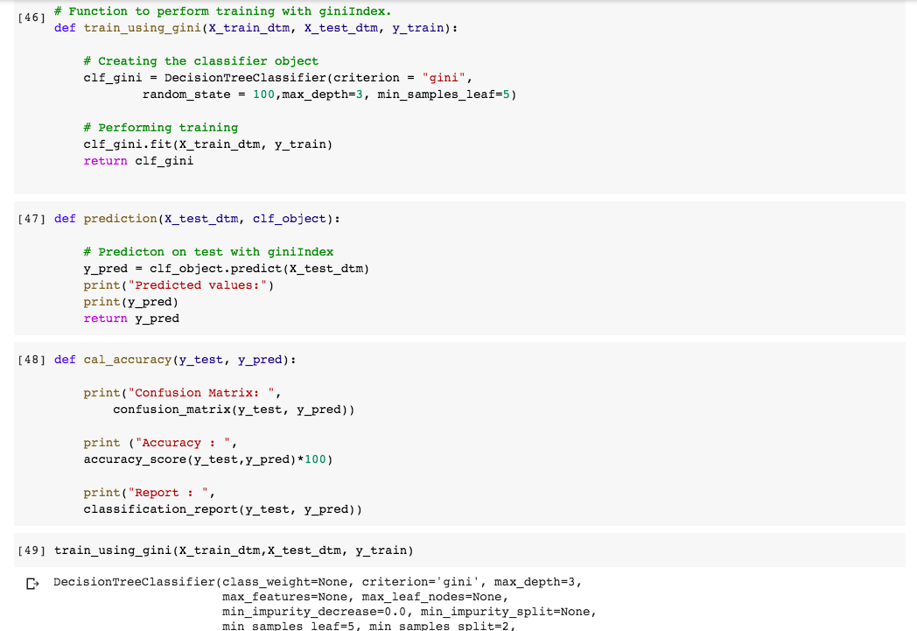
#4 MODELLING
Decision Tree Classifier

Slide 21
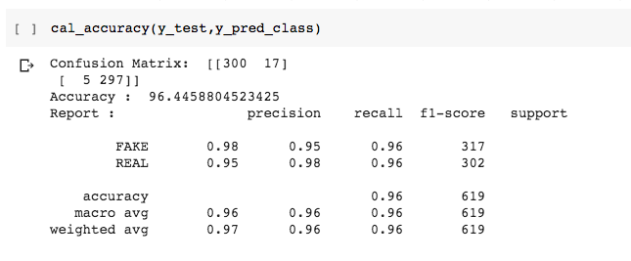
#4 MODELLING
Decision Tree Classifier

Slide 22
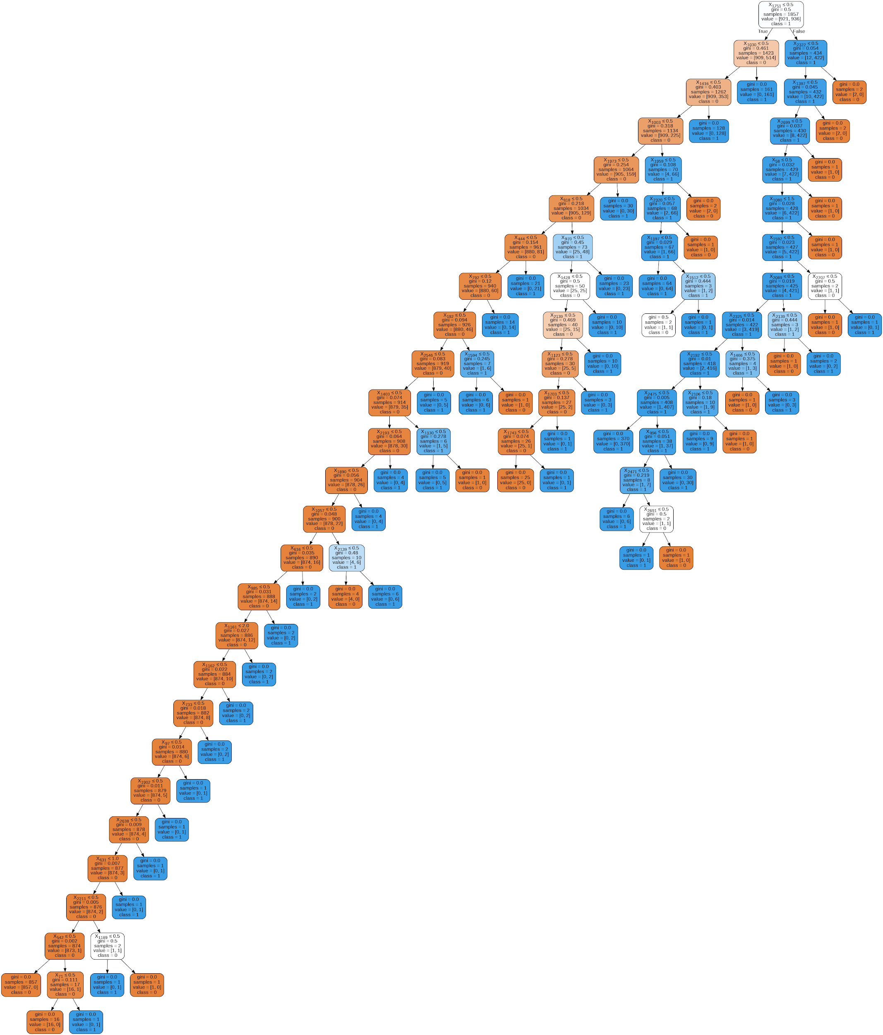
#4 MODELLING
Decision Tree Classifier
Default parameters

Slide 23
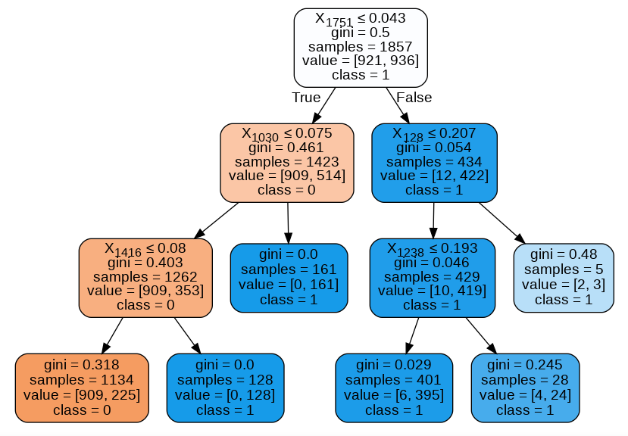
#4 MODELLING
Decision Tree Classifier
Tuned parameters

Slide 24

RESULTS AND DISCUSSION
Learning Model with best results
MultinomialNB ( 97% Accuracy) worked better than Decision Tree Classifier (96% Accuracy)
How did MultinomialNB beat DT Classifier?
MultinomialNB: used a lot in document or text classification
The project was only based on the content of the tweet [text based]

Slide 25

DATA-DRIVEN SOLUTION:
Potential Further Studies
Fake News Detection on Videos
Fake News Detection on Images

Slide 26
RELATED LITERATURE :
Automatically Identifying Fake News in Popular Twitter Threads (Buntain and Golbeck, 2018) https://www.researchgate.net/publication/321257431_Automatically_Identifying_Fake_News_in_Popular_Twitter_Threads
Fake News Identification on Twitter with Hybrid CNN and RNN Models (Ajao, Bhowmick, and Zargari, 2018) https://arxiv.org/ftp/arxiv/papers/1806/1806.11316.pdf
Can Machines Learn to Detect Fake News? A Survey Focused on Social Media (Silva, Alvez, and Garcia, 2019) https://scholarspace.manoa.hawaii.edu/bitstream/10125/59713/0273.pdf
The Detection of Fake Messages using Machine Learning (Looijenga, n.d.) https://essay.utwente.nl/77385/1/Looijenga_BA_EEMCS.pdf
Combining Machine Learning with Knowledge Engineering to detect Fake News in Social Networks-a survey (Ahmed, Hinkelmann, and Corradini, 2019) http://ceur-ws.org/Vol-2350/paper10.pdf
Hybrid Text Classification Method for Fake News Detection (Kaur, Boparai, and Singh, 2019) https://www.ijeat.org/wp-content/uploads/papers/v8i5/E7622068519.pdf
Fake News Detection on Social Media Using Geometric Deep Learning (Monti et al., 2019) https://rlgm.github.io/papers/34.pdf
Classifying Fake News Articles Using Natural Language Processing to Identify In-Article Attribution as a Supervised Learning Estimator (Traylor et al., 2019) https://ieeexplore.ieee.org/document/8665593/metrics#metrics
Deep Learning Algorithms for Detecting Fake News in Online Text (Girgis, Sherry & Amer, Eslam & Gadallah, Mahmoud 2018) https://www.researchgate.net/publication/328694360_Deep_Learning_Algorithms_for_Detecting_Fake_News_in_Online_Text/citation/download
Fake News Detection: A Deep Learning Approach (Thota, Tilak, Ahluwalia, and Lohia, 2018) https://scholar.smu.edu/cgi/viewcontent.cgi?article=1036&context=datasciencereview

