Slide 1

greeks
Paolo Manenti 1999957
Haris Sehic 1997240
Bishara Hassan 1997226
Marco Curzi 1615719
Quantitative Financial Modelling project Academic Year 2022/23

Slide 2

Table of contents
01
02
03
Introduction
Delta
04
05
06
Delta hedging
07
Gamma
Theta
Vega
Rho

Slide 3

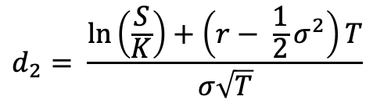

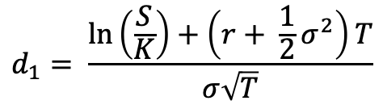


Black and Scholes Option pricing model
The Black-Scholes option pricing model is a mathematical model used to compute the fair price for a European Call [Put] option, using assumptions of constant volatility, no dividends, and other efficient market conditions.
The BS model includes the following variables:
The current stock price $S_{t}$
The strike price $K$
The time-to-maturity $T$
The risk-free interest rate $r$
The implied volatility $σ^{imp}$
$$Call=S_{t}N(d_{1})−Ke^{−rT}N(d_{2})$$
$$Put=C_{t} − S_{t}+Ke^{−rT}$$
$$where:$$
$$d_{1}= \frac{\ln\left(\frac{S}{K}\right)+\left(r+ \frac{1}{2}σ^{2}\right)T}{σ\sqrt{T}}$$
$$d_{2}= \frac{\ln\left(\frac{S}{K}\right)+\left(r− \frac{1}{2}σ^{2}\right)T}{σ\sqrt{T}}$$

Slide 4

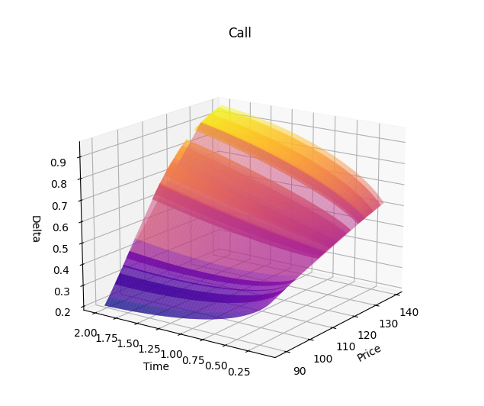
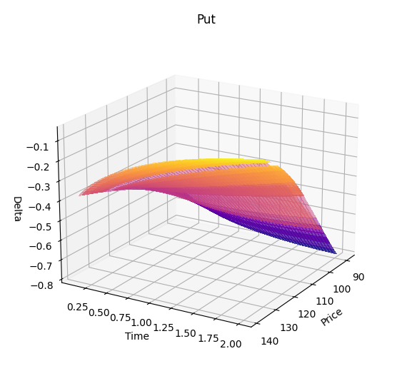
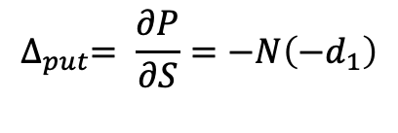
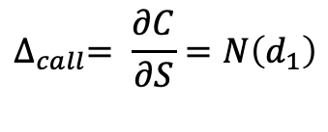
Delta
$$∆_{call}= \frac{∂C}{∂S}=N\left(d_{1}\right)$$
$$∆_{put}= \frac{∂P}{∂S}=−N\left(−d_{1}\right)$$
Delta is simply the ratio of a change in the price of an option relative to a change in the price of the underlying
A Call Delta moves in [0, 1] and a Put Delta in [-1, 0]
From a financial point of view, we should define the Delta as the number of units of the stock a trader should hold for each option sold to create a less risky portfolio that is the idea behind the option trading strategy called “Delta Hedging”.
For instance, suppose that the Delta of a call option on a stock is 0.6. This means that when the stock price changes by a small amount, the option price changes by about 60% of that amount.

Slide 5
Delta Hedging
Hedging is a strategy that tries to limit risks in financial assets. It uses financial instruments or market strategies to offset the risk of any adverse price movements. Put another way, investors hedge one investment by making a trade in another. Delta hedging is a hedging strategy that involves the use of the Greek Delta
The Black-Scholes requires that only volatility cannot be directly observed by the market and must be estimated
Issue of estimating volatility
Suppose that the price of a certain stock is $100, and the option price is $10. Imagine an investor who has sold call options to buy 2000 shares of a stock. If Δ = 60% as the previous assumption, the investor’s position could be hedged by buying 0.6 ⋅ 2000 = 1200 shares. The gain (loss) on the stock position would then tend to offset the loss (gain) on the option position.
A position with a Delta of zero is referred to as delta neutral,

Slide 6
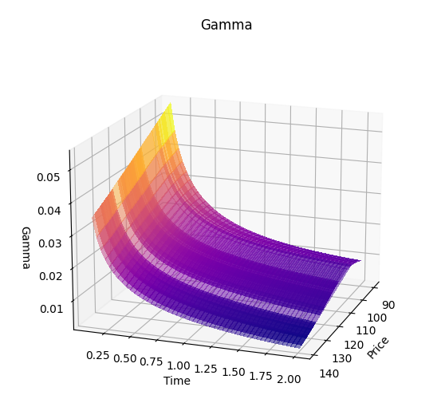
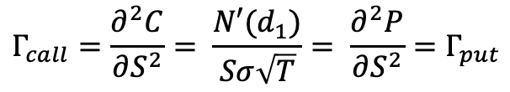
Gamma
$$Γ_{call}=\frac{∂^{2}C}{∂S^{2}}= \frac{N′(d_{1})}{Sσ\sqrt{T}}= \frac{∂^{2}P}{∂S^{2}}=Γ_{put}$$
Gamma is a measure of the rate of change in the Delta of an option with respect to the underlying asset's price. It is a second-order derivative of the option price with respect to the underlying asset's price.
For a call option, a positive Gamma means that the option’s Delta will increase as the price of the underlying asset increases. This means that the option's price is expected to increase at a faster rate as the price of the underlying asset increases.
For a put option, a positive Gamma means that the option’s Delta will decrease as the price of the underlying asset increases. This means that the option's price is expected to decrease at a slower rate as the price of the underlying asset increases.

Slide 7
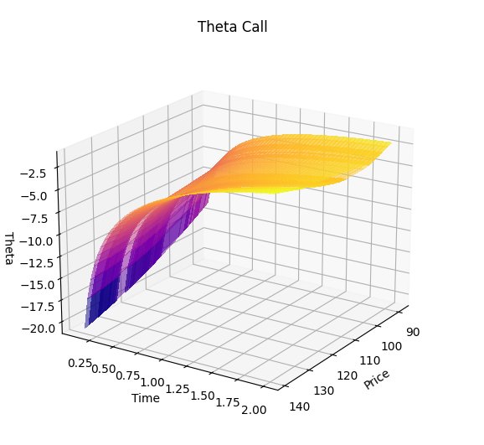
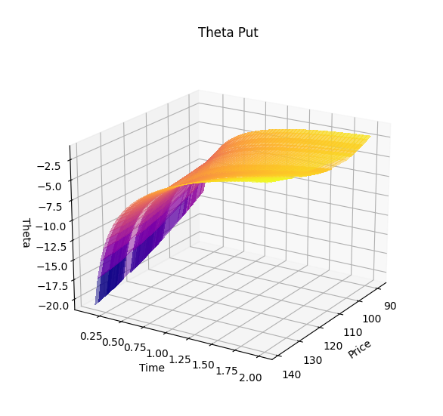


Theta
$Θ_{call}= \frac{−SσN^{′}\left(d_{1}\right)}{2\sqrt{T}}−rKe^{−rT}N\left(d_{2}\right)$
$Θ_{put}= \frac{−SσN^{′}\left(d_{1}\right)}{2\sqrt{T}}+ rKe^{−rT}N\left({−d}_{2}\right)$
Theta is a measure of the rate of decline in the value of an option with respect to the passage of time. It is a first-order derivative of the option price with respect to time.
The difference in Theta between calls and puts solely depends on the individual stock’s cost of carry. Thus, an underlying asset without a dividend or a dividend yield that is implied (i.e., stock index future) will have call and put Thetas that are equal.

Slide 8
Theta
When the cost of carry for a stock is positive (i.e., dividend yield is less than the interest rate), Theta for the call is higher than Theta for the put. When the cost of carry for the stock is negative (i.e., dividend yield is greater than the interest rate), Theta for the call is lower than that for the put.
Long options carry with them negative Theta; short options carry positive theta. Theta hurts long option positions; whereas it helps short option positions.
Not a hedge parameter since it is impossible to hedge against the passage of time.

Slide 9
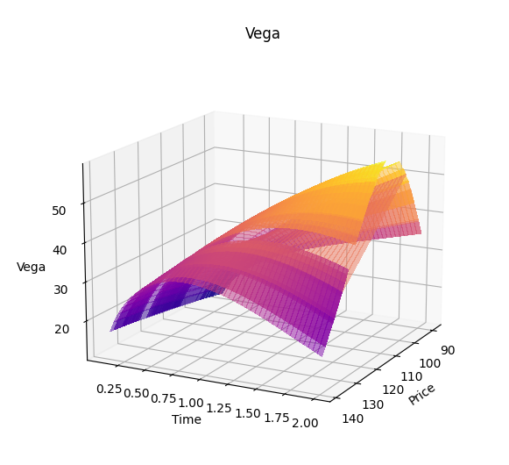
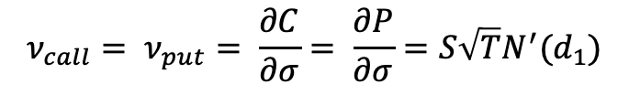
Vega
$$ν_{call}= ν_{put}= \frac{∂C}{∂σ}= \frac{∂P}{∂σ}=S\sqrt{T}N^{′}(d_{1})$$
Vega is a measure of the sensitivity of the price of an option to changes in the underlying asset's volatility. It is a first-order derivative of the option price with respect to the underlying asset's volatility.
The Black-Scholes model assumes that the volatility of the asset underpinning an option is constant. But in practice the volatility of an asset changes over time. As a result, the value of an option is liable to change because of movements in volatility as well as because of changes in the asset price and the passage of time.

Slide 10
Vega
Because ATM options have the greatest amount of time value, they will naturally have higher Vegas. ITM and OTM options have lower Vega values than those of the ATM options.
As time passes, there is less time premium in the option that can be affected by changes in IV. Consequently, Vega gets smaller as expiration approaches.

Slide 11


Rho
$$ρ_{call}=KTe^{−rT}N(d_{2})$$
$$ρ_{put}=−KTe^{−rT}N({−d}_{2})$$
Rho is used to represent the sensitivity of an option's price to changes in the risk-free interest rate
When the interest rate rises by one percentage point, the value of the call increases by the amount of its rho and the put decreases by the amount of its Rho.
Likewise, when the interest rate decrease by one percentage point, the value of the call decreases by its rho and the put increases by its rho.

Slide 12
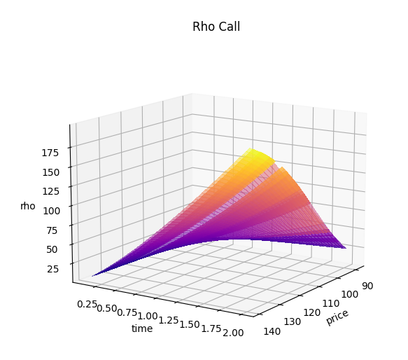
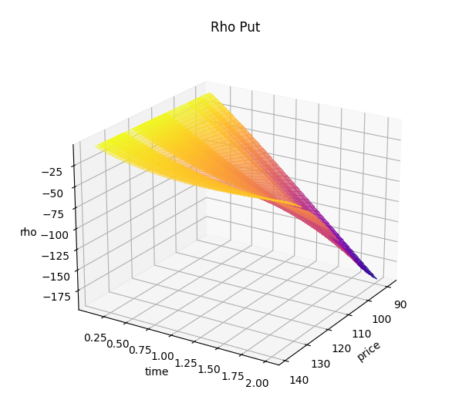
Rho
For a Put option, a positive Rho means that the option's price will decrease as the risk-free interest rate increases. This is because a higher risk-free interest rate means that the opportunity cost of owning the underlying asset is higher, which makes the put option less valuable.
For a Call option, a positive Rho means that the option's price will increase as the risk-free interest rate increases. This is because a higher risk-free interest rate means that the opportunity cost of not owning the underlying asset is higher, which makes the Call option more valuable.

Slide 13

Thanks for the attention

