Slide 1


Content analysis for ECM with Apache Tika
Paolo Mottadelli -

Slide 2
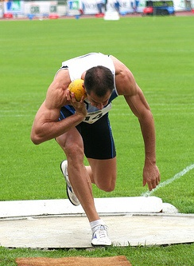
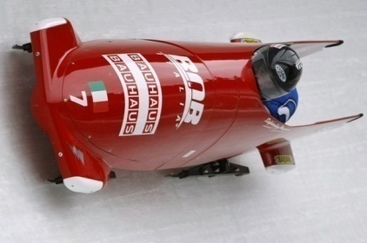
paolo@apache.org

