Slide 1



Content analysis for ECM with Apache Tika
Paolo Mottadelli -

Slide 2
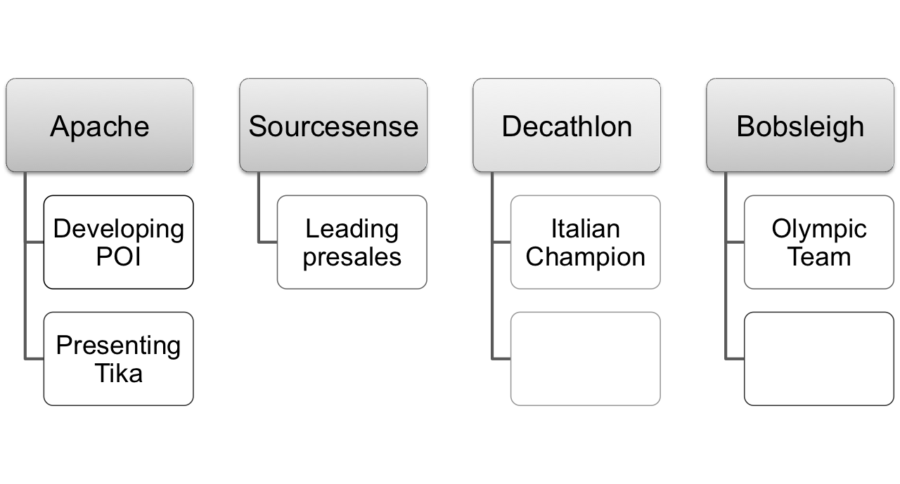
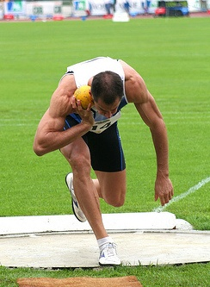
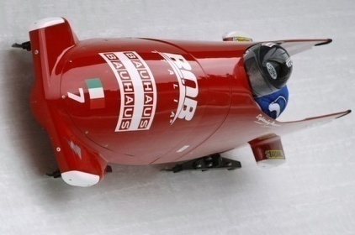
paolo@apache.org

Slide 3
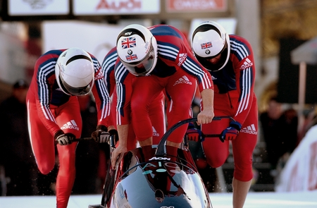
ON BOARD!

Slide 4
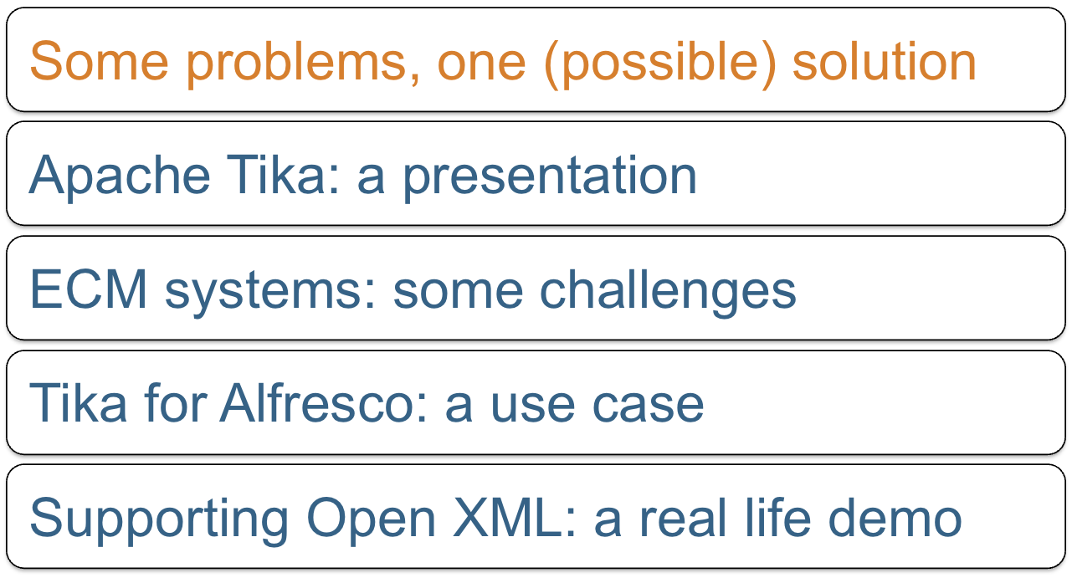
Agenda

Slide 5




















Main challenge
Lucene
index

Slide 6
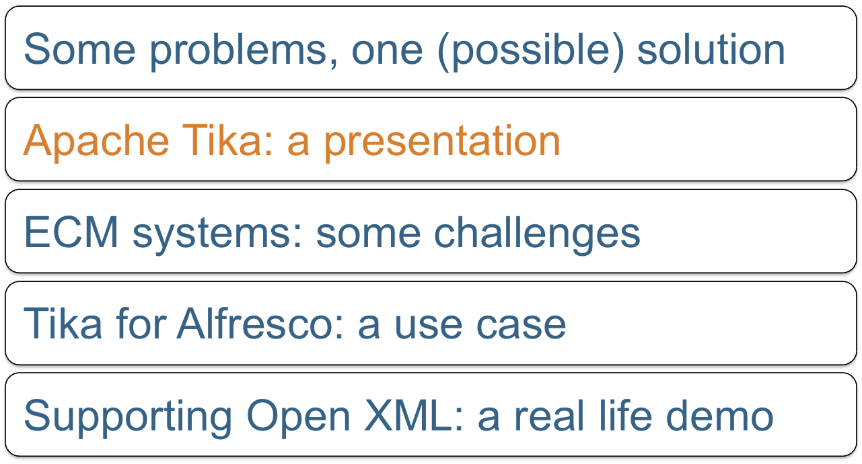
Agenda

Slide 7

What is Tika?
Another Indian Lucene project? No.

Slide 8
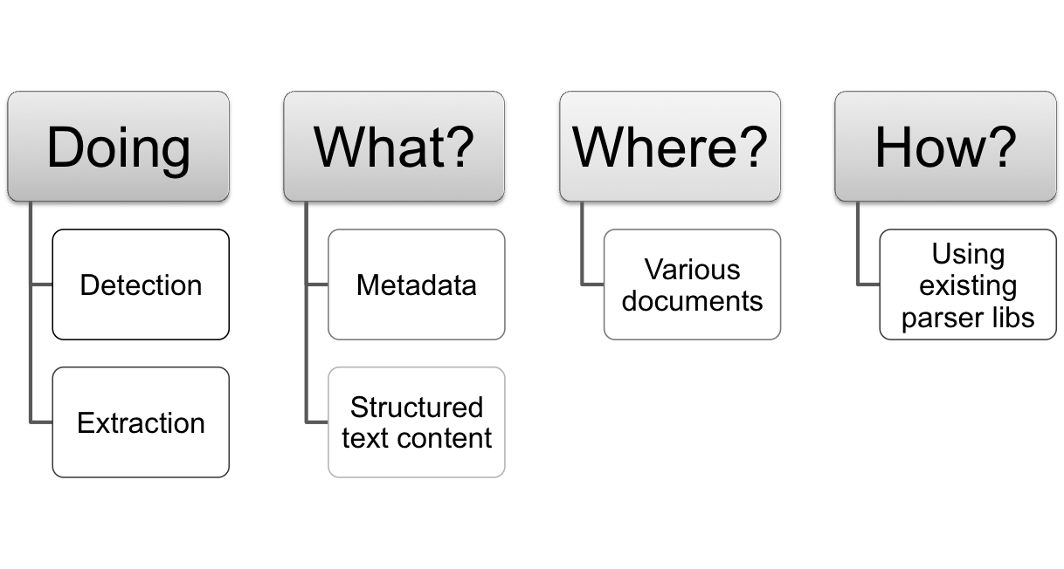
What is Tika?
It is a Toolkit

Slide 9
To be continued…
p.mottadelli@sourcesense.com

